Slide 1
Dave Lattanzi’s Laplace Planner

Slide 2
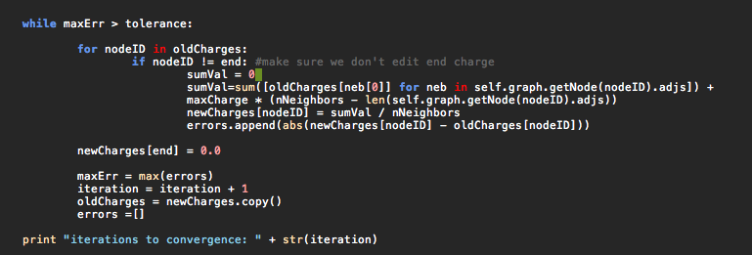
Laplace Solution
Store node charges as a dictionary
Originally used state variables and nodeList
Find Laplace solution and store in new dictionary
Not a continuously updated field

Slide 3
Path Finding
Search for neighbor with minimum charge difference
Store as a dictionary of previous nodes

Slide 4
Results
Numerical issues
What’s a good initial charge value?
What’s a good tolerance
Gets stuck at local minima (shouldn’t happen)
Can find path if initialized properly

