Slide 1
Dave Lattanzi’s Arm Planning Algorithms

Slide 2
Overview
Used Python, Pygame, and Numpy
  Extended LT’s skeleton code
Configurations found using inverse jacobian
  “Phantom” linkage method
Path planning using RRT
  Implicit map vs explicit map

Slide 3
Main Program Pseudocode
Initialize(xyz_goal, obstacles, arm_params)
Until effector_location == xyz_goal:
new_config = iKinematics(xyz_goal)
effector_location = fKinematics(new_config)
startTree(startConfig)
endTree(goalConfig)
Until arm.intersection = True:
RRTExtend(startTree,randomConfig)
RRTExtend(endTree,randomConfig)
BuildPath()
AnimatePath()

Slide 4
Inverse Kinematics
iKinematics(arm, goalxyz):
J = getJacobian(arm)
InverseJ = pseudoinverse(J)
Δxyz = β(goalxyz – arm.locationxyz)
ΔΘ = InverseJ * Δxyz
new_config = arm.config + ΔΘ
return new_config

Slide 5
Forward Kinematics
fKinematics(arm, goal_config):
T[i] = Transform(arm.joint[i], goal_config)
for i = 1:DOF:
arm.joints[i] = arm.T[i] * arm.joints[i]
return

Slide 6
RRTExtend
RRTExtend(tree, randomConfig):
nearestConfig = nearest(tree)
Δ = (randomConfig – nearestConfig) / norm (randomConfig – nearestConfig)
Until nearestConfig == randomConfig:
nearestConfig = nearestConfig + Δ
checkIntersections()
checkCollisions()

Slide 7
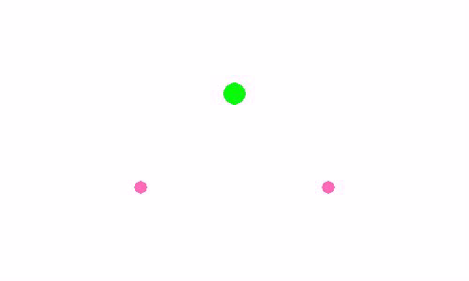
Planning Demo: 2 Obstacles

Slide 8
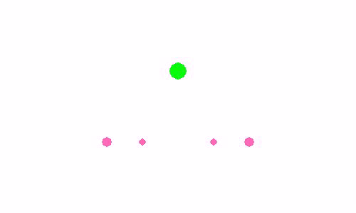
Planning Demo: 4 Obstacles

Slide 9
Issues and Future Upgrades
Restrict RRT to allowable halfspace
Refine dummy linkage method (damping?)
Optimize searches
Figure out tranpose/inverse issue

