Slide 1
Designing Interactions for Robot Active Learners
Maya Cakmak, Crystal Chao, and Andrea L. Thomaz

Slide 2
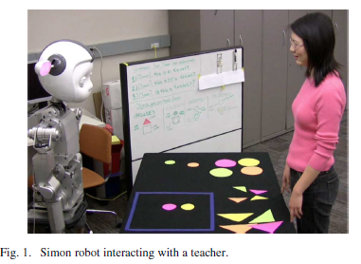

Slide 3
Goal
Let people to teach robots
“Socially guided machine learning” SG-ML
Active learning lets robot ask for more data, which results in more effective learning
This can be annoying to the user
In this paper they compare 3 interaction / learning techniques to enable robots to use active learning
1: robot queries every turn
2: robot queries under certain conditions
3: robot queries when prompted by the user

Slide 4
I-Intro
“…the queries of an active learner embed the robot in a tightly coupled dyadic interaction.”
“we look at the kind of input that human partners are capable of providing and the kind of feedback that they enjoy receiving.”
“This work provides a foundation for developing active learning systems that can be successfully deployed on robots in everyday human environments.”

Slide 5
I-Intro (2)
Active learning & transparency
Transparency: ability of robot to communicate its internal state
Supervised learning (SL)
Passive supervised learner, no queries
Active learning (AL)
Naïve AL…queries every turn
Mixed Initiative (MI)
AL that waits for correct conditions before asking
Any Questions (AQ)
Human teacher solicits questions from robot
Results
Both ML and HRI are better in “interactive modes” (2,3,4)
Observations on transparency, balance of control, and human compliance

Slide 6
II-Background
Based on models of human development---situated learning
Tight interaction loop between teacher & learner (unusual for ML)
ML with computer watching human fairly common
Active Learning requires less labeled data
But a human hasn’t been used as teacher in AL
“In our scenario, the person is trying to teach the robot independent of whether the robot makes queries. The learner can thus, gain information without making a query, and the learner is not guaranteed that the teacher will answer its query. This scenario raises a different set of questions, such as deciding when to make a query in order to maximize information gain while maintaining the engagement of the teacher.”
“Prior work has tended to look at the problem of human-in-the loop active learning from the perspective of the machine learner. In this work, we also take the perspective of the human partner. This approach uncovers several issues surrounding the design of active learning systems in the domain of HRI.”

Slide 7
III-Approach
A- Platform
Simon: upper torso w/ 2x 7 dof arms, 2x 4 dof hands, & expressive head & neck w/ 2x 2 dof ears w/ RGB LED output
C6 SW
B- Domain Description
Objects w/ color & shape
Learns object configurations / compound objects
C- Perception
Assumes always 2 objects (polygons)
Speech input (choice of 4 sentences triggered by a button)

Slide 8
III-Approach
D- Actions
a) Turn Passing: Looks up & blinks ears
b) Acknowledgement: “OK” or “Thank you”
c) Answering: Head nod or shake + speech
d) Making a query
“Can you replace the bottom piece with a large pink circle?”…Simon gazes toward the requested object, changes ear color to requested object’s

Slide 9
III-Approach (2)
E- Interaction
Teacher prepares compound object
Then either
1: teacher labels object, Simon learns example, acks
2: teacher tests Simon on the object, Simon predicts
Teacher’s next turn starts when Simon blinks his ears indicating “ready”
In interactive modes, Simon may make a query after the person provides a labeled example; Simon blinks ears after finishing a query

Slide 10
IV- Learning
A- Concepts
Ex: {color_{top} = pink ^ shape_{top} = triangle ^ shape_{bottom} = square}
B- Concept Learning
Produce hypothesis based on labeled examples
Version space: subset of hypothesis space (most) consistent with labeled examples
C- Label Prediction
Majority of predictions
Confidence: distance of majority label to average label
D- Active Learning of Concepts
Query by committee for example selection
Multiple competing hypotheses; picks example that results in maximal disagreement between the hypotheses, in terms of predicted labels
Given the interaction technique, the only valid queries are ones where one object (top or bottom) changes, since Simon can only request that the human change one thing

Slide 11
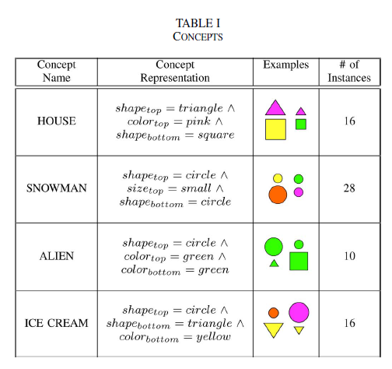
Concepts

Slide 12
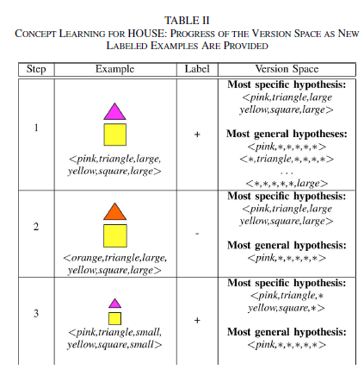
Concept learning

Slide 13
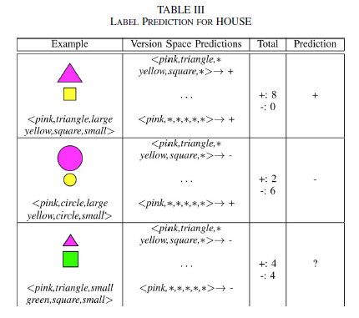
Label Prediction

Slide 14
V- Experiment
A- Teaching Task
24 subjects, 4 concepts, 4 interaction modes
“this is an x”, “this is not an x”, “is this an x?”
Positive label, negative label, test
Subject decides when to stop teaching
B- Interaction Modes
SL, AL, MI, AQ
C- Survey Questions
Who had more control?
How well did Simon learn this object?
What was your teaching strategy?
How did you decide when the session should end?
After teaching in all modes:
How difficult was it to teach each object
How clear was your mental model of what Simon knew already?
How intelligent did the robot seem?
How enjoyable was each teaching method?
Which teaching method did you prefer overall (forced choice)
Alien
Ice cream
D- Data Logged

Slide 15
V- Experiment (2)
D- Data Logged
Mode
Time
Interaction step
Current example
Current label
Sentence type
Answer type
Query

Slide 16
VI- Results
A- Learning Performance
AL better than passive SL in both speed & accuracy
The 3 interactive modes equivalent in ML performance
Difficult for human to keep track of how much of instance space has been covered
B- Interactive Preferred over Supervised
1: Perceived Intelligence
Simon seemed smarter in the 3 interactive modes…came up with combinations subject had not considered
“In reality not all the robot’s queries were informative” [I am not clear on why they did this]
Some subjects started distrusting the informativeness of the queries
Overall subjects took the robot’s contributions as demonstrating higher intelligence than asking no questions
2: Ease of Teaching
Fully active AL perceived as easiest: “easy to know what he knows and doesn’t know”
“AL really easy because I didn’t have to think”
3: Enjoyability
Interactive preferred
AQ favorite among many subjects …”Fun to answer his questions” “enjoyable getting feedback from Simon”
SL “very dull”
C- Transparency and Active Learning
SL: overestimated learning accuracy (bad because leads to early stopping)
Interactive: underestimated learning accuracy (better, but bad because people spend too long teaching)
D- Balance of Control
From most to least human control: SL, AQ, MI, AL
So many questions in AL mode
AQ mode seems appropriate when teacher is an expert
MI is more appropriate for nonexperts
For everyday people, either robot-directed shared control needs to be improved, or AL should be used for simplicity
Multiple schemes with automatic arbitration? Future work.
E- Compliance

Slide 17
VI- Results (2)
E- Compliance
Compliance: what fraction of Simon’s queries did the human choose to answer?
Expected relaxed active learning (MI and AQ) to lead to better compliance
But actually AL had higher compliance
Why? Some queries were uninformative (but were a necessary intermediate step to get to an informative query)…there are more uninformative queries in the relaxed schemes
Higher percentage of informative queries declined in AL mode (consistent with original hypothesis)
“in what way should the robot ask smart questions”? “It may be that the best query is not just an informative query from the ML perspective, but one that is appropriate wrt the teacher’s strategy. The robot may be able to model the teacher’s strategy in order to form the most appropriate informative queries.”
Our recommendations to increase compliance: 1) avoid uninformative queries 2) establish or relinquish control early and maintain these mutual expectations

Slide 18
VII- Conclusion
Humans taught a robot using several strategies
Active learning preferred
Better transparency with AL…but better mechanisms needed to communicate robot’s learning state to human
For HRI, compliance will be a big issue
Avoid uninformative queries; establish control balance early
Different people preferred each of the 3 AL modes…optimal strategy may be user dependent…AQ most preferred overall, but less efficient
Future challenge: “designing robot active learners that can achieve theoretical performance gains with nonexpert human teachers without usurping control of the interaction.”

