Slide 1
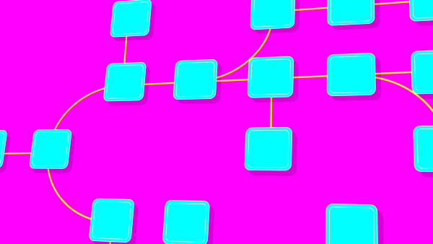
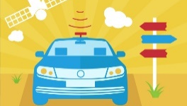
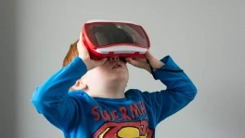
Computer Science Principles CSE 120 Winter 2017
Instructor: Teaching Assistants:
Justin Hsia Anupam Gupta, Braydon Hall, Eugene Oh, Savanna Yee
Technology trends changing the world as we look ahead “There’s an age old saying that humans tend to overestimate what can be accomplished in one day, but underestimate what can be accomplished in one year. As 2016 comes to a close, it is a good time to zoom out the lens, and get reflective on what has happened this year, and predictive about what we are excited about for the coming 3-5 years.”
https://techcrunch.com/gallery/technology-trends-changing-the-world-as-we-look-ahead/
Commercial Drones
Intelligent
Apps
Virtual
Assistants
Blockchain
(currency transfers)
Autonomous Vehicles
VR / AR

Slide 2
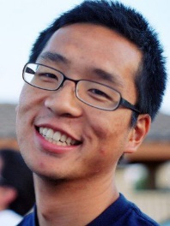
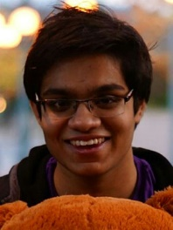
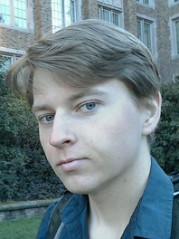
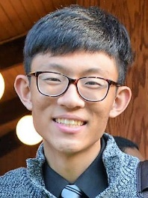
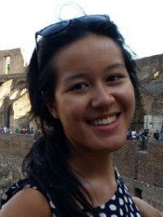
Who: Course Staff
Your Instructor: just call me Justin
From California (UC Berkeley and the Bay Area)
I like: teaching, the outdoors, board games, and ultimate
Excited to be teaching CSP for the 1st time at UW!
4 TAs:
Available during lab, in office hours, and on Piazza
An invaluable source of information and help
Get to know us
We are here to help you succeed
And to make the course better – with your help
Anupam
Braydon
Eugene
Savanna

Slide 3
Who: You!
52 students registered
Undergrads from many different majors
This class is intended for students without significant previous experience with computing/programming
Get to know each other and help each other out!
Learning is much more fun with friends
Working well with others is a valuable life skill
Diversity of perspectives expands your horizons
Submit Introduction Survey so we can find out more
Notes:
How many of you are freshman? Sophomores? Juniors? Seniors?
If you have taken APCS, or a previous text-based programming course, this is not the right class for you—consider enrolling in CSE142 instead.

Slide 4
Why Study Computer Science?
Increasingly useful for all fields of study and areas of employment
Art – computer-aided design, animation
Drama – lighting, sound, ticket sales, advertising
Lumberjacking – mapping, tracking size & # of forests
Massive impact on our lives and society as a whole
Commercial Drones
Intelligent
Apps
Virtual
Assistants
Blockchain
(currency transfers)
Autonomous Vehicles
VR / AR

Slide 5
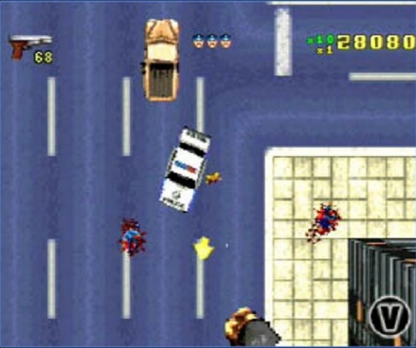
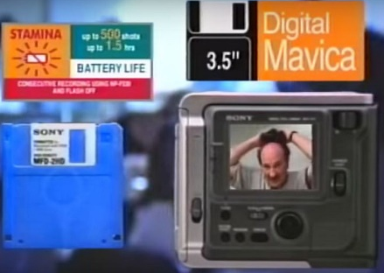
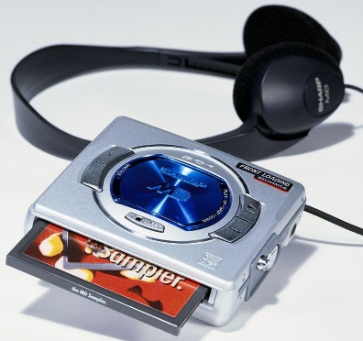
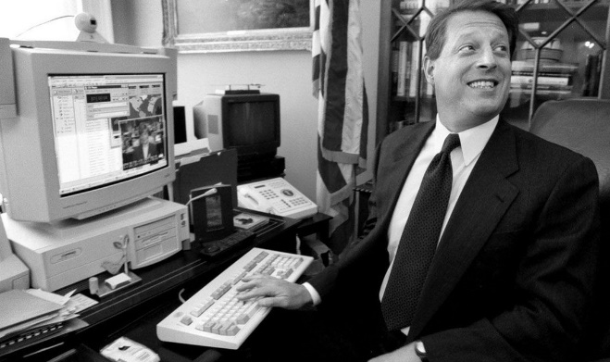
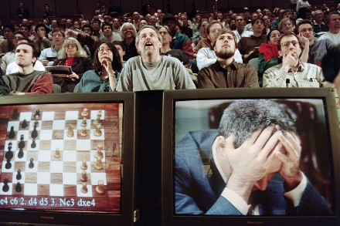
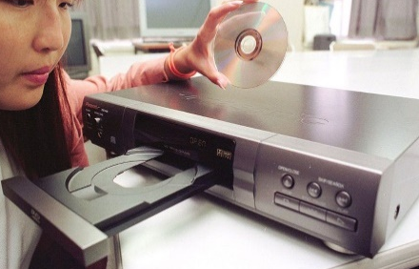
The Hottest Tech 20 Years Ago (1997)
Sharp MiniDisc Player
Sony PlayStation
Grand Theft Auto
WebTV
Palm Pilot 1000
DVD Players
Al Gore: “Atari Democrat”
Deep Blue
Sony Mavica MVC-FD5
Motorola StarTAC
Windows 95
MP3s
https://www.cnet.com/pictures/this-was-the-hottest-tech-20-years-ago-in-1997/
Notes:
Music: all streaming – no discs or CDs
Gaming: everyone is now a “casual gamer” because of smart phones; effect on economy due to microtransactions.
Politics: dick pics, private email servers, tweets

Slide 6
Computing in Your Future
Computing and its data are inescapable
You generate “digital footprints” all the time
Computing is a regular part of every job
Use computers and computational tools
Generate and process data
Dealing with IT people
Understanding the computation portion of projects
Our goal is to help you make sense of the “Digital Age” that we now all live in

Slide 7
What This Course Is
This course is split into two major themes:
Computational Thinking
How can you use computers to solve problems
Using programming as a tool
Computational Principles
The “big ideas of computing” that we think everyone should know
e.g. bits can represent anything and everything, what a computer can and can’t compute, how do websites and the Internet work, social implications of computing

Slide 8
What This Course Is NOT
Preparation for CSE142: Computer Programming I
This is not just a programming course
But great if you feel motivated to continue afterward!
Trivial
Supposed to be material you haven’t seen before
A technical class that asks you to read and write and be creative
Boring or back-breaking
Assignments intended to be fun, interesting, and reasonable

Slide 9
About Programming
programming $≠$ computational thinking
Computational thinking is knowing how to break down and solve a problem in a way that a computer can do it
Programming is the tool you use to execute your solution
We use programming in this course as a way of teaching computational thinking
Can be learned, just like any other skill
It’s not black magic; there’s no such thing as a “coding gene”
Yes, at first it may be challenging and mind-bending – just like learning your first non-native language
My hope is that you will think differently after this course
Notes:
Terrible stereotypes of programmers – it’s just another profession nowadays

Slide 10
Programming in CSE120
Use a language called Processing
Text-based language that is good for visuals and interaction
We will use Java syntax
At the end of the day, the language you use doesn’t matter as long as you develop computational thinking skills
Examples:
Jumping robot
Ripples
Constellations

Slide 11
Big Ideas of Computing
Exposure to a broad range of topics in computer science
Not going to dive into the details
These are the motivations & the applications for programming (the tool)
Focus on what to be aware of to navigate the digital world
Goal: become “literate” in computing
As new innovations arise, can you read about it, understand its consequences, and form your own opinion?
This course will ask you to read, discuss, and write about computing

Slide 12
Lecture Outline
Course Introduction
Course Policies
http://courses.cs.washington.edu/courses/cse120/17sp/policies.php
Abstraction

Slide 13
Communication
Website: http://cs.uw.edu/120
Calendar, schedule, policies, labs, links, assignments, etc.
Grade book and assignment submissions via Canvas
Discussion: http://piazza.com/washington/spring2017/cse120
Ask and answer questions – staff will monitor and contribute
ALL questions on course material should go here
Office Hours: spread throughout the week
Can also email to make individual appointments
Anonymous feedback form

Slide 14
Weekly Schedule
Lectures are Mon, Wed, Fri (3 hr)
Friday lectures will generally be reserved for “Big Ideas”
Weekly reading is due before lab on Thursday
All readings online, complete “reading check” to prep
Labs on Tue, Thu (2 hr)
Work time for labs & assignments w/help from TAs
15-20 minutes at start of Thu lab will be spent discussing the weekly reading
Can be a demanding schedule, but should be fun!
Monday | Tuesday | Wednesday | Thursday | Friday | Weekends
Lecture | Lab | Lecture | Lab (Reading) | Lecture | Assignments
Notes:
Pull up course calendar.

Slide 15
Course Components and Grading
Programming Assignments (40% total)
Labs and Assignments (mostly Processing)
Website portfolio
Mid-course “Creativity Assignment” (2 mini-projects)
Final Project (20%)
Use your newfound skills to make a project of your choosing!
Written Assignments (15% total)
Reading Checks
Living Computer Museum Report ($)
Innovation Blog
Exams: Midterm (10%) and Final (10%)
Double-check understanding of concepts and big ideas
EPA: Effort, Participation, and Altruism (5%)

Slide 16
EPA
Encourage class-wide learning!
Effort
Attending labs and office hours, completing all assignments
Keeping up with Piazza activity
Participation
Making the class more interactive by asking questions in lecture, office hours, and on Piazza
Peer instruction voting
Altruism
Helping others in lab, during office hours, and on Piazza
Notes:
We want you all to succeed!

Slide 17
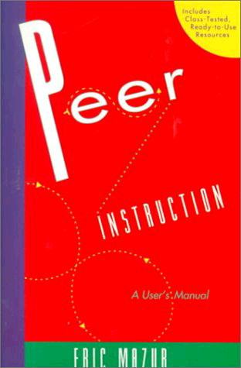
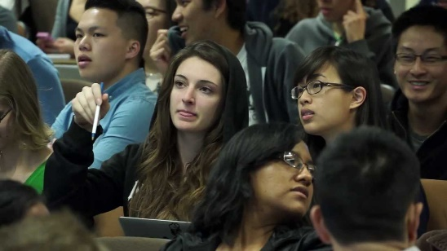
Peer Instruction
Increase real-time learning in lecture, test your understanding, increase student interactions
Lots of research supports its effectiveness
Multiple choice question at end of lecture “segment”
1 minute to decide on your own
2 minutes in pairs to reach consensus
Learn through discussion
Vote using
Use website (https://www.polleverywhere.com) or app
Linked to your UWNetID

Slide 18
Peer Instruction Question
Which of the following statements is FALSE?
Vote at http://PollEv.com/justinh
The weekly readings are intended to prepare you for the “big ideas” lecture on Friday
Your participation both in person and online count towards your class grade
Effective communication is an important skill for this class
The two major themes for this class are programming and computational principles

Slide 19
How to Get an A (I Promise!)
Attend class everyday
Complete your assignments on time
Reach out to us if you ever feel stuck or overwhelmed
If you miss ANY deadline, don't ignore it—come talk to us and tell us what is going on
Persistence is important: a lot of things will seem new and confusing at first, but you can figure them out – stick with it and don't give up!
You learn best from your mistakes
Make a good-faith effort to try everything and think about what you do!

Slide 20
What to Expect From Us
We will put forth a good faith effort to present the material in the clearest possible way
We will teach topics that are interesting and enjoyable – if it's not working for you, let us know
We will be respectful, cooperative, and understanding
We will provide help whenever you ask, both online and 1-on-1

Slide 21
What We Expect From You
Come to every class ready to learn
Make a sincere effort to understand the material
Do a little bit of work for this class each day
Turn in work on time, and communicate with us if you have special circumstances that require extensions
Submit your own work… please don't cheat ☹
Be respectful to us and other students
Everyone has different past experiences and learns at their own pace

Slide 22
Hooked on Gadgets
Gadgets reduce focus and learning
Bursts of info (e.g. emails, IMs, etc.) are addictive
Heavy multitaskers have more trouble focusing and shutting out irrelevant information
http://www.npr.org/2016/04/17/474525392/attention-students-put-your-laptops-away
This applies to all aspects of life, not just lecture
NO audio allowed (mute phones & computers)
Non-disruptive use okay
Stick to side and back seats
Stop/move if asked by fellow student

Slide 23
To-Do List
Explore website thoroughly: http://cs.uw.edu/120
Read through the full course policies!!!
Check that you are registered on Piazza, Canvas, and Poll Everywhere
Upcoming assignments:
Introduction Survey (3/28)
Personal Values (4/2)
Website setup (3/31)
Exploring Lightbot (3/29)

Slide 24
Lecture Outline
Course Introduction
Course Policies
http://courses.cs.washington.edu/courses/cse120/17sp/policies.php
Abstraction

Slide 25
Complexity and Abstraction
Programming is straightforward, as long as your programs are small
Complexity is our enemy
Abstraction is the key to conquering complexity
Abstraction allows us to build general-purpose artifacts
Detail Removal: Hide unnecessary details from users and designers
Generalization: Avoid unnecessary repetitive work
Learning to reason using the most appropriate abstraction is a key goal of computational thinking

Slide 26
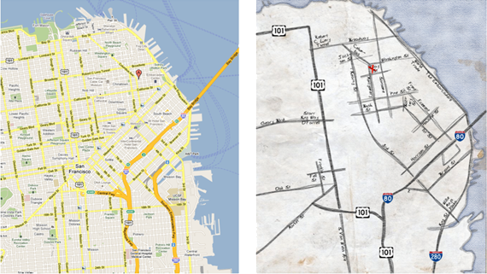
Abstraction: Detail Removal
“The act or process of leaving out of consideration one or more properties of a complex object so as to attend to others.”
Henri Matisse “Naked Blue IV”
Maps for directions

Slide 27
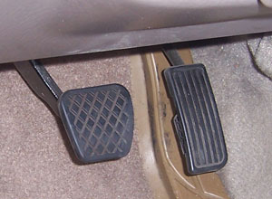
Abstraction: Detail Removal
Detail removal example:
Modern user interface: Right pedal is “accelerate”, left is “decelerate”
Even as underlying technology has changed, this abstraction has not!
Computer controlled fuel injection
Anti-lock brakes (ABS)

Slide 28
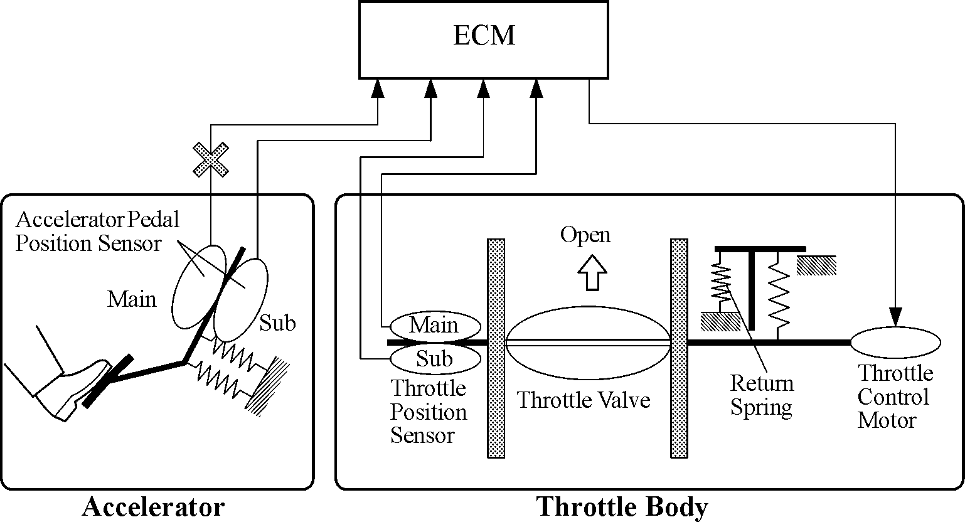
Abstraction: Detail Removal
Detail removal example:
Hide unnecessary details from other designers
e.g. Engine Control Module (ECM) designer doesn’t care about the return spring inside the Throttle!

Slide 29
Abstraction: Detail Removal
Detail removal example:
Hide unnecessary details from other designers
e.g. Engine Control Module (ECM) designer doesn’t care about the return spring inside the Throttle!
Nice to be able to think of a system as a hierarchy of well defined “chunks” with precise functionality
In CS, we say that we have a separation of concerns
Engine Control Module
Accelerator
Throttle

Slide 30
Abstraction: Generalization
“The process of formulating general concepts by abstracting common properties of instances.”
Extensible shower rods
Adjustable hats
Single recipe for <fruit> cheesecake
Feeding animals on a farm
To feed <animal>, put <animal> food in <animal> dish

Slide 31
Summary
Abstraction is one of the most important challenges in computer science
How do you identify the right abstraction you need (block to build) to solve your problem?
Think about computers:
How many of you actually know how a computer works?
How many of you can use a computer?
Thanks to abstraction!!!

