Slide 1
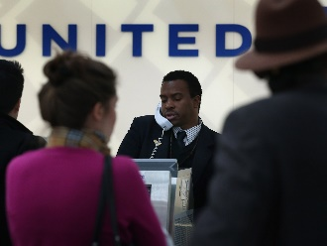
Basic Input and Output CSE 120 Spring 2017
Instructor: Teaching Assistants:
Justin Hsia Anupam Gupta, Braydon Hall, Eugene Oh, Savanna Yee
How airlines like United choose who to kick off a flight
On Sunday law-enforcement officers in Chicago forcibly removed a passenger from a United Airlines flight… [T]he airline needed to bump four passengers from the flight to make room for pilots and crew it needed to transport down to Louisville to operate flights later that evening.
Based on United Airlines’ contract of carriage, passengers with disabilities and unaccompanied minors are the least likely to bumped from a flight. For everyone else, the contract says that the airline’s decision is based on a passenger’s frequent-flyer status, the layout of his or her itinerary (whether the passenger has a connecting flight), the fare class of the ticket, and the time he or she checked in to the flight.
http://www.businessinsider.com/how-airline-choose-who-kick-off -flight-united-american-delta-2017-4

Slide 2
Administrivia
Assignments:
Animal Functions due today (4/12)
Reading Check 3 due tomorrow before lab (4/13)
Jumping Monster due Saturday (4/15)
“Big Idea” this week: Algorithms

Slide 3
Outline
Other Useful Processing Tools
User Input and Output
Mouse (input)
Keyboard (input)
Text (output)

Slide 4
System Variables
Special variables that hold values related to the state of the program, often related to user input
You don’t need to declare these variables
These variables will update automatically as the program runs
Colored pink/magenta-ish in the Processing environment
We’ve used some of these already:
mouseX, mouseY, width, height
We’ll see more today

Slide 5
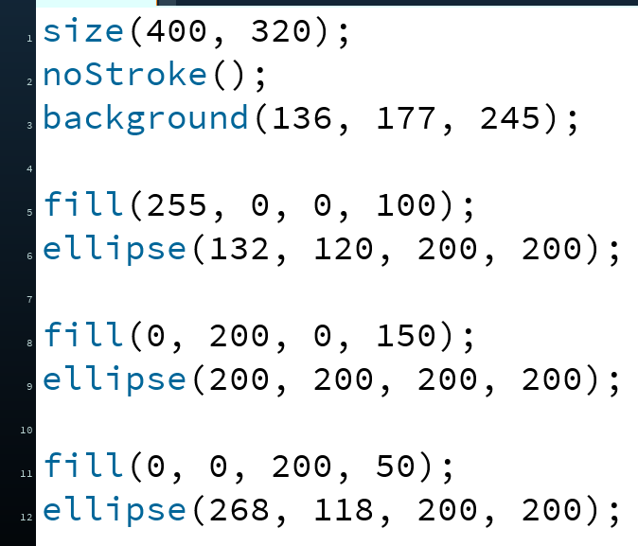
Transparency/Opacity
You can add a 4th argument to a color!
This also applies to the fill() and stroke() functions
This argument also takes an integer between 0–255
0 is fully transparent (invisible)
255 is fully opaque (the default)

Slide 6
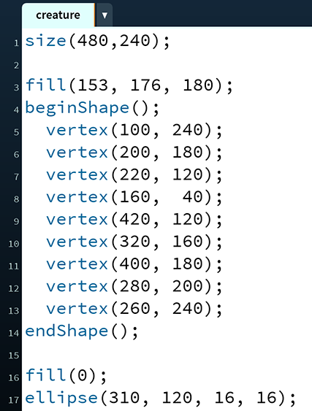
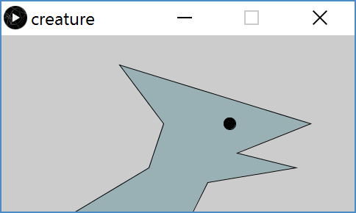
Custom Shapes
Define vertices between beginShape() and endShape()
If planning to reuse, best to create in a separate function

Slide 7
Drawing and Frames
Control and track how frequently draw() runs
Each time draw() runs, it is called a new frame
frameRate() changes the desired number of frame updates there are per second
So larger argument is faster
Default is frameRate(60)
System variable frameCount returns the number of frames since the start of the program
Starts at 0 in setup()

Slide 8
Drawing and Frames
Control and track how frequently draw() runs
Each time draw() runs, it is called a new frame
noLoop() stops draw() from being continuously executed
Can restart using loop()

Slide 9
Outline
Other Useful Processing Tricks
User Input and Output *
Mouse
Keyboard
Text
* We will look at a subset of the available Processing commands. For a full list, see the Processing Reference.

Slide 10
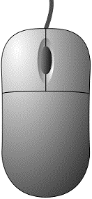
The Mouse
System variables:
mouseX – x-coordinate of mouse in current frame
mouseY – y-coordinate of mouse in current frame
pmouseX – x-coordinate of mouse in previous frame
pmouseY – y-coordinate of mouse in previous frame
mousePressed – is a button currently being pressed?
Built-in functions:
mousePressed() – called very time a button is pressed
mouseReleased() – called every time a button is released

Slide 11
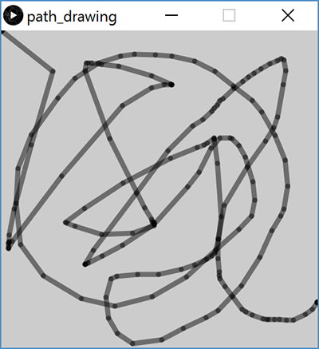
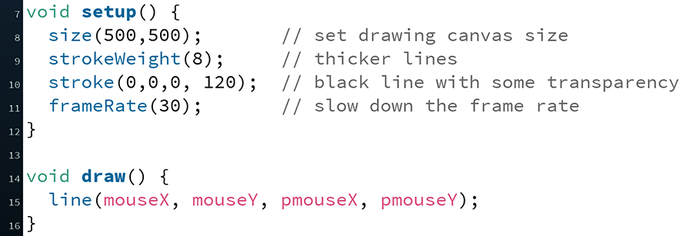
Example: Path Drawing
Last lecture we wrote a dot-drawing program
We can additionally use pmouseX and pmouseY to create a path-drawing program

Slide 12
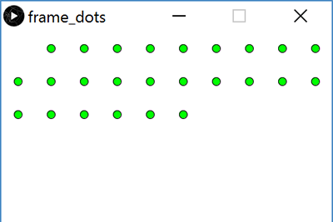
Example: Frame Dots
Slow down to 1 frame per second and have a new dot appear on each frame
Number of dots on screen will equal current frame count
Reminder: frameRate(), frameCount
Calculate position using division and modulus
Control the animation with the mouse
Pause while mouse is pressed
Reminder: loop(), noLoop()

Slide 13
Hovering Over a Rectangle
(x,y)
h
w
if(mouseX >= x)
if(mouseX <= x + w)

Slide 14
Hovering Over a Rectangle
(x,y)
h
w
if(mouseY >= y)
if(mouseY <= y + h)

Slide 15
Hovering Over a Rectangle
(x,y)
h
w
if( (mouseX >= x) &&
(mouseX <= x + w) && (mouseY >= y) && (mouseY <= y + h) )

Slide 16
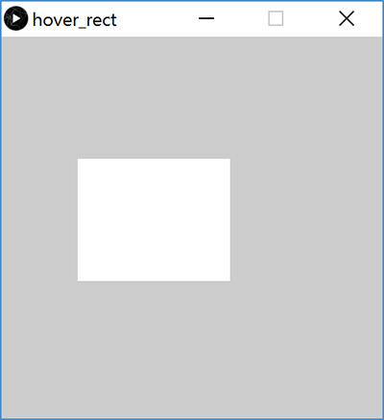
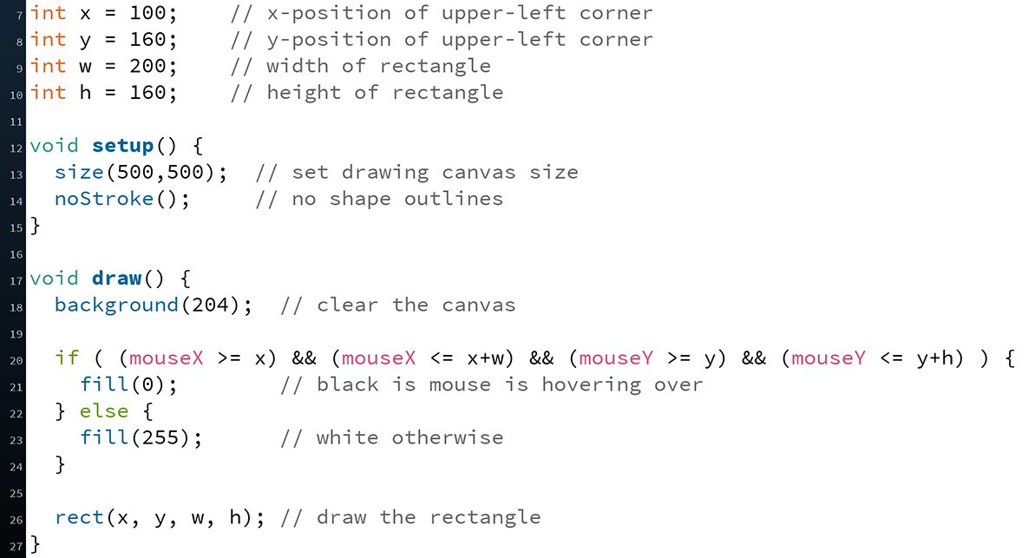
Hovering Over a Rectangle

Slide 17
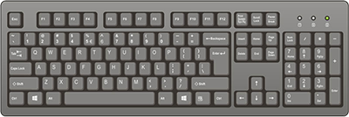
The Keyboard
System variables:
key – stores the ASCII value of the last key press
keyCode – stores codes for non-ASCII keys (e.g. UP, LEFT)
keyPressed – is any key currently being pressed?
Built-in functions:
keyPressed() – called every time a key is pressed
New datatype: char
Stores a single character (really just a number)
Should be surrounded by single quotes
e.g. char letter = ‘a’;

Slide 18
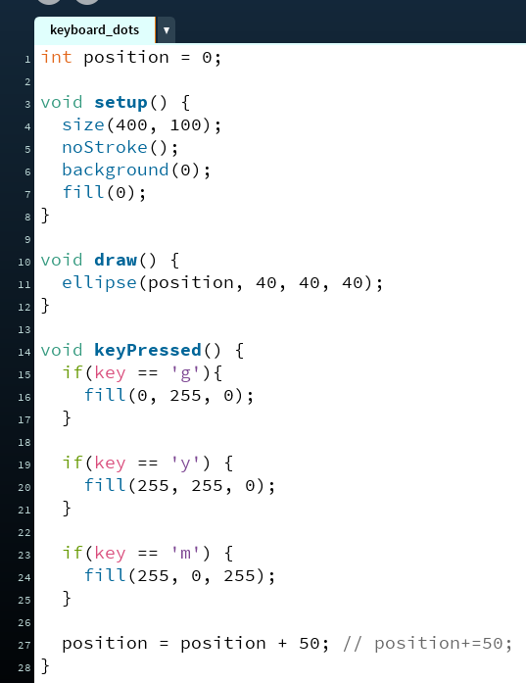
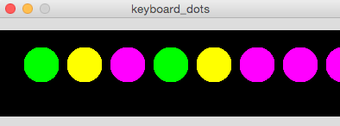
Example: Keyboard Dots

Slide 19
Text Output
println(yourText);
Prints yourText to the console, which is the black area below your Processing code
Useful for debugging, particularly your portfolio
text(yourText, x, y);
Prints yourText on the drawing canvas, starting with the bottom-left corner at coordinate (x,y)
Change the size of your text using textSize(size);
yourText should be between double quotes
We will talk about the datatype String later

Slide 20
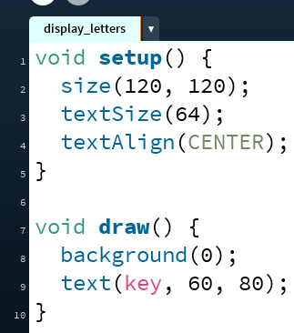
Example: Displaying Typed Keys

Slide 21
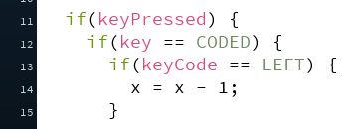
Example: Moving a Rectangle
Reminder: arrow keys (UP, DOWN, LEFT, RIGHT) are coded keys

Slide 22
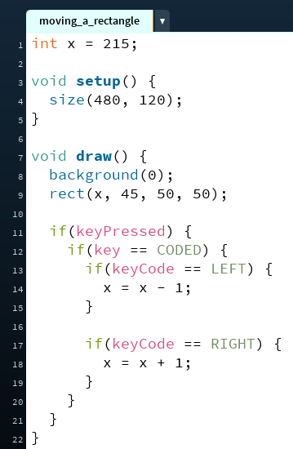
Example: Moving a Rectangle

Slide 23
Looking Forward
Next week is the Creativity Assignment
In pairs, you will be asked to create and submit TWO Processing projects of your choice
The point is to use the tools available to you to make something fun and creative!
Planning document due Tuesday (4/18)
Actual programs due next, next Monday (4/24)
Portfolio Update 1 is due Tuesday (4/18)
Building a Robot, Logo Design, Lego Family, Animal Functions, Jumping Monster
Ask your TAs for assistance!

