Slide 1
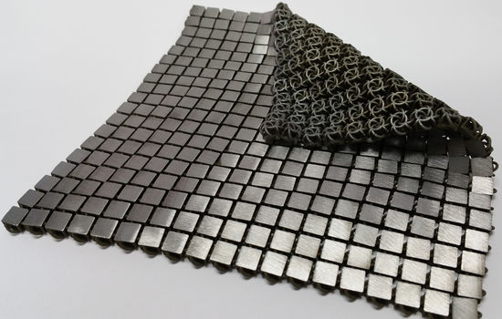
Privacy CSE 120 Spring 2017
Instructor: Teaching Assistants:
Justin Hsia Anupam Gupta, Braydon Hall, Eugene Oh, Savanna Yee
‘Space Fabric’ Links Fashion and Engineering
The material is foldable and its shape can change quickly. The fabrics could also eventually be used to shield a spacecraft from meteorites, for astronaut spacesuits, or for capturing objects on the surface of another planet.
A technique called additive manufacturing, otherwise known as 3-D printing on an industrial scale, is necessary to make such fabrics. Unlike traditional manufacturing techniques, in which parts are welded together, additive manufacturing deposits material in layers to build up the desired object. This reduces the cost and increases the ability to create unique materials.
https://www.jpl.nasa.gov/news/news.php?feature=6816

Slide 2
Administrivia
Assignments:
Arrays and Elli due tonight (4/28)
Controlling Elli due Sunday (4/30)
Living Computers Museum Report (5/14)
Midterm grades released on Gradescope by Sunday
Will have opportunity next week to submit regrade requests
You did great!
Why did we have a paper exam?

Slide 3
Outline
Privacy
Online Interactions
Multimedia Retrieval
Geotagging
Apps and Access

Slide 4
Being Online
It’s the World Wide Web
When we’re online, we typically only think about our intended audience
“Small” circle of friends and organizations
Things to consider:
The Internet is a real, physical place
Digital information is “permanent” and easy to distribute
Who can access your stuff?

Slide 5
Privacy
The right of people to choose freely what circumstances and to what extent they will reveal themselves, their attitude, and their behavior to others.
Privacy is an explicit human right in many countries
Strong privacy protections mean that receivers of information must keep it private
Unfortunately, the US has almost no privacy protections

Slide 6
Privacy and Technology
How did privacy work in the past?
Taking someone else’s stuff is illegal: theft, burglary, robbery, extortion
The 4th Amendment protects from search and seizure by the government
Technology has changed the game!
It is now possible (and easy?) to violate people’s privacy without their knowledge

Slide 7
Privacy and Technology
Former Supreme Court Justice Louis Brandeis:
“The narrower doctrine [of illegal search] may have satisfied the demands of society at a time when the abuse to be guarded against could rarely have arisen without violating a contract or a special confidence; but now that modern devices afford abundant opportunities for the perpetration of such wrongs without any participation of the injured party, the protection granted by the law must be placed upon a broader foundation. – “The Right to Privacy” (1890)
An interesting conundrum at the intersection of technology and policy
e.g. Who is liable in today’s sharing economy? https://backchannel.com/the-most-important-law-in-tech-has-a-problem-64f5464128b6

Slide 8
Outline
Privacy
Online Interactions
Multimedia Retrieval
Geotagging
Apps and Access

Slide 9
An Experiment

Slide 10
Audience Responses
In what ways do you produce information (“digital footprints”) online?
Save a password/information (local on machine)
Creating an account
Cookies (website tracking)
Browser history (browser tracking)
GPS data/location
Machine information to connect to devices

Slide 11
Your Information
Profile
Name, birthdate/age, job, photo, contact info, etc.
Transactions
Timestamp, store, product, price, payment info
Preferences
Clicks, advertisements, “likes”, browsing history
Location
Geotags, location tags, GPS data
Can these be connected to you?
Payment info, customer IDs, login accounts

Slide 12
Your Information
Profile
Name, birthdate/age, job, photo, contact info, etc.
Transactions
Timestamp, store, product, price, payment info
Preferences
Clicks, advertisements, “likes”, browsing history
Location
Geo-tags, location tags, GPS data
What happens to all of this information?
Targeted advertising, sold for $, Big Data analysis

Slide 13
What Should Be Private?
Birth Certificate demo
[See Panopto]
Is this a violation of my privacy?
Actually no: birth certificates are public record
Did this need to be online?
No… but it is and there’s nothing I can do about it
Back to transactions:
Socks might not be a sensitive product to buy
Pregnancy tests might be a sensitive product to buy
Notes:
http://www.californiabirthindex.org/

Slide 14
Security Aside
“Security questions” usually ask for personal information that is specific to you:
Mother’s maiden name
Place of birth
Street that you grew up on
Model of first car
Name of first pet
Favorite sports team
How close would someone need to be in your social circles in order to know the answer to these questions?

Slide 15
Social Cause
Increasingly, people use the Internet for regular activities
e.g. communication, shopping, information gathering
People like a highly-personalized web experience
Industry is working to improve search and retrieval techniques
Improve the user experience (and their bottom lines)
Governments improve search and retrieval to do forensics and intelligence gathering

Slide 16
Observations
Internet sites and mobile apps encourage sharing of data too easily
Users often blindly follow along
User and engineers are often unaware of search and retrieval possibilities of shared data
Local privacy protections are often ineffective against inference across websites

Slide 17
Consequences: Cybercasing
Cybercasing: Using online data and services to enable “real-world” crimes (that would not otherwise be possible)
G. Friedland and R. Sommer. “Cybercasing the Joint: On the Privacy Implications of Geotagging.” Proceedings of the Fifth USENIX Workshop on Hot Topics in Security (HotSec 10), Washington, D.C., August 2010.

Slide 18
Outline
Privacy
Online Interactions
Multimedia Retrieval
Geotagging
Apps and Access
Note: The work shown in this section is entirely that of Dr. Gerald Friedland, director of the Audio and Multimedia Group at the International Computer Science Institute (ICSI) in Berkeley, CA: https://www.icsi.berkeley.edu/icsi/projects/multimedia

Slide 19
Question
On average, how often do you post images and/or videos on the Internet?
e.g. Facebook, Instagram, Craigslist, Youtube, Twitter
Vote at http://PollEv.com/justinh
Never
About once a month or less
About once a week
About once a day
More than once a day

Slide 20
Internet Multimedia is Growing
Youtube gets 300 hours of video uploaded every minute [2016]
Instagram gets more than 80 million photos uploaded every day [2016]
Twitter gets 6000 tweets per second (~ 500 million per day) [2017]

Slide 21
Multimedia Retrieval
Can you search for an image, video, or audio file by anything other than file name?
Multimedia retrieval is improving, but still really difficult
e.g. SoundHound/Shazam, http://images.google.com
Yet multimedia retrieval is already good enough to cause major privacy issues that are not easy to solve
We will focus on geotagging here
Notes:
Search for joke or scene in a movie/video, find a song by a sequence of notes, find an image by background or type of scenery.

Slide 22
Workaround: Manual Tagging
User provides information that can be used for search and retrieval later

Slide 23
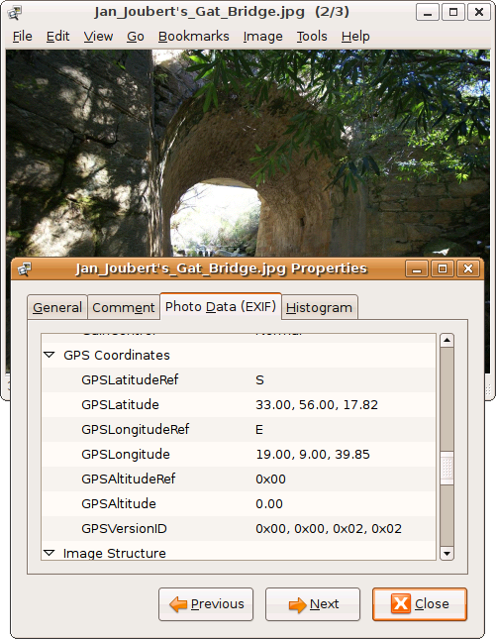
Workaround: Geotagging
Geotagging is the process of adding geographical identification metadata to media

Slide 24
Workaround: Geotagging
Geotagging is the process of adding geographical identification metadata to media
Allows for easier clustering of photo and video series

Slide 25
Workaround: Geotagging
Geotagging is the process of adding geographical identification metadata to media
Allows for easier clustering of photo and video series
Many social media portals provide Application Programming Interfaces (APIs) to access geotag data – along with other user data!
This includes Youtube, Twitter, Instagram, Flickr, …

Slide 26
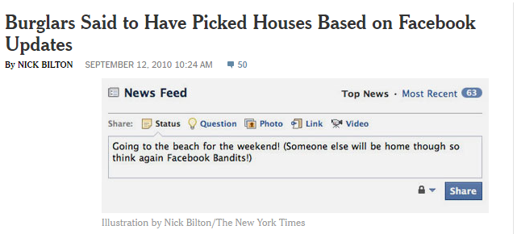
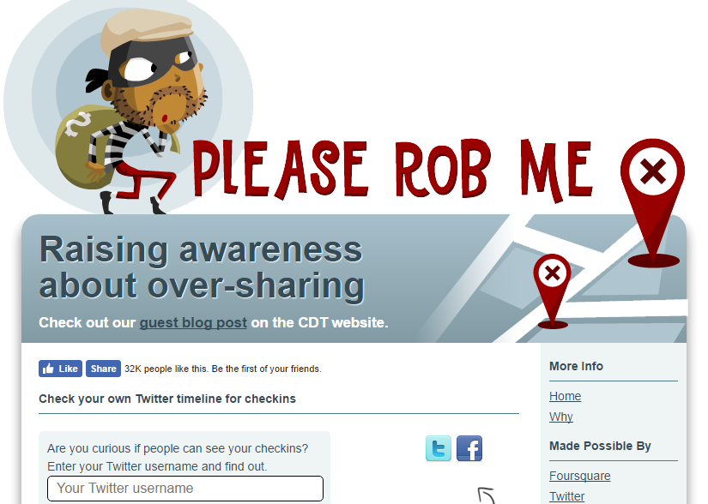
Unintended Consequences
Ready or Not? http://app.teachingprivacy.org/
Map out geotagged data from unsecured Twitter or Instagram accounts

Slide 27
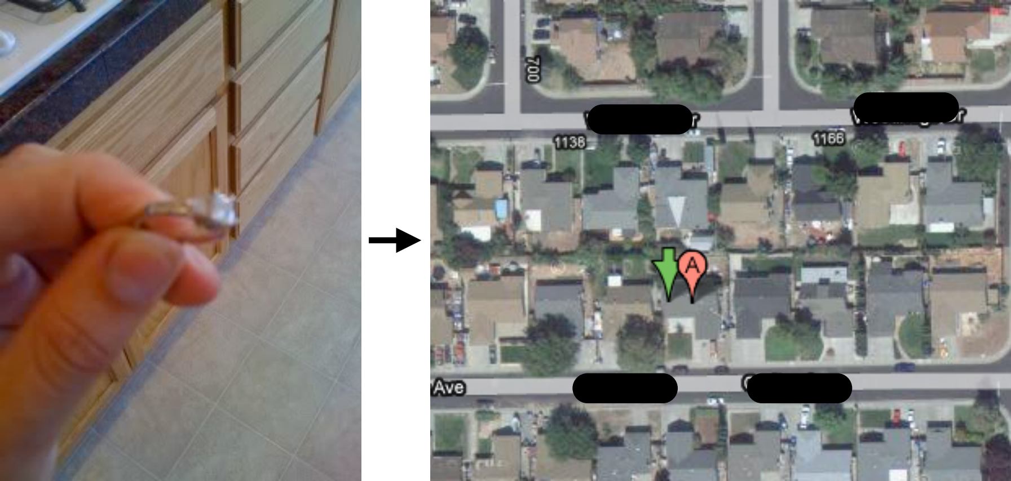
Case Study: Craigslist
Many ads on Craigslist are anonymized… except for geotags on photos
More geotagged photos = higher coordinate accuracy
Sometimes ad is for high-valued goods (e.g. cars, diamonds)
Sometimes ad specifies availability (e.g. “call Sunday after 6pm”)

Slide 28
Question
What do you think has to be done?
Vote at http://PollEv.com/justinh
Nothing can be done – privacy is dead
We need to educate people about this and try to save privacy [fight]
I agree with (A) and will really think before I post
I agree with (B) and will really think before I post
I won’t post anything anymore [flee]

Slide 29
Outline
Privacy
Online Interactions
Multimedia Retrieval
Geotagging
Apps and Access

Slide 30
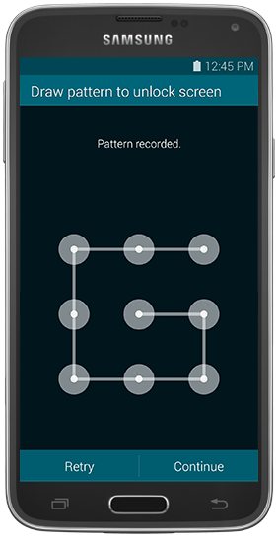
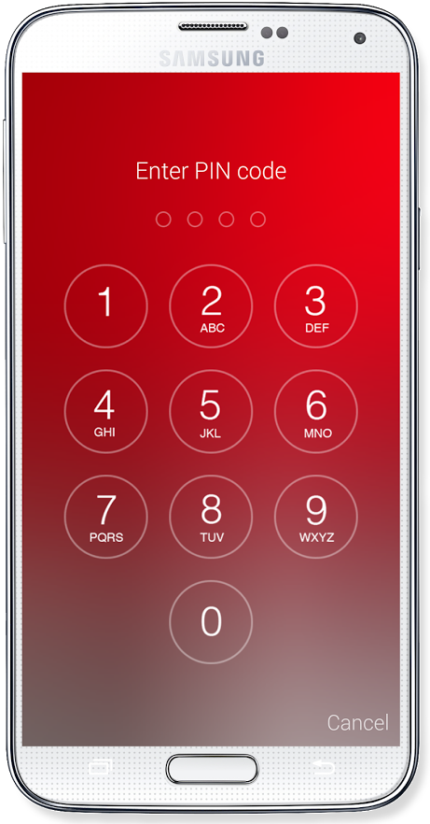
How Secure is Your Phone?
Nowadays, your smart phone contains or has access to all sorts of personal information about you
How do you keep it safe?
Do you cover your screen when you unlock?
How often do you change your lock?
Even if our phones are physically secure, we often give away our privacy!

Slide 31
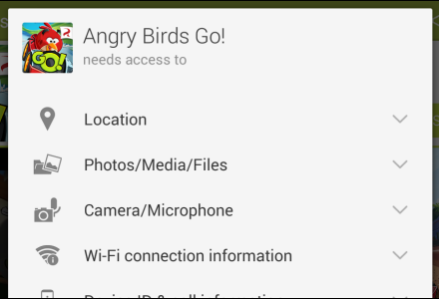
Permissions: Android
Contacts
“Use your device’s contacts, which may include the ability to read and modify your contacts”
Calendar
“Read, add and modify calendar events as well as send email to guests without owners’ knowledge”

Slide 32
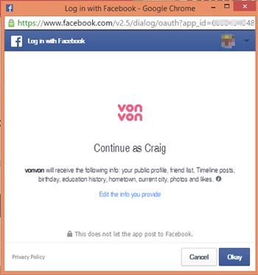
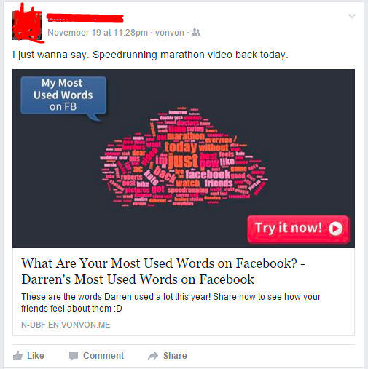
Permissions: Facebook
“Most Used Words” went viral in late 2015

Slide 33
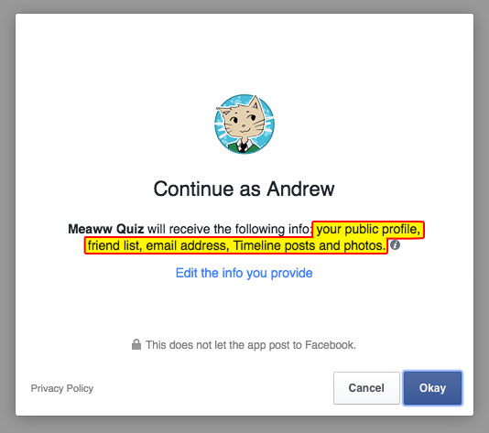
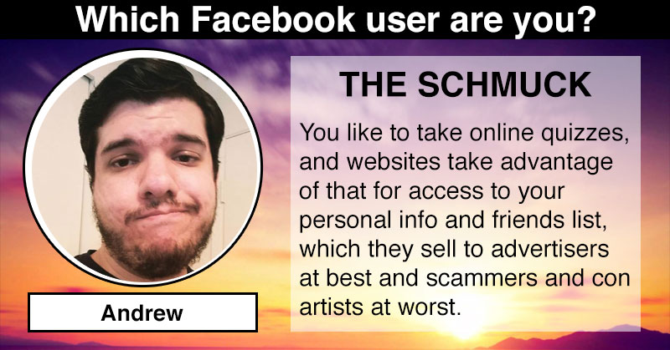
Permissions: Facebook
In general, be very wary of “quizzes”
http://www.itscovarr.com/2016/05/the-trouble-with-online-quizzes/

Slide 34
Privacy Settings
Always pay attention to privacy settings
Usually dictates visibility, ownership, and distribution of data
Actually read the Terms of Service (ToS)
tos;dr https://tosdr.org/

Slide 35
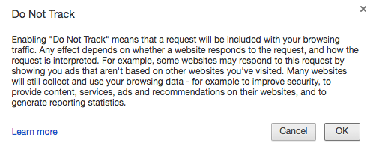
Website Tracking
Recall the connectivity model of the Internet
Info sent between machines, meaning not everything is local
This is why “private browsing” is not truly anonymous
Individual websites sometimes store information about you in “cookies”
Browsers often collect data on you as well

Slide 36
Be Deliberate About What You Reveal
Remember that you’re not really anonymous and that the WWW is accessible to everyone
Even on “closed” sites like Facebook
Remember that digital information on the Internet rarely ever goes away, even if you try to delete it
Archives, or copies on other machines
Even if you choose to do the revealing (no privacy violation), might not be wise to reveal “all”
What image do you want to present?

Slide 37
Privacy in Our New Reality
Everything is “public” and persistent
People have lost jobs based on Facebook and Twitter posts
https://medium.com/@aristoNYC/social-justice-bullies-the-authoritarianism-of-millennial-social-justice-6bdb5ad3c9d3
Resurfacing of digital information (old posts, emails, photos) is almost an inevitability
People are aware of availability of information
Human Resources (HR) departments sometimes check your social media profiles when you apply for jobs
People often “cyberstalk” others before or after meeting

Slide 38
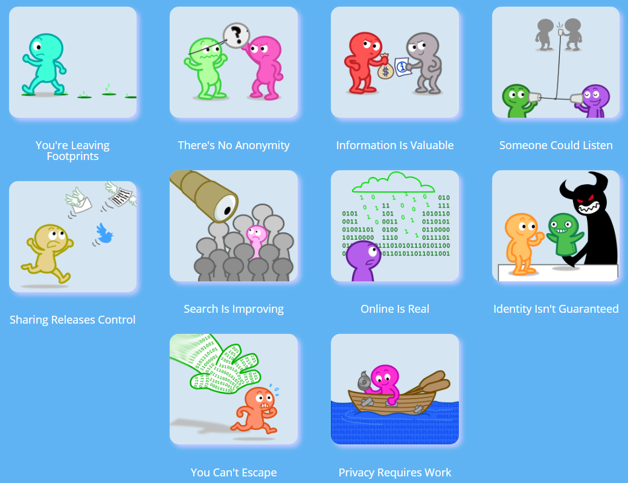
Want to Learn More?
http://teachingprivacy.org/

