Slide 1
Developing an App II CSE 120 Spring 2017
Instructor: Teaching Assistants:
Justin Hsia Anupam Gupta, Braydon Hall, Eugene Oh, Savanna Yee
The Art of Data: How Artists With IBM Watson Turned Data Into Unusually Insightful Portraits
When it comes to the installation at Cadillac House, Watson’s role was that of collaborator, processing and unpacking data galore to inform the artists’ works. Watson was able to recognize common semantic features and themes — even when they weren’t explicitly called out in the text. From there, artists took the reins and interpreted Watson’s findings in their preferred mediums.
http://nymag.com/daily/intelligencer/2017/04/art-with-watson.html
Notes:
https://www.youtube.com/watch?v=eAo9oy9D-JU

Slide 2
LCM Report Wrap-Up

Slide 3
Administrivia
Assignments:
Tic-Tac-Toe due Friday (5/19)
Project Proposal due Saturday (5/20)
Innovation Exploration post (5/21)
Big Ideas lecture on Friday: Artificial Intelligence
Reading Check (5/18) before lab section

Slide 4
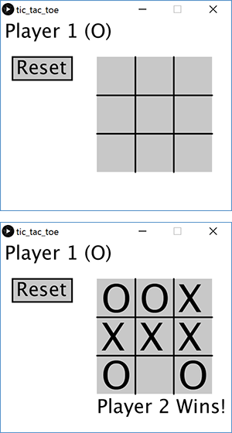
Tic-Tac-Toe
Put together an app from scratch!
Work with a partner
Game states, grid clicking, reset button, winning condition

Slide 5
Final Project
Three parts:
Proposal due Saturday (5/20)
Includes project name and “storyboard”
Update due Thursday (5/25) in lab
Project due Friday (6/2)
Includes video and README
Single program, done with a partner
Must be significantly more substantial than Creativity Assignments
Must include 3+ “hand-created” assets

Slide 6
Outline
15 Puzzle, continued

Slide 7
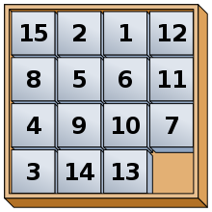
Where We Left Off
Implement game mechanics of sliding puzzle of numbered square tiles
Done:
Draw reset button
Implement reset function
Draw game board (border and tiles)
Implement board state and display numbers on tiles
Don’t display tile with value 0 (empty/open)
Detect clicks on reset button and on grid

Slide 8
Where We Left Off
Implement game mechanics of sliding puzzle of numbered square tiles
To Do:
Determine if click is adjacent to open square
Can only be in up/down/left/right directions
Implement “sliding” (swap function)
[if time] Extra functionality!

Slide 9
Layout Reminder

Slide 10
Tile Grid Reminder

Slide 11
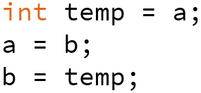
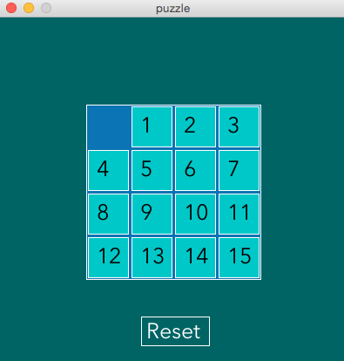
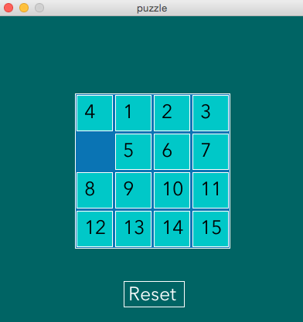
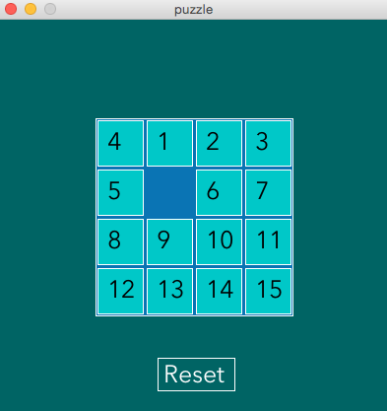
Tile Movements

Slide 12
If Time: Extensions
Change Reset button hover color
Create overReset() function that returns a boolean
Randomize initial tile placements
Tricky! How to avoid repeats?
Check for win condition: tiles ordered 0-15
Note: This is not achievable for many randomized starting orderings

Slide 13
Summary
Sketched the idea on paper
Planned out coding representations
Started with the things we knew how to do first
Built on previous work by adding one function or idea at a time
Ran the program after every improvement to make sure that it worked correctly
Unit and integration testing!!!

