Slide 1
Binary CSE 120 Winter 2020
Instructor: Teaching Assistants:
Sam Wolfson Yae Kubota Eunia Lee Erika Wolfe
Lime is laying off about 100 people and ceasing operations in 12 markets
Lime is hoping to achieve profitability this year by laying off about 14% of its workforce and ceasing operations in 12 markets, Axios first reported.
“Financial independence is our goal for 2020, and we are confident that Lime will be the first next-generation mobility company to reach profitability,” Lime CEO Brad Bao said in a statement to TechCrunch. “We are immensely grateful for our team members, riders, Juicers and cities who supported us, and we hope to reintroduce Lime back into these communities when the time is right.”
That means Lime is shutting down in Atlanta, Phoenix, San Diego, San Antonio, Linz, Bogotá, Buenos Aires, Montevideo, Lima, Puerto Vallarta, Rio de Janeiro and São Paulo.
https://techcrunch.com/2020/01/09/lime-is-laying-off-about-100-people-and-ceasing-operations-in-12-markets/

Slide 3
Administrivia
Assignments:
Symbolic Lightbot (checkoff) due tonight (1/10)
Lightbot Functions (submit) due Monday (1/13)
Make sure you read the specifications carefully!

Slide 4
Lecture Outline
Binary Worksheet: Part 1
Decimal, Binary, and Hexadecimal
Binary Encoding
Binary Worksheet: Part 2
Hints:
2⁰ = 1 2¹ = 2 2² = 4 2³ = 8 2⁴ = 16 2⁵ = 32 2⁶ = 64 2⁷ = 128 2⁸ = 256 2⁹ = 512 2¹⁰ = 1024

Slide 5
Lecture Outline
Binary Worksheet: Part 1
Decimal, Binary, and Hexadecimal
Binary Encoding
Binary Worksheet: Part 2

Slide 6
Decimal Numbering System
Ten symbols: 0, 1, 2, 3, 4, 5, 6, 7, 8, 9
Represent larger numbers as a sequence of digits
Each digit is one of the available symbols
Example: 7061 in decimal (base 10)
7061₁₀ = (7 $×$ 10³) + (0 $×$ 10²) + (6 $×$ 10¹) + (1 $×$ 10⁰)
Notes:
As humans, we use decimal numbering system. Why? Hard to say. Maybe because we have 10 fingers?
For 0-9, just use one digits.
To make larger numbers, can combine digits.
Annotate: Ones digit, Tens digit, Hundreds digit, etc. Tells the “weight” of each particular symbol.
Annotate: base raised to power of position. (10^0, 10^1, etc.)

Slide 7
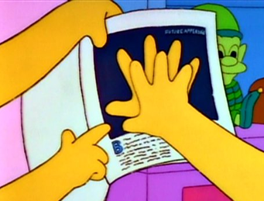
Octal Numbering System
Eight symbols: 0, 1, 2, 3, 4, 5, 6, 7
Notice that we no longer use 8 or 9
Base comparison:
Base 10: 0, 1, 2, 3, 4, 5, 6, 7, 8, 9, 10, 11, 12…
Base 8: 0, 1, 2, 3, 4, 5, 6, 7, 10, 11, 12, 13, 14…
Example: What is 7061₈ in base 10?
7061₈ = (7 $×$ 8³) + (0 $×$ 8²) + (6 $×$ 8¹) + (1 $×$ 8⁰) = 3633₁₀
Notes:
Annotate:
0-7, then we run out of symbols, so must use an extra digit.
in 10, 1 is not the 8’s digit.
Subscript indicates base
7061 looks the same, but now means something else.
Annotate: sum up powers of 8 (512, 64, 8, 1)

Slide 8
Binary and Hexadecimal
Binary is base 2
Symbols: 0, 1
Convention: 2₁₀ = 10₂ = 0b10
Example: What is 0b110 in base 10?
0b110 = 110₂ = (1 $×$ 2²) + (1 $×$ 2¹) + (0 $×$ 2⁰) = 6₁₀
Hexadecimal (hex, for short) is base 16
Symbols? 0, 1, 2, 3, 4, 5, 6, 7, 8, 9, …?
Convention: 16₁₀ = 10₁₆ = 0x10
Example: What is 0xA5 in base 10?
0xA5 = A5₁₆ = (10 $×$ 16¹) + (5 $×$ 16⁰) = 165₁₀
9, A, B, C, D, E, F
Notes:
Computers typically use binary and hexadecimal. Binary is just base 2 – we only have 0 and 1!
Annotate: can use subscript 2, or prefix ”0b” means the same thing “zero bee”
Same procedure as hex to convert, but now we have 1’s, 2’s, 4’s.
Annotate: 2^2 = 4, 2^1 = 2, 2^0 = 1 (but it’s a zero, so don’t count it)
Hexadecimal is also often used for computers
Ask: where can we get the extra numbers that we want?
Annotate: 10 → a, 11 → b, etc.
Annotate: “0x” or “zero ex”
Same procedure, but now we have to associate symbol with value
With A in 16’s position, corresponds to 10 * 16^1

Slide 9
Aside: Why Base 2?
Electronic implementation
Easy to store with bi-stable elements
Reliably transmitted on noisy and inaccurate wires
Other bases possible, but not yet viable:
DNA data storage (base 4: A, C, G, T) is a hot topic
Quantum computing
0
1
0
3.3V
2.8V
0.5V
0.0V
Notes:
adenine (A), cytosine (C), guanine (G), or thymine (T)
bi-stable: having two stable elements (i.e., “on” and “off”)

Slide 10
Base Comparison
Why does this matter?
Humans think about numbers in base 10, but computers “think” about numbers in base 2
Binary encoding is what allows computers to do all of the amazing things that they do!
Base 10 | Base 2 | Base 16
0 | 0000 | 0
1 | 0001 | 1
2 | 0010 | 2
3 | 0011 | 3
4 | 0100 | 4
5 | 0101 | 5
6 | 0110 | 6
7 | 0111 | 7
8 | 1000 | 8
9 | 1001 | 9
10 | 1010 | A
11 | 1011 | B
12 | 1100 | C
13 | 1101 | D
14 | 1110 | E
15 | 1111 | F
Notes:
Annotate: decimal, binary, hex; each row is equivalent in value, different representations

Slide 11
Lecture Outline
Binary Worksheet: Part 1
Decimal, Binary, and Hexadecimal
Binary Encoding
Binary Worksheet: Part 2

Slide 12
Numerical Encoding
AMAZING FACT: You can represent anything countable using numbers!
Need to agree on an encoding
Kind of like learning a new language
Examples:
Decimal Integers: 0$→$0b0, 1$→$0b1, 2$→$0b10, etc.
English Letters: CSE$→$0x435345, yay$→$0x796179
Emoticons: 😃 0x0, 😞 0x1, 😎 0x2, 🤠 0x3, 😈 0x4, 🙋 0x5
Notes:
As long as we agree on a translation from the number to what it represents, we can use numbers for (nearly) anything!
let’s agree that happy face is 0, etc.
Base 2 is too hard for humans to read, so we use base 16 as a convenient way to hold what is effectively binary data in our brains.

Slide 13
Binary Encoding
With N binary digits, how many “things” can you represent?
Need N binary digits to represent $n$ things, where 2^{N} $≥n$
Example: 5 binary digits for alphabet because 2⁵ = 32 > 26
A binary digit is known as a bit
A group of 4 bits (1 hex digit) is called a nibble
A group of 8 bits (2 hex digits) is called a byte
1 bit $→$ 2 things, 1 nibble $→$ 16 things, 1 byte $→$ 256 things
Notes:
With N decimal digits, how many things can you represent? (1 → 10, 2 → 100, N → 10^N)
1’s place: 0 or 1
2’s place: 0 or 2
4’s place: 0 or 4
Etc.
Annotate: 2^N
I prefer “nybble” but some people write “nibble”

Slide 14
So What’s It Mean?
A sequence of bits can have many meanings!
Consider the hex sequence 0x4E6F21
Common interpretations include:
The decimal number 5140257
The characters “No!”
The background color of this slide
The real number 7.203034 $×$ 10⁻³⁹
It is up to the program/programmer to decide how to interpret the sequence of bits
Notes:
Well… it depends.
Numbers aren’t really useful without context.

Slide 15
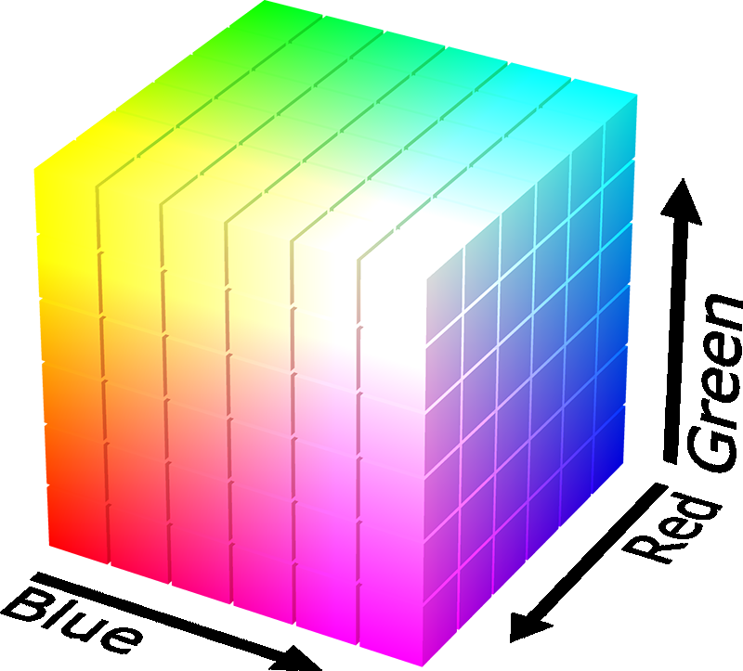
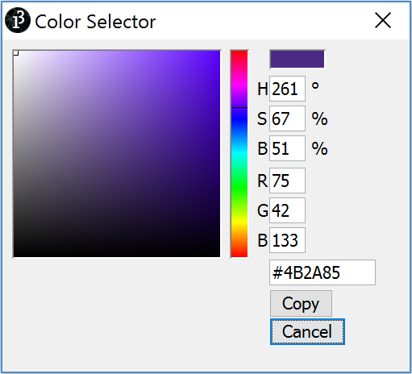
Binary Encoding – Colors
RGB – Red, Green, Blue
Additive color model (light): byte (8 bits) for each color
Commonly seen in hex (in HTML, photo editing, etc.)
Examples: Purple$→$0x4B2A85, Gold$→$0xBAA47B, Orange$→$0xE2661A, Turqoise$→$0x33997E
Notes:
Each of red, green, and blue gets a number between 0 and 255 to specify how much of that color we have.
Why 255? The largest number you can fit in 8 bits. (2^8 is 256, or the numbers 0-255)

Slide 16
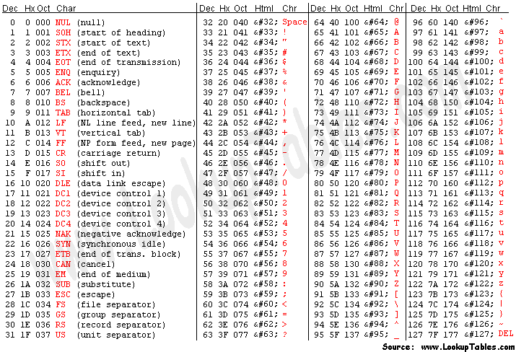
Binary Encoding – Characters/Text
ASCII Encoding (www.asciitable.com)
American Standard Code for Information Interchange
Notes:
Annotate: “yay” → 0x796179 if we tell the computer to interpret as text

Slide 17
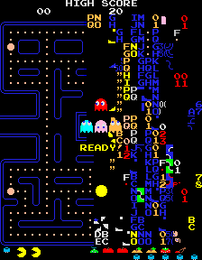
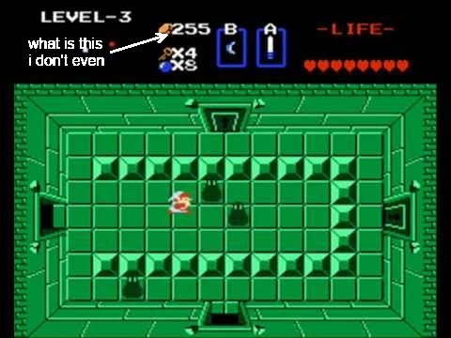
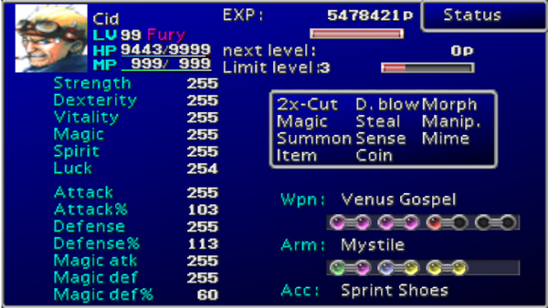
Binary Encoding – Video Games
As programs run, in-game data is stored somewhere
In many old games, stats would go to a maximum of 255
Pacman “kill screen”
http://www.numberphile.com/videos/255.html
Notes:
Annotate: 255 is max number stored in a byte

Slide 18
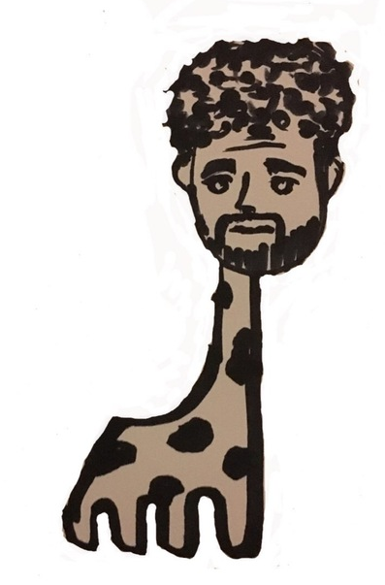
Binary Encoding – Files and Programs
At the lowest level, all digital data is stored as bits!
Layers of abstraction keep everything comprehensible
Data/files are groups of bits interpreted by program
Program is actually groups of bits being interpreted by your CPU
Computer Memory Demo
Can try to open files using a text editor
From vim: %!xxd
giraffe.jpg

Slide 19
Lecture Outline
Binary Worksheet: Part 1
Decimal, Binary, and Hexadecimal
Binary Encoding
Binary Worksheet: Part 2
Hints: 2⁰ = 1 2¹ = 2 2² = 4 2³ = 8 2⁴ = 16 2⁵ = 32 2⁶ = 64 2⁷ = 128 2⁸ = 256 2⁹ = 512 2¹⁰ = 1024

Slide 20
Summary
Humans think about numbers in decimal; computers think about numbers in binary
Base conversion to go between them
Hexadecimal is more human-readable than binary
All information on a computer is binary
Binary encoding can represent anything!
Computer/program needs to know how to interpret the bits

Slide 21
Summary

