Slide 1
Variables & Datatypes CSE 120 Winter 2020
Instructor: Teaching Assistants:
Sam Wolfson Yae Kubota Eunia Lee Erika Wolfe
Tesla hacking competition offers $1 million and free car if someone can hijack Model 3
San Francisco: Electric automaker Tesla has once again challenged hackers to find bugs in its connected cars.
The Elon Musk-run company is returning to the annual hackers' competition "Pwn20wn" to be held in Vancouver in March, reports electrek.
Some Model 3 cars and $1 million in award money will be up for grabs.
In March last year, a group of hackers won a Tesla Model 3 and $35,000 for hacking into its systems.
https://www.livemint.com/auto-news/tesla-hacking-competition -offers-1-million-and-free-car-if-someone-can-hijack-model-3- 11578889743038.html

Slide 2
Administrivia
Assignments
Taijitu [checkoff] due Thursday (1/16)
Reading Check 2 due Thursday by 3:30 pm (1/16)
Logo Design due Monday (1/20)
Quiz Friday
Review packet posted on website

Slide 3
Homework: Logo Design
Notes:
Homework, submitted individually and on Canvas
Can be an organization, team, etc. that you really like – or something that you design yourself!
Stress planning – don’t just start coding willy-nilly, make a “blueprint” for what you want to do with coordinates drawn on
Makes it more straightforward to convert to Processing
Example: rect starting at (20, 20) with width 40 and height 180
Draw: reminder of coordinate system

Slide 4
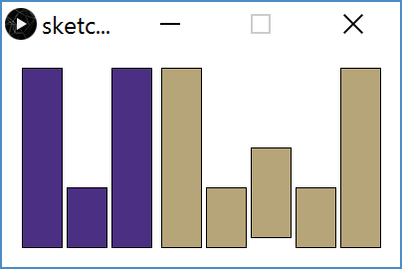
Homework: Logo Design

Slide 5
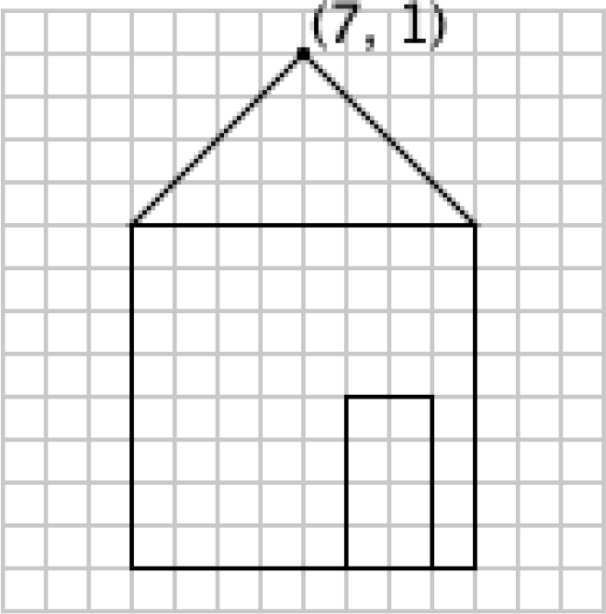
Drawing a House
One solution from worksheet:
triangle(7, 1, 3, 5, 11, 5); rect(3, 5, 8, 8); rect(8, 9, 2, 4);
What if we wanted to move the house?
Notes:
(from section yesterday – drawing a house): triangle, rect, rect.
Suppose we want to move the house 10 to the right.
Draw:
Re-draw house 10 to the right
Annotate triangle and rect with what arguments mean
cross out all the x coordinates, replace with +10
5 changes to the code!

Slide 6
Variables
Piece of your program that holds the value of something
Every variable must be given a name and a data type
The values of these variables can change (i.e. vary) during the execution of your program
Warning: Not like a variable in Algebra (i.e. an unknown)
Assignment/Write: give a variable a specific value
e.g. x = 12;
Notes:
Contrast w/ math – not a variable that we want to solve for, but holds a value
Draw:
“storage space, like a box”
Name: “identifier (which box?)”
Data type: “what kind of thing is in the box?”
E.g., “integer” box holds whole numbers, etc.
Assignment: draw box, label x, write 12 inside “put value 12 in box x”
In programming “=“ means x <-- 12”

Slide 7
Variables
Piece of your program that holds the value of something
Every variable must be given a name and a data type
The values of these variables can change (i.e. vary) during the execution of your program
Warning: Not like a variable in Algebra (i.e. an unknown)
Read: use the current value of a variable
e.g. ellipse(x+1, 50, 20, 20);
Notes:
Anytime you see a variable that isn’t on the left hand side of an assignment statement, this means “read the value”
Draw:
x = 12;
box, name x, containing 12
Arrow to x in ellipse, x+1 ➔ 12+1
“look in box x and use current value”
Ellipse draws an ellipse with center at (13,50)

Slide 8
Datatypes
int integers (e.g. 12 or -3)
float decimal/real numbers (e.g. 3.14)
color RGB (e.g. color(0))
char characters (e.g. 'J')
boolean true or false (e.g. true)
Many more exist and can be found in the Processing Reference:
Notes:
To use a variable, we need to give it a type – this will determine what kind of “thing” the box holds.
For example…
You’ll get more practice with these throughout the course.
Other types exist but these will be what we use most frequently.

Slide 9
Declarations
We declare a variable by telling Processing the variable’s datatype, followed by the variable’s name:
You can also give a variable a starting value (initialization) in the same line as the declaration:
Notes:
Draw:
Notice we do the datatype first: “Datatype → int” (highlighted in orange)
Then a name: “Name → x”
Then a semicolon
Draw box with x
“separate declaration and initialization”
Draw second box: // combined declaration and initialization

Slide 10
Variable Manipulation
Executed sequentially, just like other statements
For variable assignments, compute right-hand side first, then store result in variable
Example: int x = 4; x = x + 1;
Read the current value of x (4) for the right-hand side
Add 1 to the current value of x
Store the result (5) back into x
Notes:
Order matters (statements sequential).
Can have same variable on LHS and RHS e.g., x = x + 1 (doesn’t make sense as math, but in programming means x ← x + 1)
Draw:
Initialize x to 4
Increment x by 1

Slide 11
Drawing a House with Variables
Initial solution:
triangle(7, 1, 3, 5, 11, 5); rect(3, 5, 8, 8); rect(8, 9, 2, 4);
What properties might be useful to store in variables?
Notes:
Draw:
int houseX = 7;
At top of triangle: 7 → houseX
Replace all x values with houseX, houseX-4, houseX+4,houseX-4,houseX+1 (“where are all the other changes relative to houseX?”)
Changing houseX to 17 moves house right by 10!
Draw house 10 to the right
Only need to change one thing to move the house!
Other useful variables: houseY, size

Slide 12
Variable Rules & Guidelines
Variable naming rules:
Variables are case-sensitive (e.g. myx vs. myX)
Numbers allowed, but not at beginning (e.g. k9 vs. 9k)
Generally avoid symbols
Variable names are meaningless to computers, but meaningful to humans
Choosing informative names improves readability and reduces confusion
In Processing, variables written in “camelCase”
In this class, most of our variables will be declared and initialized at the very top of our programs
Notes:
Draw: myx and myX are different
Talk about camel case and what it means

Slide 13
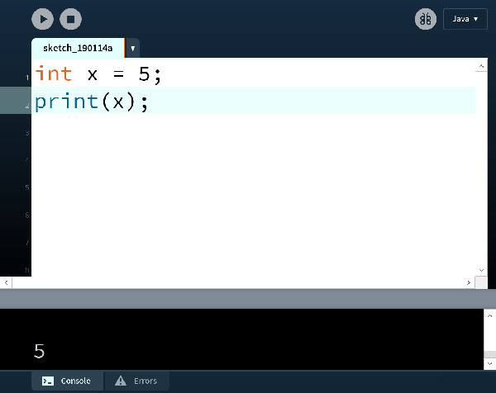
Variable Worksheet
New functions: print(), println()
prints the value of x to the console
Notes:
Please do this worksheet in pairs – will involve Processing, so try to do pair-programming similar to last time (one person on computer, one person doing worksheet)
Draw: print() prints value to console

Slide 14
System Variables
Special variables that hold values related to the state of the program, often related to user input
You don’t need to declare these variables
These variables will update automatically as the program runs
Colored pink/magenta-ish in the Processing environment
Examples: width and height hold the value of the width and height of the drawing canvas, respectively
Notes:
These variables will automatically be updated based on the state of the program.
Will be pink.
Code:
size(300,500);
println(width); ← will be in pink
println(height); ← will be in pink
Console will show “300” “500”

Slide 15
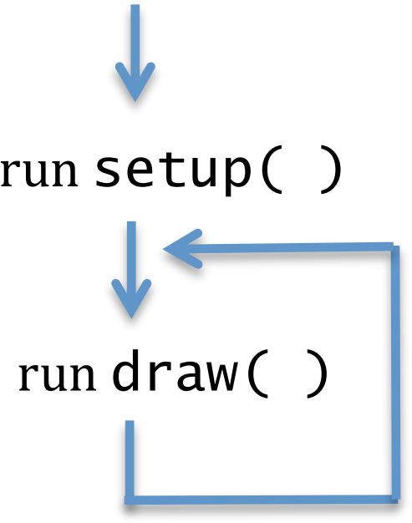
Active Mode in Processing
We enter active mode by creating the functions setup() and draw() in our program
setup() automatically executes once at the start
draw() executes infinitely afterwards
Each time draw() executes, it is called a new frame
Notes:
To make more interesting programs with motion (no longer static), can write functions for setup and draw
All the commands in setup run once
Then draw runs, then starts over, ad infinitum
Every time draw runs, we’re going to call it a new frame
Draw: program start → run setup once, run draw until program is closed

Slide 16
Drawing and Frames
System variable frameCount returns the number of frames since the start of the program
Starts at 0 in setup()
frameRate() changes the desired number of frame updates there are per second
Larger argument is faster
Default is frameRate(60)
noLoop() stops draw() from being continuously executed
Can restart using loop()
Notes:
Draw: diagram of setup → draw (loop), frameCount starts as 0, increased for each loop of draw()
Draw: framerate(30) refreshes half as frequently (higher frame rates faster, lower ones slower)
noLoop() probably not something that will be used very often
Warning: noLoop() will mean that next draw() doesn’t run so you can’t rely on restarting in the next call!

Slide 17
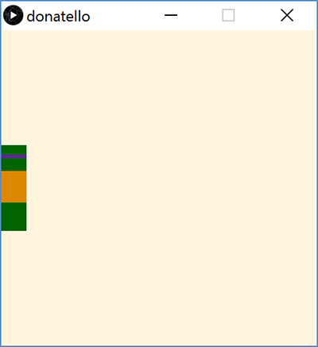
Motion with Variables
Create your drawing
Introduce a variable
Substitute values in your drawing with expressions that use the new variable
Change the variable value in-between frames
Use background() to cover old frames
Notes:
i.e., the house
Use the variable to control where the house is drawn
By changing the value of the variable, the picture will be drawn somewhere else on every frame
Much like a flipbook
Imagine a painter drawing on a canvas, then throwing a bucket of paint on it, then drawing a slightly different canvas, etc., 60x per second.

Slide 18
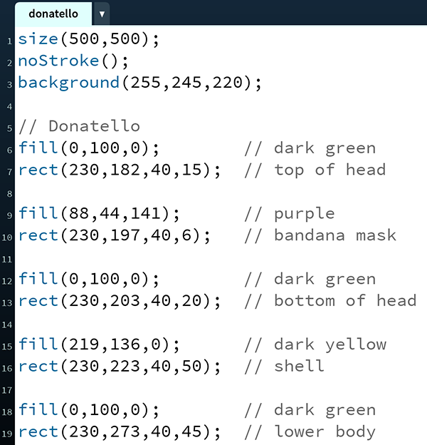
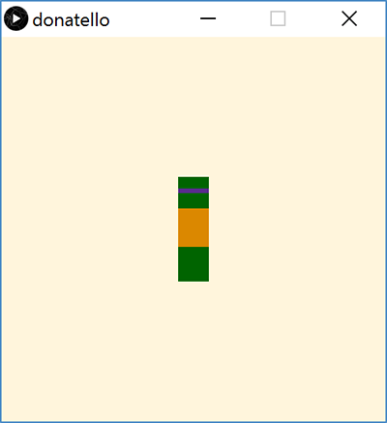
TMNT: Donatello
Notes:
Draw:
1) rect -> head
2) rect -> mask
3) rect -> face
4) rect -> body/shell
5) rect -> lower body/legs
Ask: notice anything here we could replace with a variable?

Slide 19
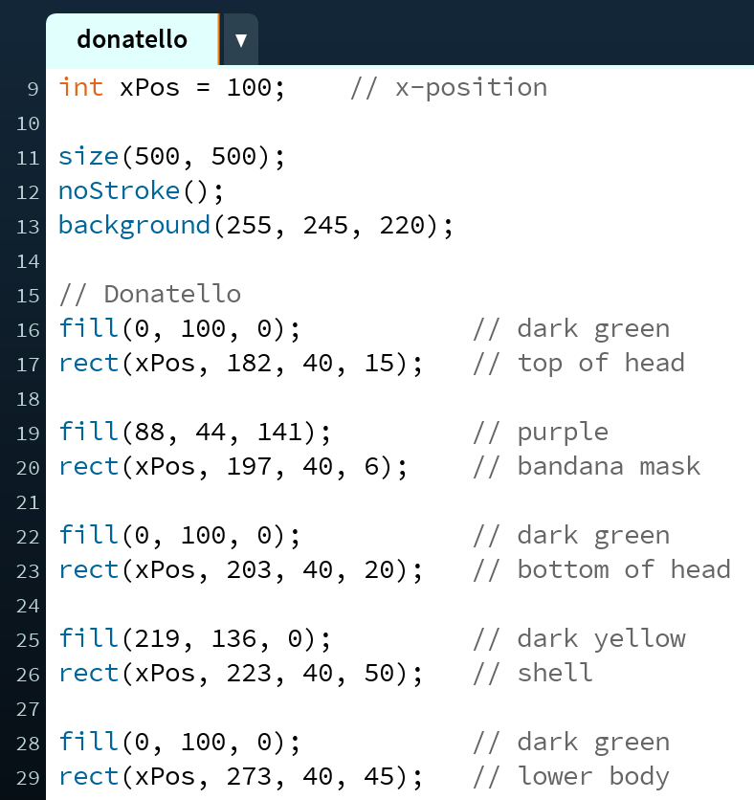
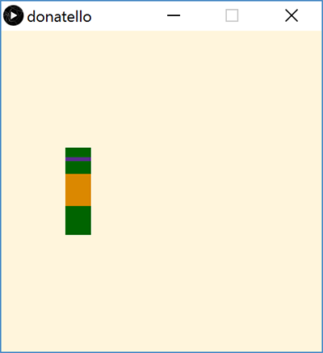
Donatello with a Variable
Notes:
Draw: xPos is a new variable! Moves the entire drawing when it changes.
Code: make Donatello active. Add setup() and draw(). Add update statements for xPos so that it moves right.

Slide 20
Stopping Motion
Stop Donatello from running off the right side of the screen:
xPos = xPos + 1;
xPos = min(xPos + 1, width-40);
Stop Donatello from running off the left side of the screen:
xPos = xPos – 1;
xPos = max(xPos - 1, 0);
Notes:
Draw: min() returns the minimum of two numbers
This means that x_pos will increased by 1 until it reaches width-40
Draw: max() returns maximum of two numbers
This means that x_pos will decrease by 1 until it reaches 0
In draw(), change x_pos: x_pos = min(x_pos + 1, 460);
In draw(), change x_pos: x_pos = max(x_pos - 1, 0);
What if I want to make Donatello move faster?

Slide 21
Falling Into Place
Introduce variables for each body segment:
Update each variable at different speeds:
Notes:
Mention that this should be camel case
Can also introduce variables for every segment and have them fall at different speeds.
Draw: initial y-positions for each body segment
Draw: higher segments fall slower, lower segments fall faster
Draw: variables that use decimals need to be float, not int

Slide 22
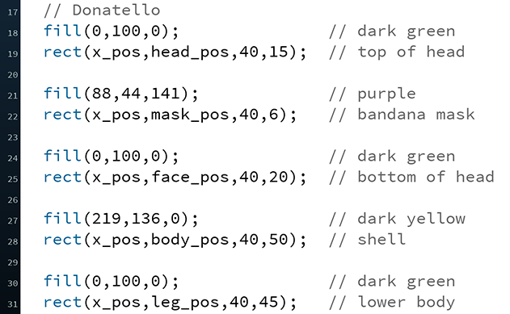
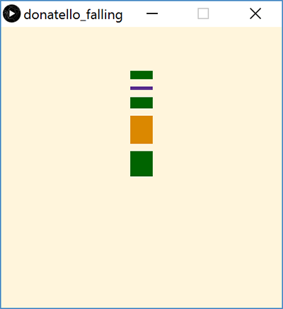
Falling Into Place
Update y-positions of drawing based on new variables:
Notes:
Draw: “mid-fall” on canvas
Underline: different variables for each part of Donatello

Slide 23
Summary
Variables are named quantities that can vary during the execution of a program
Datatypes specific different forms of data
e.g. int, float, color, boolean
Variable declarations specify a variable datatype and name to the program
Generally occur at top of program
Active mode uses setup() and draw()
Motion can be introduced by changing the values of variables used in drawing commands in-between frames
min() and max() functions can be used to limit or stop change in a variable value

Slide 24
Variable Practice
int x = 1; int y = 2; int z = 3; x = x + 1; y = y - 1; z = z + 2;
int x = 7; int y = 2; int z = 0; x = x + 3; y = y – 2; z = x + y;
int x = -1; int y = 0; int z = 5; x = x + z; y = y – x; z = x + z;
x | y | z
x | y | z
x | y | z

