Slide 1
Functions in Processing CSE 120 Winter 2020
Instructor: Teaching Assistants:
Sam Wolfson Yae Kubota Eunia Lee Erika Wolfe
Apple dropped plan for encrypting backups after FBI complained
“Apple Inc dropped plans to let iPhone users fully encrypt backups of their devices in the company’s iCloud service after the FBI complained that the move would harm investigations, six sources familiar with the matter told Reuters.
The tech giant’s reversal, about two years ago, has not previously been reported. It shows how much Apple has been willing to help U.S. law enforcement and intelligence agencies, despite taking a harder line in high-profile legal disputes with the government and casting itself as a defender of its customers’ information.”
https://www.reuters.com/article/us-apple-fbi-icloud-exclusive/exclusive-apple-dropped-plan-for-encrypting-backups-after-fbi-complained-sources-idUSKBN1ZK1CT

Slide 2
Administrivia
Assignments:
Website Setup [checkoff] due tomorrow (1/23)
Reading Check 3 due tomorrow @ 3:30 pm (1/23)
Lego Family [submit] due Friday (1/24)
Animal Functions [submit] due next Tuesday (1/28)
Editing your portfolio from home
Download and install Cyberduck & VS Code
Re-do Steps 3 & 4 from the website setup
Quiz grades released – regrade requests open
Make sure to take advantage of office hours and Piazza!

Slide 3
Lego Family
Create an abstracted family/group of characters
Can’t use the Simpsons or Teenage Mutant Ninja Turtles
Be careful with level of detail vs. time you want to spend
Add motion to get them to come together
Notes:
This is something that we’ll talk more about next week but as a quick introduction.

Slide 4
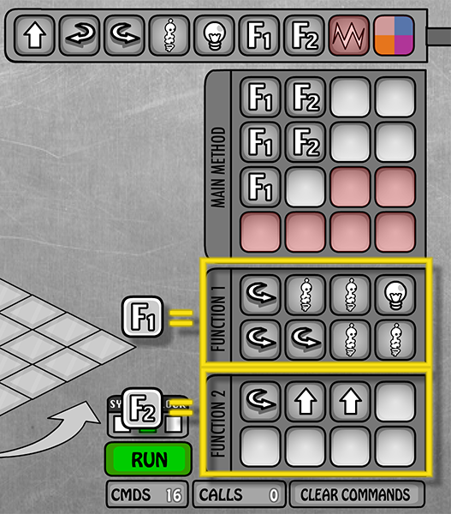
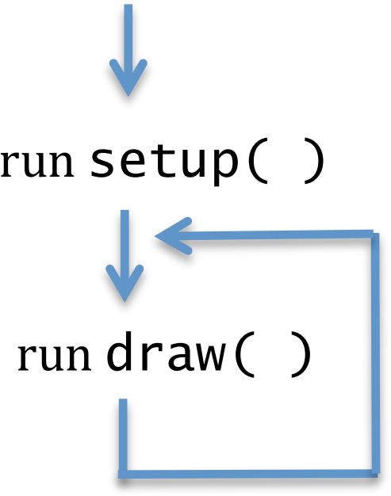
Functions (So Far)
Used for abstraction
Detail Removal: subtasks with intuitive names
Generalization: don’t repeat code
Lightbot:
Processing:
line(), rect(), …
min(), max()
Notes:
So far, we’ve used functions as a tool for abstraction.
Can give a nice name that describes how it works
Don’t need to worry too much about implementation
Write a function for what would otherwise be repetitive code
Lightbot: up to 2 functions, when we encounter a function, transfer control to the function block, then when we hit the end, back to …?
Processing: we’ve written the functions setup() and draw(), implicitly called
But the commands that we’ve written are also functions! e.g., line, rect.
How to define our own?

Slide 5
Program Execution with Functions
Functions “break” the normal sequential execution model
When function is called, begin execution of function code
When end of function is reached, jump back to where function was called from
The keyword associated with this is return
Analogy: Song lyrics with a repeated chorus
Notes:
Commands no longer totally in order
Stop what you’re doing, run this piece of code, then go back to the next line of code afterwards.
Emphasize ”call” and “return”
Eg. Line() is a function (one that is built-in – you don’t need to write it)
Will jump to the code inside that function, draw the line, then jump back to the line after the call
Same idea as lightbot, but now text-based.
“return” keyword -- go back to where we started

Slide 6
Rick Astley could’ve used some functions…
We're no strangers to love
You know the rules and so do I
A full commitment's what I'm thinking of
You wouldn't get this from any other guy
I just wanna tell you how I'm feeling
Gotta make you understand
Never gonna give you up
Never gonna let you down
Never gonna run around and desert you
Never gonna make you cry
Never gonna say goodbye
Never gonna tell a lie and hurt you
We've known each other for so long
Your heart's been aching but you're too shy to say it
Inside we both know what's been going on
We know the game and we're gonna play it
And if you ask me how I'm feeling
Don't tell me you're too blind to see
Never gonna give you up
Never gonna let you down
Never gonna run around and desert you
Never gonna make you cry
Never gonna say goodbye
Never gonna tell a lie and hurt you
Never gonna give you up
Never gonna let you down
Never gonna run around and desert you
Never gonna make you cry
Never gonna say goodbye
Never gonna tell a lie and hurt you
We've known each other for so long
Your heart's been aching but you're too shy to say it
Inside we both know what's been going on
We know the game and we're gonna play it
I just wanna tell you how I'm feeling
Gotta make you understand
Never gonna give you up
Never gonna let you down
Never gonna run around and desert you
Never gonna make you cry
Never gonna say goodbye
Never gonna tell a lie and hurt you
Never gonna give you up
Never gonna let you down
Never gonna run around and desert you
Never gonna make you cry
Never gonna say goodbye
Never gonna tell a lie and hurt you
Verse 1
Verse 1
Chorus
Verse 2
Chorus
Chorus
Verse 3
Chorus
Chorus
Chorus
Verse 2
Chorus
Chorus
Verse 3
Notes:
We’re pulling in the chorus five times here! So much writing…
(I happen to know that the chorus comes twice more after we run out of room on the slide…)

Slide 7
Rick Astley could’ve used some functions…
We're no strangers to love
You know the rules and so do I
A full commitment's what I'm thinking of
You wouldn't get this from any other guy
I just wanna tell you how I'm feeling
Gotta make you understand
Never gonna give you up
Never gonna let you down
Never gonna run around and desert you
Never gonna make you cry
Never gonna say goodbye
Never gonna tell a lie and hurt you
We've known each other for so long
Your heart's been aching but you're too shy to say it
Inside we both know what's been going on
We know the game and we're gonna play it
And if you ask me how I'm feeling
Don't tell me you're too blind to see
Never gonna give you up
Never gonna let you down
Never gonna run around and desert you
Never gonna make you cry
Never gonna say goodbye
Never gonna tell a lie and hurt you
Never gonna give you up
Never gonna let you down
Never gonna run around and desert you
Never gonna make you cry
Never gonna say goodbye
Never gonna tell a lie and hurt you
We've known each other for so long
Your heart's been aching but you're too shy to say it
Inside we both know what's been going on
We know the game and we're gonna play it
I just wanna tell you how I'm feeling
Gotta make you understand
Never gonna give you up
Never gonna let you down
Never gonna run around and desert you
Never gonna make you cry
Never gonna say goodbye
Never gonna tell a lie and hurt you
Never gonna give you up
Never gonna let you down
Never gonna run around and desert you
Never gonna make you cry
Never gonna say goodbye
Never gonna tell a lie and hurt you
Verse 1
Verse 1
Chorus
Verse 2
Chorus
Chorus
Verse 3
Chorus
Chorus
Chorus
Verse 2
Chorus
Chorus
Verse 3
Notes:
Why not just grab it from the same chorus each time? It doesn’t change…

Slide 8
Rick Astley could’ve used some functions…
We're no strangers to love
You know the rules and so do I
A full commitment's what I'm thinking of
You wouldn't get this from any other guy
I just wanna tell you how I'm feeling
Gotta make you understand
Never gonna give you up
Never gonna let you down
Never gonna run around and desert you
Never gonna make you cry
Never gonna say goodbye
Never gonna tell a lie and hurt you
We've known each other for so long
Your heart's been aching but you're too shy to say it
Inside we both know what's been going on
We know the game and we're gonna play it
And if you ask me how I'm feeling
Don't tell me you're too blind to see
We've known each other for so long
Your heart's been aching but you're too shy to say it
Inside we both know what's been going on
We know the game and we're gonna play it
I just wanna tell you how I'm feeling
Gotta make you understand
Verse 1
Verse 1
Chorus
Verse 2
Chorus
Chorus
Verse 3
Chorus
Chorus
Chorus
Verse 2
Verse 3
We can eliminate writing down all but 1 of the choruses!

Slide 9
Data Passing with Functions
It takes in zero or more inputs, completes some task(s), and then returns a value
Functions can do more in Processing than in Lightbot!
Analogy: An Oven
Analogy: Song lyrics with that change slightly
Parameterized Example: Old MacDonald
Chorus(cow, moo), Chorus(pig, oink), Chorus(duck, quack)
Inputs
Output
Notes:
Not something we could do in lightbot – functions are more versatile in Processing!
Label: dough, tomato, cheese, etc., as inputs
Oven as function
Pizza as output
Could add mushrooms! Same hardware (oven), different results based on different inputs
We call these inputs parameters.

Slide 10
Old MacDonald had a farm…
Old MacDonald had a farm, E-I-E-I-O And on his farm he had a cow, E-I-E-I-O With a moo-moo here and a moo-moo there Here a moo there a moo Everywhere a moo-moo Old MacDonald had a farm, E-I-E-I-O Old MacDonald had a farm, E-I-E-I-O And on his farm he had a pig, E-I-E-I-O With a (snort) here and a (snort) there Here a (snort) there a (snort) Everywhere a (snort-snort) Old Macdonald had a farm, E-I-E-I-O
Old MacDonald had a farm, E-I-E-I-O
And on his farm he had a horse, E-I-E-I-O
With a neigh, neigh here and a neigh, neigh there
Here a neigh there a neigh
Everywhere a neigh, neigh
Old Macdonald had a farm, E-I-E-I-O
verse(animal, noise) {
Old MacDonald had a farm, E-I-E-I-O And on his farm he had a {animal}, E-I-E-I-O With a {noise}-{noise} here and a {noise}-{noise} there Here a {noise} there a {noise} Everywhere a {noise}-{noise} Old Macdonald had a farm, E-I-E-I-O
}
verse(“cow”, “moo”)
verse(“pig”, “(snort)”)
verse(“horse”, “neigh”)

Slide 11
House-Drawing Function
void setup() {
size(500, 500);
}
void draw() {
background(255);
drawHouse(70, 10);
rect(0, 0, 10, 10);
}
void drawHouse(int x, int y) {
triangle(x, y, x-40, y+40, x+40, y+40); // roof
rect(x-40, y+40, 80, 80); // walls
rect(x+10, y+80, 20, 40); // door
return;
}
Notes:
Draw line from 70 → x, 10 → y
Values get passed into the function: within the function, x will have value 70 and y will have value 10.
Illustrate execution: when drawHouse() executed, runs though entire function before going back to rect()
Go through execution for house program.
Setup() once, draw() continuously – remember that draw() is executing over and over again.

Slide 12
Return Type
return type
What the function sends back to whoever called it
Can be any of the datatypes: int, float, color, etc.
If not returning anything, then we use void
void drawHouse(int x, int y) {
triangle(x, y, x-40, y+40, x+40, y+40); // roof
rect(x-40, y+40, 80, 80); // walls
rect(x+10, y+80, 20, 40); // door
return;
}
Notes:
First thing when writing a function: return type.
Can return 0 or 1 values.
If we don’t want to return anything, special keyword ”void” means “nothing.” Otherwise, one of the other data types that we’ve learned.

Slide 13
Function Name
function name
Does not matter to computer, but does to humans
Should describe what the function does
Subject to same naming constraints as variables
No two functions (or variables) can have the same name
void drawHouse(int x, int y) {
triangle(x, y, x-40, y+40, x+40, y+40); // roof
rect(x-40, y+40, 80, 80); // walls
rect(x+10, y+80, 20, 40); // door
return;
}
Notes:
Next: function name. Same constraints as variables.
Just like variables need to have names, so do functions. (example: my name “Sam” is common, if at a large gathering, multiple people likely named Sam)
The computer doesn’t care what you call it, but like when naming a variable, it should describe what it does.

Slide 14
Parameters
parameters
Required part of every function definition
Must be surrounded by parentheses
If no parameters, parentheses are left empty
Datatype and name for every parameter must be specified
Separate parameters with commas
void drawHouse(int x, int y) {
triangle(x, y, x-40, y+40, x+40, y+40); // roof
rect(x-40, y+40, 80, 80); // walls
rect(x+10, y+80, 20, 40); // door
return;
}
Notes:
After the name, comes the parameter list
The set of data that you’ll be passing into the function.
In this case, two coordinates, x and y
If none, just write empty parens
Must specify data type and name: essentially declaring variables, for use just within the function.

Slide 15
Function Body
body
Body is enclosed in curly braces {}
Parameters are variables that are used inside the body
As opposed to globals: defined outside a function
Body of a function is indented for better readability
Processing uses two spaces by default
Can use Edit → “Auto Format” (Ctrl+T on Windows or Cmd+T on Mac) to clean yours up automatically ☺
void drawHouse(int x, int y) {
triangle(x, y, x-40, y+40, x+40, y+40); // roof
rect(x-40, y+40, 80, 80); // walls
rect(x+10, y+80, 20, 40); // door
return;
}
Notes:
Now, what does the function actually do?
Function body enclosed in curly braces. Annotate start / end of body.
“Return” jumps back to execution (program counter) where the function was called.
Code inside of function body should be indented (processing uses 2 spaces by default) so we can distinguish it
- we’ll introduce other indentation later – just helpful for you to help keep track
Return statement is optional if not actually returning anything (“void”) but may be helpful reminder.
Please use auto format ☺

Slide 16
Lightbot Functions
Lightbot functions had a different syntax, but similar parts:
F.turn_around() Right, Right.
function name
parameters
body
F.turn_around() Right, Right.
Notes:
You’ve sort of seen this before: with Lightbot Functions.
Name
Empty argument list (now makes more sense?)
No curly braces, but period at the end to distinguish end of sentence.

Slide 17
Functions Worksheet
Make sure you explain why you see what you see!
void setup() {
size(500, 500);
}
void draw() {
drawHouse(70, 10);
}
void drawHouse(int x, int y) {
triangle(x, y, x-40, y+40, x+40, y+40); // roof
rect(x-40, y+40, 80, 80); // walls
rect(x+10, y+80, 20, 40); // door
return;
}
function call
function name
return type
parameters
body
Notes:
Recommended to do this in pairs, one person can write and one person can type.
Tempting to just go through this and just write down what you see, but remember to think about why!
Do worksheet until 10 min left.

Slide 18
Donatello as a Function
// draw Donatello
void drawDon() {
fill(0, 100, 0); // dark green
rect(xPos, 182, 40, 15); // top of head
fill(88,44,141); // purple
rect(xPos, 197, 40, 6); // bandana mask
fill(0, 100, 0); // dark green
rect(xPos, 203, 40, 20); // bottom of head
fill(219, 136, 0); // dark yellow
rect(xPos, 223, 40, 50); // shell
fill(0, 100, 0); // dark green
rect(xPos, 273, 40, 45); // lower body
}
Notes:
Previously: Donatello all inside of draw().
Now: move into new function called drawDon().
What’s wrong with this function?
Move Donatello into a function so we don’t need to put everything inside draw()
- Abstract away details, make code easier to understand
What’s wrong with this code? What happens if we call drawDon() twice?
- Always reads from same variable xPos. What if we want to change position?

Slide 19
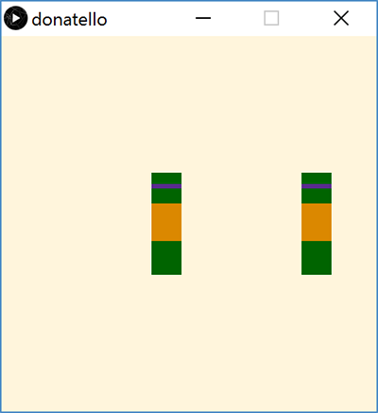
Donatello Function Parameterized
Can now call drawDon() function with different arguments (stored in parameter xDon):
We can also add parameter color mask to draw the other Teenage Mutant Ninja Turtles!
// draw Donatello
void drawDon(int xDon) {
fill(0, 100, 0); // dark green
rect(xDon,182,40,15); // top of head
...
void draw() {
background(255, 245, 220);
drawDon(200);
drawDon(400);
}
Notes:
Add parameters to the function
When we call it, give arguments
The parameters will take the value of the arguments
Start with just xPos
Add mask color
Change function name to drawTurtle since we can now draw other turtles as well
Add comments to distinguish ☺

Slide 20
Parameters vs. Arguments
Implicit parameter/variable initialization with argument values
// draw TMNT with parameters
void draw() {
background(255, 245, 220);
drawTurtle(200, color(88, 44, 141)); // donatello
drawTurtle(400, color(255, 0, 0)); // raphael
}
// parameterized ninja turtle drawing function
void drawTurtle(int x, color mask) {
fill(0, 100, 0); // dark green
rect(x, 182, 40, 15); // top of head
fill(mask); // apply mask color
rect(x, 197, 40, 6); // bandana mask
...
arguments
parameters
Notes:
Parameters are what you write when you make a function – declaring what the function will expect
Arguments the the values that the parameters take when you call the function
X gets 400, mask gets color(…)

Slide 21
Parameters vs. Arguments
When you define a function, you specify parameters
Parameters are internal variables/boxes for functions
Use parameters for values that you want to be different on different calls to this function
When you call a function, you pass arguments
The order of the arguments must match the order of the parameters
Inside of the function, the parameters take the value of the arguments
We define a function once but can call it as many times as we want (and in different ways)!
Notes:
Parameters are variables that are internal to a single function
Order of arguments must match expected order of parameters
Can call a function with different arguments to make it do different things – generalization!
Let’s see an example of how to break down a problem into functions.

Slide 22
Solving Problems
Understand the problem
What is the problem description?
What is specified and what is unspecified?
What has been given to you (e.g. starter code)?
Break the task down into less complex subtasks
Example: Make a function that draws a row of five mice with their ears touching/overlapping. The mice should all be the same color except for the middle one, which should be red.
Notes:
Need to understand the problem before you write the function
Row: different x, same y
Colors: must be different
Main subtask: draw a mouse
What parameters will we need? xPos, color
Something like: void mouse(int xPos, color c)

Slide 23
Parameter Example
Notes:
This just draws a mouse in a single position with one color – what’s missing? (parameters!)

Slide 24
Parameter Example
Notes:
We added parameters for x, y, and color so we can draw different mice in different places (& in different colors)!

Slide 25
Looking Forward
Portfolio
Don’t forget to add Taijitu, Logo Design, and Lego Family (one you finish it)!
Animal Functions
Start in lab on Thursday, due Tuesday (1/28)
Design your own animal (like the frog shown here)
Example from CSE 120 18wi student

Slide 26
Parameters Analogy
Executing a program is like walking down a hallway
Calling a function is like stepping into a room
Step back into the hallway after you are done with the task in that room
Parameters are boxes (our variable analogy) bolted to floor of room – can use while you’re there, but can’t leave room with them
Arguments are the values you place in boxes when you enter the room

