Slide 1
The Internet CSE 120, Winter 2020
Instructor: Teaching Assistants:
Sam Wolfson Yae Kubota Eunia Lee Erika Wolfe
CenturyLink, Frontier took FCC cash, failed to deploy all required broadband
“CenturyLink and Frontier Communications have apparently failed to meet broadband-deployment requirements in numerous states where they are receiving government funding to expand their networks in rural areas.”
“CenturyLink and Frontier were among 10 ISPs that accepted funding in the FCC's 2015 Connect America Fund auction in exchange for promises to deploy Internet service with speeds of at least 10Mbps downstream and 1Mbps upstream. CenturyLink is receiving $505.7 million in annual support for six years to deploy service to 1,174,142 homes and businesses in 33 states.”
https://arstechnica.com/tech-policy/2020/01/centurylink-frontier-took-fcc-cash-failed-to-deploy-all-required-broadband/
Notes:
Hot tip: if you want to cancel Comcast, tell them you’re moving to Europe.
Then just sign up under a new name (or get your roommate to sign up) and enjoy new customer deals for another year.

Slide 2
Administrivia
Assignments
Lego Family [submit] due tonight!
Animal Functions [submit] due Tuesday (1/28)
Continue adding projects to your portfolio
Notes:
The Internet will relate to a lot of the Big Ideas topics that we’ll go into later in the course.

Slide 3
Outline
Networks
Growth of the Internet
Sending Information
Encryption

Slide 4
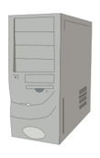
Communication Channels
We often transmit sequences of bits between computers – why?
Only capability we need because of binary encoding!
Via wire: Ethernet
Via wireless: Wi-Fi, 3G/4G/5G, Bluetooth
A network is a group of computing devices connected together, either by wire or wirelessly
Notes:
Why is it useful to transmit bits between computers?
Access more information and software than is stored locally.
Help users communicate & exchange information.
Perform other remote services.
Simplest network is just two computers connected together.

Slide 5
A Simple Model for Networks
One way to represent computer networks is a graph
Each node represents one machine on the network
Each edge represents a connection between two machines
Below is a network with just two computers
2 nodes, and 1 edge
Node
Node
Edge
Notes:
Why is it useful to transmit bits between computers?
Access more information and software than is stored locally.
Help users communicate & exchange information.
Perform other remote services.
Simplest network is just two computers connected together.
Graphs will come up more in later lectures – they’re extremely useful in computer science.

Slide 6
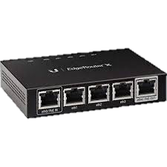
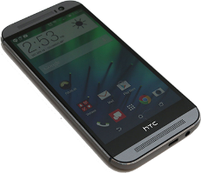
Example: Home Network
The network at my house: 7 nodes, 6 edges
Not counting the outside world
Notes:
Router is “hub”
Laptop asks router “hey, can you send this data to the printer”
Router knows where the printer is connected, sends data on its way
Router is also connected to the outside world – if you ask for google.com, the router knows to send that query to the modem, which directs it onwards to your ISP, etc.

Slide 7
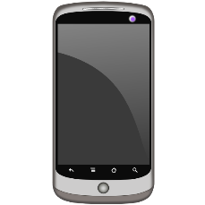
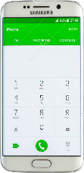
Example: Cellular Network
Notes:
Different technology than Wi-Fi – different types of radio waves – but still a network

Slide 8
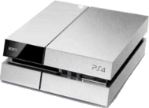
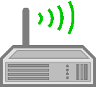
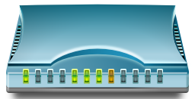
Internetworking
If you connect two networks, you still have a network
Sometimes called an “internetwork”
The largest network of networks on the planet is usually called “The Internet”

Slide 9
The Interwebs?
The Internet: All of the hardware and data associated with the network of all networks (wires, fibers, switches, routers, servers, files, etc.)
The World Wide Web: The system used to access the Internet (data transmission via browsers, web servers, web services, etc.)
Notes:
The Internet is the hardware + data
WWW is the software technologies used to access the Internet
Today we’ll cover the Internet, but now they’re very closely related

Slide 10
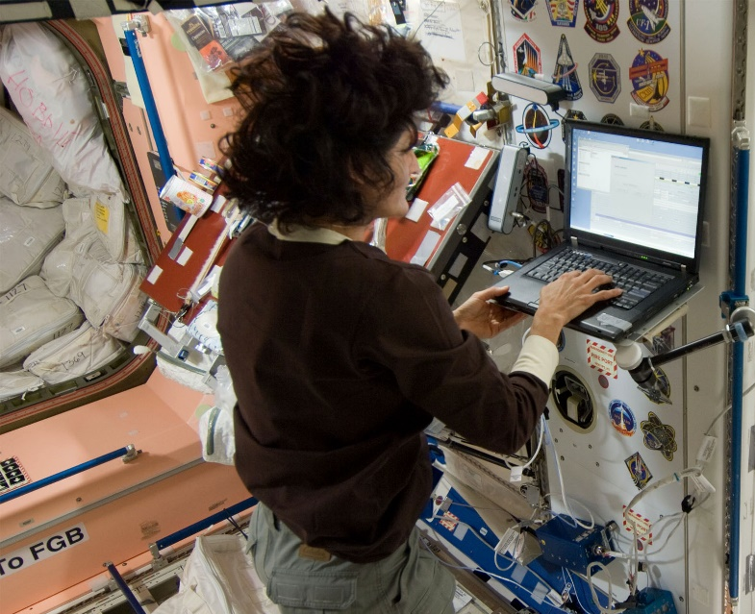
Internet Accessibility
Can now get Internet almost anywhere:
On a bus
On a plane
On a mountain
In outer space
StarTribune
united.com
Slash Gear
NASA
Notes:
We’re in a bubble in Seattle in the US – accessibility still lacking in other places

Slide 11
The Internet Today (well, sort of)
Internet Usage as a Percentage of Population (2015)
By Jeff Ogden (W163) - Own work, based on figures from the Wikipedia: List of countries by number of Internet users article in the English Wikipedia, which is in turn based on figures from the International Telecommunications Union (ITU) for 2010 (updated to use figures for 2012 on 28 June 2013). The source code of this SVG is valid. This vector image was created with a text editor. This vector image includes elements that have been taken or adapted from this: BlankMap-World6.svg., CC BY-SA 3.0, https://commons.wikimedia.org/w/index.php?curid=19202338
Notes:
Internet access varies a lot around the globe. Lots of research in how we can help improve internet access worldwide.
Interesting: US is only 70-79%! Not at the top.

Slide 12
The Internet Today
Internet users per 100 inhabitants
By Jeff Ogden (W163) and Jim Scarborough (Ke4roh) - Own work, CC BY-SA 3.0, https://commons.wikimedia.org/w/index.php?curid=18972898
Notes:
Large gap between proportion of internet users in developing vs. developed countries
Information and Communication Technology for Development (ICTD) Lab: http://ictd.cs.washington.edu/

Slide 13
Outline
Networks
Growth of the Internet
Sending Information
Encryption
Data Storage

Slide 14
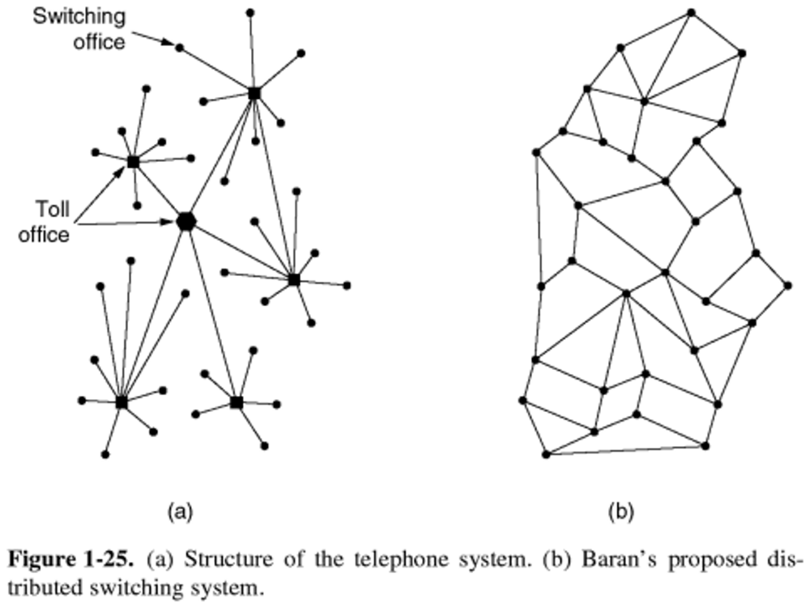
The DoD and Computer Networks
The Department of Defense (DoD) observed that central offices made communication network vulnerable to attack
1950s – The Cold War
Can we build a more robust, decentralized system?
Figure from Computer Networks by Tanenbaum and Wetherall
Notes:
Original idea was from the DOD – attempt to solve a security issue.
LHS: cities connected via one large node in the middle – if that goes down, breaks everything! (show crossing out node)
RHS: multiple paths between each two devices / smaller networks (show alternate path)
Aside: in the old days, it was common to use the telephone system to access the Internet. You would “call” your ISP and they would send binary signals down your phone line, encoded as sound!

Slide 15
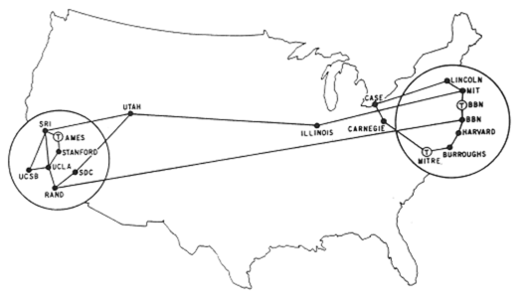
ARPANET
First 4 nodes of ARPANET connected in 1969
Stanford, UC Los Angeles, UC Santa Barbara, Utah
By Sept. 1971, there were 18 nodes across the US
Grew exponentially from there for a long, long time
ARPANET superseded by NSFNET in ‘86, Internet in ‘91
Notes:
At first, “Arpanet” just connected a few universities
Slowly grew at first, but then began to grow much more quickly because of…

Slide 16
Growth of the Internet
The major point in building networks is agreement
The only way to get seamless integration
Open standards/protocols enabled rapid growth
Internet Engineering Task Force (IETF)
Request for Comments (RFC)
World Wide Web Consortium (W3C)
HTML
International Standards Organization (ISO)
JPEG, MPEG
Institute of Electrical and Electronics Engineers (IEEE)
Wi-Fi
Notes:
Standardization makes life a lot easier (ex. Imagine you’re the only one with an iphone and you are at your friends house without a charger)
The ability to standardize the internet in an open fashion helps to ensure that it’s accessible to as many people (and device types) as possible.
HTML standard way to represent webpages
Wi-Fi standard for wireless connection

Slide 17
Outline
Networks
Growth of the Internet
Sending Information
Encryption
Data Storage
Notes:
So how do we actually transmit these bits?

Slide 18
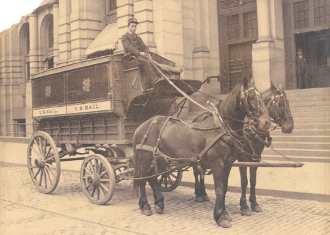
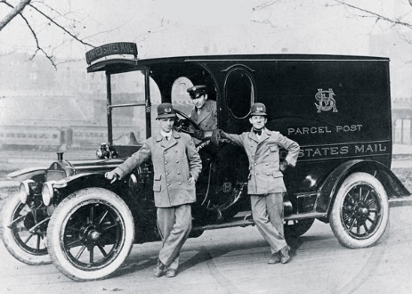
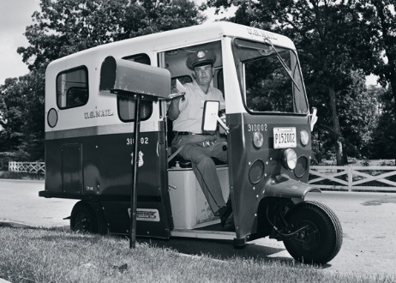
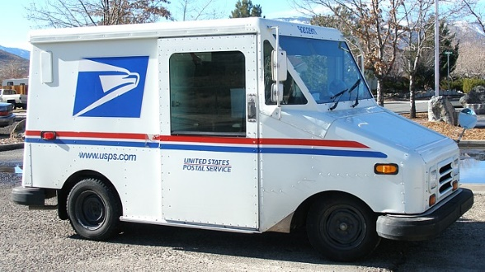
Analogy: Mailing a Letter
I want to send a letter to my friend in France
Write her unique address on the envelope
Stamp it
Drop it in a mailbox
I rely on the abstraction that the postal service will magically deliver the letter to the specified address
1895
1913
1964
present
Notes:
Specify a unique destination, even one in a different country
Trust that the postal service will get the letter there – we don’t care exactly how (has changed drastically over time)

Slide 19
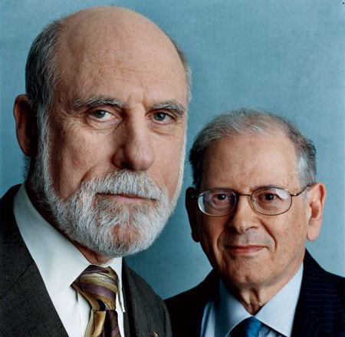
IP Addresses
In 1974, Vint Cerf and Bob Kahn completed the specifications for the Internet Protocol (IP)
Every device given a unique 32-bit address (IP address)
Large entities (e.g. companies, universities) can keep an IP address forever and allocate to physical machines as desired
For home networks, IP address is typically not permanent
Address is used to get information to the right computer on a network
Check your IP address: https://www.whatismyip.com
Image: Archeologia Informatica
Notes:
IPs are the addresses of the internet world
Each device has a unique IP within a network
You specify the IP so the router(s) know where to send the data
Aside: how many IPs? 2^32 = ~4 billion.
At the time, they should that would be enough. (not true anymore!)
IPv6 uses 128 bit IP addresses: 2^128 address → enough so that every grain of sand on earth could have 664 billion IP addresses!

Slide 20
The Internet Protocol
Internet Protocol (IP) routes data across multiple networks
Every computer has a unique IP address
Individual networks are connected by routers that span networks
128.95.10.55
128.95.10.72
128.95.10.95
host
host
host
128.95.10.1
ethernet
router
128.95.4.1
ethernet
host
host
host
128.95.4.3
128.95.4.10
128.95.4.12
Notes:
.10.55 sends data to the router .10.1
The router looks at the data and realizes that it’s intended for .4.12
Sends it onward to the correct host within its other network
(this also works with many routers in between)

Slide 21
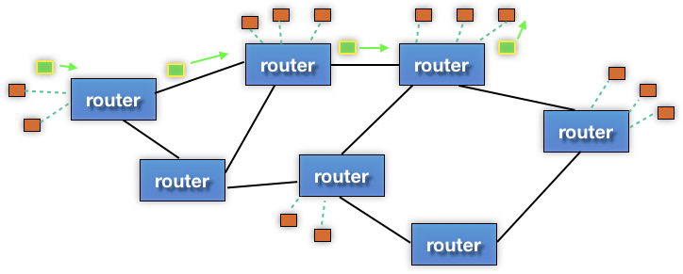
Internet Communication
Break the information into lots of tiny pieces called packets, about 1500 bytes long each
Packets are sent through the network (passing through many different machines) to their destination
The packets are reassembled on the other side
destination
source
Notes:
Instead of sending all the data (e.g., postcard) all at once), send a bunch of smaller postcards with an order specified
Suppose I want to send the book Moby Dick to my friend in France
I could send it all at once, but if it gets lost, need to send it all again
Instead, send it page-by-page
Easier to re-send lost pages
Each card can take a different route to the destination (makes the internet resilient to failures of individual nodes)
At the other end, the recipient re-assembles them, and requests that the sender re-send any packets it didn’t receive

Slide 22
Internet Communication
Packets must contain:
Destination address
Sequence/piece number
Content/data
addr | # | data
destination
source
Notes:
Each packets must contain
address (so we know where to send it)
Sequence number (so we know how to reassemble)
Data: the info that the recipient wants

Slide 23
Internet Communication
Advantages:
Packets can take separate routes
Can even originate from different locations
If packet is lost, only must resend small amount of info
addr | # | data
destination
source
Notes:
Much easier than re-sending an entire webpage/image/etc!

Slide 24
Internet Communication
Disadvantages:
Extra transmission data
e.g. same destination address for many packets
Every computer (!!) along a packet’s path sees the content of the packet
addr | # | data
destination
source
Notes:
!! Security / privacy issue !!
We’ll see how to solve this in a bit…

Slide 25
Domain Name System
Remembering IP addresses would be brutal for humans
Instead we use domain names, which are human-readable and more flexible
e.g. cs.washington.edu instead of 128.208.3.88
Computers find IP address for a domain name from the domain name system (DNS)
Another computer that acts as an IP address book
Your computer does need to know the IP address of the DNS server
DNS is an automatic directory search – it’s huge!
Notes:
We would rather not remember IP addresses (and, they can change!)
DNS: allows some computers to act as address books: given a domain name, find the corresponding IP
Computer does need IP of DNS server, but many fewer to remember vs. all websites
Large organizations run DNS servers: google, Comcast, etc.

Slide 26
Outline
Networks
Growth of the Internet
Sending Information
Encryption
Data Storage
The following slides are courtesy of Prof. Franzi Roesner and Eric Zeng from the Security and Privacy Research Lab at UW CSE.

Slide 27
Something You May Not Have Noticed
Your communication with Google is encrypted
You know that you’re talking to Google, as opposed to someone pretending to be Google (probably)
What does this actually mean???
Notes:
“s” stands for “secure”

Slide 28
Why Encryption?
Notes:
Any number of “bad actors” could be sitting in the middle of our connection, trying to sniff our packets
Would be nice to skip all those intermediaries, but then you’d need a connection directly to Gmail (not through any other computers)

Slide 29
Symmetric-Key Encryption
Use a secret key to both encrypt and decrypt the message/data
Both parties must have access to the secret key
How do we exchange keys???
Notes:
Annotate this! Simple example: Caesar cipher, shift all characters by n.
Use the same key to both encrypt and decrypt.
Ask: how to exchange? (both parties must have access)

Slide 30
Asymmetric Encryption
How do we know that this key is really from Google???
Use public key encryption to bootstrap symmetric key
Much slower to do public key encryption than symmetric
Notes:
We might get into this in more detail when talking about security.
I have a symmetric key I want to use with Gmail
Server generates public-private keypair and sends me the public key (can be used to encrypt, but not decrypt)
I encrypt symmetric key with public key and send that to the server
Only the server can decrypt the message containing the private key
Now, we can communicate using the symmetric key
Problem: so we know our connection is private – but how do I know that the server that I’m talking to is actually Google?

Slide 31
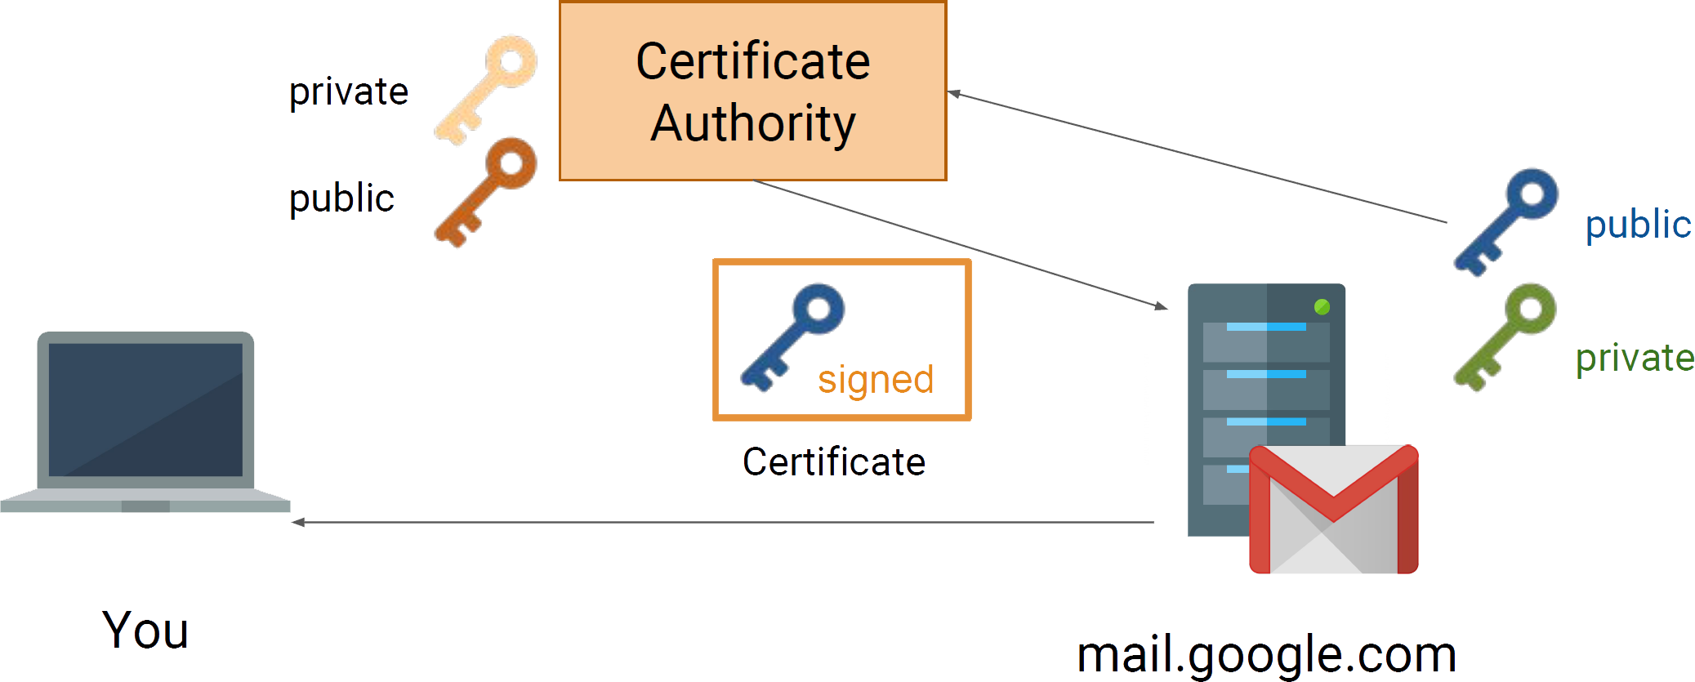
Certificate Authorities
Your browser knows some trusted authorities!
Notes:
There are some organizations that we’ve decided that we “trust” to verify that a certain name/IP combination is using a certificate that actually belongs to them.
If someone tries to impersonate Google, your browser can tell that the certificate is not valid

Slide 32
Trusted(?) Certificate Authorities
Notes:
Why do we trust Apple? AffirmTrust? Etc?

Slide 33
It’s turtles all the way down
Used to describe a problem that seems to have infinite dependencies
How do we know we can trust certificate authorities?
How to verify the verifiers?
How to verify the verifier-verifiers?
How to verify the verifier-verifier-verifiers?
At some point, we just have to trust without verification :/
Notes:
"Turtles all the way down" is an expression of the problem of infinite regress. The saying alludes to the mythological idea of a World Turtle that supports the earth on its back. It suggests that this turtle rests on the back of an even larger turtle, which itself is part of a column of increasingly large turtles that continues indefinitely (i.e., "turtles all the way down").
A well-known scientist (some say it was Bertrand Russell) once gave a public lecture on astronomy. He described how the earth orbits around the sun and how the sun, in turn, orbits around the center of a vast collection of stars called our galaxy. At the end of the lecture, a little old lady at the back of the room got up and said: "What you have told us is rubbish. The world is really a flat plate supported on the back of a giant tortoise." The scientist gave a superior smile before replying, "What is the tortoise standing on?" "You're very clever, young man, very clever", said the old lady. "But it's turtles all the way down!"

Slide 34
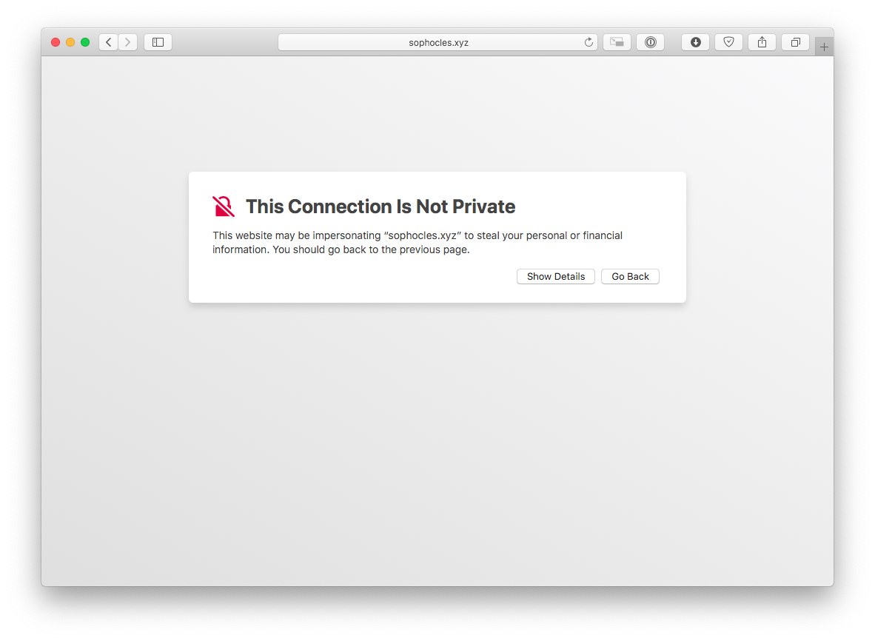
What If the Certificate is Bad?
Notes:
In this case, the certificate authority has not verified that this URL controls this certificate
Notice: no option to “continue”
Need to click “show details” first, etc.

Slide 35
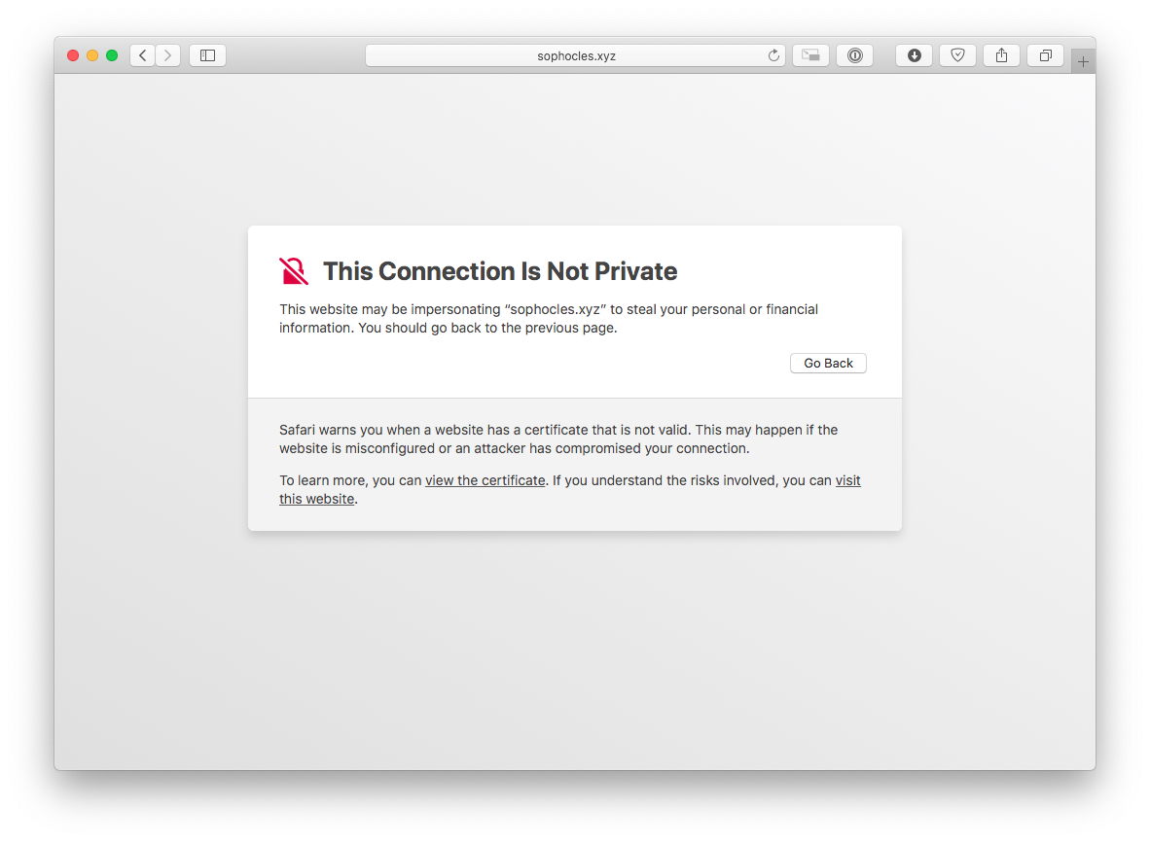
What If the Certificate is Bad?
Notes:
Notice: no option to “continue”
Need to click “show details” first, etc.

Slide 36
Summary
A network is a group of computing devices connected together, either by wire or wirelessly
The Internet is the largest network of networks
The Internet grew rapidly
Highly fault-tolerant due to decentralization
Growth aided by open standards (agreement)
Data is passed between computing devices in small pieces called packets
The domain name system translates from domain names to IP addresses in order to reach a specific device
Encryption helps us secure data transmissions between devices

