Slide 1
Digital Distribution CSE 120 Winter 2020
Instructor: Teaching Assistants:
Sam Wolfson Yae Kubota Eunia Lee Erika Wolfe
Quiz 2
You will have 20 minute to complete the quiz.
No outside materials are allowed – just your mind.
If you have a question, raise your hand.
Relax. You are here to learn ☺.
Finish: 3:51

Slide 2
Administrivia
Assignments:
Jumping Monster [submit] due tonight (1/31)
Creativity Planning (2/4)
Portfolio Update 1 due Wednesday (2/5)
Creativity Project (2/7)

Slide 3
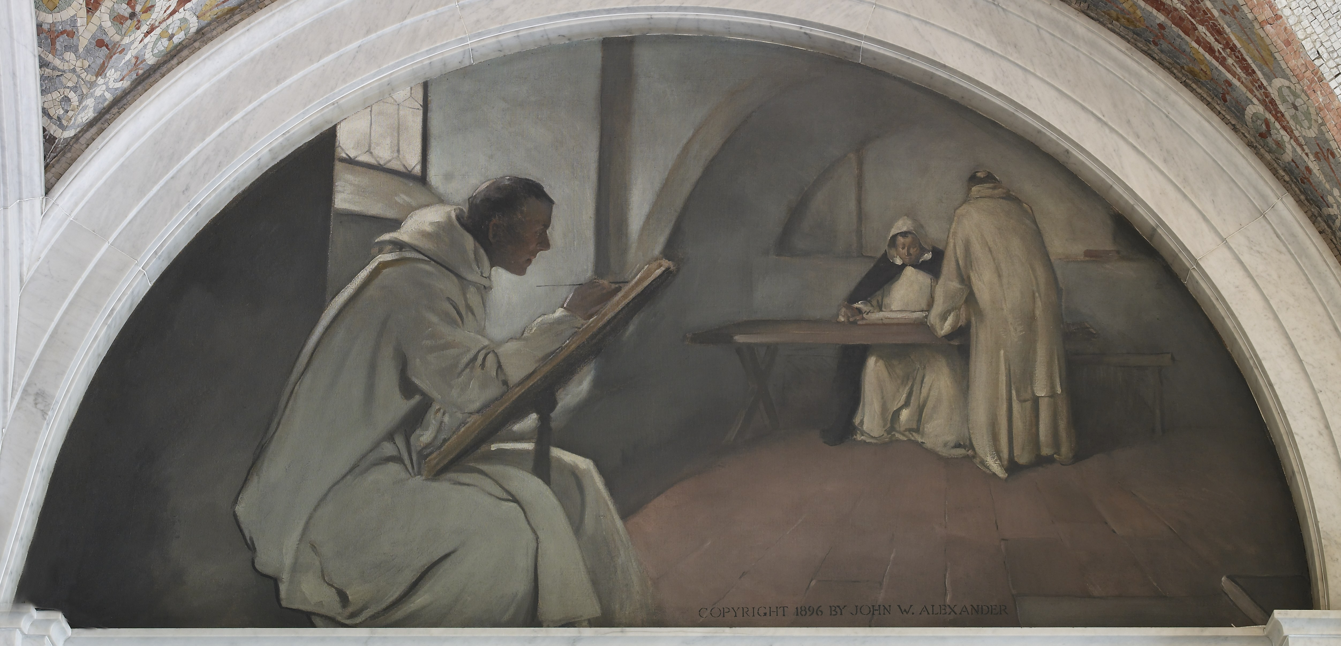
Biggest Impact of Digitization?
Digital information can be copied instantaneously and without loss
Analog copying: almost always with loss
Biological copying: mutations and recombination
Notes:
Profound impact on society – what’s the biggest impact?
- I claim: can copy instantaneously, without loss
Digital: can directly replicate bits
Analog: small things get “smoothed” out (like vinyl record), pressing a record will be slightly different than original

Slide 4
Copying is Easy
myCopy = myData;
File: right-click $→$ Copy
Lossless, instantaneous copying leads to a wealth of societal issues:
Privacy issues
Theft of private data
Interception of transmitted data
Persistence of digital data
Usage of digital works
Copyright
Legal, cultural, and economic impacts
Notes:
In Processing: copy a variable to another variable
Privacy: perhaps a future lecture
Right now, you may be primarily a consumer – but as you become more of a producer, this may become more important to you
Also, I’m not an expert.

Slide 5
Prompts
Do you think the following are “right”? Legal? How have the rules changed in the digital vs. physical realm?
Theft: Taking something from someone else without permission
Giving a song that you purchased to your friends
Your friend sends you a photo; you share it without asking
Using an image you found on the Internet on your website (or as your profile picture)
Notes:
Quick discussion?
Have rules changed? Vinyl record vs cd; vhs vs mp4
Theft: original owner still has it
Giving a song: how to define “lending”?
Sharing a photo: can share much more easily

Slide 6
Outline
Copyright
Sharing and open-source
Creative Commons

Slide 7
Intellectual Property (IP)
Intellectual property is something produced by one’s intellect
e.g. artwork, books, photos, music, poetry, performances, software
Distribution, copying, and sale of a work is the right of the creator
It is illegal to copy someone else’s creation for anything “other than personal use”
You are the creator of all that you create
Unless otherwise specified by a contract (e.g. at work)
Notes:
Produced: can’t just be an idea

Slide 8
Copyright: A Primer
http://www.youtube.com/watch?v=Uiq42O6rhW4

Slide 9
Copyright Terminology Review
Copyright: legal right granting creator of an original work exclusive rights over use and distribution
Set by laws of a country
Public domain: exclusive IP rights expired, forfeited, or inapplicable
Fair Use: right to use copyrighted material without permission in specific circumstances
e.g. commentary, search engines, criticism, parody, news, scholarship, education
Judged based on (1) purpose/character of use, (2) nature of the work, (3) amount used, and (4) effect on work’s value
Notes:
Web makes it tricky to follow laws of country
Sometimes you can use copyright even without permission from the author

Slide 10
Copyright Notes
Applies to wide variety of works: articles, artwork, books, choreography, photos, podcasts, screenplays, software, songs
Does not apply to ideas, facts/data, or logos
Copyright is automatically applied, even without the copyright symbol ©!
Once it is “captured in a fixed format”
Copyright has a limited duration
Usually tied to life of creator
Attribution is not a substitution for permission
Notes:
Copyright applies to pretty much everything – and automatically.

Slide 11
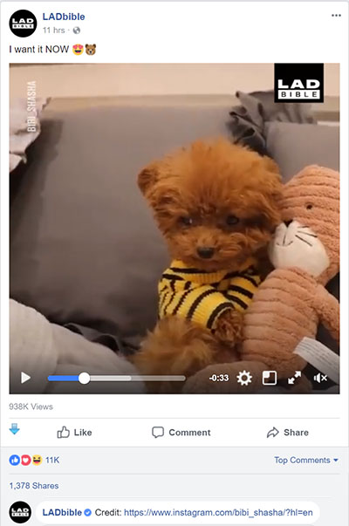
Copyright Violations
Why would people violate copyright?
Inadvertent – copying is too easy!
Inadvertent – unknown copyright status of material or misunderstanding of fair use
Financial – don’t want to pay
Financial – making money through clicks, views, and advertising
Notes:
Example: clearly ripped off video from YouTube. Re-poster might think it’s OK because they attribute the source, but that’s not how it works…

Slide 12
Copyright Violations
Most people who have posted on the Internet have probably violated copyright laws at one point
Illegal sharing of music and videos
Napster, Kazaa, DC++, BitTorrent
Illegal sharing of games
ISO images of games (to be played on emulators)
“Cracked” versions of games
Illegal usage of photos and works
Misrepresentation, plagiarism
Notes:
Photos: why would someone buy the rights to a photo when they can just right click > save ?

Slide 13
Digital Rights Management (DRM)
Technologies that are used to restrict usage of proprietary hardware and copyrighted works
Not universally accepted or used; can be inconvenient
Software: Product (serial) keys
Internal algorithm checks validity of entered key
“Cracked” keys can fool the validity check
Audio: non-standard CDs or restricted usage of downloaded music
Only playable with certain devices or applications
Games: Persistent online authentication
Notes:
Some older games have pretty ingenious DRM: see https://www.youtube.com/user/jimako123 for lots of interesting videos

Slide 14
Digital Millennium Copyright Act (DMCA)
Anti-circumvention provisions
Illegal to attempt to circumvent DRM (even if copyright isn’t breached)
Often viewed as anti-tinkering
Proven to be rather toothless – circumvention still happens
Safe harbor provisions
Protect “providers of online services” (e.g. ISPs, YouTube, Facebook) from being sued for copyright infringements of its users
DMCA Takedown Notice: copyright holders can request sites to remove or block access to material that violates their copyright
Notes:
Passed in 1998
Two separate parts.
Illegal to attempt to violate DRM, even if you don’t actually get anywhere!
anti-tinkering: does this mean you can’t take things apart?
ISPs can’t be sued for illegal activity of users.
Youtube & Facebook can’t be sued for

Slide 15
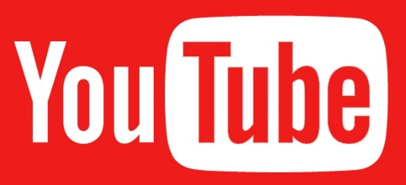
Most Effective Piracy Solution?
Online Streaming!
Make it so convenient to stream content (video, music, games) that pirating seems unnecessary
Notes:
Though, recently this has sort of gone backwards as companies each start their own service instead of cooperating, and things get more expensive again…

Slide 16
Copyright and Laws
Owners must “defend” their copyrights
RIAA and MPAA are at war with users
Stop Online Piracy Act (SOPA) – 2011, never voted on
Would have allowed court orders to bar access to websites with copyright infringement to advertising networks, payment facilities, and Internet service providers
Service blackout in 2012 by Wikipedia, Google, and others in protest
As of 2016, only 4 members of Congress (all in the House) have CS degrees
Notes:
RIAA – Recording Industry Association of America
MPAA – Motion Picture Association of America
Huge disconnect between people who are in charge and people who actually know how this works!
Anyone want to go into politics?

Slide 17
The following slides are considered “extra” material – since we didn’t get to them in lecture, we won’t test you on them. However, they’re left here in case you find them interesting.

Slide 18
Outline
Copyright
Sharing and open-source
Creative Commons

Slide 19
Copyright and Software
Copyright applies to software source code
Software is often distributed in executable form so that the source code is not viewable
Proprietary software has IP rights restrictions – copyright of source code or patent rights
Rapid growth – developers wanted to share ideas and build more complex software
Option 1: grant permission on a case-by-case basis
Option 2: put software in the public domain
Notes:
Sometimes you do want to share what you create – how?
Public domain works can be freely used for derivative works without permission.
Works derived from public domain works can be copyrighted.
Richard Stallman burned by Symbolics on Lisp interpreter in early 1980s: allowed them to use his software, they improved it then refused to show him improvements.

Slide 20
Copyleft
Form of licensing that offers people the right to freely distribute copies and modified versions of a work with the stipulation that the same rights be preserved in derivative works down the line
http://www.youtube.com/watch?v=u2k07BbPkDk
Notes:
Copyleft: can only use it if you allow others to use your modified versions.
First described in GNU Manifesto in 1985.

Slide 21
Open-Source Licenses
GNU General Public License (v2, v3)
Apache License
MIT License
BSD License
Public Domain
These licenses differ in:
Attribution requirements
Commercial use restrictions
Derivative work restrictions
Notes:
Open source: you can look at this software, use it, and make improvements, as long as you follow the licenses.

Slide 22
Why Use Open Source?
Pros:
Cheaper – free to install on all machines
Crowd-sourced fixes and improvements
Can persist beyond company that created it
You can personally contribute and become part of the community
Can reduce possibility of security flaws
Cons:
Can be more difficult to use and support
Notes:
Only one con, but it’s a BIG con
e.g., why do I use Mac and not Linux.

Slide 23
Open-Source Software
 | Proprietary | Open-Source
Operating Systems | Windows, Mac OS | Linux, Android *
Web Browsers | IE/Edge, Safari | Chrome *, Firefox
Email Client | Outlook | Thunderbird
Music Player | Windows Media Player, iTunes | VLC
Audio Editing | Cubase, Logic Pro | Audacity
Image Editing | Photoshop | GIMP
Text Editor | Word, Notepad, Sublime Text | Notepad++, VS Code
* includes some proprietary software for accessing Google services
Notes:
Most software includes open-source versions.

Slide 24
Outline
Copyright and protection
Sharing and open-source
Creative Commons
Notes:
Creative Commons is like open source, but for non-software.

Slide 25
Open Source for Non-Software?
Copyright ≈ all rights reserved
What if you don’t want/need all rights?
You can use a Creative Commons license
Maintained by Creative Commons non-profit organization, founded in 2001
Specify what uses you want to allow without needing permission
Notes:
The idea of “open source” doesn’t really apply to other types of works.

Slide 26
Layers of Creative Commons Licenses
Legal layer
Sustain lawsuits
Human-readable
Understandable for ‘everybody’
Machine-readable
Understandable for search engines
Notes:
These images are both human-readable, and able to be interpreted by a search engine (so they can tell what is allowed)

Slide 27
Creative Commons Symbols
Attribution (BY)
Must give creator credit in derived/distributed works
Noncommercial (NC)
Derived/distributed work can’t be sold
No Derivative Work (ND)
Must use AS IS
Share Alike (SA)
Derivative works may be distributed under the same license as this one

Slide 28
Types of Creative Commons Licenses

Slide 29
CC vs. Open Source
Creative Commons Licenses are not recommended for program code
Use open-source licenses instead
CC does not account for:
Patents
License compatibility
Binary vs. source code case distinction

Slide 30
Summary
Copyright is intended to protect the rights to intellectual property by the owner
Often protected by Digital Rights Management software
Legal protections and implementations are still a “work in progress”
Open-source licenses for software allow you to freely distribute your source code for use by others who agree to follow the same licensing rules
For works that you would like to share, you can waive some of your rights using Creative Commons licenses

