Slide 1
Loops & Nested Loops CSE 120 Winter 2020
Instructor: Teaching Assistants:
Sam Wolfson Yae Kubota Eunia Lee Erika Wolfe
The EARN IT Act: How To Ban End-to-end Encryption Without Actually Banning It
“There’s a new bill afoot in Congress called the EARN IT Act. This bill is trying to convert your anger at Big Tech into law enforcement’s long-desired dream of banning strong encryption. It is a bait-and-switch. Don’t fall for it. I’m going to explain where it came from, why it’s happening now, why it’s such an underhanded trick, and why it will not work for its stated purpose. And I’m only going to barely scratch the surface of the many, many problems with the bill.”
https://cyberlaw.stanford.edu/blog/2020/01/earn-it-act-how-ban-end-end-encryption-without-actually-banning-it
Notes:
Essentially a way to allow the Attorney General to decide what cloud providers are allowed to do on their platforms re: encryption, etc.
A sneaky way to allow banning encryption outright.

Slide 2
Administrivia
Creativity Project this week!
Planning document due tomorrow
Discuss your ideas with the TAs during section!
Final submission due Friday (2/7) on Canvas
Portfolio Update 1 due Wednesday (2/5)
Convert your existing projects to p5.js and upload them to your portfolio
Guest lecture this Friday: Data Visualization!
Reading check & presentations in section on Thursday

Slide 3
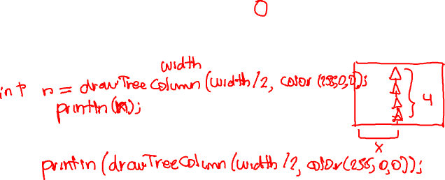
Quiz Recap
Quiz 2 was more challenging than Quiz 1.
Question 2 (Functions) was particularly difficult.
Our goal is to help you learn, and making mistakes is part of that process.
x
Notes:
Yes, this question was confusingly worded (sorry)
X is only used inside of drawTreeColumn, we must specify what value it takes
Remind about width
Show both possibilities for return value (explicit assignment vs println(dTC(…))

Slide 4
Outline
Loops
Nested Loops

Slide 5
Looping
Sometimes we want to do the same (or similar) things over and over again
Looping saves us time from writing out all the instructions
Loops control a sequence of repetitions

Slide 6
But First: Remember If-Statements?
if (condition) {
// "then"
// statements
}
Execute “then” statements if condition is true
Start
Condition?
False
True
“Then”
Statements
End
Notes:
First, let’s remind ourselves about if-statements.

Slide 7
While-Loop
Start
Basic form:
while (condition) {
// loop
// body
}
Repeat loop body until condition is false
Must make sure to update conditional variable(s) in loop body, otherwise you cause an infinite loop
draw() is basically a while (true) loop
Condition?
True
Loop Body
False
End
Notes:
The only difference here is that we continue to execute the contents of the loop body until the condition is no longer true.

Slide 8
While-Loop Example [Demo]
Row of six animals:
Using a while-loop:
void drawRow() {
??? // draw six mice
}
void drawMouse(float x, float y, color c) {
... // drawing commands
}
void drawRow() {
int count = 0;
while (count < 6) {
drawMouse(80*count, 20, color(150));
count = count + 1;
}
}
Notes:
Demo: replace 6 calls with while-loop. mouse_loop.pde

Slide 9
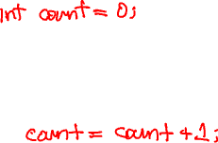
While-Loop
Start
More general form:
// init cond var(s)
while (condition) {
// loop body
// update var(s)
}
Initialize Var(s)
Update Var(s)
Condition?
True
Loop Body
False
End
Notes:
Int count = 0;
Inside: count = count + 1;

Slide 10
Loops Worksheet
while (condition) {
// loop body
}
Start
Condition?
True
Loop Body
False
End

Slide 11
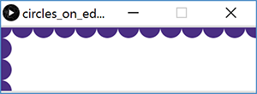
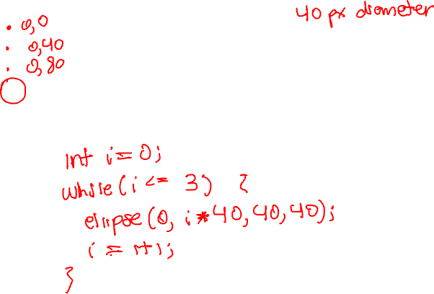
Processing Demo: Circles on Canvas Edge
Notes:
each circle has diameter of 40px.
Demo w/ left edge.

Slide 12
Processing Demo: Circles on Canvas Edge
size(720, 120); // canvas size
background(255); // white background
noStroke(); // no outline on circles
fill(75, 47, 131); // UW purple
int diam = 40;
// loop for circles along the top edge
int x = 0;
while (x <= width) {
ellipse(x, 0, diam, diam);
x = x+diam;
}
// loop for circles along the left edge
int y = 0;
while (y <= height) {
ellipse(0, y, diam, diam);
y = y+diam;
}

Slide 13
Outline
Loops
Nested Loops

Slide 14
Nested Loops
Generally a loop has a single loop variable that changes with each iteration
What if you need/want more things to change?
Can nest loops – i.e. put a loop inside of another loop

Slide 15
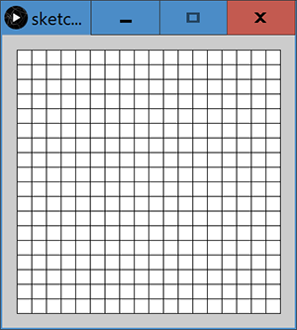
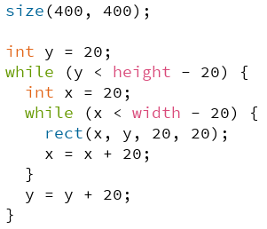
Processing Demo: Rectangle Grid
Notes:
Start by analyzing what happens during the inner loop.
y is initially 20.
Will draw rectangles starting at x = 20 until x = width – 20
Y will remain 20 for the entire first pass through the inner loop.
Then, increase y by 20, and repeat until canvas is filled.

Slide 16
Additional Material For Loops
This material is optional, and you won’t be tested on it, but it may help you to write more concise code.

Slide 17
For-Loop
Start
for(init; cond; update){
// loop body
}
First runs init expression(s)
Then checks cond
If true, runs loop body followed by update statement(s)
For-Loop can do exactly the same thing as a while-loop, but more compactly.
Initialize Var(s)
Update Var(s)
Condition?
True
Loop Body
False
End

Slide 18
For-Loop Example
Without loop:
line( 20, 40, 80, 80);
line( 80, 40, 140, 80);
line(140, 40, 200, 80);
line(200, 40, 260, 80);
line(260, 40, 320, 80);
line(320, 40, 380, 80);
line(380, 40, 440, 80);
With loop:
for (int i = 20; i < 400; i = i + 60) {
line(i, 40, i + 60, 80);
}

Slide 19
Understanding the For-Loop
Choice of variable name(s) is not critical
Represent the value(s) that vary between different executions of the loop body
Think of as temporary variable(s)
If variable i is declared in the initialization statement, then it only exists within this loop
initialization
for (int i = 20; i < 400; i = i + 60) {
line(i, 40, i + 60, 80);
}

Slide 20
Understanding the For-Loop
Condition evaluated before the loop body and must evaluate to true or false
Reminder: > greater than < less than >= greater than or equal to >= less than or equal to == equal to != not equal to
condition
for (int i = 20; i < 400; i = i + 60) {
line(i, 40, i + 60, 80);
}

Slide 21
Understanding the For-Loop
Update is an assignment that is executed after the loop body
Loop body is enclosed by curly braces {} and should be indented for readability
update
for (int i = 20; i < 400; i = i + 60) {
line(i, 40, i + 60, 80);
}
loop body

