Slide 1
Arrays CSE 120 Winter 2020
Instructor: Teaching Assistants:
Sam Wolfson Yae Kubota Eunia Lee Erika Wolfe
YouTuber uses neural networks to upscale 1896 short film to 4K 60 fps
“Someone was able to achieve remarkable results in upscaling a very old, low-resolution, black and white video from 1896 to a crystal-clear 4K video at 60 frames per second. This is one of many experiments that prove AI tech can be used to improve content that would normally seem impossible to "enhance" in any way.”
AI is so big that companies like Google, Apple, Intel, Microsoft, Amazon, and others are all racing to buy or invest in every new and obscure startup in the field to foster talent for their various projects. It's even the subject of ample discussion on the role AI in copyright and trademark law moving forward. It will be interesting to see what's in store for the next decade, and, thanks to Nvidia, we might have a hint - AI-rendered, interactive virtual worlds based on massive libraries of real-world footage.”
https://www.techspot.com/news/83867-youtuber-uses-neural-networks-upscale-1896-short-film.html
https://digg.com/2020/arrival-train-la-ciotat-upscaled

Slide 2
Administrivia
Assignments:
Portfolio Update 1 due tonight (2/6)
Creativity Assignment (2/7
You should already have feedback for your proposals!
Guest lecture on Friday: Data Visualization!
Reading check due before section, as usual
Living Computers Museum “field trip” upcoming

Slide 3
Outline
Loop Review
Arrays
Arrays and Loops

Slide 4
Example: Line Gradient
size(400, 400);
background(255);
strokeWeight(5);
int i = 0;
while (i < 400) {
stroke(i);
line(i, 0, i, 400);
i = i + 8;
}
Notes:
Common: vertical lines
Changing: x-pos and line color

Slide 5
Exercise: Circle Loop
Consecutive concentric circles differ in diameter by 10:
size(400, 400);
noFill();
int d = 450;
while (________) {
ellipse( ______, ______, _____, _____ );
__________;
}
Notes:
Common: concentric circles
Change: radius
Init: d = 450
Condition: d > 0
Update: d = d - 10

Slide 6
Example: Looping with User Interaction?
Draw lines from left side of screen to the horizontal position of the mouse
Notes:
Mouse pos at (mouseX, mouseY)
Draw lines from x = 0 to x = mouseX

Slide 7
Example: Draw Lines to mouseX
void setup() {
size(400, 400);
strokeWeight(4);
}
void draw() {
background(204);
int i = 10;
while (i < mouseX) {
line(i, 10, i, 390);
i = i + 8;
}
}
Notes:
Init: int I = 10;
Cond: I < mouseX
Update: I = I + 8
Note: draw background between every frame so we go over old lines

Slide 8
Outline
Loop Review
Arrays
Arrays and Loops

Slide 9
Arrays
“Structures” that store many values of the same datatype
Can think of as a group of related variables
Arrays store large amounts of data that you can access using a single name
Accessing arrays with loops is very convenient
Analogy: creating a street with lots of houses on it; can access houses via house numbers
Notes:
Note: houses must all be the same type

Slide 10
Arrays Terminology
“Structures” that store many values of the same datatype
Element: a single value in the array
Index: a number that specifies the location of a particular element of the array
Start from 0
Length: total number of elements in the array
Example:
Index: | 0 | 1 | 2 | 3 | 4
Value: | 12 | 49 | -2 | 5 | 17
length of 5
“element 0”
“element 4”
Notes:
Element: a house
Index: the house number, numbered 0 through length – 1
Length: total # of houses on the street
Note: index != value
Example: notice length = 5, elements from 0 thru 4

Slide 11
Declaring Arrays in Processing
Declaration: type[] name
Warning: an array variable is NOT an array!
Examples:
int[] myNums declares an array variable for arrays of integers
float[] myData
color[] rainbow
Could represent the colors of the rainbow in order
boolean[] correct
Could represent correctness on a multiple choice test
Notes:
“name” is the array’s name
Tell processing, “I want a box that will hold an array”
Not the same thing as actually putting something in the box

Slide 12
Creating Arrays in Processing
Creation: new type[num]
Remember that actual indices are from 0 to num-1
Default value for all elements is “zero-equivalent” (0, 0.0, false, black)
Examples:
int[] intArr = new int[5];
intArr associated with int array {0, 0, 0, 0, 0}
boolean[] quiz = new boolean[3];
quiz associated with boolean array {false, false, false}
new float[7];
Creates a float array, but you can’t use it because you didn’t associate it with an array variable!
Notes:
Now we say “fill this box with num items” like building num houses on the street.
Each element of the array will be assigned default value
New float: built the houses but didn’t give them a name – no way to find them!

Slide 13
Initializing Arrays in Processing
Initialization: {elem0, elem1, …, elemN}
The "curly brace" notation can be used to create an array with specified/initialized element values
Don’t confuse this usage of {} with that for a code block
Examples:
int[] intArr = {12, 49, -2, 5, 17};
Create a new array with specified values and associate it with the array variable intArr
intArr = {1, 2, 3, 4};
Discards the old array and associates the array variable intArr with this new array!
Notes:
If you don’t want each element to just get their “zero-value”, can use this notation.
Different from {} showing code block!
What is the length of intArr for each example?

Slide 14
Using Arrays in Processing
Use element: name[index]
In expression, uses value of that index of the array
In assignment, modifies value of that index of the array
Get length: name.length
Example:
int[] intArr = {12, 49, -2, 5, 17};
println(intArr[0]); // prints 12 to console
intArr[2] = intArr.length; // changes -2 to 5
Index: | 0 | 1 | 2 | 3 | 4
Value: | 12 | 49 | -2 | 5 | 17
Notes:
Suppose we have an array called name
To use an element, can put in expression or assignment with same notation
Exp: READ assign: WRITE
“dot notation” to get length
Show picking out element from example
Show overwriting element

Slide 15
Arrays and Loops
Arrays are very convenient to use with loops!
Loops usually change numerical value in loop variable (e.g. Update: i = i + 1)
You access array element values using a numerical value (e.g. intArr[i])
Loops provide an easy way to perform the same/similar action on all/many elements of an array
Examples:
Read each array value to use in a drawing command
Sum up the numbers in an array

Slide 16
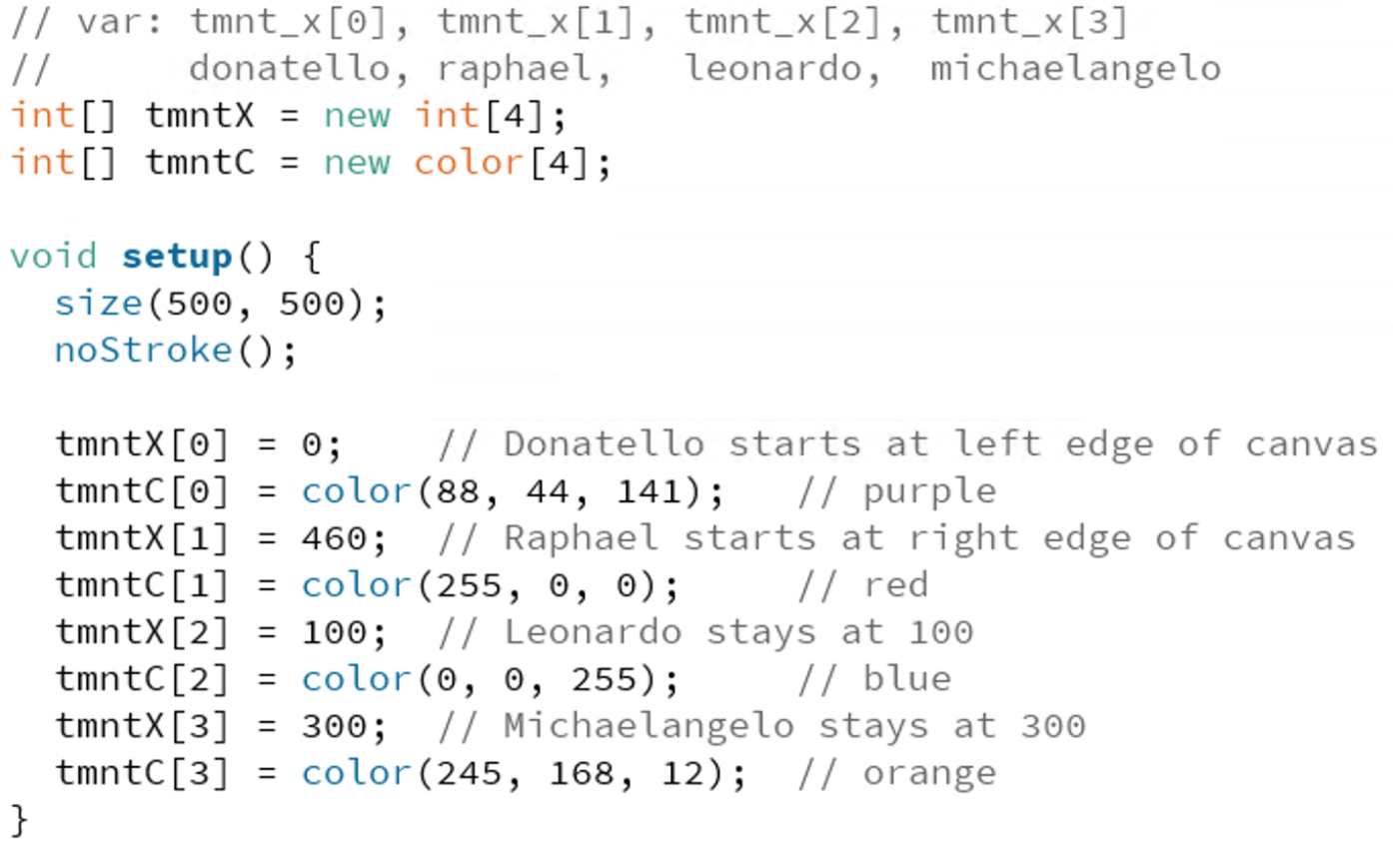
Example: TMNT

Slide 17
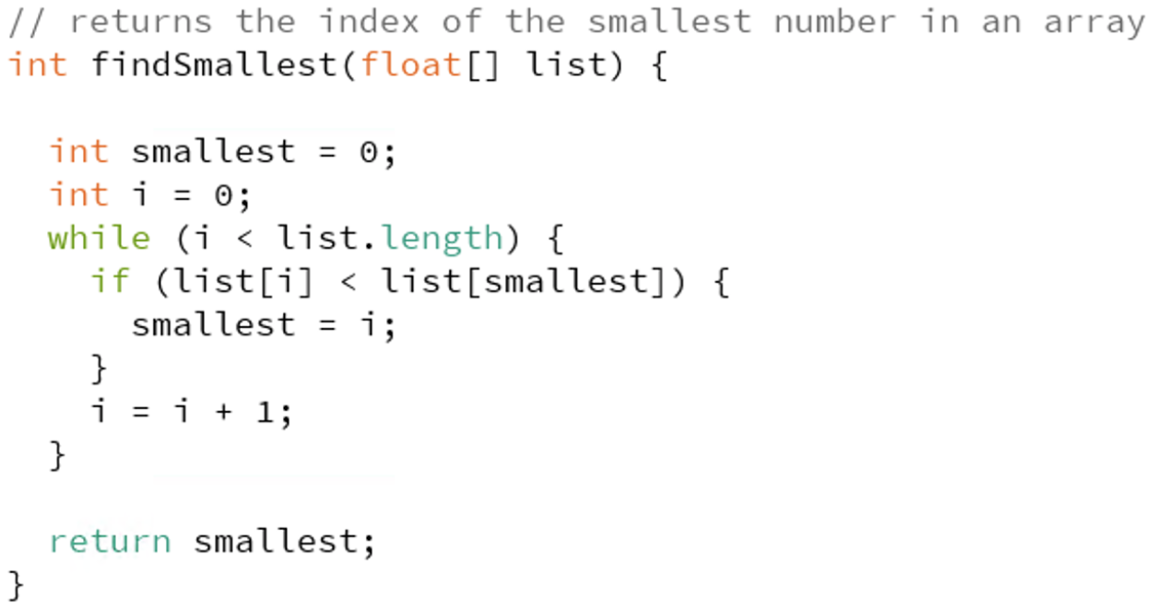
Example: Index of Smallest Number
Algorithm:
Keep track of the index of the smallest number seen so far
Start with index 0
Check each element 1-by-1; if number is smaller, then update the smallest index
Notes:
Now we can talk more about implementation of algorithms

Slide 18
Arrays Visual Demo
Rd: “read” Wr: “write”
0
1
2
3
4
1) int[] ar;
2) ar = new int[4];
3) ar[1] = 1;
4) ar[3] = ar[1] + 1;
5) if (ar[2] < ar[1]) {
ar[2] = 4;
}
6) ar[0] = ar[1] + ar[3];
7) ar[4] = 0;
Notes:
Pass out demo kits
Use RHS of slide to draw out arrays
Place cardboard on table ”here’s an empty array”
Put the boxes on the cardboard – give the array a value
Assign 1: open “wr” side of box
Two parts: eval RHS first
need to calculate value, start by reading 1: open “rd” size (1)
Add 1
Open “wr” size of 3, place 2 there

Slide 19
Arrays Visual Demo
0
1
2
3
4
Demo Notes:
Array creation only gives you as many buckets as you request
Creation of array automatically initializes it
When WRITING, replace ball in bucket
When READING, take ball of same color (leave current one in bucket)
Trying to use an invalid index (off either end) will result in an ArrayIndexOutOfBoundsException

Slide 20
Arrays Worksheet
Attach buckets to velcro when array is created
Creation of array automatically initializes it
Access array using notation arName[index]
Indices are numbered starting from 0
Use just like you would a variable
When WRITING, replace ball in bucket
When READING, take ball of same color (leave current one in bucket)
0
1
2
3
4

