Slide 1
Machine Learning, Bias, and Hype
CSE 120, Winter 2020
Slides from Prof. Noah Smith (nasmith@cs.washington.edu)

Slide 2
Administrivia
Assignments
Arrays & Elli: check off by the end of the day today
Word Guessing: checkoff by Tuesday (Feb 18)
Controlling Elli: submit by Friday (Feb 21)
We’re done with new Processing material in lecture! 🥳
“Big Ideas” lectures for the rest of the quarter
See course calendar for a sneak peak – should be fun!

Slide 3
Report
Field trip out to the Living Computers: Museum + Labs in SoDo
Admission is paid for you!
Transportation: Link + walk, bus, drive
Go when you can: open Wed-Sun each week
Report: PDF including photos and responses due Mar 2
Part 1: Favorite Exhibit
Part 2: Computer History
Part 3: Modern Tech Exhibit Reflection

Slide 4
Outline
Basic introduction to machine learning
Bias in machine learning
Inoculation against AI hype

Slide 5
blickets
forgs
Notes:
Suppose we want to classify these shapes.
LHS clearly blickets, RHS clearly forgs.

Slide 6
Notes:
Now you try for these ones…

Slide 7
Classifier
output
“blicket” or “forg”
label
input
shape
Notes:
Goal: build a machine that takes an unknown shape as input (blicket or forg) and gives a label as output.

Slide 8
Supervised Learner
classifier
output
input
b
f
f
b
f
b
b
f
labeled examples
Notes:
Training: give a bunch of labeled examples to the classifier, allow it to “adjust itself” so that it can “learn” which are which and eventually build the classifier.
Each input “turns the knobs” in a slightly different way to tune the classifier.
More training examples generally means classifier will be able to better identify new-ish shapes.

Slide 9
Some Secrets about Supervised Learning
The data matter a lot
How we represent the data as an “input” matters a lot
Sources of error in generalizing to new (non-training) examples:
Flaws in our representation of the problem (“irreducible”)
Assumptions made by a learning algorithm (“bias”)
Randomness/noise in the data (“variance”)
There is a tradeoff between bias and variance!
Notes:
The data that we choose to give as input to the classifier
What attributes of the data do we use? (e.g., encode an image as pixels)
Lots of ways to end up with errors when trying to generalize
Tradeoff – next slide

Slide 10
On Bias
Bias is prejudice or preference held prior to exposure to evidence (held by a human or a program)
Learners cannot generalize without (inductive) bias!
Put another way: if you eliminate all bias, your model will be extremely flexible and will tend to be extremely sensitive to the particular training instances.
Result: higher variance, unless there’s “enough” data
Notes:
Bias sometimes necessary to confidently classify something – don’t necessarily want to eliminate it all!
Individual pieces of training data can affect the model a lot.
So bias is not inherently “good” or “bad” …

Slide 11
Examples of Bias
Input | Output | Result
image of tank | American or Russian?
tweet | abusive?
speech stream | sequence of words
details about person convicted of a crime | sentence length
two English sentences | semantic relationship (entailment, contradiction, …)
product reviews | sentiment of author
Notes:
Sometimes we think we’re training a model to distinguish one thing, but it ends up figuring something out that is totally different!

Slide 12
Examples of Bias
Input | Output | Result
image of tank | American or Russian? | clear/blurry
tweet | abusive?
speech stream | sequence of words
details about person convicted of a crime | sentence length
two English sentences | semantic relationship (entailment, contradiction, …)
product reviews | sentiment of author
Notes:
Many of the Russian tanks had blurry photos, whereas American tanks had clear photos.

Slide 13
Examples of Bias
Input | Output | Result
image of tank | American or Russian? | clear/blurry
tweet | abusive? | AAVE
speech stream | sequence of words
details about person convicted of a crime | sentence length
two English sentences | semantic relationship (entailment, contradiction, …)
product reviews | sentiment of author
Notes:
Abusive language is context-sensitive, and the model did not account for the fact that “abusive” applies different to different dialects of English.

Slide 14
Examples of Bias
Input | Output | Result
image of tank | American or Russian? | clear/blurry
tweet | abusive? | AAVE
speech stream | sequence of words | only worked for men
details about person convicted of a crime | sentence length
two English sentences | semantic relationship (entailment, contradiction, …)
product reviews | sentiment of author
Notes:
Only trained on men.

Slide 15
Examples of Bias
Input | Output | Result
image of tank | American or Russian? | clear/blurry
tweet | abusive? | AAVE
speech stream | sequence of words | only worked for men
details about person convicted of a crime | sentence length | longer sentences for minorities
two English sentences | semantic relationship (entailment, contradiction, …)
product reviews | sentiment of author
Notes:
Reflects bias in our current justice system (remember: trained on existing data; can pick up on certain patterns in the data that we don’t realize)

Slide 16
Examples of Bias
Input | Output | Result
image of tank | American or Russian? | clear/blurry
tweet | abusive? | AAVE
speech stream | sequence of words | only worked for men
details about person convicted of a crime | sentence length | longer sentences for minorities
two English sentences | semantic relationship (entailment, contradiction, …) | “cat” → contradiction
product reviews | sentiment of author
Notes:
For some reason, found that the word “cat” seems to go together with contradictions

Slide 17
Examples of Bias
Input | Output | Result
image of tank | American or Russian? | clear/blurry
tweet | abusive? | AAVE
speech stream | sequence of words | only worked for men
details about person convicted of a crime | sentence length | longer sentences for minorities
two English sentences | semantic relationship (entailment, contradiction, …) | “cat” → contradiction
product reviews | sentiment of author | fails on political speech
Notes:
Sentiment of political speech different from other writing styles.

Slide 18
Where does bias come from?
The real-world process that produced the labels, or the data sample, might be biased. Just because something comes from data, that doesn’t mean it’s “fair” or “unbiased”!
The design/definition of the task might encode bias.
The design of the program itself might encode bias.
Deployed systems that affect their own future inputs can create feedback loops and exacerbate their own biases.
Notes:
1. E.g., reproducing already-biased judges’ decisions, or training on data collected only on people charged with crimes.
2. E.g., advertising that assumes binary categories like male/female, Democrat/Republican, etc.
3. E.g., language translation systems that ignore context that disambiguates appropriate pronouns.
E.g., if a minority class is infrequent, it may end up being ignored completely.
4. E.g., spammers adapt to spam-filtering tools, changing the data distribution.

Slide 19
Disparate Impact
US law (hiring and housing): 80% rule Informally: your rate of hiring women (for instance) must be at least 80% of your rate of hiring men.
Can we just hide the sex attribute from the learner?
No!
There are many alternative definitions of fairness.
Open question: can we guarantee high accuracy and still be unbiased?
Notes:
Disparate impact: even though the rules are technically “fair”, can adversely affect some groups of people more than others.
The difference between a policy that is neutral on its face vs. the impacts of that policy
Why not just hide the sex? Learner can probably infer it from other attributes.
Lots of ways to think about fairness
Unsure if high accuracy can be combined with lack of bias

Slide 20
We aren’t aware of all the biases!
Typically we measure the accuracy of learned programs: what proportion of inputs do they correctly label, in a held-out test set?
Sometimes we look at accuracy for particular subcategories.
We don’t always know which biases to look for!
Notes:
The difficulty with bias: hard to identify.
Need to somehow understand what the learner is inferring from the data.

Slide 21
Inoculation against Hype

Slide 22
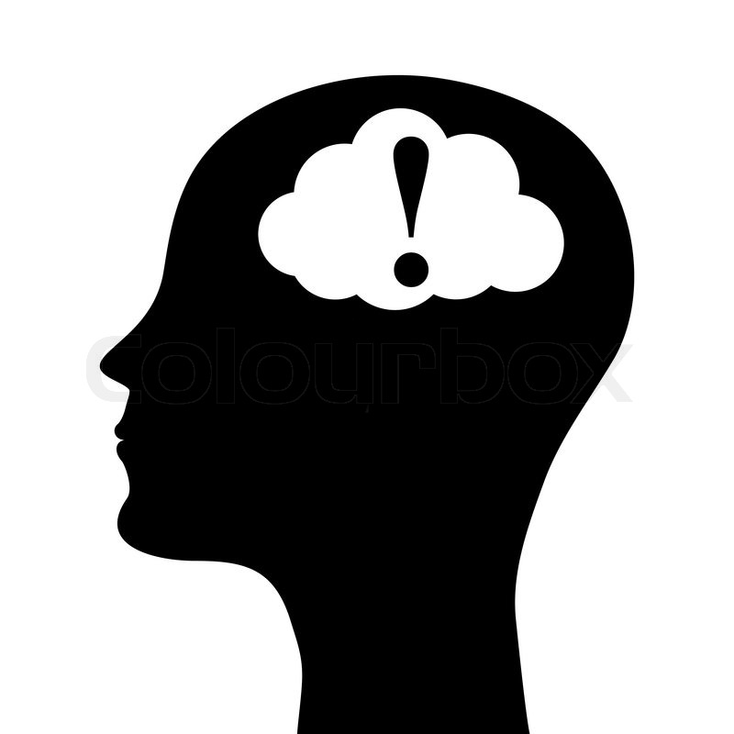
A translation problem
… deep … cognitive … understanding … neural … attention … intelligence … learning …
Notes:
Lots of research in this area, but media can hype it up and make it seem like we know more than we really do.
Buzzwords and scientific jargon also complicate this.
Disconnect between researchers and general public.

Slide 23
Tips
“Human level performance” has a very narrow meaning
“95% accuracy” was measured only on a specific type of input
Ask about the data and computation requirements (i.e., cost)
Researchers’ benchmarks are not real-world systems
Do not trust anthropomorphic descriptions of systems
Notes:
Question everything!
Why is “human level performance” the goal? When do we want the learner to do better than humans?
Very hard to find diverse inputs and hard to see bias in the inputs that we do have. Remember, tradeoff between accuracy and bias.
Training models is expensive in terms of time, energy usage, etc.
The real world is messy and has lots of unexpected scenarios -- when was the last time Siri didn’t know how to respond to you (yesterday?)
Robots are not humans!

Slide 24
Learn More
A Course in Machine Learning, by Hal Daumé III. http://ciml.info
CSE 416 or 446

