Slide 1
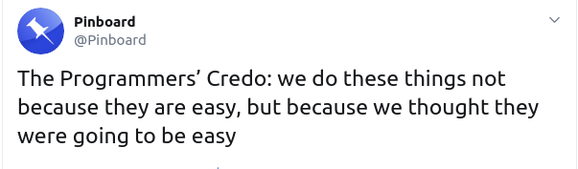
Timing & Algorithmic Complexity
Sam Wolfson
CSE 120, Winter 2020

Slide 2
Administrivia
Portfolio Update 2 due tonight!
Tic-Tac-Toe due Friday
The focus of section this week
Check off or submit on Canvas
Quiz 4 on Friday
Living Computers Museum Report due Monday
Go this weekend if you haven’t yet!
TAs will post on Piazza about when they will be there.
Also in section this week: brainstorming final project ideas!
Section next week: Innovation Exploration Presentations

Slide 3
Innovation Exploration
Explore a topic in the broad field of computing and its implications on society.
You will give a 3-5-minute presentation aimed at teaching others about a computing-related innovation that is interesting to you, including:
Purpose
Effects & Impacts
Technical Aspects
You will have a large degree of freedom concerning the topic of your presentation and you will be presenting to the rest of the class on March 3 or March 5 during section.

Slide 4
Collaboration Expectations
In this course, we did not give a strong definition of the line between collaboration and cheating.
Compared to other CSE courses, we have been very relaxed about what constitutes cheating.
Here, we really want to encourage collaboration.
Particularly in courses that count for admission (CSE 14x) you will need to be more cognizant.
As a general rule: you should discuss high-level concepts and ideas with your classmates, but you shouldn’t be sharing specific lines of code.
Notes:
Just an FYI if you plan to continue further with CS
Unfortunately, the competitiveness of CSE makes cheating very tempting in 14x courses
The line can be difficult to find and we understand that
But know that if you continue further in CS, you’ll need to ensure that you aren’t close to it

Slide 5
Outline
What is algorithm analysis?
How can we compare how long algorithms take?
How can we “formalize” how long an algorithm takes?
How can we optimize our algorithms?

Slide 6
Reprise: Algorithm Correctness
Correctness is probably the most important aspect by which we can analyze algorithms.
An algorithm is considered correct if, for every input, it:
returns the correct output,
doesn’t run forever, and
doesn’t cause an error.
Incorrect algorithms could run forever, or crash, or not return the correct answer.

Slide 7
Algorithm Analysis: Timing
One way to analyze algorithms: computation time
How long does it take to run and finish its job?
We can use this to compare efficiency of two different algorithms that solve the same task.
Example: multiple ways to sort a list
But how can we measure time?
Counting in your head
With a stopwatch
Within the program itself

Slide 8
Timing in Processing
The function millis() returns the number of milliseconds since starting your program (as an int).
To start timing, call and store the value in a variable: int startTime = millis();
Call again after your function is complete, and subtract: void draw() { int startTime = millis(); computeSomething(); int totalTime = millis() - startTime; println(“Took “ + totalTime + “ ms”); noLoop(); }

Slide 9
Outline
What is algorithm analysis?
How can we compare how long algorithms take?
How can we “formalize” how long an algorithm takes?
How can we optimize our algorithms?

Slide 10
Algorithm Example: Fibonacci
Function: Fibonacci
$\text{fibonacci}\left(1\right)=1$
$\text{fibonacci}\left(2\right)=1$
$\text{fibonacci}\left(3\right)=$ $\text{fibonacci}\left(1\right)$ + $\text{fibonacci}\left(2\right)=1+1=2$
$\text{fibonacci}\left(n\right)=\text{fibonacci}\left(n−2\right)+\text{fibonacci}\left(n−1\right)$
Code: Fibonacci
int fibonacci(int n) { if (n == 1 || n == 2) { return 1; } return fibonacci(n-1) + fibonacci(n-2); }
Let’s see it in action…
Notes:
Fibonacci demo here

Slide 11
Comparison: Fibonacci
One of our Fibonacci functions seemed a lot faster than the other one – why?
Let’s look at a more concrete way to figure it out.
We can analyze time without ever getting out millis(), just by reasoning our way through an algorithm!

Slide 12
Outline
What is algorithm analysis?
How can we compare how long algorithms take?
How can we “formalize” how long an algorithm takes?
How can we optimize our algorithms?

Slide 13
How To Analyze Algorithmic Time
Silly Example Function: SumPlus1
Input: an array of ints
Output: the sum of all ints in the array, plus 1
Code: SumPlus1 int sumPlus1(int[] array) { int sum = 0; int i = 0; while (i < array.length) { sum = sum + array[i]; i = i + 1; } sum = sum + 1; return sum; }
Notes:
Let’s start with a silly example.

Slide 14
How To Analyze Algorithmic Time
Cost: the amount of time it takes to do something.
The cost of a “simple” line of code (i.e., no function calls or loops) is 1 “time.” int z = x + y; // cost: 1
The cost of a loop is the cost of all the lines of code inside of it, multiplied by the number of times it loops. int i = 0; while (i < n) { // cost: 2 * n int x = 3; // cost: 1 i = i + 1; // cost: 1 }
The cost of a function is the sum of the cost of all the lines of code within the function.

Slide 15
Analysis of SumPlus1
int sumPlus1(int[] array) { int sum = 0; int i = 0; while (i < array.length) { sum = sum + array[i]; i = i + 1; } sum = sum + 1; return sum; }
Cost: 1
Cost: 1
Cost: 1
Loop Cost: 2 * array.length
Cost: 1
Cost: 1
Cost: 1
Let the length of array be equal to $n$. Then the total cost is:
$$\text{cost}\left(n\right)=1+1+\left(2∗n\right)+1+1=2n+4$$

Slide 16
Analysis of SumPlus1
When analyzing functions, we only care about the term that grows the fastest.
For $\text{cost}\left(n\right)=2n+4$, which term is this?
4 is constant – it never grows no matter how large $n$ becomes.
$2n$, however, grows linearly with $n$ – so it is the fastest-growing term in this cost.
$\text{cost}(n)≈2n$
Furthermore, we don’t really care about the 2, since it’s constant.
$𝒪\left(n\right)=n$
We call this “Big-Oh” notation – we’re only concerned with the fastest-growing term, and with the parts of it that actually grow.

Slide 17
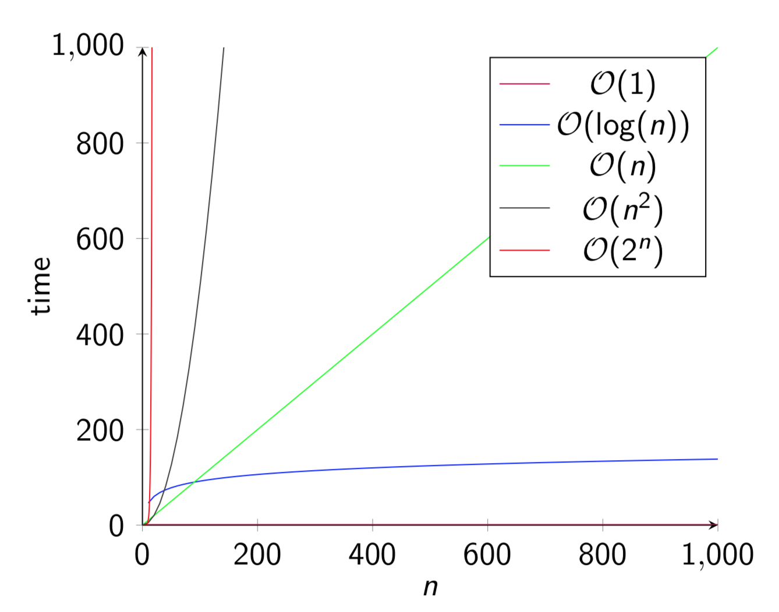
Time Complexity
The amount of time it take to run an algorithm.
The fastest-growing term in the cost function (“order of growth”).
Written in terms of the size $n$ of the input (e.g., number of elements in an array, $n$^{th} Fibonacci number) with “Big-Oh” notation.

Slide 18
Time Analysis: Fibonacci
int fibonacci(int n) { if (n == 1 || n == 2) { return 1; } return fibonacci(n-1) + fibonacci(n-2); }
Everything inside fibonacci besides the recursive call is just $𝒪(1)$. This is also called “constant time” since it doesn’t grow as $n$ grows.
Cost: 1
Cost: ????

Slide 19
Time Analysis: Fibonacci
$$f\text{ibonacci}(6)$$
$$f(5)$$
$$f(4)$$
$$f(4)$$
$$f(3)$$
$$f(3)$$
$$f(2)$$
$$1$$
$$f(3)$$
$$f(2)$$
$$f(2)$$
$$f(1)$$
$$f(2)$$
$$f(1)$$
$$1$$
$$1$$
$$1$$
$$1$$
$$1$$
$$f(2)$$
$$f(1)$$
$$1$$
$$1$$
How many times do we call fibonacci for $n=6$?

Slide 20
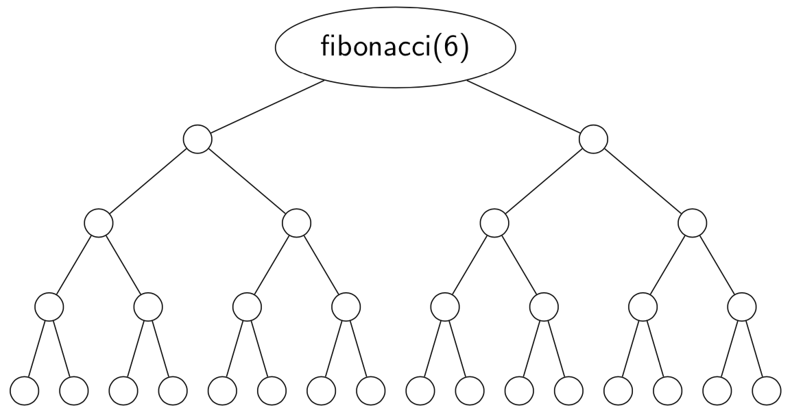
Relax!
Let’s relax this problem a bit.
How many circles are there on this tree?
$\text{cost}\left(n\right)=\text{???}=31$
All I’ve done is filled in the missing nodes to make the tree “full”
Notes:
I’ve just filled in the free to make it easier to figure out how many nodes there are.

Slide 21
Relax!
Let’s relax this problem a bit.
How many circles are there on this tree?
$\text{cost}\left(n\right)=2^{5}−1=31$
All I’ve done is filled in the missing nodes to make the tree “full”

Slide 22
Relax!
Let’s relax this problem a bit.
How many circles are there on this tree?
$\text{cost}\left(n\right)=2^{n−1}−1=31$
So what’s the time cost?
$c\text{ost}\left(n\right)=2^{n−1}−1≈𝒪(2^{n})$
All I’ve done is filled in the missing nodes to make the tree “full”

Slide 23
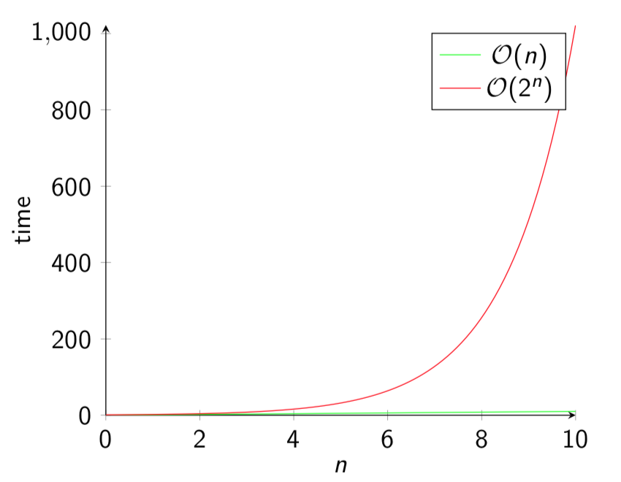
Big oof…
Remember that the time taken by SumPlus1 was $𝒪\left(n\right).$
Can we do better?
(Yes!)

Slide 24
Outline
What is algorithm analysis?
How can we compare how long algorithms take?
How can we “formalize” how long an algorithm takes?
How can we optimize our algorithms?

Slide 25
Improving Fibonacci
Which calculations here are redundant?
By remembering the calculations we already performed, we can save a lot of time. $f(6)$ now only needs 6 function calls (not 15).
This looks a lot more like $𝒪\left(n\right).$
Most of them!
$$f\text{ibonacci}(6)$$
$$f(5)$$
$$f(4)$$
$$f(4)$$
$$f(3)$$
$$f(3)$$
$$f(2)$$
$$f(3)$$
$$f(2)$$
$$f(2)$$
$$f(1)$$
$$f(2)$$
$$f(1)$$
$$1$$
$$f(2)$$
$$f(1)$$
$$1$$
$$1$$
$$1$$
$$1$$
$$1$$
$$1$$
$$1$$
Notes:
Notice that all of the fib(..) calls are on the leftmost branch of the tree. All the rest are just repeated.

Slide 26
Speedy Fibonacci 🏎
int fibonacci(int n) { if (isStored(n)) { return getStored(n); } if (n == 1 || n == 2) { return 1; } int fibN = fibonacci(n-1) + fibonacci(n-2); store(n, fibN); return fibN; }
Assume that isStored, getStored, and store all have constant cost ($𝒪(1)$).
Now, we only need to compute each number once!

Slide 27
Memoization
The programming technique of remembering previous calculations so we don’t need to redo them every time.
As we saw with fibonacci, this can save a lot of time!

Slide 28
Who Cares???
In The Real World™, most algorithms aren’t as simple to optimize (or as bad when not optimized) as fibonacci.
But some some applications, even small improvements can be helpful when $n$ gets really large.
For Facebook, $n$ (number of users) is $≈1$ billion!
Want to generate a list of suggested friends? You’d better have a fast algorithm as a function of $n.$

Slide 29
Summary
There are many ways we can analyze algorithms, such as for correctness.
Analyzing the time complexity of an algorithm is useful for determining how long it will take when the input gets large.
Time complexity can be analyzed within your code using millis() to see how long a function takes to run.
It can also be analyzed by reasoning through the code and understanding how long each piece takes, then finding a cost function $\text{cost}(n)$ where $n$ is the size of the input.
Time complexity is expressed in “Big-Oh” notation, where we drop all the pieces of the cost function except the one that grows the fastest. We call the fastest-growing term the order of growth.

