Slide 1
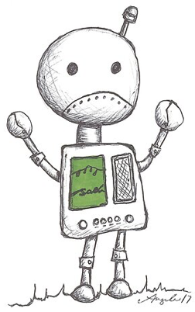
Limits of Computing, Course Wrap-Up
Take a look at the worksheet and start trying to fill it out!
Sam Wolfson
CSE 120, Winter 2020
Notes:
https://help.redbubble.com/hc/en-us/articles/201579195

Slide 2
Administrivia
Assignments: just the final project!
  Instead of giving a presentation to the class, we ask that you record a video of yourself presenting.
    If necessary, you and your partner can each present half separately then cut the videos together afterwards.
    It’s OK to make a recording of your screen and talk over it.
  The assignment page and rubrics have been updated – please read through them and let us know if you have questions or concerns.
Next week:
  We will plan to hold office hours remotely (details to come)
  The TAs and I will continue to monitor Piazza
  Remote lecture on Computing for Good
Course evaluation: https://uw.iasystem.org/survey/221453
Notes:
Please please PLEASE fill out evals.

Slide 3
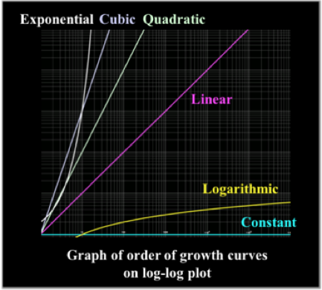
Revisiting Algorithm Complexity
Recall: the runtime of an algorithm is based on the size of its input (e.g., the size of an array)
  The “order of growth”
Different algorithms have
different orders of growth:
  Constant
  Logarithmic
  Linear
  Quadratic
  Cubic
  Exponential
Notes:
Explain each order of growth,
constant: doesn't change as input grows
Log: changes slowly
Cubic: much faster growth but still considered "ok"
Exponential: not so much

Slide 4
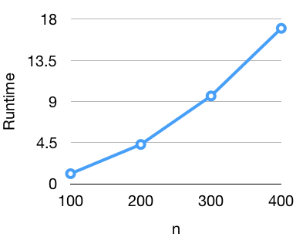

A Wild Question Appears!
Algorithm: do any two numbers in an array sum to zero?
Question: what function does the runtime look like?
$\sqrt{n}$
$\log{(n)}$
$n$
$n^{2}$
$2^{n}$
Notes:
Review algorithm complexity!
Looks like n^2, show how 100 => 1, 200 => 4, etc.

Slide 5
What problems do we encounter?
Unsolvable Problems
"Hard" problems: impossible to solve in "reasonable" time
???
"Easy" problems: solvable in "reasonable" time
Notes:
Different difficulties based on how long an algorithm takes to solve a problem

Slide 6
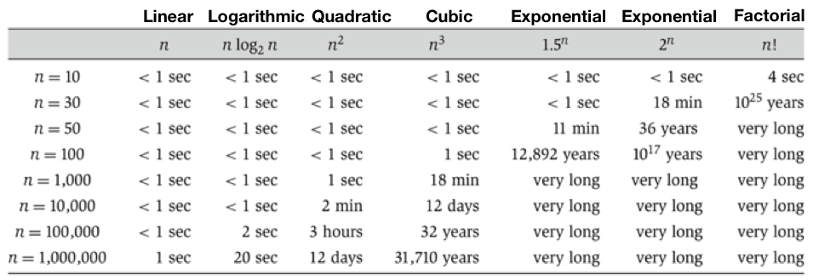

Problem Difficulty
We call polynomial or faster problems “easy”
  Runtime $≤𝒪\left(n^{b}\right)$, where $b$ is a constant ($𝒪\left(n\right), 𝒪(n^{2})$, …)
Exponential, factorial, & slower problems are “hard”
Easy
Hard
Notes:
Remember big-oh notation: just means drop out everything except for the fastest-growing terms, and get rid of constants (only interested in the overall shape of the function)
Linear, logarithmic, quadratic can be solved pretty quickly even for very large inputs
Cubic also not so bad until n=100,000
Exponential and friends take unreasonable long for n = 100!

Slide 7

“Easy” Problems
Is this list sorted?
  Look at each number and make sure it's greater than or equal to the one before it
Do any two numbers in this array sum to 0?
  Check every number against every other number
We say that these problems are "in P"
  They can be solved in polynomial time
Notice: these are all yes/no problems (i.e., decision problems)
Notes:
Remember sorting? How do we check? Only need to look at every number once.
Discuss amongst yourselves, come up with algorithm? Timing dependent. Negatives OK!
Recall polynomial: in terms of input size n, n^b, b is constant
Oftentimes decision problems are used because they allow a precise and simple definition of the problem and, as stated, many other problems can be converted to an equivalent decision problem.

Slide 8
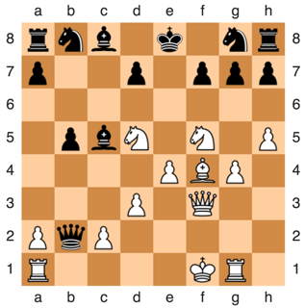
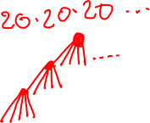
“Hard” Problems
Given the chess board, is there a move that white can make that ensures white will eventually win?
  There is an answer.
  There's no way to compute it
  in any reasonable time.
This problem is not “in P.” It takes exponential time.
Notes:
Discuss amongst yourselves: how might we solve this, in general? (Not necessarily for this specific board)
Draw out game tree -- we have approximately 20 moves per turn and ~40 turns per game ==> would take forever
Now we've looked at some polynomial problems, and some that we know are not.

Slide 9
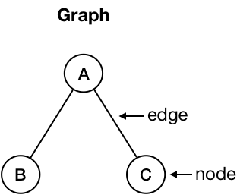

Let’s solve some problems!
Problem: is it possible to color each node so that no two directly connected node are the same color?
  On the first page of your worksheet, try to do this using only two colors.
  Can you think of an efficient algorithm for this?
Two nodes are adjacent if there is an edge directly connecting them.
A and B, B and C are adjacent.
B and C are not.
Notes:
Remember we talked about graphs in the networking lecture
consists of nodes
Some nodes are connected by edges
Adjacent nodes have an edge between them
Give example of coloring in sample graph

Slide 10
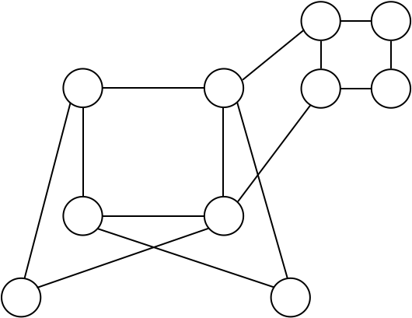

2-Colored Graph
Is it possible to color each node so that no two directly connected nodes are the same color?
Start with a random node, and fill with a color
Fill every adjacent node with the other color
Do the same thing with every node adjacent to that node
Repeat until:
  We find a node that can't be either color → answer is NO
  The graph is completely filled in → answer is YES
This problem is “in P” (only need to look at each node once)
Notes:
Can we write down an algorithm for this?
Write out algorithm in margin:
Pick any circle and fill it with a color
For each of the adjacent circles
Fill with the other colors
Repeat for all adjacent circles until graph is filled (YES), or we encounter a circle that can't be either color (NO)

Slide 11
Let’s solve some problems!
Problem: is it possible to color each node so that no two directly connected node are the same color?
  On the second page, try to do the same thing, but now you have three colors to work with.
  Can you think of an efficient algorithm for this?
Two nodes are adjacent if there is an edge directly connecting them.
A and B, B and C are adjacent.
B and C are not.
Notes:
Remember we talked about graphs in the networking lecture
consists of nodes
Some nodes are connected by edges
Adjacent nodes have an edge between them
Give example of coloring in sample graph

Slide 12
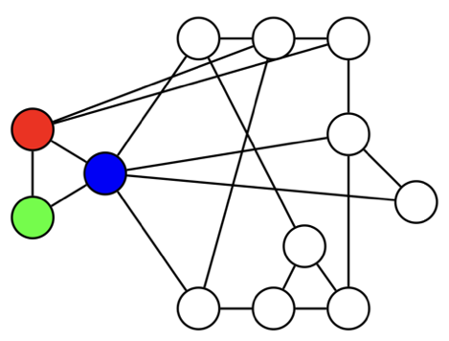

3-Colored Graph
Is it possible to color each node so that no two directly connected nodes are the same color?
Start with a random node, and fill with a color
Fill all the adjacent nodes with a different color
What if we reach a point where no colors will work??
  Backtrack and try different colors
Repeat until:
  We find a node where no combination of other colors in the graph will make it work → answer is NO
  The graph is completely filled in → answer is YES
May need to try every possible combination of colors
This problem is not “in P” (why?)
Notes:
Not as simple as 2-coloring, since we need to make a decision about the color each time (btwn two)

Slide 13

3-Colored Graph
Runtime for our algorithm: $𝒪(3^{n})$
  In the worse case, we’d need to try every possible combination of colors!
Does a polynomial algorithm exist?
  This is an unsolved problem
This problem is “in NP”
We don’t know of any polynomial time solutions
But we haven’t been able to prove they don’t exist
We can easily check whether a solution is correct
Notes:
For a graph with n nodes, each node can be 3 possible colors => 3*3*3*3*... = 3^n possible combinations that might make this work.
Clearly, our solution to this problem was not efficient. Does an efficient solution exist?
Each node has three possible options.
Well, we don't really know. (We have efficient approximations, but nothing exact)
How to check? Just look at each node and make sure no adjacent nodes are the same color.
Ok, but why is this useful?

Slide 14
Example: Exam Planning
Course
440
446
Student | CSE Courses
Sam | 120, 440, 446
Eunia | 120, 351, 446
Yae | 120, 332, 440
Erika | 120, 332, 351
Justin | 120, 332, 351
120
Student taking both courses
332
351
We have three available exam slots.
How to schedule exams without conflicts?
Monday Morning
Monday Afternoon
Tuesday Morning
Called a reduction
Equivalent to 3-coloring!
Notes:
Can't have any courses that a student is taking hold an exam at the same time
conflicts if nodes are the same color
Show graph being filled out starting with 120
Give example: see how each person has three different colors!
See how it's easy to check that this is a solution
If someone took 120, 440, and 351 it wouldn't work
For this small graph, we can reason out a solution quickly -- but much worse for larger ones (consider once you can no longer visualize the entire graph at once)

Slide 15
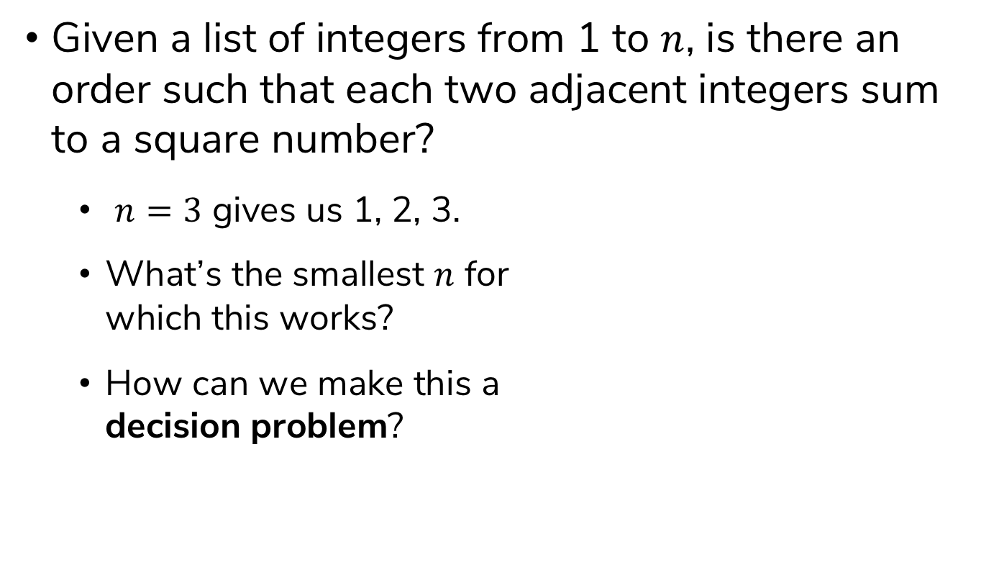
Example: Square Sums
Given a list of integers from 1 to $n$, is there an order such that each two adjacent integers sum to a square number?
  $n=3$ gives us 1, 2, 3.
  What’s the smallest $n$ for
  which this works?
  How can we make this a
  decision problem?

Slide 16
Let’s Reframe The Problem
Turn each number into a node
Draw edges between each two numbers that sum to a square number
Is there a path through the graph that touches each node exactly once?
3
4
1
5
2
8
6
7
In this case, no: not all the nodes are connected.

Slide 17
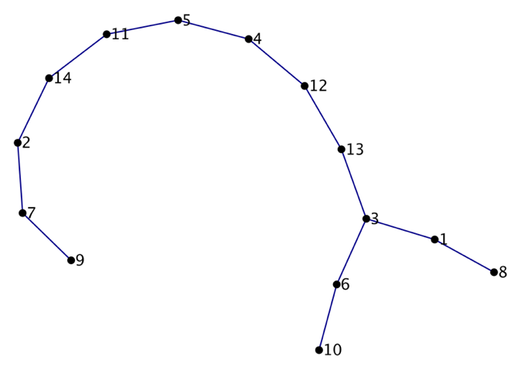

A Larger Example
Does this work for $n=14$?
Notes:
No, but n=15 does!
add node for 15
Connect it with 10 and 1
Now we can draw a path
This is the smallest example

Slide 18
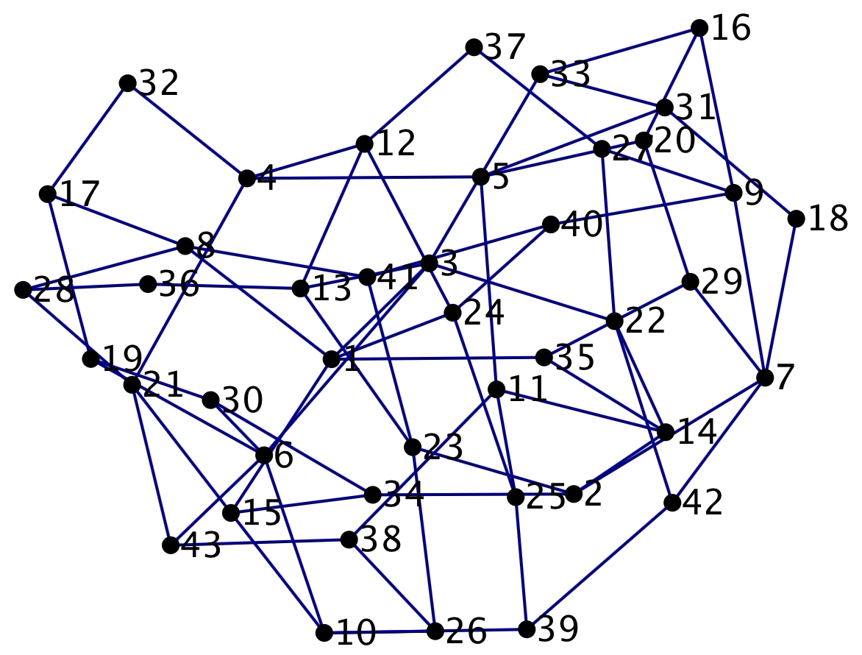

Another Large Example
What about $n=43$?
Not so simple to
trace the path…
Called a reduction
This problem is equivalent to 3-coloring (also in NP)
There is no known polynomial time solution.

Slide 19
P vs. NP
P problems have polynomial time algorithms
NP problems have solutions that can be efficiently verified, but no known efficient way to find them
$1 million reward!
Big open problem in computer science: is P = NP?

Slide 20
What if P=NP?
"If P=NP, then the world would be a profoundly different place than we usually assume it to be. There would be no special value in “creative leaps,” no fundamental gap between solving a problem and recognizing the solution once it’s found."
-Scott Aaronson

Slide 21
What if P=NP?
The Good
Lots of optimization problems become easy to solve
  Exam scheduling
  Logistics: shipping, transportation, etc.
  Protein folding
The Bad
Most modern encryption becomes easy (or easier) to break
  Credit card information, banking transactions, etc.
Notes:
This is assuming that
- we can constructively prove P=NP (e.g., that we can show the algorithm for solving an NP problem in P time).
- The algorithm has reasonable constants (e.g., O(n^{10^16}) would be polynomial but not practical)

Slide 22
Beyond NP: Unsolvable Problems
Are there problems that we can't solve, no matter how much time you're given?
  Remember: an algorithm is only a solution if is produces the correct answer in a finite amount of time
  A problem is decidable if it has a solution
Some problems are undecidable

Slide 23

The Halting Problem
Is there a way to tell whether mystery will ever finish?
void mystery(String input) {
/* here be dragons */
.
.
.
}
Assume the function doesItHalt(String code, String args) exists:
  Input: a function's code code and the function's arguments args
  Output: true if that function halts, false if it doesn't
Notes:
Talk amongst yourselves -- is there a way to check that this function will finish (i.e. won't run forever)
Example of passing args? Show f(args)

Slide 24
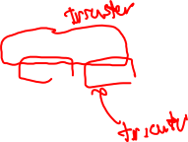
The Halting Problem
Assume the function doesItHalt(String code, String args) exists:
  Input: a function’s code code and the function's arguments args
  Output: true if that function halts, false if it doesn't
Can we fool this function?
We’re checking if code halts when given its own code as input!
void trickster(String code) {
if (doesItHalt(code, code)) {
while(true == true) { }; // run forever
} else {
return; // halt
}
}
code(f) returns the code for f as a String
What happens if we run trickster(code(trickster))?
(i.e., give it its own code as input)
If doesItHalt returns true, then trickster will run forever.
If doesItHalt returns false, then trickster will halt.
Contradiction!
This means that doesItHalt cannot exist.
Notes:
We can always fool doesItHalt.

Slide 25
The Problem Complexity Zoo
Unsolvable Problems
"Hard" problems: impossible to solve in "reasonable" time
NP problems: easy to verify but (probably) hard to solve
"Easy” (P) problems: solvable in "reasonable" time
For a more in-depth version of this lecture: https://uw.hosted.panopto.com/Panopto/Pages/Viewer.aspx?id=245f2b87-13d4-42f8-a967-ab3c016ce30b
Notes:
Different difficulties based on how long an algorithm takes to solve a problem

Slide 26
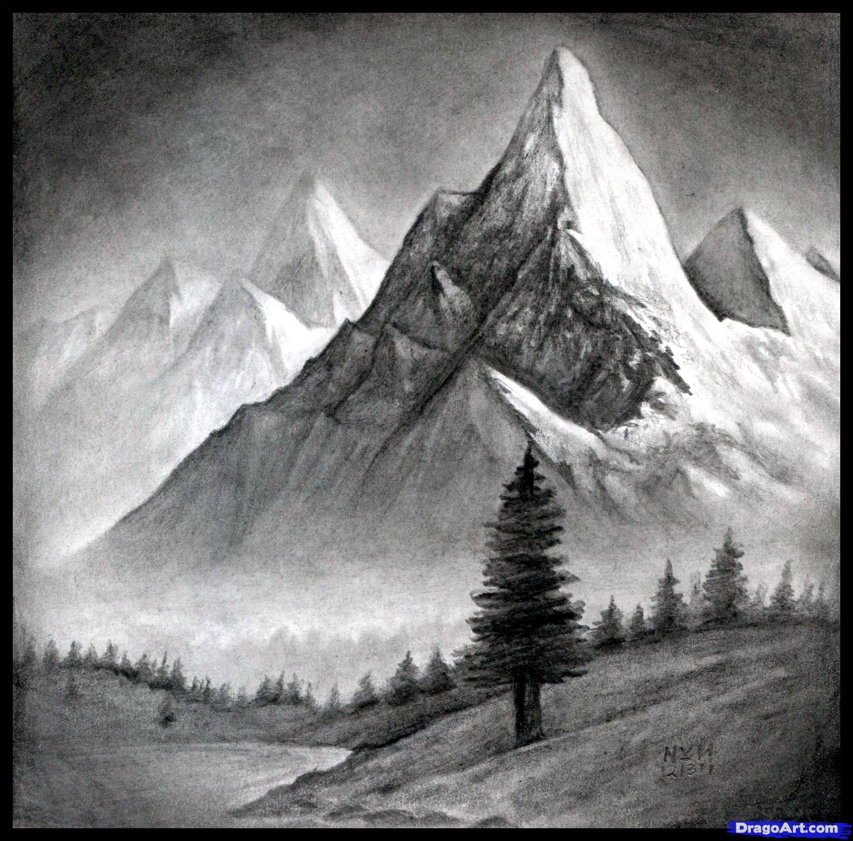
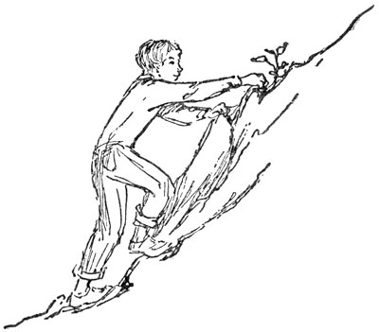
Course Wrap-Up
What We’ve Learned
Lecture 1 Revisited
Your Future Beyond CSE120
Source: DragoArt.com
Source: Project Gutenberg

Slide 27
Computational Thinking
It’s all about problem solving
  How to attack your problem in a way that a computer can help
Most important idea: abstraction!
  Detail removal and generalization help us decompose complex problems
  Use bits to represent everything (i.e. digitization)
  Reuse and combine building blocks (algorithms) in ways that hopefully scale well

Slide 28
Building Blocks of Algorithms
Sequencing
  The application/execution of each step of an algorithm in the order given
Iteration
  Repeat part of algorithm a specified number of times
Selection
  Use of conditionals to select which instruction to execute next
Functional Abstraction
  Break larger problem into smaller, reusable parts
fill(255);
rectMode(CORNERS);
rect(-r, -r, 0, r);
ellipse(0, -r/2, r, r);
if(mousePressed) {
fill(0,0,255);
}
int i=20;
while(i<40) {
line(i,40,i+60,80);
i=i+60;
}

Slide 29
Programming
Learned our first programming language
  Processing (Java syntax)
Iterative design cycle:
  The value of a precise specification
  Design, prototype, implement, and evaluate
  Testing and debugging
Coding style and documentation
  Proper commenting and formatting are essential for maintenance and collaboration

Slide 30
Some Big Ideas
Computers can only do a small number of things
  Execute exactly what you tell it to
Computing has physical and theoretical limits
The Internet is a physical realm
Data is constantly generated, stored, and analyzed
  And can be copied and distributed
Machines can “think” and “learn”?
  AI & the importance of probability and training sets

Slide 31
Social Context and Impact
Impacts of computing:
  Algorithms can have unintended consequences
  Privacy and security (or lack thereof)
  Social media influences the way we access and share information
  Can improve the lives of those with disabilities (and everyone else) as well as those in developing countries
Design matters!
  Must keep in mind users and user interface
  What are the ethical implications and whose values are we promoting?

Slide 32
Course Wrap-Up
What We’ve Learned
Lecture 1 Revisited
Your Future Beyond CSE120

Slide 33
Why Study Computer Science?
Massive impact on our lives and society as a whole
Increasingly useful for all fields of study and areas of employment
  Farmer – machines to help farm, drones for pesticides
  Chef – analyze customer data: popular dishes, hours, etc.
  Street Performers
  Dancer, Gymnast – monitor and evaluate performance, diet, etc.

Slide 34
Computing in Your Future
Computing and its data are inescapable
  You generate “digital footprints” all the time
Computing is a regular part of every job
  Use computers and computational tools
  Generate and process data
  Dealing with IT people
  Understanding the computation portion of projects
Our goal is to help you make sense of the “Digital Age” that we now all live in

Slide 35
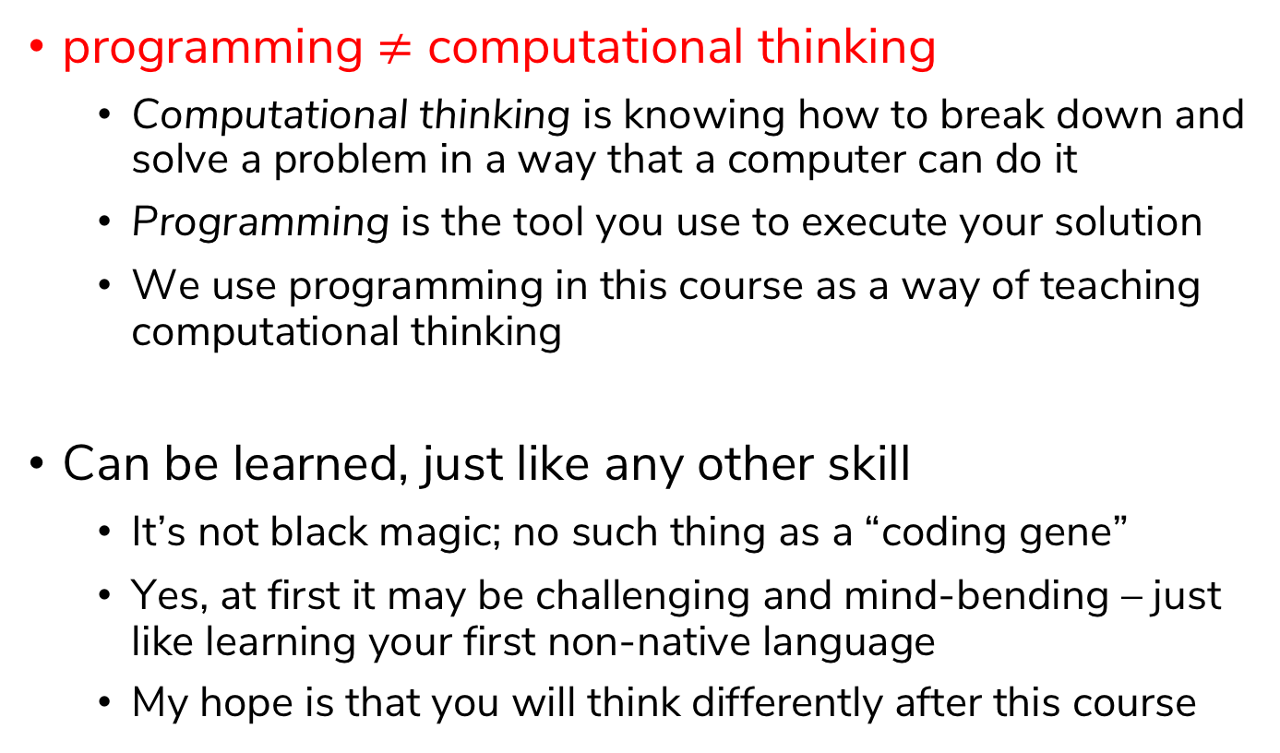
About Programming
programming $≠$ computational thinking
  Computational thinking is knowing how to break down and solve a problem in a way that a computer can do it
  Programming is the tool you use to execute your solution
  We use programming in this course as a way of teaching computational thinking
Can be learned, just like any other skill
  It’s not black magic; no such thing as a “coding gene”
  Yes, at first it may be challenging and mind-bending – just like learning your first non-native language
  My hope is that you will think differently after this course
Notes:
Terrible stereotypes of programmers – it’s just another profession nowadays

Slide 36

Big Ideas of Computing
Exposure to a broad range of topics in computer science
  Not going to dive into the details
  These are the motivations & the applications for programming (the tool)
  Focus on what to be aware of to navigate the digital world
Goal: become “literate” in computing
  As new innovations arise, can you read about it, understand its consequences, and form your own opinion?
  This course will ask you to read, discuss, and write about computing

Slide 37
Course Wrap-Up
What We’ve Learned
Lecture 1 Revisited
Your Future Beyond CSE120

Slide 38
Keep What You’ve Made!
You’ve all done some amazing work!
  We will make a “Student Showcase” Piazza post
Make sure your files and programs are saved somewhere so you can access them later
  Can re-download from Canvas submissions if necessary
  Could be helpful as examples for future projects
Portfolio
  Your website will remain live until you disable it or graduate
  You can download a copy of your website files using Cyberduck

Slide 39
Giving Back to CSE 120
Enjoyed the class? Lots of ways to help out!
  Feedback: course evaluations, feedback on final “quiz”, send me an email with your thoughts 😊
  Examples: Permission to show your work to future classes?
    I’ll make a “Student Showcase” Piazza post later
  Recommendations: CSE120 will hopefully be offered in winter 2021 – tell your friends!

Slide 40
Future Courses
Intro CS courses descriptions:
  https://www.cs.washington.edu/academics/ugrad/overview/intro-courses
Staff recommendations and descriptions:
  https://docs.google.com/presentation/d/1JP0tMaCgTWYWM7ALeSNHWOqjv3iporODr1tB0rg8NvM/edit?usp=sharing

Slide 41
More CS at UW
CSE 142 + CSE 143: Computer Programming I/II
  Needed for declaring CSE major
CSE 160 + CSE 163: Data Programming I/II
  Recommended to take 142 first
CSE/STAT/INFO 180: Intro to Data Science
  A basic math prerequisite
CSE 154: Web Programming
  Must have taken 142, 143, or 160

Slide 42
Social Implications Courses
Informatics
  INFO 101: Social Networking Technologies
  INFO 102: Gender and Information Technology
  INFO 200: Intellectual Foundations of Informatics
  INFO 270: Calling Bullshit: Data Reasoning in a Digital World
Human Centered Design & Engineering
  HCDE 210: Explorations in Human Centered Design

Slide 43





No More CS at UW or Break
You are now somewhat programming-literate
  Can automate tasks to make your life easier
  More aware of possibilities of computing
  Easier to interact with IT/CS staff at work
Figure out what will be most useful to you
  Some languages specific to type of work
  (e.g. R, MATLAB, Ruby on Rails, SQL)
  Learn on your own via the Internet:

Slide 44
Making the Most of College
Seek out experiences that lead to new experiences
  Build skills, interests, relationships
  Meet new people, join interesting clubs, go on adventures
Don’t go it alone – find a friend group for classes
Take advantage of educational opportunities
  Research: https://www.washington.edu/undergradresearch/students/find/
  Student Groups: ACM, Animation Research Labs, Husky Robotics, WOOF3D, etc.
  Classes: non-major courses, P.E., languages, anything of interest
Take care of yourself ☺️

Slide 45
Making the Most of Our Future
Computing is resurfacing our world
  Now almost everyone has access to everything, always
  New technology affects privacy, jobs, safety, beliefs, etc.
You now know the most important parts of how it all works!
  Can bring computing to new fields/jobs/areas
  Keep these considerations in mind as you use and/or build things

Slide 46
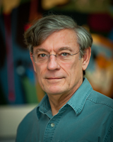

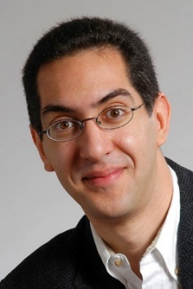
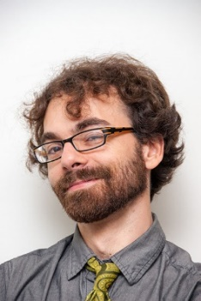
Thanks for a great quarter!
Huge thanks to your awesome TAs!
Thanks to course content creators:
Best of luck in the future! I am happy to chat more if you have questions about CSE, college, etc.
Larry
Snyder
Susan
Evans
Dan
Garcia
Josh
Hug

