Slide 1
Graphs
Michael Ernst
CSE 140
University of Washington

Slide 2
A graph contains nodes and edges
Example: auto part compatibility
Notes:
TODO: Add picture of graph of auto part compatibility

Slide 3
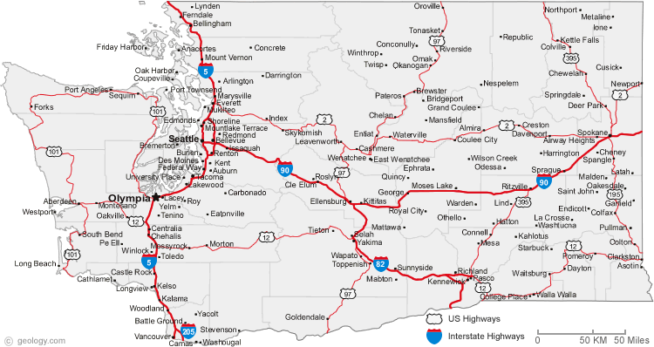

Slide 4
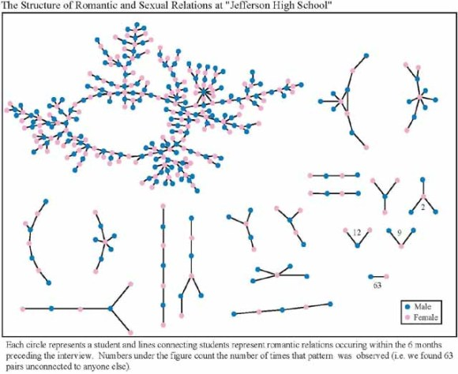
+ 350 students in no romantic and/or sexual relationship
From: “Chains of Affection: The Structure of Adolescent Romantic and Sexual Networks”, American Journal of Sociology, by Peter Bearman of (Columbia), James Moody (Ohio State), and Katherine Stovel (U. of Washngton);

Slide 5
Graphs
A graph can be thought of as either of:
a collection of edges
Each edge represents some relationship
for each node, a collection of neighbors
The neighbors are those connected by an edge

Slide 6
Operations on a graph
Creation:
Create an empty graph
Querying:
Look up a node: Does it exist? What are its neighbors?
Look up an edge (= a pair of nodes): does it exist? (You know the nodes it connects.)
Iterate through the nodes or edges
Modification:
Add/remove a node
Add/remove an edge

