Slide 1
BackBone.js
By. Phil Sheperd

Slide 2
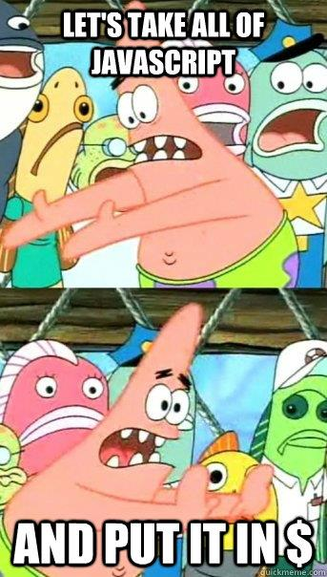
What is BackBone
BackBone is a Javascript Framework
How is this different From jQuery or Prototype?
Libraries vs Framework
BackBone is a way to structure your code

Slide 3
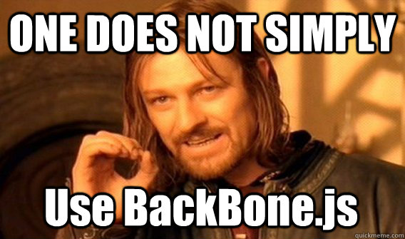
Why/When should you use BackBone
You should use BackBone to get your ‘Truth out of the DOM’.
Doesn’t make sense all the time

Slide 4
Signs to use BackBone
You use a lot of data attributes in your html
You have a lot of hidden content to be displayed only on certain events happening
You ever see a line in your js like this: $($(this).children()[1]).html().trim();

Slide 5
How is a BackBone App Structured
MCV
NOT MVC (Model, View, Controller)
Models
Data of your application
Models generally have attributes
Collections
A collections of the models
Views
Generally templates rendered with underscore.js

Slide 6
Model
Create a new model by calling: var Question = Backbone.Model.extend({});
Models can have default data
defaults: { attribute : value }
Can also have url of where to save from (to advanced for this demo)

Slide 7
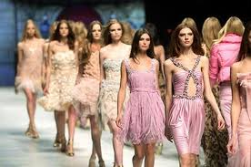
Collection
var Questions = Backbone.Collection.extend(
{ model : Question} );
It is a collection of models
These can also have a rootURL but again, to advance for this demo

Slide 8
Views
var CategoryView = Backbone.View.extend({
collection : Questions,
template : _.template($('#column').html())
});
View can be for collections or models
Templates are defined by underscore.js

Slide 9
Views and Events and Templates
events : {
'click #fade' : 'clear',
'click .hint_button' : "showHint",
'click .showAnswer' : 'showAnswer’
}
<script type="template/text" id='modalView’> <span class='<%= answered ? "done" : ""%>' > <%= value %> </span> </script>

Slide 10
Rendering The View
There is one very important function in views at it is: Render
Every view has a this.el
this.el is the element that is put in the dom
this.$el is the jquery version of that element
Lets just start coding this stuff up
MORE Resources
http://backbonejs.org/
http://documentcloud.github.com/backbone/#examples

