Slide 1
More on Functions; Some File I/O
UW CSE 190p
Summer 2012

Slide 2
Review
def myfunc(n):
total = 0
for i in range(n):
total = total + i
return total
print myfunc(4)
What is the result?

Slide 3
Exercise: Control Flow
def c_to_f(c):
print “c_to_f”
return c / 5.0 * 9 + 32
def make_message(temp):
print “make_message”
return “The temperature is “+str(temp)
for tempc in [19,22,21]:
tempf = c_to_f(tempc)
message = make_message(tempf)
print message
c_to_f
make_message
The temperature is 66.2
c_to_f
make_message
The temperature is 71.6
c_to_f
make_message
The temperature is 69.8

Slide 4
Loop Gotcha: Indentation
def c_to_f(c):
print “c_to_f”
return c / 5.0 * 9 + 32
def make_message(temp):
print “make_message”
return “The temperature is “+str(temp)
for tempc in [19,22,21]:
tempf = c_to_f(tempc)
message = make_message(tempf)
print message
c_to_f
make_message
c_to_f
make_message
c_to_f
make_message
The temperature is 69.8
Notes:
c_to_f
make_message
c_to_f
make_message
c_to_f
make_message
The temperature is 69.80000000000001

Slide 5
Problem 5: Indentation
1
2
6
24
120
720
5040
40320
362880
3628800
for i in range(1, 10+1):
fac = 1
for j in range(1,i+1):
fac = fac * j
print fac
Notes:
c_to_f
make_message
c_to_f
make_message
c_to_f
make_message
The temperature is 69.80000000000001

Slide 6
Problem 5: Indentation
1
1
2
1
2
6
1
2
6
24
1
2
6
24
120
1
2
6
24
120
720
for i in range(1, 10+1):
fac = 1
for j in range(1,i+1):
fac = fac * j
print fac
Notes:
c_to_f
make_message
c_to_f
make_message
c_to_f
make_message
The temperature is 69.80000000000001

Slide 7
Function Gotcha: Local Variables
def c_to_f(c):
result = c / 5.0 * 9 + 32
return result
tempf = c_to_f(19)
print result
A mistake! What happens here?
See examples in the book:
http://thinkcspy.appspot.com/build/functions.html#variables-and-parameters-are-local

Slide 8
Local variables
def c_to_f(c):
result = c / 5.0 * 9 + 32
return result
tempf = c_to_f(19)
print result
Local scope
Global scope
English definition:
scope (n): extent or range of view, outlook, application, operation, effectiveness, etc.:

Slide 9
Local Scope and Global Scope
def normal_pressure(pressure):
result = pressure – pressure_at_sea_level
return result
pressure_at_sea_level = 7
print normal_pressure(16)
Does this work? How?

Slide 10
Local Scope and Global Scope
When Python encounters a variable, it
first checks to see if the variable is defined in the local scope
then checks to see if the variable is defined in the global scope
But: try to avoid this feature.
Keep global variables global, and local variables local

Slide 11
Local Scope and Global Scope
def normal_pressure(pressure):
pressure_at_sea_level = 7
result = pressure – pressure_at_sea_level
return result
print normal_pressure(16)
Better

Slide 12
Confusing Variables
def atm_to_mbar(pressure):
return pressure * 1013.25
def mbar_to_mmHg(pressure):
return pressure * 0.75006
pressure = 1.2 # in atmospheres
pressure = atm_to_mbar(pressure)
pressure = mbar_to_mmHg(pressure)
print pressure

Slide 13
A Better Way
def atm_to_mbar(pressure):
return pressure * 1013.25
def mbar_to_mmHg(pressure):
return pressure * 0.75006
in_atm = 1.2
in_mbar = atm_to_mbar(in_atm)
in_mmHg = mbar_to_mmHg(in_mbar)
print in_mmHg
Much more clear!!

Slide 14
Function Gotcha: Return Value
def c_to_f(c):
print c / 5.0 * 9 + 32
print c_to_f(19)
No return value!?!
Anything wrong here?
Good practice: Always include a return statement!

Slide 15
Review: functions calling functions
def atm_to_mbar(pressure):
return pressure * 1013.25
def mbar_to_mmHg(pressure):
return pressure * 0.75006
def atm_to_mmHg(pressure):
in_mbar = atm_to_mbar(pressure)
in_mmHg = mbar_to_mmHg(in_mbar)
return in_mmHg
print atm_to_mmHg(5)

Slide 16
Local Scope and Global Scope revisited
When Python encounters a variable, it
first checks to see if the variable is defined in the local scope
then checks to see if the variable is defined in the next most outer scope
then checks to see if the variable is defined in the next most outer scope
…
then checks to see if the variable is defined in the global scope

Slide 17
Function Engineering
Breaking down a program into functions is the fundamental activity of programming!
How do you decide when to use a function?
One rule from the last lecture: DRY
Whenever you are tempted to copy and paste code, don’t!
Now, how do you design a function?

Slide 18
Function Engineering
How do you design a function?
Step 1: Write the program as if the function you want already existed
print “This is the temperature in Farenheit: ”, tempf
tempc = f_to_c(tempf)
print “This is the temperature in Celsius: ”, tempc
Always start this way!

Slide 19
Function Engineering
How do you design a function?
Step 2: Describe the inputs and output. Refer to their type.
# Inputs: a number representing degrees farenheit
# Return value: a number representing degrees celsius

Slide 20
Function Engineering
How do you design a function?
Step 3: Implement the function
def f_to_c(num):
result = (f – 32) / 9.0 * 5
return result

Slide 21
File Input and Output
As a programmer, when would one use a file?
As a programmer, what does one do with a file?

Slide 22
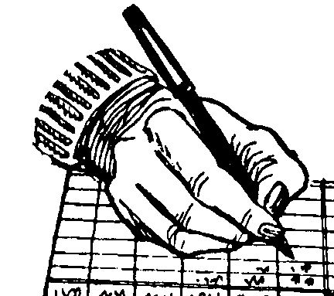
Important operations
open a file
close a file
read data
write data

Slide 23
Read a file in python
myfile = open(“datafile.dat”, “r”)
for line_of_text in myfile:
print line_of_text
historical convention
Assumption: file is a sequence of lines
File Gotcha: where does Python expect to find this file?

Slide 24
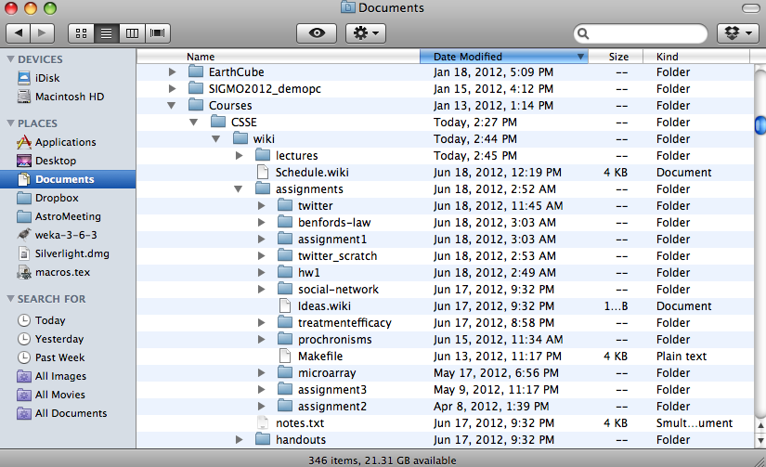
“Current Working Directory”

Slide 25
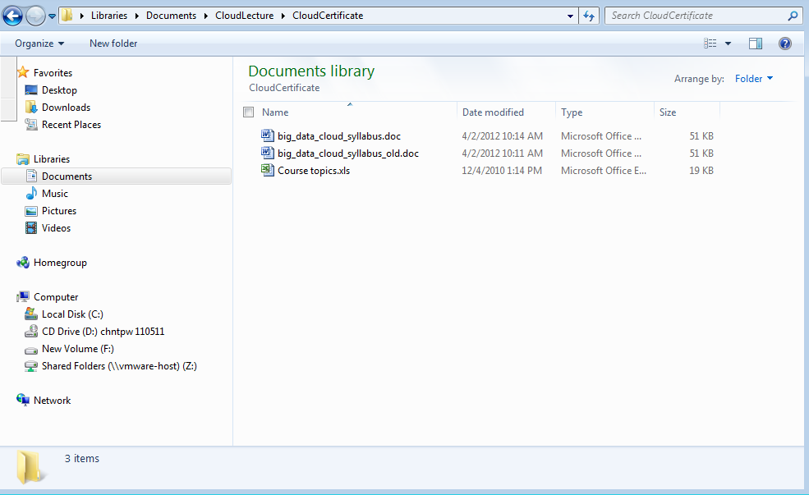
“Current Working Directory”

Slide 26
“Current Working Directory” in Python
>>> import os # “os” stands for “operating system”
>>> os.getcwd()
'/Users/billhowe/Documents'
This point is minor, but can be the source of confusion and bugs.
A reasonable practice is just to work from the default location.
On my systems:
Windows: 'C:\\Python27'
Mac: ‘/Users/billhowe/Documents’

Slide 27
Read a file in python
myfile = open(“datafile.dat”, “r”)
all_data_as_a_big_string = myfile.read()
Another way to read data

Slide 28
Write to a file in python
myfile = open(“output.dat”, “w”)
myfile.write(“a bunch of data”)
historical convention

Slide 29
Write to a file in python
myfile = open(“output.dat”, “w”)
myfile.write(4)
historical convention
Traceback (most recent call last):
File "writefile.py", line 3, in <module>
myfile.write(4)
TypeError: expected a character buffer object
myfile.write(str(4))

Slide 30
Write to a file in python
myfile = open(“output.dat”, “w”)
myfile.write(“a line of text\n”)
Use “\n” to indicate the end of a line

