Slide 1
Data Structures: Lists
UW CSE 190p
Summer 2012

Slide 2
Motivating data structures
Problem: Compute the number of unique words in a document
first attempt:
doc = list_of_words
number_of_words = len(list_of_words)
print number_of_words

Slide 3
Motivating data structures
Problem: Compute the number of unique words in a document
doc = list_of_words
number_of_words = 0
for word in doc:
if not already_seen_it(word):
number_of_words = number_of_words + 1
remember: first write the program you wish you had!
Notes:
wishful thinking
“wishful thinking”

Slide 4
Motivating data structures
Problem: Compute the number of unique words in a document
doc = list_of_words
number_of_words = 0
scratchpad = []
for word in doc:
if not already_seen_it(word, scratchpad):
save(word, scratchpad)
number_of_words = number_of_words + 1

Slide 5
Motivating data structures
Problem: Compute the number of unique words in a document
doc = list_of_words
number_of_words = 0
scratchpad = []
for word in doc:
if not (word in scratchpad):
number_of_words = number_of_words + 1
scratchpad.append(word)

Slide 6
Motivating data structures
Problem: Compute the number of unique words in a document
doc = list_of_words
number_of_words = 0
scratchpad = set() # a set!
for word in doc:
scratchpad.add(word)
print len(scratchpad)

Slide 7
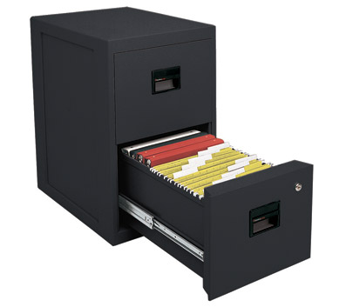
Data Structures
A data structure is way of organizing data such that certain operations are convenient or efficient
Example: What operations are efficient with
a file cabinet sorted by date?
a shoe box?

Slide 10
Exercise
Write a function to compute the position of the first occurrence of the element value in a list somelist
def index(value, somelist):
i = 0
for c in somelist:
if c == value:
return i
i = i + 1
return None

Slide 11
Lists
A list is a sequence of elements
What operations should a list support efficiently and conveniently?

Slide 12
List Basics (demo)

Slide 13
“method syntax”
>>> mylist = [10,20,30]
>>> mylist.append(4) # think “append(mylist, 4)”
>>> mylist.index(10)
0
>>> mylist.sort()
>>>

Slide 14
List methods (demo)

Slide 15
Other list methods
list.index(x)
Return the index in the list of the first item whose value is x. It is an error if there is no such item.
list.sort()
Sort the items of the list, in place.
list.reverse()
Reverse the elements of the list, in place.
list.insert(i, x)
Insert an item at a given position. The first argument is the index of the element before which to insert, so a.insert(0, x) inserts at the front of the list, and a.insert(len(a), x) is equivalent to a.append(x).

Slide 16
More list methods
list.extend(L)
Extend the list by appending all the items in the given list; equivalent to a[len(a):] = L.
list.count(x)
Return the number of times x appears in the list.
list.remove(x)
Remove the first item from the list whose value is x. It is an error if there is no such item.
list.pop([i])
Remove the item at the given position in the list, and return it. If no index is specified, a.pop() removes and returns the last item in the list. (The square brackets around the i in the method signature denote that the parameter is optional, not that you should type square brackets at that position. You will see this notation frequently in the Python Library Reference.)

Slide 17
Exercise: Convert Units
ctemps = [17.1, 22.3, 18.4, 19.1]
ftemps = []
for c in ctemps:
f = celsius_to_farenheit(c)
ftemps.append(f)
ftemps = [celsius_to_farenehit(c) for c in ctemps]
doubles = [i*2 for i in range(5)]

Slide 18
Sets
What’s a set?
What’s the difference between a set and a list?
What operations should a set support efficiently and conveniently?

