Slide 1
Debugging and Interpreting Exceptions
UW CSE 190p
Summer 2012

Slide 2
Review
>>> print "foo"
foo
>>> x = "foo"
>>> print x
foo
>>>

Slide 3
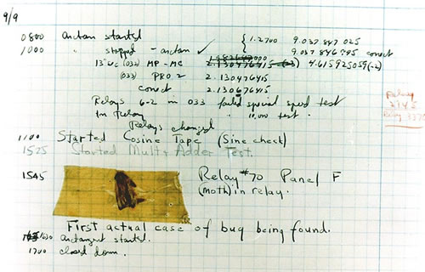
Debugging
It has been just so in all of my inventions. The first step is an intuition, and comes with a burst, then difficulties arise — this thing gives out and [it is] then that "Bugs" — as such little faults and difficulties are called — show themselves and months of intense watching, study and labor are requisite before commercial success or failure is certainly reached.
Thomas Edison, 1878
Harvard Mark II

Slide 4
Debugging Matters
Ariane 5, 1996
Therac 25, 1980s

Slide 5
The Way I Think About Debugging
Apologies for the mixed metaphors….
If it doesn’t work as expected, then by definition you don’t understand what is going on.
You’re lost in the woods.
You’re behind enemy lines.
All bets are off.
Don’t trust anyone or anything.
Don’t press on into unexplored territory -- go back the way you came!
(and leave breadcrumbs!)
You’re trying to “advance the front lines,” not “trailblaze”

Slide 6
My Favorite Time-Saving Trick: Make Sure you’re Debugging the Right Problem
The game is to go from “working to working”
When something doesn’t work, STOP!
It’s wild out there!
FIRST: go back to the last situation that worked properly.
Rollback your recent changes and verify that everything still works as expected.
Don’t make assumptions – by definition, you don’t understand the code when something goes wrong, so you can’t trust your assumptions.
You may find that even what previously worked now doesn’t
Perhaps you forgot to consider some “innocent” or unintentional change, and now even tested code is broken

Slide 7
Timeline
A works, so celebrate a little
Now try B
B doesn’t work
Change B and try again
Change B and try again
Change B and try again
…

Slide 8
Timeline
A works, so celebrate a little
Now try B
B doesn’t work
Rollback to A
Does A still work?
Yes: Find A’ that is somewhere between A and B
No: You have unintentionally changed something else, and there’s no point futzing with B at all!
These “innocent” and unnoticed changes happen more than you would think!
You add a comment, and the indentation changes.
You add a print statement, and a function is evaluated twice.
You move a file, and the wrong one is being read
You’re on a different computer, and the library is a different version

Slide 9
Once you’re on solid ground you can set out again
Once you have something that works and something that doesn’t work, it’s only a matter of time
You just need to incrementally change the working code into the non-working code, and the problem will reveal itself.
Variation: Perhaps your code works with one input, but fails with another. Incrementally change the good input into the bad input to expose the problem.

Slide 10
Scientific Method
By definition, unexpected behavior means you don’t understand the code.
How do you learn about something you don’t understand?
1) Form a hypothesis
2) Make a prediction
3) Test and analyze

Slide 11
Simple Debugging Tools
print
shows what’s happening whether there’s a problem or not
does not stop execution
assert
Raises an exception if some condition is not met
Does nothing if everything works
Use this liberally! Not just for debugging!
raw_input
Stops execution
(Designed to accept user input, but I rarely use it for this.)

Slide 12
assert statement
assert len(rj.edges()) == 16
Traceback (most recent call last):
File "assertion.py", line 28, in <module>
assert len(rj.edges()) == 16
AssertionError

Slide 13
Recommendation 2: Read the error message!
As unhelpful as they sometimes can be, they are your best (and often only) starting point for diagnosis.
The developers went through a lot of trouble to provide these messages – use them.
You need to master
1) the literal meaning of the error
2) the underlying problems certain errors tend to suggest

Slide 14
def friends_of_friends(graph, user):
"""Returns a set of friends of friends of the given user, in the given graph. The result does not include the user nor their friends """
fof = set()
f = friends(graph, user)
for fren in f:
friend = set(graph.neighbors(fren))
fof = fof | friend
g = (fof - f) – user
return g
Mecutio -> Romeo -> Juliet
Traceback (most recent call last):
File ”social_network.py", line 20, in <module>
friends_of_friends(g, 2)
File ”social_network.py", line 14, in friends_of_friends
g = (fof - f) - user
TypeError: unsupported operand type(s) for -: 'set' and 'int'

Slide 15
def friends_of_friends(graph, user):
"""Returns a set of friends of friends of the given user, in the given graph. The result does not include the user nor their friends """
fof = set()
f = friends(graph, user)
for fren in f:
friend = set(graph.neighbors(fren))
fof = fof | friend
f.add([user])
g = (fof - f)
return g
Traceback (most recent call last):
File "unhashable_type.py", line 21, in <module>
friends_of_friends(g, "Mercutio")
File "unhashable_type.py", line 14, in friends_of_friends
f.add([user])
TypeError: unhashable type: 'list'

