Slide 1
Elementary statistics
Michael Ernst
CSE 190p
University of Washington

Slide 2
A dice-rolling game
Two players each roll a die
The higher roll wins
Goal: roll as high as you can!
Repeat the game 6 times

Slide 3
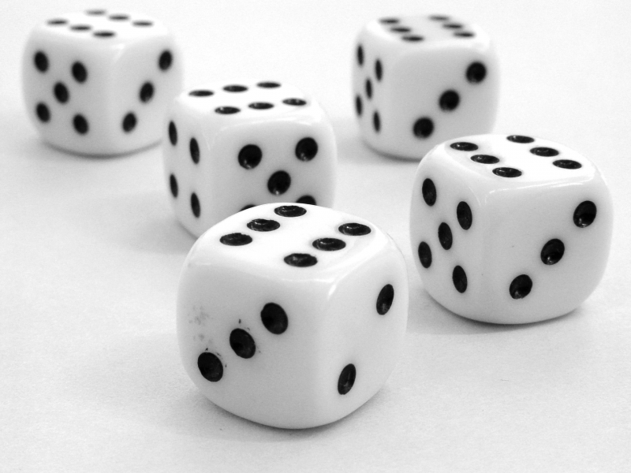
Hypotheses regarding Mike’s success
Luck
Fraud
loaded die
inaccurate reporting
How likely is luck?
How do we decide?

Slide 4
Questions that statistics can answer
I am flipping a coin. Is it fair? How confident am I in my answer?
I have two bags of beans, each containing some black and some white beans. I have a handful of beans. Which bag did the handful come from?
I have a handful of beans, and a single bag. Did the handful come from that bag?
Does this drug improve patient outcomes?
Which website design yields greater revenue?
Which baseball player should my team draft?
What premium should an insurer charge?
Which chemical process leads to the best-tasting beer?
Notes:
“Student” was William Gosset, a chemist working for the Guinness brewery in Dublin

Slide 5
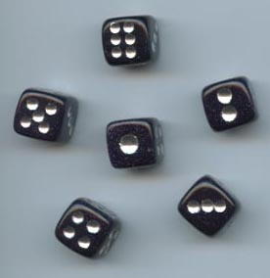
What can happen when you roll a die?
What is the likelihood of each?

Slide 6
A dice-rolling experiment
Game: Roll one die, get paid accordingly:
Player self-reports the die roll and takes the money
no verification of the actual roll
From “Lies in disguise: An experimental study on cheating”
by Urs Fischbacher and Franziska Heusi
Roll | 1 | 2 | 3 | 4 | 5 | 6
Payoff | 1 CHF | 2 CHF | 3 CHF | 4 CHF | 5 CHF | 0 CHF

Slide 7
What can happen when you roll two dice?
How likely are you to roll 11 or higher?
This probability is known as the “p value”.
2
3
4
5
6
7
8
9
10
11
12

Slide 8
How to compute p values
Via a statistical formula
Requires you to make assumptions and know which formula to use
Computationally (simulation)
Run many experiments
Count the fraction with a better result
Requires a metric/measurement for “better”
Requires you to be able to run the experiments

Slide 9
Interpreting p values
p value of 5% or less = statistically significant
This is a convention; there is nothing magical about 5%
Two types of errors may occur in statistical tests:
false positive (or false alarm or Type I error): no real effect, but report an effect (through good/bad luck or coincidence)
If no real effect, a false positive occurs about 1 time in 20
If there is a real effect, a false positive occurs less often
false negative (or miss or Type II error): real effect, but report no effect (through good/bad luck or coincidence)
The smaller the effect, the more likely a false negative is
How many die rolls to detect a die that is only slightly loaded?
The larger the sample, the less the likelihood of a false positive or negative

Slide 10
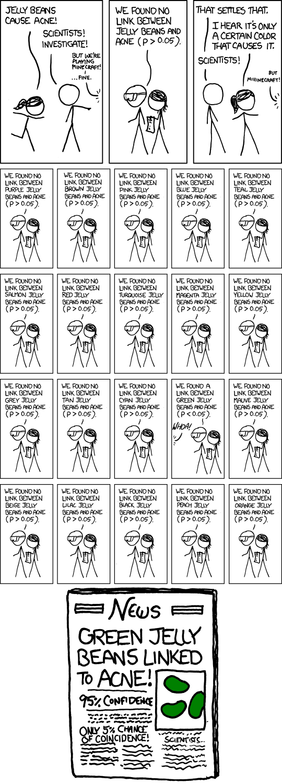
A false positive
http://xkcd.com/882/

Slide 11
http://xkcd.com/882/
http://xkcd.com/882/

Slide 12
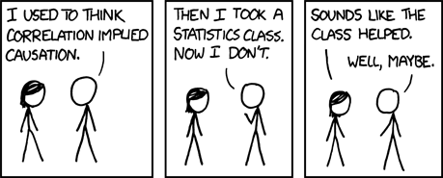
Correlation ≠ causation
Ice cream sales and murder rates are correlated
http://xkcd.com/552/

Slide 13
Statistical significance ≠ practical importance

