Slide 1
Recursion
To seal: moisten flap, fold over, and seal
Michael Ernst
CSE 190p
University of Washington

Slide 2
Three recursive algorithms
Sorting
GCD (greatest common divisor)
Exponentiation
Used in cryptography, which protects information and communication

Slide 3
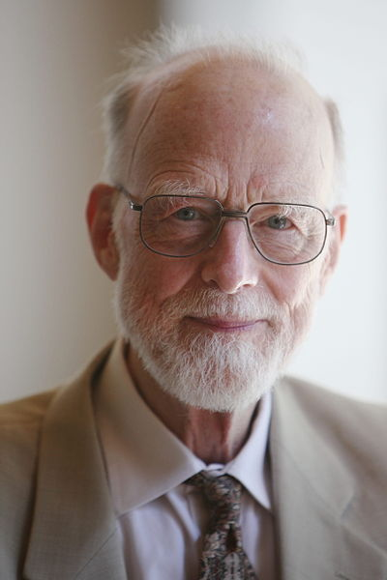
Sorting a list
Python’s sorted function returns a sorted version of a list.
sorted([4, 1, 5, 2, 7]) ⇒ [1, 2, 4, 5, 7]
How could you implement sorted?
Idea (“quicksort”, invented in 1960):
Choose an arbitrary element (the “pivot”)
Collect the smaller items and put them on its left
Collect the larger items and put them on its right
Sir Anthony Hoare

Slide 4
First version of quicksort
def quicksort(thelist):
pivot = thelist[0]
smaller = [elt for elt in thelist if elt < pivot]
larger = [elt for elt in thelist if elt > pivot]
return smaller + [pivot] + larger
print quicksort([4, 1, 5, 2, 7])
There are three problems with this definition
Write a test case for each problem

Slide 5
Near-final version of quicksort
def quicksort(thelist):
if len(thelist) < 2:
return thelist
pivot = thelist[0]
smaller = [elt for elt in thelist if elt < pivot]
larger = [elt for elt in thelist if elt > pivot]
return quicksort(smaller) + [pivot] + quicksort(larger)
How can we fix the problem with duplicate elements?

Slide 6
Handling duplicate pivot items
def quicksort(thelist):
if len(thelist) < 2:
return thelist
pivot = thelist[0]
smaller = [elt for elt in thelist if elt < pivot]
pivots = [elt for elt in thelist if elt == pivot]
larger = [elt for elt in thelist if elt > pivot]
return quicksort(smaller) + pivots + quicksort(larger)
def quicksort(thelist):
if len(thelist) < 2:
return thelist
pivot = thelist[0]
smaller = [elt for elt in thelist[1:] if elt <= pivot]
larger = [elt for elt in thelist if elt > pivot]
return quicksort(smaller) + [pivot] + quicksort(larger)

Slide 7
GCD (greatest common divisor)
gcd(a, b) = largest integer that divides both a and b
gcd(4, 8) = 4
gcd(15, 25) = 5
gcd(16, 35) = 1
How can we compute GCD?

Slide 8
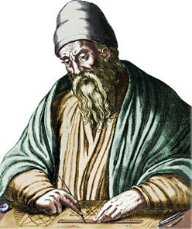
Euclid’s method for computing GCD (circa 300 BC, still commonly used!)
a if b = 0
gcd(a, b) = gcd(b, a) if a < b
gcd(a-b, b) otherwise

Slide 9
Python code for Euclid’s algorithm
def gcd(a, b):
if b == 0:
return a
if a < b:
return gcd(b, a)
return gcd(a-b, b)

Slide 10
Exponentiation
Goal: Perform exponentiation, using only addition, subtraction, multiplication, and division. (Example: 3⁴)
def exp(base, exponent):
"""Exponent is a non-negative integer"""
if exponent == 0:
return 1
return base * exp(base, exponent - 1)
Example:
exp(3, 4)
3 * exp(3, 3)
3 * (3 * exp(3, 2))
3 * (3 * (3 * exp(3, 1)))
3 * (3 * (3 * (3 * exp(3, 0))))
3 * (3 * (3 * (3 * 1)))

Slide 11
Faster exponentiation
Suppose the exponent is even.
Then, base^{exponent} = (base*base)^{exponent/2}
Examples: 3⁴ = 9² 9² = 81¹ 5¹² = 25⁶ 25⁶ = 625³
New implementation:
def exp(base, exponent):
"""Exponent is a non-negative integer"""
if exponent == 0:
return 1
if exponent % 2 == 0:
return exp(base*base, exponent/2)
return base * exp(base, exponent - 1)

Slide 12
Comparing the two algorithms
Original algorithm: 12 multiplications
Fast algorithm: 5 multiplications
5¹²
5 * 5¹¹
5 * 5 * 5¹⁰
5 * 5 * 5 * 5⁹
…
5 * 5 * 5 * 5 * 5 * 5 * 5 * 5 * 5 * 5 * 5 * 5 * 5⁰
5 * 5 * 5 * 5 * 5 * 5 * 5 * 5 * 5 * 5 * 5 * 5 * 1
5 * 5 * 5 * 5 * 5 * 5 * 5 * 5 * 5 * 5 * 5 * 5
5 * 5 * 5 * 5 * 5 * 5 * 5 * 5 * 5 * 5 * 25
5 * 5 * 5 * 5 * 5 * 5 * 5 * 5 * 5 * 125
…
244140625
5¹²
(5 * 5)⁶
25⁶
(25 * 25)³
625³
625 * 625²
625 * 625 * 625¹
625 * 625 * 625 * 625⁰
625 * 625 * 625 * 1
625 * 625 * 625
625 * 390625
244140625
Speed matters: In cryptography, exponentiation is done with 600-digit numbers.
Notes:
600 digits = 2000 bits

Slide 13
Recursion: base and inductive cases
Recursion expresses the essence of divide and conquer
Solve a smaller subproblem, use the answer to solve the original problem
A recursive algorithm always has:
a base case (no recursive call)
an inductive or recursive case (has a recursive call)
What happens if you leave out the base case?
What happens if you leave out the inductive case?

Slide 14
Recursion vs. iteration
Any recursive algorithm can be re-implemented as a loop instead
This is an “iterative” expression of the algorithm
Any loop can be implemented as recursion instead
Sometimes recursion is clearer and simpler
Mostly for data structures with a recursive structure
Sometimes iteration is clearer and simpler

Slide 15
More examples of recursion
List algorithms: recursively process all but the first element of the list, or half of the list
Map algorithms: search for an item in part of a map (or any other spatial representation)
Numeric algorithms: Process a smaller value

