Slide 1
CSE 190p wrapup
Michael Ernst
CSE 190p
University of Washington

Slide 2
Progress in 9 weeks
9 weeks ago: you knew no programming
Goals:
Computational problem-solving
Python programming language
Experience with real datasets
Fun of extracting understanding and insight from data, and of mastery over the computer
Ability to go on to more advanced computing classes
Today: you can write a useful program to solve a real problem
You can even pose the problem yourself

Slide 3
A huge thanks to the rest of the staff
Bill Howe
Dun-Yu Hsiao

Slide 4
Why do you care about processing data?
The world is awash in data
Processing and analyzing it is the difference between success and failure
for a team or for an individual
Manipulating and understanding data is essential to:
Astronomers
Biologists
Chemists
Economists
Engineers
Entrepreneurs
Linguists
Political scientists
Zoologists
… and many more!

Slide 5
Python concepts
Assignments
Variables
Types
Programs & algorithms
Control flow: loops (for), conditionals (if)
File I/O
Python execution model
How Python evaluates expressions, statements, and programs

Slide 6
Data structures: managing data
List
Set
Dictionary
Tuple
Graph
List slicing (sublist)
List comprehension: shorthand for a loop
Mutable and immutable data structures
Immutable: easier to reason about, less efficient
Distinction between identity and value

Slide 7
Functions
f(x) = x²
Procedural abstraction
avoid duplicated code
the implementation does not matter to the client
Using functions
Defining functions
A function is an ordinary value
assign to variables
in a call, use an expression as the function: myfns[i](arg)
Method syntax: put first argument before a period (.)
arg1.methodname(arg2, arg3)
used for “objects”
(period also means “look up variable in a namespace”)

Slide 8
Data abstraction
Dual to procedural abstraction (functions)
A module is: operations
An object is: data + operations
Clients use the operations, never directly access data
The representation of the data does not matter
Programmer defines a class. Each instance of a class is an object.

Slide 9
Testing and debugging
Write enough tests:
Cover every branch of each boolean expression
especially when used in a conditional expression (if statement)
Cover special cases:
numbers: zero, positive, negative, int vs. float
data structures: empty, size 1, larger
Assertions are useful beyond tests
Debugging: after you observe a failure
Divide and conquer
this is also a key program design concept
The scientific method
state a hypothesis; design an experiment; understand results
Think first
Be systematic: record everything; have a reason for each action

Slide 10
Recursion
Base case: does all the work for a small problem
Inductive case:
passes the buck for most of a large problem
does a small amount of work (or none) to the subanswer
returns whole result

Slide 11
Speed of algorithms
Affected primarily by number of times you iterate over data
“Constant factors” don’t matter (looping 2 times or 3 times)
Nested looping matters a lot

Slide 12
Data analysis
Statistics
Run many simulations
How uncommon is what you actually saw?
Graphing/plotting results

Slide 13
Program design
How to write a function:
Name, arguments, and documentation string
Tests
Body/implementation
How to write a program:
Decompose into parts (functions, modules)
Each part should be a logical unit, not too large or small
Write each part
Define the problem
Choose an algorithm
In English first; test it via manual simulation
Translate into code
When necessary, use wishful thinking
Assume a function exists, then write it later
Can test even before you write if, via a stub

Slide 14
There is more to learn
Data analysis, data science, and data visualization
Scaling up:
larger programs
“big data”: out-of-memory data, parallel programming, …
Ensuring correctness
Principled, systematic design, testing, and programming
Coding style
Managing complexity
Programming tools: testing, version control, debugging, deployment
GUIs, user interaction
Data structures and algorithms
Working in a team

Slide 15
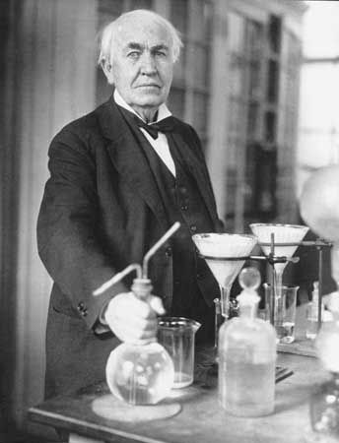
What you have learned in CSE 190p
Compare your skills today to 9 weeks ago
Theory: abstraction, specification, design
Practice: implementation, testing
Bottom line: The assignments would be easy for you today
This is a measure of how much you have learned
There is no such thing as a “born” programmer!
Your next project can be more ambitious
Genius is 1% inspiration and 99% perspiration.
Thomas A. Edison
Notes:
Practice: also “teamwork” in some terms.

Slide 16
What you will learn later
Your next project can be much more ambitious
Know your limits
Be humble (reality helps you with this)
You will continue to learn
Building interesting systems is never easy
Like any worthwhile endeavor
Practice is a good teacher
Requires thoughtful introspection
Don’t learn only by trial and error!
Get lots of practice and feedback

Slide 17
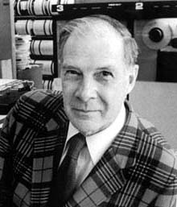
What comes next?
Classes
Java: CSE 142 (you may skip), CSE 143
MATLAB, other programming languages
Data analysis: classes, research, jobs
In software engineering & programming systems
In any topic that involves software
Having an impact on the world
Jobs (and job interviews)
Larger programming projects
The purpose of computing is insight, not numbers.
Richard W. Hamming
Numerical Methods for Scientists and Engineers

Slide 18
Go forth and conquer
System building is fun!
It’s even more fun when you build it successfully
Pay attention to what matters
Use the techniques and tools of CSE 190p effectively

