Slide 1
"If it weren't for C, we'd be writing programs in BASI, PASAL, and OBOL."
http://www.gdargaud.net/Humor/C_Prog_Debug.html
David Notkin  Autumn 2009  CSE303 Lecture 10

Slide 2
Today
Some C leftovers from Monday
C memory model; stack allocation
computer memory and addressing
stack vs. heap
pointers
parameter passing
by value
by reference

Slide 3
Arrays as parameters
Arrays do not know their own size; they are just memory chunks – harder than in Java
int sumAll(int a[]);
int main(void) {
int numbers[5] = {7, 4, 3, 15, 2};
int sum = sumAll(numbers);
return 0;
}
int sumAll(int a[]) {
int i, sum = 0;
for (i = 0; i < ... ???
}

Slide 4
Solution 1: declare size
Declare a function with the array's exact size
int sumAll(int a[5]);
int main(void) {
int numbers[5] = {7, 4, 3, 15, 2};
int sum = sumAll(numbers);
return 0;
}
int sumAll(int a[5]) {
int i, sum = 0;
for (i = 0; i < 5; i++) {
sum += i;
}
return sum;
}

Slide 5
Solution 2: pass size
Pass the array's size as a parameter
int sumAll(int a[], int size);
int main(void) {
int numbers[5] = {7, 4, 3, 15, 2};
int sum = sumAll(numbers, 5);
return 0;
}
int sumAll(int a[], int size) {
int i, sum = 0;
for (i = 0; i < size; i++) {
sum += i;
}
return sum;
}

Slide 6
Returning an array
arrays (so far) disappear at the end of the function: this means they cannot be safely returned
int[] copy(int a[], int size);
int main(void) {
int numbers[5] = {7, 4, 3, 15, 2};
int numbers2[5] = copy(numbers, 5); // no
return 0;
}
int[] copy(int a[], int size) {
int i;
int a2[size];
for (i = 0; i < size; i++) {
a2[i] = a[i];
}
return a2; // no
}

Slide 7
Solution: output parameter
workaround: create the return array outside and pass it in -- "output parameter" works because arrays are passed by reference
void copy(int a[], int a2[], int size);
int main(void) {
int numbers[5] = {7, 4, 3, 15, 2};
int numbers2[5];
copy(numbers, numbers2, 5);
return 0;
}
void copy(int a[], int a2[], int size) {
int i;
for (i = 0; i < size; i++) {
a2[i] = a[i];
}
}

Slide 8
A bit about strings (more soon)
String literals are the same as in Java
printf("Hello, world!\n");
but there is not actually a String type in C; they are just char[]
Strings cannot be made, concatenated, or examined as in Java:
String s = "hello"; // no
int answer = 42;
printf("The answer is " + answer); // no
int len = "hello".length(); // no
int printMessage(String s, int times) { ... // no

Slide 9
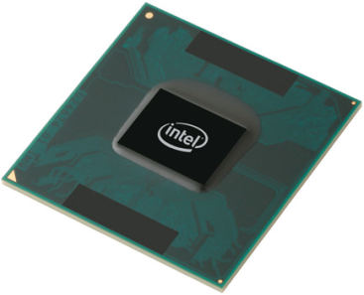
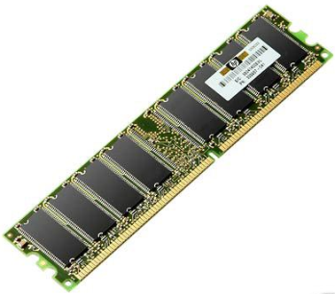
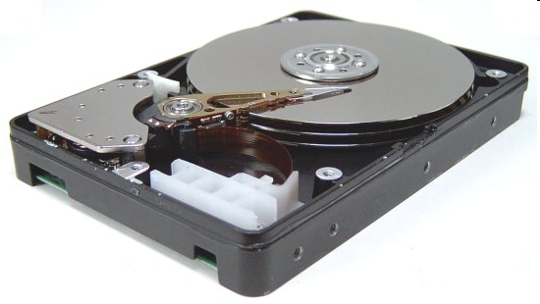
Memory hierarchy
CPU registers
a few bytes
L1/L2 cache (on CPU)
1-4 MB
physical RAM (memory)
1-2 GB
virtual RAM (on a hard disk)
2-8 GB
secondary/permanent storage (hard disks, removable drives, network)
500 GB

Slide 10
Virtual addressing
each process has its own virtual address space of memory to use
each process doesn't have to worry about memory used by others
OS maps from each process's virtual addresses to physical addresses
process 1
process 2
reality
virtual

Slide 11
Process memory layout
0xFFFFFFFF
when a process runs, its instructions/globals load into memory
address space is like a huge array of bytes
total: 2³² bytes
each int = 4 bytes
as functions are called, data goes on a stack
dynamic data is created on a heap
stack (function calls)
available memory
heap (dynamically allocated data)
global/static variables ("data segment")
code instructions ("text segment")
address
space
0x00000000

Slide 12
Stack frames
stack frame or activation record: memory for a function call
stores parameters, local variables, and return address to go back to
int f(int p1, int p2) {
int x;
int a[3];
...
return x + y;
}
stack
available
heap
global data
code
offset | contents
24 | p2
20 | p1
16 | return address
12 | a[2]
8 | a[1]
4 | a[0]
0 | x

Slide 13
Tracing function calls
int main(void) {
int n1 = f(3, -5);
n1 = g(n1);
}
int f(int p1, int p2) {
int x;
int a[3];
...
x = g(a[2]);
return x + y;
}
int g(int param) {
return param * 2;
}
stack
available
heap
global data
code main f g
main
n1
g
p
f
p1, p2
x, a
g
p

Slide 14
The & operator
&variable produces variable's memory address
#include <stdio.h>
int main(void) {
int x, y;
int a[2];
// printf("x is at %d\n", &x);
printf("x is at %p\n", &x); // x is at 0x0022ff8c
printf("y is at %p\n", &y); // y is at 0x0022ff88
printf("a[0] is at %p\n", &a[0]); // a[0] is at 0x0022ff80
printf("a[1] is at %p\n", &a[1]); // a[1] is at 0x0022ff84
return 0;
}
%p placeholder in printf prints a memory address in hexadecimal

Slide 15
Danger!
array bounds are not enforced; can overwrite other variables
#include <stdio.h>
int main(void) {
int x = 10, y = 20;
int a[2] = {30, 40};
printf("x = %d, y = %d\n", x, y); // x = 10, y = 20
a[2] = 999; // !!!
a[3] = 111; // !!!
printf("x = %d, y = %d\n", x, y); // x = 111, y = 999
return 0;
}

Slide 16
Segfault
segmentation fault ("segfault"): A program crash caused by an attempt to access an illegal area of memory
#include <stdio.h>
int main(void) {
int a[2];
a[999999] = 12345; //out of bounds
return 0;
}

Slide 17
Segfault
#include <stdio.h>
void f() {
f();
}
int main(void) {
f();
return 0;
}

Slide 18
The sizeof operator
sizeof(type) or (variable) returns memory size in bytes
#include <stdio.h>
int main(void) {
int x;
int a[5];
printf("int=%d, double=%d\n", sizeof(int), sizeof(double));
printf("x uses %d bytes\n", sizeof(x));
printf("a uses %d bytes\n", sizeof(a));
printf("a[0] uses %d bytes\n", sizeof(a[0]));
return 0;
}
Output:
int=4, double=8
x uses 4 bytes
a uses 20 bytes
a[0] uses 4 bytes

Slide 19
sizeof continued
arrays passed as parameters do not remember their size
#include <stdio.h>
void f(int a[]);
int main(void) {
int a[5];
printf("a uses %d bytes\n", sizeof(a));
f(a);
return 0;
}
void f(int a[]) {
printf("a uses %2d bytes in f\n", sizeof(a));
}
Output:
a uses 20 bytes
a uses 4 bytes in f

Slide 20
Pointer: a memory address referring to another value
type* name; // declare
type* name = address; // declare/initialize
int x = 42;
int* p;
p = &x; // p stores address of x
printf("x is %d\n", x); // x is 42
printf("&x is %p\n", &x); // &x is 0x0022ff8c
printf("p is %p\n", p); // p is 0x0022ff8c
int* p1, p2; // int* p1; int p2;
int* p1, *p2; // int* p1; int* p2

Slide 21
Dereferencing: access the memory referred to by a pointer
*pointer // dereference
*pointer = value; // dereference/assign
int x = 42;
int* p;
p = &x; // p stores address of x
*p = 99; // go to the int p refers to; set to 99
printf("x is %d\n", x);
Output: x is 99

Slide 22
* vs. &
many students get * and & mixed up
& references (ampersand gets an address)
* dereferences (star follows a pointer)
int x = 42;
int* y = &x;
printf("x is %d \n", x); // x is 42
printf("&x is %p\n", &x); // &x is 0x0022ff8c
printf("y is %p\n", y); // y is 0x0022ff8c
printf("*y is %d \n", *y); // *y is 42
printf("&y is %p\n", &y); // &y is 0x0022ff88
What is *x ?
Notes:
mention the subtle bug that:
int *p, p2;
creates a pointer named p and a NORMAL INT named p2?

Slide 23
L-values and R-values
L-value: Suitable for being on left-side of an = assignment -- a valid memory address to store into
R-value: Suitable for right-side of an = assignment
int x = 42;
int* p = &x;
L-values : x or *p (store into x), p (changes what p points to)
not &x, &p, *x, *(*p), *12
R-values : x or *p, &x or p, &p
not &(&p), &42

Slide 24
Pass-by-value: copy parameters' values
Cannot change the original (“actual”) parameter variable
int main(void) {
int a = 42, b = -7;
swap(a, b);
printf("a = %d, b = %d\n", a, b);
return 0;
}
void swap(int a, int b) {
int temp = a;
a = b;
b = temp;
}

Slide 25
Pass-by-reference: point to parameters
Can change the actual parameter variable using the “formal”
int main(void) {
int a = 42, b = -7;
swap(a, b);
printf("a = %d, b = %d\n", a, b);
return 0;
}
void swap(int a, int b) {
int temp = a;
a = b;
b = temp;
}
Notes:
make connection to scanf and how you use & when you pass parameters to it

Slide 26
Questions?

