Slide 1
#preprocessor Debugging is twice as hard as writing the code in the first place. Therefore, if you write the code as cleverly as possible, you are, by definition, not smart enough to debug it.
--Brian W. Kernighan
David Notkin  Autumn 2009  CSE303 Lecture 16

Slide 2
C preprocessor
Part of the C compilation process; recognizes special # statements, modifies your source code before it is compiled
This is generally considered to be a “macro processing” tool
function | description
#include <filename> | insert a library file's contents into this file
#include "filename" | insert a user file's contents into this file
#define name [value] | create a preprocessor symbol ("variable")
#if test | if statement
#else | else statement
#elif test | else if statement
#endif | terminates an if or if/else statement
#ifdef name | if statement; true if name is defined
#ifndef name | if statement; true if name is not defined
#undef name | deletes the given symbol name

Slide 3
Constant replacement
The preprocessor can be used to create constants:
#define NUM_STUDENTS 100
#define DAYS_PER_WEEK 7
...
double grades[NUM_STUDENTS];
int six_weeks = DAYS_PER_WEEK * 6; // 42
printf("Course over in %d days", six_weeks);
When the preprocessor runs before compilation, 7 is literally inserted into the code wherever DAYS_PER_WEEK is seen: DAYS_PER_WEEK does not exist in the eventual program
int six_weeks = 7 * 6; // 42

Slide 4
Optional debugging code
#define DEBUG
...
#ifdef DEBUG
// debug-only code
printf("Size of stack = %d\n", stack_size);
printf("Top of stack = %p\n", stack);
#endif
stack = stack->next; // normal code
How is this different from declaring a bool/int named DEBUG?

Slide 5
Advanced definitions
#define can be used to modify the C language
(No different in mechanism than constants)
#define AND &&
#define EQUALS ==
#define DEREF ->
...
Point p1 = (Point*) malloc(sizeof(Point));
p1 DEREF x = 10;
p1 DEREF y = 10;
if (p1 DEREF x EQUALS p1 DEREF y AND p1 DEREF y > 0) {
p1 DEREF x++;
}
Good idea? Bad idea? Neutral idea?

Slide 6
Preprocessor macros
Similar to a function, but created inline before compilation
#define SQUARED(x) x * x
#define ODD(x) x % 2 != 0
int a = 3;
int b = SQUARED(a);
if (ODD(b)) {
printf("%d is an odd number.\n", b);
}
The above literally converts the code to the following and compiles:
int b = a * a;
if (b % 2 != 0) { ...

Slide 7
Subtleties
the preprocessor just replaces tokens with tokens
#define foo 42
int food = foo; // int food = 42; ok
int foo = foo + foo; // int 42 = 42 + 42; bad
preprocessor macros can do a few things functions cannot:
#define NEW(t) (t*) calloc(1, sizeof(t))
...
Node* list = NEW(Node);

Slide 8
Caution with macros
since macros are expanded directly, strange things can happen if you pass them complex values
#define ODD(x) x % 2 != 0
...
if (ODD(1 + 1)) {
printf("It is odd.\n"); // prints!
}
The above converts the code to the following
if (1 + 1 % 2 != 0) {
Fix: Always surround macro parameters in parentheses.
#define ODD(x) (x) % 2 != 0

Slide 9
Running the preprocessor
to define a preprocessor variable, use the -D argument
$ gcc -D DEBUG -o example example.c
to run only the preprocessor, use the -E argument to gcc
$ gcc -E example.c
int main(void) {
if ((1 + 1) % 2 != 0) {
printf("It is odd.\n");
}
return 0;
}
rarely used in practice, but can be useful for debugging / learning

Slide 10
gdb
gdb : GNU debugger. Helps you step through C programs.
absolutely essential for fixing crashes and bad pointer code
your program must have been compiled with the -g flag
usage
$ gdb program
GNU gdb Fedora (6.8-23.fc9)
Copyright (C) 2008 Free Software Foundation, Inc...
(gdb) run parameters
...
redirecting input:
$ gdb program
(gdb) run parameters < inputfile

Slide 11
gdb commands
command | description
run or r parameters | run the program
break or b place | sets a breakpoint at the given place: - a function's name - a line number - a source file : line number
print or p expression | prints the given value / variable
step or s | advances by one line of code ("step into")
next or n | advances by one line of code ("step over")
finish | runs until end of function ("step out")
continue or c | resumes running program
backtrace or bt | display current function call stack
quit or q | exits gdb

Slide 12
A gdb session
$ gdb intstack
GNU gdb 5.2.1
Copyright 2002 Free Software Foundation, Inc.
(gdb) b 34
Breakpoint 1 at 0x4010ea: file intstack.c, line 34.
(gdb) r
Starting program: /home/user/intstack
Breakpoint 1, main () at intstack.c:34
34 Node* oldFront = stack;
(gdb) p stack
$1 = (Node *) 0x4619c0
(gdb) n
35 printf("%d\n", stack->data);
(gdb) n
36 stack = stack->next;
(gdb) n
37 free(oldFront);
(gdb) p stack
$4 = (Node *) 0x462856
(gdb) p oldFront
$2 = (Node *) 0x4619c0
(gdb) p *oldFront
$3 = {data = 10, next = 0x462856}
(gdb) c
Continuing.

Slide 13
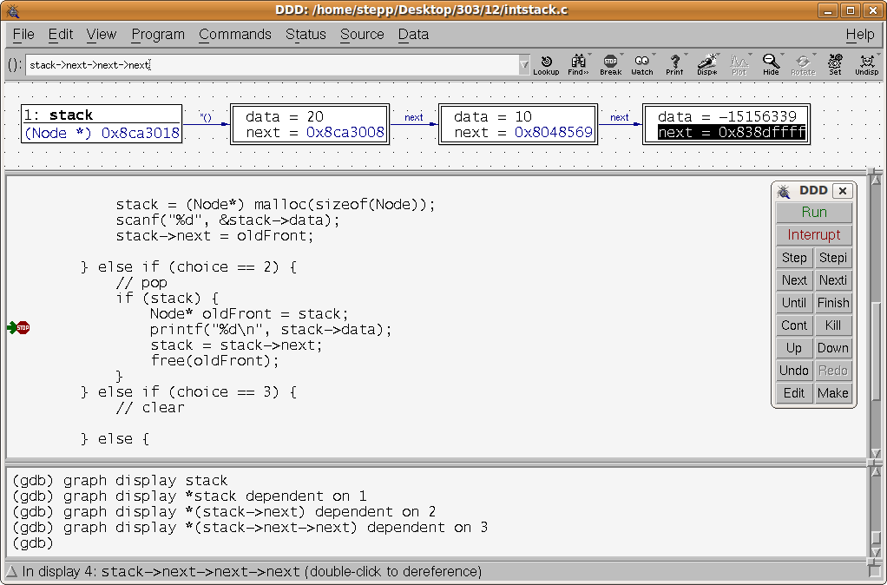
ddd
ddd (Data Display Debugger): Graphical front-end for gdb
allows you to view the values of your variables, pointers, etc.
$ ddd programName

Slide 14
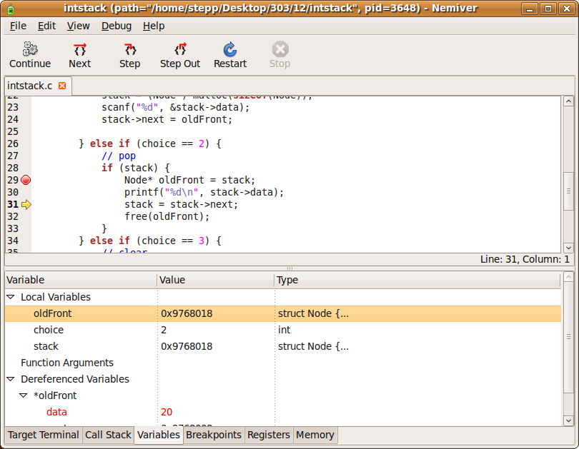
nemiver
nemiver : Another graphical debugger front-end
design goal: Be usable even if you don't know gdb commands
$ nemiver programName arguments

Slide 15
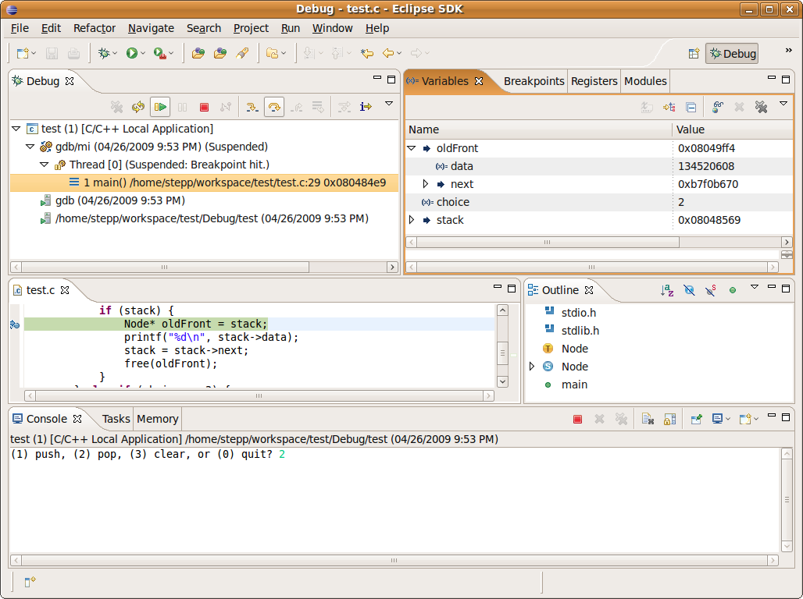
Other debuggers
Eclipse CDT (C/C++ Development Toolkit)
create a new Managed Make C Project
right-click project name, choose Debug As, Local C/C++ Application

Slide 16
valgrind
valgrind : A memory-leak detector and debugging tool valgrind programName arguments
(1) push, (2) pop, (3) clear, or (0) quit? 2
==3888== Conditional jump or move depends on uninitialised value(s)
==3888== at 0x80484E7: main (intstack.c:28)
==3888==
==3888== Use of uninitialised value of size 4
==3888== at 0x80484F2: main (intstack.c:30)
-15156339
==3888==
==3888== Use of uninitialised value of size 4
==3888== at 0x8048507: main (intstack.c:31)
==3888==
==3888== Invalid free() / delete / delete[]
==3888== at 0x4025DFA: free (vg_replace_malloc.c:323)
==3888== by 0x8048517: main (intstack.c:32)
==3888== Address 0x8048569 is in the Text segment of /home/stepp/intstack

Slide 17
Valgrind: leaks, too
stats about leaked memory on program exit
(1) push, (2) pop, (3) clear, or (0) quit? 1
Number to push? 10
(1) push, (2) pop, (3) clear, or (0) quit? 1
Number to push? 20
(1) push, (2) pop, (3) clear, or (0) quit? 2
20
(1) push, (2) pop, (3) clear, or (0) quit? 2
10
(1) push, (2) pop, (3) clear, or (0) quit? 0
==5162== LEAK SUMMARY:
==5162== definitely lost: 16 bytes in 2 blocks.
==5162== possibly lost: 0 bytes in 0 blocks.
==5162== still reachable: 0 bytes in 0 blocks.
==5162== suppressed: 0 bytes in 0 blocks.

Slide 18
lint / splint: checks for possible errors
famously picky (sometimes should be ignored)
but good for helping you find potential sources of bugs/errors
not installed on attu, but can install it on your Linux: $ sudo apt-get install splint
$ splint *.c
Splint 3.1.2 --- 07 May 2008
part2.c: (in function main)
part2.c:8:2: Path with no return in function declared to return int
There is a path through a function declared to return a value on which there
is no return statement. This means the execution may fall through without
returning a meaningful result to the caller. (Use -noret to inhibit warning)
use_linkedlist.c:5:5: Function main defined more than once
A function or variable is redefined. One of the declarations should use
extern. (Use -redef to inhibit warning)
part2.c:8:1: Previous definition of main

Slide 19
Questions?

