Slide 1
Here Early?
Here for CSE 311?
Welcome! You’re early!
Want a copy of these slides to take notes?
You can download them from the webpage cs.uw.edu/311
Want to be ready for the end of the lecture?
Download the Activity slide from the same place
Go to pollev.com/cse311 and login with your at-uw email (not at-cs!)
You should see something about “presentation hasn’t started yet”

Slide 2
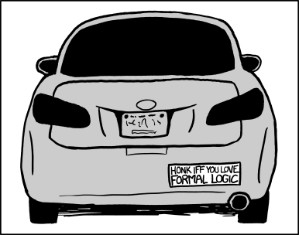
Logistics and Propositional Logic
CSE 311: Foundations of Computing I Lecture 1

Slide 3
Outline
Course logistics (e.g. how are we doing this online?)
What is the goal of this course?
Start of Propositional Logic

Slide 4
Zoom Logistics
We’ll always have a TA watching chat – if you have a question, ask it there (either general or direct to the TA).
Don’t send direct to me, I won’t see it
TA may answer directly, interrupt me, or wait a few minutes and have me answer at a good stopping point.
If you’re comfortable (and have the wifi) to turn on your video please do
Nodding/confused looks/glazed over eyes help me know if I said something super confusing.
We will put recordings of (both) lectures on the course webpage.

Slide 5
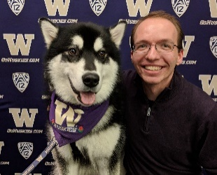
Staff
TAs
Timothy Akintilo
Austin Chan
Yijie Deng
Daniel Fuchs
Raymond Guo
Arthur Liang
Melissa Lin
Arthur Liang
Andrey Ryabtsev
Zoey Shi
Josh Shin
Alicia Stepin
Jason Waataja
Alice Wang
Howard Xiao
Instructor: Robbie Weber
Ph.D. from UW CSE in theory
First quarter as teaching faculty
Third time as an instructor
TAed 8 different courses.
Office: CSE2 311
Email: rtweber2@cs.washington.edu

Slide 6
Sections
Sections start tomorrow!
Mostly a chance to practice and ask questions
Please attend your registered section if you can.
There can be multiple sections at the same time, make sure you know the two-letter code for your section.
Zoom links on Canvas or Ed.
Some sections introduce new material.
TA walkthroughs will be posted for reference, but sections aren’t recorded.

Slide 7
Syllabus
It’s all on the webpage: https://courses.cs.washington.edu/courses/cse311/20au/
In general, when in doubt, it’s on the webpage.
We’ll talk through syllabus details as they become relevant, only a few highlights today…

Slide 8
Textbook
We’ll have occasional pre- or post-lecture readings. All required readings will be available on the webpage.
There is also an optional Book:
Discrete Mathematics and its Applications (Kenneth Rosen)
We’ll tell you the relevant sections for 6th or 7th editions.
Many used copies available
Good for practice with solved problems
Older (or newer) editions also have necessary content, but it may be moved around.

Slide 9
Work
Homework (70%)
Approximately weekly. Mostly due Fridays.
Graded on both accuracy and clarity/style.
Exams (22.5%)
We’ll have two take-home exams (think “shorter homework” rather than one-hour exam). Approximate dates: Nov. 13-16, Dec. 11-14
Lecture activities (7.5%)
Completed either online “live” or (if you’re asynchronous, or miss a lecture) online by the following Sunday.

Slide 10
Communication
Ed Discussion board will be our primary means of communication.
Please check frequently.
You are also already be on the class email list
Occasional announcements here.
If you want to contact us:
Private post on Ed (seen by staff, all TAs)
Email Robbie
Anonymous Feedback form on webpage

Slide 11
Pre-Quarter Survey
There’s a “quiz” up on canvas.
Asking you questions like “what time zone are you in?”
This will help us schedule office hours, connect people who might want study groups, etc.
Please fill it out by tonight!

Slide 12
Collaboration Policy
PLEASE collaborate! Please talk to each other and work with each other.
(subject to the policy – details on webpage)
We’re remote – it’s going to be harder to find people to work with.
Ed posts to help find people
Stay after section tomorrow
Pre-course survey to help asynchronous people
Let us know how we can help.

Slide 13
Form Study Groups!
311 is just a different course than intro programming.
If programming “came easy” for you, 311 might not (and vice versa).
Form a study group!
"when people said form study groups they meant form study groups“ --Chloe Dolese Mandeville, CSE advisor

Slide 14
CSE 390Z
CSE 390Z is a workshop designed to provide academic support to students enrolled concurrently in CSE 311. During each 1.5-hour workshop, students will reinforce concepts through:
collaborative problem solving
practice study skills and effective learning habits
build community for peer support
All students enrolled in CSE 311 are welcome to register for this class.If you are interested in receiving an add code, please fill out a form here. If you have any questions or concerns please contact Rob (minneker@uw.edu).

Slide 15
We’re in a pandemic…
…this just isn’t normal.
This probably isn’t how you envisioned
Your first quarter in CSE
Your first quarter at UW
This definitely isn’t how I envisioned my first quarter as a professor…
We’re going to do our best to support you
If there’s something you’re “missing” that we can help with tell us!

Slide 16
What is this course?

Slide 17
What is this course?
In this course, you will learn how to make and communicate rigorous and formal arguments.
Why? Because you’ll have to do technical communication in real life.
If you become a PM – you’ll have to convert non-technical requirements from experts into clear, unambiguous statements of what is needed.
If you become an engineer – you’ll have to justify to others exactly why your code works, and interpret precise requirements from your PM.
If you become an academic – to explain to other academics how your algorithms and ideas improve on everyone else’s.

Slide 18
What is this course?
In this course, you will learn how to make and communicate rigorous and formal arguments.
Two verbs
Make arguments – what kind of reasoning is allowed and what kind of reasoning can lead to errors?
Communicate arguments – using one of the common languages of computer scientists (no one is going to use your code if you can’t tell them what it does or convince them it’s functional)

Slide 19
Course Outline
Symbolic Logic (training wheels; lectures 1-8)
Just make arguments in mechanical ways.
Using notation and rules a computer could understand.
Understand the rules that are allowed, without worrying about pretty words.
Set Theory/Arithmetic (bike in your backyard; lectures 9-20)
Make arguments, and communicate them to humans
Arguments about numbers and sets, objects you already know
Models of computation (biking in your neighborhood; lectures 21-30)
Still make and communicate rigorous arguments
But now with objects you haven’t used before.
A first taste of how we can argue rigorously about computers.

Slide 20
Some Perspective
Computer Science
and Engineering
Programming
Theory
CSE 14x
Hardware
CSE 311

Slide 21
Symbolic Logic

Slide 22
What is symbolic logic and why do we need it?
Symbolic Logic is a language, like English or Java, with its own
words and rules for combining words into sentences (syntax)
ways to assign meaning to words and sentences (semantics)
Symbolic Logic will let us mechanically simplify expressions and make arguments.
The new language will let us focus on the (sometimes familiar, sometimes unfamiliar) rules of logic.
Once we have those rules down, we’ll be able to apply them “intuitively” and won’t need the symbolic representation as often
but we’ll still go back to it when things get complicated.

Slide 23
Propositions: building blocks of logic
Propositions are the basic building blocks in symbolic logic.
Here are two propositions.
All cats are mammals
True, (and a proposition)
All mammals are cats
False, but is well-formed and has a truth value, so still a proposition.
A statement that has a truth value (i.e. is true or false) and is “well-formed”
Proposition

Slide 24
Analogy
In 142/143 you talked about a variable type that could be either true or false.
You called it a “Boolean”
Boolean variables are a useful analogy for propositions.
They aren’t identical, but they’re very similar.

Slide 25
Are These Propositions?
2 + 2 = 5
This is a proposition. It’s okay for propositions to be false.
x + 2 = 5
Not a proposition. Doesn’t have a fixed truth value
Akjsdf!
Not a proposition because it’s gibberish.
Who are you?
This is a question which means it doesn’t have a truth value.
There is life on Mars.
This is a proposition. We don’t know if it’s true or false, but we know it’s one of them!

Slide 26
Propositions
We need a way of talking about arbitrary ideas…
To make statements easier to read we’ll use propositional variables like $p, q, r, s,…$
Lower-case letters are standard.
Usually start with $p$ (for proposition), and avoid $t$,$f$, because…
Truth Values:
T for true (note capitalization)
F for false

Slide 27
Analogy
We said propositions were a lot like Booleans…
How did you connect Booleans in code?
&&
||
!

Slide 28
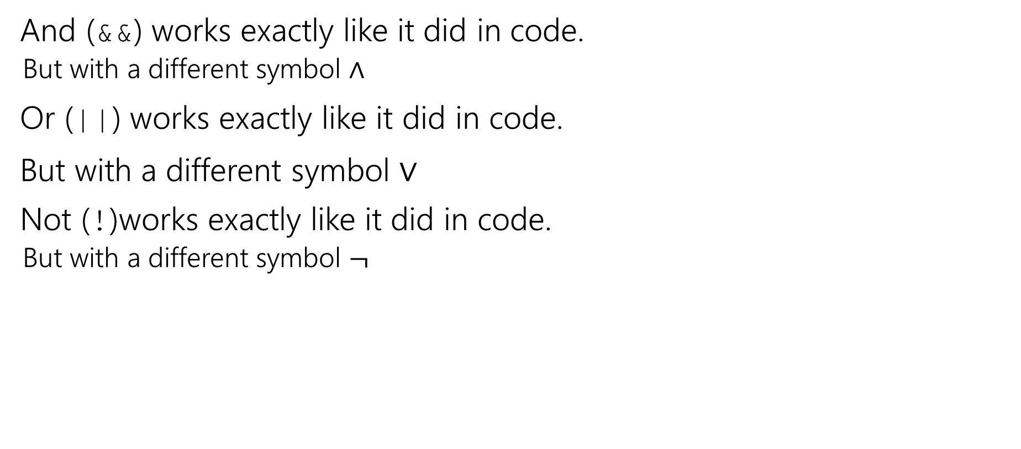
Logical Connectives
And (&&) works exactly like it did in code.
But with a different symbol $∧$
Or (||) works exactly like it did in code.
But with a different symbol $∨$
Not (!)works exactly like it did in code.
But with a different symbol $¬$

Slide 29
Some Truth Tables
p | ¬p
p | q | p ∧ q
p | q | p ∨ q
Truth tables are the simplest way to describe how logical connectives operate.

Slide 30
Some Truth Tables
p | ¬p
T | F
F | T
p | q | p ∧ q
T | T | T
T | F | F
F | T | F
F | F | F
p | q | p ∨ q
T | T | T
T | F | T
F | T | T
F | F | F
Truth tables are the simplest way to describe how logical connectives operate.

Slide 31

Implication
Another way to connect propositions
If $p$ then $q$.
“If it is raining, then I have my umbrella.”
$p→q$
Think of an implication as a promise.

Slide 32
Implication
p | q | p → q
T | T | T
T | F | F
F | T | T
F | F | T
The first two lines should match your intuition.
The last two lines are called “vacuous truth.” For now, they’re the definition. We’ll explain why in a few lectures.
This is the definition of implication.
When you write “if…then…” in a piece of mathematical English, this is how you will be interpreted.

Slide 33
Implication ($p→q)$
“If it’s raining, then I have my umbrella”
It’s useful to think of implications as promises. An implication is false exactly when you can demonstrate I’m lying.
p | q | p → q
T | T | T
T | F | F
F | T | T
F | F | T
 | It’s raining | It’s not raining
I have my umbrella
I do not have my umbrella

Slide 34
Implication ($p→q)$
“If it’s raining, then I have my umbrella”
It’s useful to think of implications as promises. An implication is false exactly when you can demonstrate I’m lying.
p | q | p → q
T | T | T
T | F | F
F | T | T
F | F | T
 | It’s raining | It’s not raining
I have my umbrella | No lie. True | No lie. True
I do not have my umbrella | LIE! False | No lie. True

Slide 35
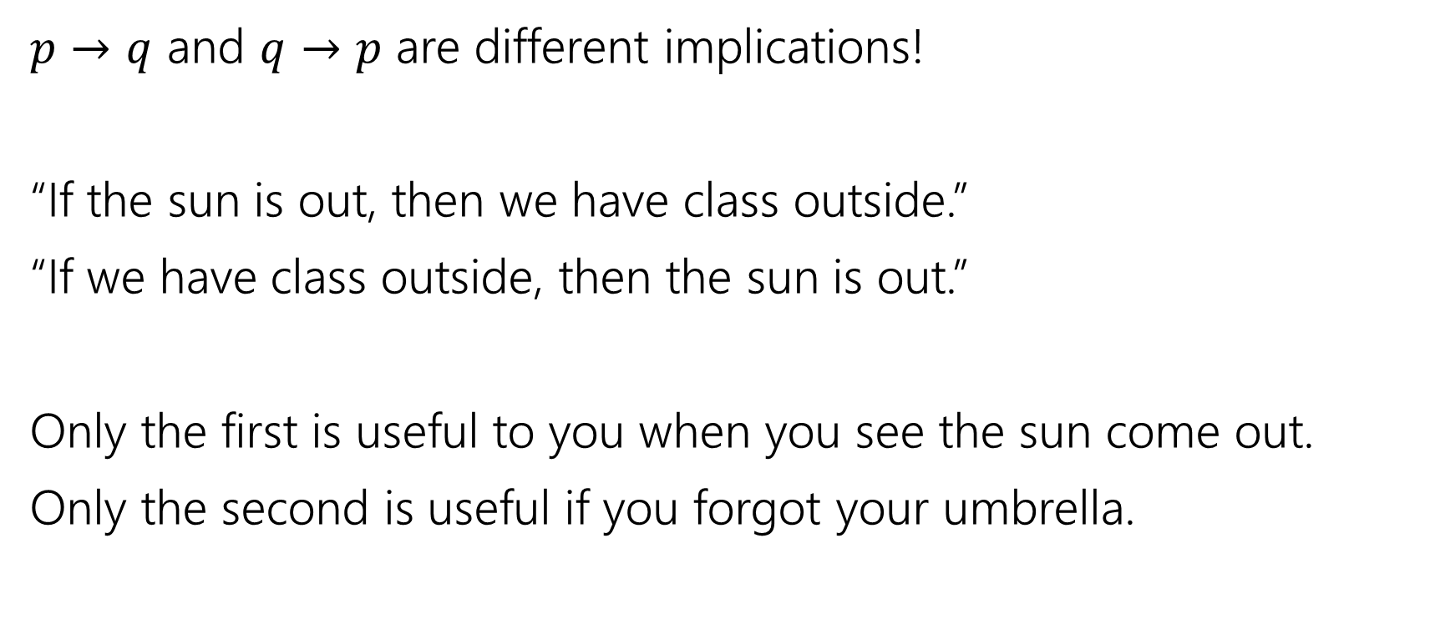
$$p → q$$
$p→q$ and $q→p$ are different implications!
“If the sun is out, then we have class outside.”
“If we have class outside, then the sun is out.”
Only the first is useful to you when you see the sun come out.
Only the second is useful if you forgot your umbrella.

Slide 36
$$p → q$$
p | q | p → q
T | T | T
T | F | F
F | T | T
F | F | T
Implication:
p implies q
whenever p is true q must be true
if p then q
q if p
p is sufficient for q
p only if q
q is necessary for p
Implications are super useful, so there are LOTS of translations.
You’ll learn these in detail in section.

Slide 37
A More Complicated Statement
“Robbie knows the Pythagorean Theorem if he is a mathematician and took geometry, and he is a mathematician or did not take geometry.”
Is this a proposition?
We’d like to understand what this proposition means.
In particular, is it true?

Slide 38
A Compound Proposition
“Robbie knows the Pythagorean Theorem if he is a mathematician and took geometry, and he is a mathematician or did not take geometry.”
We’d like to understand what this proposition means.
First find the simplest (atomic) propositions:
$p$ “Robbie knows the Pythagorean Theorem”
$q$ “Robbie is a mathematician”
$r$ “Robbie took geometry”
($p$ if ($q$ and $r$)) and ($q$ or (not $r$))
($p$ if ($q$ $∧$ $r$)) $∧$ ($q$ $∨$ ($¬r$))

Slide 39
A Compound Proposition
“Robbie knows the Pythagorean Theorem if he is a mathematician and took geometry, and he is a mathematician or did not take geometry.”
$p$ “Robbie knows the Pythagorean Theorem”
$q$ “Robbie is a mathematician”
$r$ “Robbie took geometry”
($p$ if ($q$ $∧$ $r$)) $∧$ ($q$ $∨$ ($¬r$))
How did we know where to put the parentheses?
Subtle English grammar choices (top-level parentheses are independent clauses).
Context/which parsing will make more sense.
Conventions
A reading on this is coming soon!

Slide 40
Back to the Compound Proposition…
“Robbie knows the Pythagorean Theorem if he is a mathematician and took geometry, and he is a mathematician or did not take geometry.”
($p$ if ($q$ $∧$ $r$)) $∧$ ($q$ $∨$ ($¬r$))
$p$ “Robbie knows the Pythagorean Theorem”
$q$ “Robbie is a mathematician”
$r$ “Robbie took geometry”
What promise am I making?
( ($q$ $∧$ $r$)$→p$) $∧$ ($q$ $∨$ ($¬r$))
($p$ $→$ ($q$ $∧$ $r$)) $∧$ ($q$ $∨$ ($¬r$))
The first one! Being a mathematician and taking geometry goes with the “if” knowing the Pythagorean Theorem is the consequence.

Slide 41
Breakout Rooms
We’ll use breakout rooms to give you a chance to try problems with other students.
Why? It works!
https://www.pnas.org/content/111/23/8410 a meta-analysis of 225 studies.
Just listening to me isn’t as good for you as listening to me then trying problems on your own and with each other.

Slide 42
Breakout Rooms
Every lecture we’ll give you an activity to do in the breakout rooms.
Directions are in Activity pdf
Go to cs.uw.edu/311 and get that pdf!

Slide 43
Lecture 1 Activity
Practice filling out a poll everywhere for Activity Credit!
Go to pollev.com/cse311 and login with your UW identity
Or text cse311 to 22333
Introduce yourselves!
If you can turn your video on, please do.
If you can’t, please unmute and say hi.
If you can’t do either, say “hi” in chat.
Choose someone to share screen, showing this pdf.
Answer these “get to know you” questions until you’re pulled back to the main room.
What is your favorite socially-distanced activity?
What class are you most excited about this quarter?
And why is it 311?
Found a new friend? A new study group? Share your emails!

Slide 44
Todo
Tonight: Pre-course survey on canvas.
Make sure you can access the Ed discussion board
Tomorrow:
Go to section
Soon:
Form a study group!

