Slide 1
Normal Forms and Predicates
CSE 311 Spring 2022
Lecture 4

Slide 2
Announcements
We’re putting resources on the resources page:
The list of logical equivalences
A Translation Tips reading (for going from English to Logic)
Might be useful if you’re still working on homework 1.
There’s a lot of other resources on the page that will be useful as we get further along (e.g. reference sheets for particular topics).
We’ll try to remind you about important ones, but it’s good to keep in mind that it’s there.

Slide 3
Our First Proof
$\left(p∧q\right)∨\left(¬p∧q\right)∨(¬p∧¬q)$
$≡\left(p∧q\right)∨[\left(¬p∧q\right)∨\left(¬p∧¬q\right)]$
$≡\left(p∧q\right)∨\left[¬p∧\left(q∨¬q\right)\right]$
$≡\left(p∧q\right)∨[¬p∧T]$
$≡\left(p∧q\right)∨[¬p]$
$≡\left[¬p\right]∨(p∧q)$
$≡\left(¬p∨p\right)∧\left(¬p∨q\right)$
$≡\left(p∨¬p\right)∧(¬p∨q)$
$≡T∧\left(¬p∨q\right)$
$≡$ $\left(¬p∨q\right)∧T$
$≡(¬p∨q)$
Associative
Distributive
Negation
Identity
Commutative
Distributive
Commutative
Negation
Commutative
Identity
The last two terms are “vacuous truth” – they simplify to $¬p$
$p$ no longer matters in $p∧q$ if $¬p$ automatically makes the expression true.

Slide 4
More on Our First Proof
With practice (and quite a bit of squinting) you can see not just the ironclad guarantee, but also the reason why something is true.
That’s not easy with a truth table.
Proofs can also communicate intuition about why a statement is true.
We’ll practice extracting intuition from proofs more this quarter.

Slide 5
Modifying Implications

Slide 6
Converse, Contrapositive
Implication:
p → q
Converse:
q → p
Contrapositive:
¬q → ¬p
Inverse:
¬p → ¬q
If it’s raining, then I have my umbrella.
If I don’t have my umbrella, then it is not raining.
If I have my umbrella, then it is raining.
If it is not raining, then I don’t have my umbrella.
How do these relate to each other?
p | q | p → q | q → p | ¬p | ¬q | ¬p → ¬q | ¬q → ¬p
T | T
T | F
F | T
F | F

Slide 7
Converse, Contrapositive
Implication:
p → q
Converse:
q → p
Contrapositive:
¬q → ¬p
Inverse:
¬p → ¬q
An implication and its contrapositive have the same truth value!
p | q | p → q | q → p | ¬p | ¬q | ¬p → ¬q | ¬q → ¬p
T | T | T | T | F | F | T | T
T | F | F | T | F | T | T | F
F | T | T | F | T | F | F | T
F | F | T | T | T | T | T | T

Slide 8
Contrapositive
We showed $p→q≡¬q→¬p$ with a truth table. Let’s do a proof.
Try this one on your own. Remember
Know what you’re trying to show.
Stay on target – take steps to get closer to your goal.
Hint: think about your tools.
There are lots of rules with AND/OR/NOT,
but very few with implications…
pollev.com/uwcse311
Help me adjust my explanation!

Slide 9
Contrapositive
$p→q$
$≡¬p∨q$
$≡q∨¬p$
$≡¬¬q∨¬p$
$≡¬q→¬p$
Law of Implication
Commutativity
Double Negation
Law of Implication
All of our rules deal with ORs and ANDs, let’s switch the implication to just use AND/NOT/OR.
And do the same with our target
It’s ok to work from both ends. In fact it’s a very common strategy!
Now how do we get the top to look like the bottom?
Just a few more rules and we’re done!

Slide 10
Work from both ends, but…
…make sure at the end, if you read from top-to-bottom, every step makes sense.
When proving an equivalence you must: 1. Start with the left side (or right side)
2. Modify what you had in the last step (using an equivalence)
3. Derive the right side (or left side if you started with the right)
You may not start with the equivalence you’re trying to show, and simplify to something “obviously true.”
More on why later in the quarter, but tl;dr for now is you can’t use your goal as a starting assumption (it’s what you’re trying to show! If you knew it, no need to write a proof).

Slide 11
Today
More notation
Wrap up digital logic with “standard” ways to read propositions from truth tables.
Predicate logic – how do we handle logic with more than one “entity”

Slide 12
On notation…
Logic is fundamental. Computer scientists use it in programs, mathematicians use it in proofs, engineers use it in hardware, philosophers use it in arguments,….
…so everyone uses different notation to represent the same ideas.
Since we don’t know exactly what you’re doing next, we’re going to show you a bunch of them; but don’t think one is “better” than the others!

Slide 13
Digital Logic

Slide 14
Digital Circuits
Computing With Logic
T corresponds to 1 or “high” voltage
F corresponds to 0 or “low” voltage
Gates
Take inputs and produce outputs (functions)
Several kinds of gates
Correspond to propositional connectives (most of them)

Slide 15
And Gate
AND Connective
vs.
AND Gate
p ∧ q
p
AND
OUT
q
p | q | p ∧ q
T | T | T
T | F | F
F | T | F
F | F | F
p | q | OUT
1 | 1 | 1
1 | 0 | 0
0 | 1 | 0
0 | 0 | 0
p
q
AND
OUT
“block looks like D of AND”

Slide 16
Or Gate
OR Connective
vs.
OR Gate
p ∨ q
p
OR
OUT
q
p | q | p ∨ q
T | T | T
T | F | T
F | T | T
F | F | F
p | q | OUT
1 | 1 | 1
1 | 0 | 1
0 | 1 | 1
0 | 0 | 0
p
OR
OUT
q
“arrowhead block looks like V”

Slide 17
Not Gates
NOT Connective
vs.
NOT Gate
¬p
p
NOT
OUT
Also called
inverter
p | ¬ p
T | F
F | T
p | OUT
1 | 0
0 | 1
p
NOT
OUT

Slide 18
Blobs are Okay!
You may write gates using blobs instead of shapes!
p
q
AND
OUT
p
q
OR
OUT
p
NOT
OUT

Slide 19
Combinational Logic Circuits
p
NOT
AND
OUT
q
NOT
AND
r
s
OR
Values get sent along wires connecting gates

Slide 20
Combinational Logic Circuits
p
NOT
AND
OUT
q
NOT
AND
r
s
OR
Values get sent along wires connecting gates

Slide 21
Combinational Logic Circuits
p
AND
q
NOT
OR
OUT
r
AND
Wires can send one value to multiple gates!

Slide 22
Combinational Logic Circuits
p
AND
q
NOT
OR
OUT
r
AND
Wires can send one value to multiple gates!
$$\left(p∧¬q \right)∨(¬q∧r)$$

Slide 23
More Practice
In Fall Quarters, we spend about half-a-lecture building out a circuit to represent a moderately complicated function.
It’s 50% a way to practice with the different notation, 50% fun historical context (people used to build circuits by-hand a lot. It’s less common now – decent programs exist to do it now).
If you want to get that extra practice, I’ll post an extra video with that content.
But you’ll also have practice in section if you would rather get the content that way.
There are no new principles/ideas here. Only new ways of representing them.

Slide 24
More Vocabulary

Slide 25
Vocabulary!
Tautology if it is always true.
Contradiction if it is always false.
Contingency if it can be both true and false.
A proposition is a….
$$p∨¬p$$
Tautology
If $p$ is true, $p∨¬p$ is true; if $p$ is false, $p∨¬p$is true.
$$p⊕p$$
Contradiction
If $p$ is true, $p⊕p$ is false; if $p$ is false, $p⊕p$is false.
$$\left(p→q\right)∧p$$
Contingency If $p$ is true and $q$ is true, $\left(p→q\right)∧p$is true;
If $p$ is true and $q$ is false, $\left(p→q\right)∧p$is false.

Slide 26
Meet Boolean Algebra
Preferred by some mathematicians and circuit designers.
“or” is $+$
“and” is $⋅$ (i.e. “multiply”)
“not” is ‘ (an apostrophe after a variable)
Why?
Mathematicians like to study “operations that work kinda like ‘plus’ and ‘times’ on integers.”
Circuit designers have a lot of variables, and this notation is more compact.

Slide 27
Meet Boolean Algebra
Name | Variables | “True/False” | “And” | “Or” | “Not” | Implication
Java Code | boolean b | true,false | && | || | ! | No special symbol
Propositional Logic | $$"p,q,r"$$ | T, F | $$∧$$ | $$∨$$ | $$¬$$ | $$→$$
Circuits | Wires | 1, 0 |  |  |  | No special symbol
Boolean Algebra | $$a,b,c$$ | 1,0 | $$⋅$$ (“multiplication”) | $$+$$ (“addition”) | $$′$$ (apostrophe after variable) | No special symbol
Propositional logic
Boolean Algebra
$$\left(p∧q∧r\right)∨s∨¬t$$
$$pqr+s+t′$$

Slide 28
Comparison
Propositional logic
Boolean Algebra
$$\left(p∧q∧r\right)∨s∨¬t$$
$$pqr+s+t′$$
Remember this is just an alternate notation for the same underlying ideas.
So that big list of identities? Just change the notation and you get another big list of identities!
Sometimes names are different (“involution” instead of “double negation”), but the core ideas are the same.

Slide 29
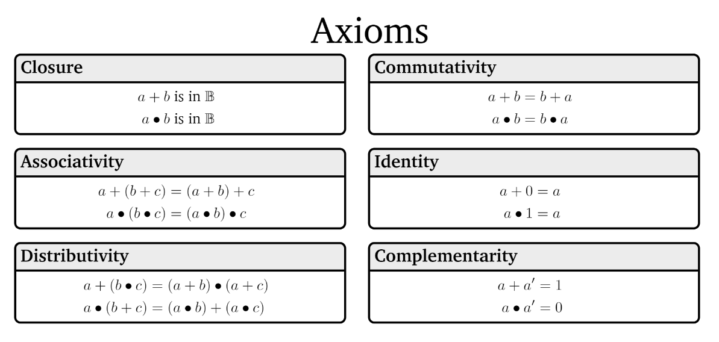
Boolean Algebra

Slide 30
Boolean Algebra

Slide 31
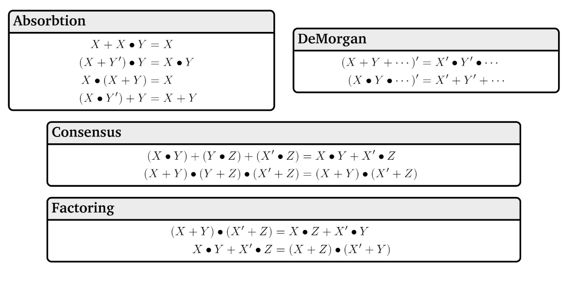
Boolean Algebra

Slide 32
A Few Fun Facts
That you’re not responsible for:
The identities are divided into “axioms” and “theorems”
Mathematicians (and some computer scientists, like me ☺ ) will sometimes study what minimum starting points (“the axioms”) will be enough to derive all the usual facts we rely on (“the theorems”)
That’s what I meant by “operations that work kinda like plus and times”
For our purposes, we won’t make a distinction here, but we will use similar thinking later in the course.
Boolean algebra makes things like commutativity axioms (starting points, things we assume) with propositional logic, we start from the truth tables and can derive that commutativity is true. For this class, though, it’s a fact you can use either way.

Slide 33
Why ANOTHER way of writing down logic?
This is the third one!?
Because, in your future courses, you’ll use any/all of them.
Remember there aren’t new concepts here, just new representations.
We mostly use propositional notation ($∧,∨,¬,$etc.) but we’ll use them all a bit so you’re ready for any of them in your future courses.
Practice in section and on homework.

Slide 34
Canonical Forms
Back to the old notation.

Slide 35
Canonical Forms
A truth table is a unique representation of a Boolean Function.
If you describe a function, there’s only one possible truth table for it.
Given a truth table you can find many circuits and many compound prepositions to represent it.
Think back to when we were developing the law of implication…
It would be nice to have a “standard” proposition (or standard circuit) we could always write as a starting point.
So we have a (possibly) shorter way of telling if we have the same function.

Slide 36
Using Our Rules
WOW that was a lot of rules.
Why do we need them? Simplification!
Let’s go back to the “law of implication” example.
$p$ | $q$ | $$p→q$$
T | T | T
T | F | F
F | T | T
F | F | T
When is the implication true? Just “or” each of the three “true” lines!
$$\left(p∧q\right)∨\left(¬p∧q\right)∨(¬p∧¬q)$$
Also seems pretty reasonable
So is $\left(p∧q\right)∨\left(¬p∧q\right)∨\left(¬p∧¬q\right)≡(¬p∨q)$
i.e. are these both alternative representations of $p→q$?

Slide 37
Disjunctive Normal Form (DNF)
a.k.a. OR of ANDs
a.k.a Sum-of-Products Form
a.k.a. Minterm Expansion
Read the true rows of the truth table
AND together all the settings in a given (true) row.
OR together the true rows.

Slide 38
Disjunctive Normal Form
Read the true rows of the truth table
AND together all the settings in a given (true) row.
OR together the true rows.
$p$ | $q$ | $$G(p,q)$$
T | T | T
T | F | F
F | T | T
F | F | F
$$p∧q$$
$$¬p∧q$$
$$G\left(p,q\right)≡\left(p∧q\right)∨(¬p∧q)$$

Slide 39
Another Canonical Form
DNF is a great way to represent functions that are usually false.
If there are only a few true rows, the representation is short.
What about functions that are usually true?
Well $G$ is equivalent to $¬¬G$, and $¬G$ is a function that is usually false.
Let’s try taking the Sum-of-Products of $¬G$ and negating it.

Slide 40
Another Canonical Form
Read the true rows of the truth table
AND together all the settings in a given (true) row.
OR together the true rows.
$p$ | $q$ | $$G(p,q)$$ | $$¬G(p,q)$$
T | T | T | F
T | F | F | T
F | T | T | F
F | F | F | T
$$p∧¬q$$
$$¬p∧¬q$$
$$¬G\left(p,q\right)≡\left(p∧¬q\right)∨(¬p∧¬q)$$
$$G\left(p,q\right)≡¬[\left(p∧¬q\right)∨\left(¬p∧¬q\right)]$$
$$G\left(p,q\right)≡\left[¬\left(p∧¬q\right)∧¬\left(¬p∧¬q\right)\right]$$
$$G\left(p,q\right)≡[\left(¬p∨q\right)∧\left(p∨q\right)]$$
This is not in Disjunctive Normal Form! It’s something else, though…

Slide 41
Conjunctive Normal Form
a.k.a. AND of ORs
a.k.a. Product-of-Sums Form
a.k.a. Maxterm Expansion
Read the false rows of the truth table
OR together the negations of all the settings in the false rows.
AND together the false rows.
Or take the DNF of the negation of the function you care about, and distribute the negation.

Slide 42
Normal Forms
Don’t simplify any further! Don’t factor anything out (even if you can). The point of the canonical form is we know exactly what it looks like, you might simplify differently than someone else.
Why? Easier to understand for people.
Inside the parentheses are only ORs between the parentheses are only ANDs (or vice versa).
You’ll use these more in later courses.

Slide 43
Predicate Logic

Slide 44
Predicate Logic
So far our propositions have worked great for fixed objects.
What if we want to say “If $x>10$ then $x^{2}>100.$”
$x>10$ isn’t a proposition. Its truth value depends on $x$.
We need a function that can take in a value for $x$ and output True or False as appropriate.

Slide 45
Predicates
A function that outputs true or false.
Predicate
Cat(x):= “x is a cat”
Prime(x) := “x is prime”
LessThan(x,y):= “x$<$y”
Sum(x,y,z):= “x$+$y$=$z”
HasNChars(s,n):= “string s has length n”
Numbers and types of inputs can change. Only requirement is output is Boolean.

Slide 46
Analogy
Propositions were like Boolean variables.
What are predicates? Functions that return Booleans
public boolean predicate(…)

Slide 47
Translation
Translation works a lot like when we just had propositions.
Let’s try it…
$x$ is prime or $x^{2}$ is odd or $x=2$.
Prime$\left(x\right)∨$Odd$\left(x^{2}\right)∨$Equals$\left(x,2\right)$

Slide 48
Domain of Discourse
$x$ is prime or $x^{2}$ is odd or $x=2$.
Prime$\left(x\right)∨$Odd$\left(x^{2}\right)∨$Equals$\left(x,2\right)$
Can $x$ be 4.5? What about “abc” ?
I never intended you to plug 4.5 or “abc” into $x$.
When you read the sentence you probably didn’t imagine plugging those values in….

Slide 49
Domain of Discourse
$x$ is prime or $x^{2}$ is odd or $x=2$.
Prime$\left(x\right)∨$Odd$\left(x^{2}\right)∨$Equals$\left(x,2\right)$
To make sure we can’t plug in 4.5 for $x,$predicate logic requires deciding on the types we’ll allow
The types of inputs allowed in our predicates.
Domain of Discourse

Slide 50
Try it…
What’s a possible domain of discourse for these lists of predicates?
“$x$ is a cat”, “$x$ barks”, “$x$ likes to take walks”
“$x$ is prime”, “$x$=5” “$x<20“$ “$x$ is a power of two”
“$x$ is enrolled in course $y$”, “$y$ is a pre-req for $z"$

Slide 51
Try it…
What’s a possible domain of discourse for these lists of predicates?
“$x$ is a cat”, “$x$ barks”, “$x$ likes to take walks”
“$x$ is prime”, “$x$=5” “$x<20“$ “$x$ is a power of two”
“$x$ is enrolled in course $y$”, “$y$ is a pre-req for $z"$
“Mammals”, “pets”, “dogs and cats”, …
“positive integers”, “integers”, “numbers”, …
“objects in the university course enrollment system”, “university entities”, “students and courses”, …
More than one domain of discourse might be reasonable…if it might affect the meaning of the statement, we specify it.

Slide 52
Quantifiers
Now that we have variables, let’s really use them…
We tend to use variables for two reasons:
The statement is true for every $x$, we just want to put a name on it.
There’s some $x$ out there that works, (but I might not know which it is, so I’m using a variable).

Slide 53
Quantifiers
We have two extra symbols to indicate which way we’re using the variable.
The statement is true for every $x$, we just want to put a name on it.
$∀x (p\left(x\right)∧q\left(x\right))$ means “for every $x$ in our domain, $p(x)$ and $q(x)$ both evaluate to true.”
There’s some $x$ out there that works, (but I might not know which it is, so I’m using a variable).
$∃x(p\left(x\right)∧q\left(x\right))$ means “there is an $x$ in our domain, such that $p(x)$ and $q\left(x\right)$ are both true.

Slide 54
Quantifiers
We have two extra symbols to indicate which way we’re using the variable.
The statement is true for every $x$, we just want to put a name on it.
$∀x (p\left(x\right)∧q\left(x\right))$ means “for every $x$ in our domain, $p(x)$ and $q(x)$ both evaluate to true.”
There’s some $x$ out there that works, (but I might not know which it is, so I’m using a variable).
$∃x(p\left(x\right)∧q\left(x\right))$ means “there is an $x$ in our domain, $p(x)$ and $q\left(x\right)$ are both true.
“$∀x“$
“for each $x$”, “for every $x$”, “for all $x$” are common translations
Remember: upside-down-A for All.
Universal Quantifier

Slide 55
Quantifiers
“$∃x“$
“there is an $x$”, “there exists an $x$”, “for some $x$” are common translations
Remember: backwards-E for Exists.
Existential Quantifier
We have two extra symbols to indicate which way we’re using the variable.
The statement is true for every $x$, we just want to put a name on it.
$∀x (p\left(x\right)∧q\left(x\right))$ means “for every $x$ in our domain, $p(x)$ and $q(x)$ both evaluate to true.”
There’s some $x$ out there that works, (but I might not know which it is, so I’m using a variable).
$∃x(p\left(x\right)∧q\left(x\right))$ means “there is an $x$ in our domain, for which $p(x)$ and $q\left(x\right)$ are both true.

Slide 56
Translations
“For every $x$, if $x$ is even, then $x=2$.”
“There are $x,y$ such that $x<y$.”
$∃x ($Odd$\left(x\right)∧$LessThan$\left(x,5\right))$
$∀y ($Even$\left(y\right)∧$Odd$\left(y\right))$
pollev.com/uwcse311
Help me adjust my explanation!

Slide 57
Translations
“For every $x$, if $x$ is even, then $x=2$.”
“There are $x,y$ such that $x<y$.”
$∃x ($Odd$\left(x\right)∧$LessThan$\left(x,5\right))$
$∀y ($Even$\left(y\right)∧$Odd$\left(y\right))$
$∀x($Even$\left(x\right)→$Equal$\left(x,2\right))$
$∃x∃y($LessThan$\left(x,y\right))$
There is an odd number that is less than 5.
All numbers are both even and odd.

Slide 58
Translations
More practice in section and on homework.
Also a reading on the webpage –
An explanation of why “for any” is not a great way to translate $∀$(even though it looks like a good option on the surface)
More information on what happens with multiple quantifiers (we’ll discuss more next week).

Slide 59
Evaluating Predicate Logic
“For every $x$, if $x$ is even, then $x=2$.” / $∀x($Even$\left(x\right)→$Equal$\left(x,2\right))$
Is this true?

Slide 60
Evaluating Predicate Logic
“For every $x$, if $x$ is even, then $x=2$.” / $∀x($Even$\left(x\right)→$Equal$\left(x,2\right))$
Is this true?
TRICK QUESTION! It depends on the domain.
Prime Numbers | Positive Integers | Odd integers
True | False | True (vacuously)

Slide 61
One Technical Matter
How do we parse sentences with quantifiers?
What’s the “order of operations?”
We will usually put parentheses right after the quantifier and variable to make it clear what’s included. If we don’t, it’s the rest of the expression.
Be careful with repeated variables…they don’t always mean what you think they mean.
$∀x\left(P\left(x\right)\right)∧∀x(Q\left(x\right))$ are different $x$’s.

Slide 62
More Practice
Let your domain of discourse be fruits.
There is a fruit that is tasty and ripe.
For every fruit, if it is not ripe then it is not tasty.
There is a fruit that is sliced and diced.
$∃x($Tasty$\left(x\right)∧$Ripe$\left(x\right))$
$∀x(¬$Ripe$\left(x\right)→¬\text{Tasty}\left(x\right))$
$∃x($Sliced$\left(x\right)∧\text{Diced}\left(x\right))$

Slide 63
Properties of Logical Connectives
For every propositions $p,q,r$ the following hold:
DeMorgan’s Laws
– $¬\left(p∨q\right)≡¬p∧¬q$
– $¬\left(p∧q\right)≡¬p∨¬q$
Double Negation
$¬¬p≡p$
Law of Implication
$p→q≡¬p∨q$
Contrapositive
$p→q≡¬q→¬p$

