Slide 1
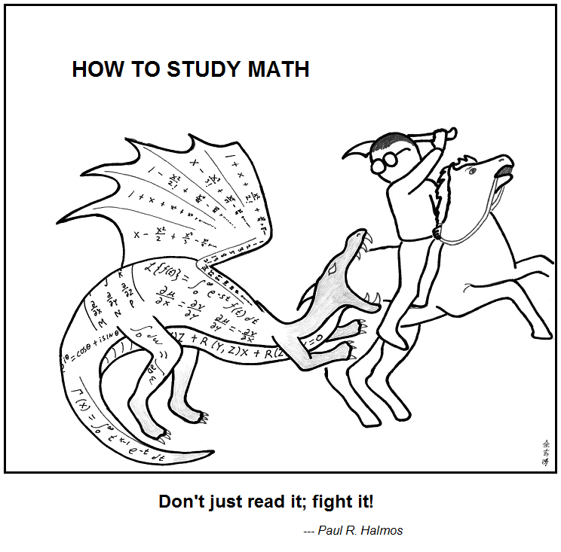
Number Theory
https://abstrusegoose.com/353
CSE 311 Spring 2022
Lecture 11

Slide 2
Proof By Cases
Let $A=\{x :$ Prime$(x)\}$, $B=\{x:$ Odd$\left(x\right)∨$ PowerOfTwo$(x)\}$
Where PowerOfTwo$\left(x\right)≔∃c($Integer$\left(c\right)∧x=2^c)$
Prove $A⊆B$
We need two different arguments – one for 2 and one for all the other primes…

Slide 3
Proof By Cases
Let $x$ be an arbitrary element of $A$.
We divide into two cases.
Case 1: $x$ is even
If $x$ is even and an element of $A$(i.e. both even and prime) it must be $2$.
So it equals $2^c$ for $c=1$, and thus is in $B$ by definition of $B.$
Case 2: $x$ is odd
Then $x∈B$ by satisfying the first requirement in the definition of $B$.
In either case, $x∈B$. Since an arbitrary element of $A$ is also in $B$, we have $A⊆B$.

Slide 4
Proof By Cases (Skeleton)
We divide into cases based on []
Case 1: [condition for case 1]
[suppose condition and arrive at target]
Case 2: [condition for case 2]
[suppose condition and arrive at target]
[more cases if necessary]
In every case we have [target].
Often the [target] is an intermediate one and you need a few more steps and/or a conclusion.

Slide 5
Proof By Cases
Make it clear how you decide which case your in.
It should be obvious your cases are “exhaustive”
Reach the same conclusion in each of the cases, and you can say you’ve got that conclusion no matter what (outside the cases).
Advanced version: sometimes you end up arguing a certain case “can’t happen”

Slide 6
Two More Set Operations
Given a set, let’s talk about it’s powerset.
$𝒫\left(A\right)=\{X:X$ is a subset of $A\}$
The powerset of $A$ is the set of all subsets of $A.$
$𝒫\left(\left\{1,2\right\}\right)=\{∅, \left\{1\right\}, \left\{2\right\}, \left\{1,2\right\}\}$

Slide 7
Two More Set Operations
$A×B=\left\{\left(a,b\right):a∈A∧b∈B\right\}$
Called “the Cartesian product” of $A$ and $B$.
$ℝ×ℝ$ is the “real plane” ordered pairs of real numbers.
$\left\{1,2\right\}×\left\{1,2,3\right\}=\{\left(1,1\right),\left(1,2\right),\left(1,3\right), \left(2,1\right), \left(2,2\right), \left(2,3\right)\}$

Slide 8
Read on Your Own

Slide 9
Some old friends (and some new ones)
ℕ is the set of Natural Numbers; ℕ = {0, 1, 2, …}
ℤ is the set of Integers; ℤ = {…, -2, -1, 0, 1, 2, …}
ℚ is the set of Rational Numbers; e.g. ½, -17, 32/48
ℝ is the set of Real Numbers; e.g. 1, -17, 32/48, π,$\sqrt{2}$
[n] is the set {1, 2, …, n} when n is a positive integer
{} = ∅ is the empty set; the only set with no elements

Slide 10
Some old friends (and some new ones)
Our natural numbers start at $0$.
Common in CS, other resources start at $1$.
ℕ is the set of Natural Numbers; ℕ = {0, 1, 2, …}
ℤ is the set of Integers; ℤ = {…, -2, -1, 0, 1, 2, …}
ℚ is the set of Rational Numbers; e.g. ½, -17, 32/48
ℝ is the set of Real Numbers; e.g. 1, -17, 32/48, π,$\sqrt{2}$
[n] is the set {1, 2, …, n} when n is a positive integer
{} = ∅ is the empty set; the only set with no elements
In LaTeX \mathbb{R}
In Office \doubleR
Use this symbol not {}.
In LaTex \varnothing In Office \emptyset.

Slide 11
More connectors!
$A∖B$ “A minus B”
$A⊕B$ “XOR” (also called “symmetric difference”)
$$A∖B=\{x:x∈A∧x∉B\}$$
$$A⊕B=\{x:x∈A⊕x∈B\}$$

Slide 12
Number Theory

Slide 13
Why Number Theory?
Applicable in Computer Science
“hash functions” (you’ll see them in 332) commonly use modular arithmetic
Much of classical cryptography is based on prime numbers.
More importantly, a great playground for writing English proofs.

Slide 14
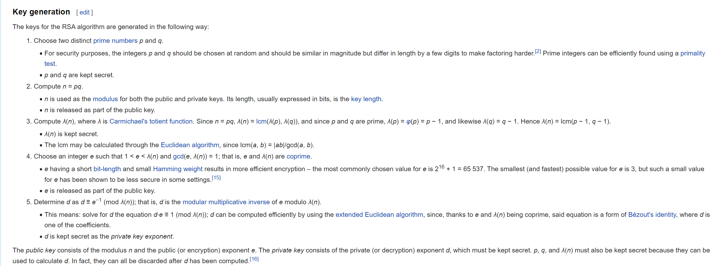
Framing Device
We’re going to give you enough background to (mostly) understand the RSA encryption system.

Slide 15
Framing Device
We’re going to give you enough background to (mostly) understand the RSA encryption system.
Prime Numbers
Modular Arithmetic
Modular Multiplicative Inverse
Bezout’s Theorem
Extended Euclidian Algorithm

Slide 16
Framing Device
We’re going to give you enough background to (mostly) understand the RSA encryption system.

Slide 17
Framing Device
We’re going to give you enough background to (mostly) understand the RSA encryption system.
Modular Exponentiation

Slide 18
Divides
For integers $x,y$ we say $x|y$ (“$x$ divides $y$”) iff there is an integer $z$ such that $xz=y.$
Divides
“$x$ is a divisor of $y$” or $"x$ is a factor of $y$” means (essentially) the same thing as $x$ divides $y$.
(“essentially” because of edge cases like when a number is negative or $y=0$)
“The small number goes first”

Slide 19
Divides
For integers $x,y$ we say $x|y$ (“$x$ divides $y$”) iff there is an integer $z$ such that $xz=y.$
Divides
Which of these are true?
$2|4$ $4|2$ $2|−2$
$5|0$ $0|5$ $1|5$

Slide 20
Divides
For integers $x,y$ we say $x|y$ (“$x$ divides $y$”) iff there is an integer $z$ such that $xz=y.$
Divides
Which of these are true?
$2|4$ $4|2$ $2|−2$
$5|0$ $0|5$ $1|5$
$$True$$
$$False$$
$$True$$
$$True$$
$$False$$
$$True$$

Slide 21
A useful theorem
For every $a∈ℤ$, $d∈ℤ$ with $d>0$
There exist unique integers $q,r$ with $0≤r<d$
Such that $a=dq+r$
The Division Theorem
Remember when non integers were still secret, you did division like this?
$q$ is the “quotient”
$r$ is the “remainder”

Slide 22
Unique
For every $a∈ℤ$, $d∈ℤ$ with $d>0$
There exist unique integers $q,r$ with $0≤r<d$
Such that $a=dq+r$
The Division Theorem
“unique” means “only one”….but be careful with how this word is used.
$r$ is unique, given $a,d$. – it still depends on $a,d$ but once you’ve chosen $a$ and $d$
“unique” is not saying $∃r∀a,d P(a,d,r)$ It’s saying $∀a,d∃r[P\left(a,d,r\right)∧\left[P\left(a,d,x\right)→x=r\right]]$

Slide 23
A useful theorem
For every $a∈ℤ$, $d∈ℤ$ with $d>0$
There exist unique integers $q,r$ with $0≤r<d$
Such that $a=dq+r$
The Division Theorem
The $q$ is the result of a/d (integer division) in Java
The $r$ is the result of a%d in Java
That’s slightly a lie, $r$ is always non-negative, Java’s % operator sometimes gives a negative number.

Slide 24
Terminology
You might have called the % operator in Java “mod”
We’re going to use the word “mod” to mean a closely related, but different thing.
Java’s % is an operator (like + or $⋅)$ you give it two numbers, it produces a number.
The word “mod” in this class, refers to a set of rules

Slide 25
Modular Arithmetic
“arithmetic mod 12” is familiar to you. You do it with clocks.
What’s 3 hours after 10 o’clock?
1 o’clock. You hit 12 and then “wrapped around”
“13 and 1 are the same, mod 12” “-11 and 1 are the same, mod 12”
We don’t just want to do math for clocks – what about if we need to talk about parity (even vs. odd) or ignore higher-order-bits (mod by 16, for example)

Slide 26
Modular Arithmetic
To say “the same” we don’t want to use $=$ … that means the normal $=$
We’ll write $13≡1(mod 12)$
$≡$ because “equivalent” is “like equal,” and the “modulus” we’re using in parentheses at the end so we don’t forget it.
(we’ll also say “congruent mod 12”)
The notation here is bad. We all agree it’s bad. Most people still use it.
$13≡_{12}1$ would have been better. “mod $12$” is giving you information about the $≡$ symbol, it’s not operating on $1.$

Slide 27
Modular Arithmetic
We need a definition! We can’t just say “it’s like a clock”
Pause what do you expect the definition to be?
Is it related to % ?

Slide 28
Modular Arithmetic
We need a definition! We can’t just say “it’s like a clock”
Pause what do you expect the definition to be?
Let $a∈ℤ, b∈ℤ, n∈ℤ$ and $n>0$.
We say $a≡b (mod n)$ if and only if $n|(b−a)$
Equivalence in modular arithmetic
Huh?

Slide 29
Long Pause
It’s easy to read something with a bunch of symbols and say “yep, those are symbols.” and keep going
STOP Go Back.
You have to fight the symbols they’re probably trying to pull a fast one on you.
Same goes for when I’m presenting a proof – you shouldn’t just believe me – I’m wrong all the time!
You should be trying to do the proof with me. Where do you think we’re going next?

Slide 30
Why?
We’ll post an optional (15-minute-ish) video over the weekend with why.
Here’s the short version:
It really is equivalent to ”what we expected” a%n=b%n if and only if $n|(b−a)$
The divides version is much easier to use in proofs…
$$27$$
When you subtract, the remainders cancel. What you’re left with is a multiple of 12.
$$15$$
$$27−15=12$$

Slide 31
Claim: for all $a,b,c,n∈ℤ,n≥0:$ $a≡b \left(mod n\right)→a+c≡b+c (mod n)$
Before we start, we must know:
1. What every word in the statement means.
2. What the statement as a whole means.
3. Where to start.
4. What your target is.
For integers $x,y$ we say $x|y$ (“$x$ divides $y$”) iff there is an integer $z$ such that $xz=y.$
Divides
Pollev.com/uwcse311
Let $a∈ℤ, b∈ℤ, n∈ℤ$ and $n>0$.
We say $a≡b (mod n)$ if and only if $n|(b−a)$
Equivalence in modular arithmetic

Slide 32
Claim: $a,b,c,n∈ℤ,n≥0:$ $a≡b \left(mod n\right)→a+c≡b+c (mod n)$
Proof:
Let $a,b,c,n$ be arbitrary integers with $n≥0$, and suppose $a≡b(mod n)$.
$a+c≡b+c (mod n)$
For integers $x,y$ we say $x|y$ (“$x$ divides $y$”) iff there is an integer $z$ such that $xz=y.$
Divides
Let $a∈ℤ, b∈ℤ, n∈ℤ$ and $n>0$.
We say $a≡b (mod n)$ if and only if $n|(b−a)$
Equivalence in modular arithmetic

Slide 33
A proof
Claim: $a,b,c,n∈ℤ,n≥0:$ $a≡b \left(mod n\right)→a+c≡b+c (mod n)$
Proof:
Let $a,b,c,n$ be arbitrary integers with $n>0$, and suppose $a≡b(mod n)$.
By definition of mod, $n|(b−a)$
By definition of divides, $nk=(b−a)$ for some integer $k$.
Adding and subtracting $c,$we have $nk=(\left[b+c\right]−\left[a+c\right])$.
Since $k$ is an integer $n|(\left[b+c\right]−\left[a+c\right])$
By definition of mod, $a+c≡b+c (mod n)$

Slide 34
You Try!
Claim: for all $a,b,c,n∈ℤ, n>0:$If $a≡b (mod n)$ then $ac≡bc (mod n)$
Before we start we must know:
1. What every word in the statement means.
2. What the statement as a whole means.
3. Where to start.
4. What your target is.
For integers $x,y$ we say $x|y$ (“$x$ divides $y$”) iff there is an integer $z$ such that $xz=y.$
Divides
Let $a∈ℤ, b∈ℤ, n∈ℤ$ and $n>0$.
We say $a≡b (mod n)$ if and only if $n|(b−a)$
Equivalence in modular arithmetic

Slide 35
Claim: for all $a,b,c,n∈ℤ, n>0:$If $a≡b (mod n)$ then $ac≡bc (mod n)$
Proof:
Let $a,b,c,n$ be arbitrary integers with $n>0$ and suppose $a≡b(mod n)$.
$ac≡bc (mod n)$

Slide 36
Claim: for all $a,b,c,n∈ℤ, n>0:$If $a≡b (mod n)$ then $ac≡bc (mod n)$
Proof:
Let $a,b,c,n$ be arbitrary integers with $n>0$ and suppose $a≡b(mod n)$.
By definition of mod $n|(b−a)$
By definition of divides, $nk=b−a$ for some integer $k$
Multiplying both sides by $c$, we have $n\left(ck\right)=bc−ac$.
Since $c$ and $k$ are integers, $n|(bc−ac)$ by definition of divides.
So, $ac≡bc (mod n)$, by the definition of mod.

Slide 37
Don’t lose your intuition!
Let’s check that we understand “intuitively” what mod means:
$x≡0 (mod 2)$
$−1≡19 (mod 5)$
$y≡2 (mod 7)$
“$x$is even” Note that negative (even) $x$ values also make this true.
This is true! They both have remainder $4$ when divided by $5$.
This is true as long as $y=2+7k$ for some integer $k$

Slide 38
Extra Set Practice

Slide 39
Extra Set Practice
Show $A∪\left(B∩C\right)=\left(A∪B\right)∩(A∪C)$
Proof: Firse, we’ll show: $A∪\left(B∩C\right)⊆\left(A∪B\right)∩(A∪C)$
Let $x$ be an arbitrary element of$A∪\left(B∩C\right)$.
Then by definition of $∪,∩$ we have:
$x∈A∨(x∈B∧x∈C)$
Applying the distributive law, we get $\left(x∈A∨x∈B\right)∧(x∈A∨x∈C)$
Applying the definition of union, we have:
$x∈(A∪B)$ and $x∈(A∪C)$
By definition of intersection we have $x∈\left(A∪B\right)∩(A∪C)$.
So $A∪\left(B∩C\right)⊆\left(A∪B\right)∩(A∪C)$.
Now we show $\left(A∪B\right)∩\left(A∪C\right)⊆A∪\left(B∩C\right)$
Let $x$ be an arbitrary element of $\left(A∪B\right)∩\left(A∪C\right).$
By definition of intersection and union, $\left(x∈A∨x∈B\right)∧(x∈A∨x∈C)$
Applying the distributive law, we have $x∈A∨(x ∈B∧x∈C)$
Applying the definitions of union and intersection, we have $x∈A∪(B∩C)$
So $\left(A∪B\right)∩\left(A∪C\right)⊆A∪\left(B∩C\right)$.
Combining the two directions, since both sets are subsets of each other, we have $A∪\left(B∩C\right)=\left(A∪B\right)∩(A∪C)$

Slide 40
Extra Set Practice
Suppose $A⊆B$. Show that $𝒫\left(A\right)⊆𝒫(B)$.
Let $A,B$ be arbitrary sets such that $A⊆B$.
Let $X$be an arbitrary element of $𝒫\left(A\right).$
By definition of powerset, $X⊆A$.
Since $X⊆A,$ every element of $X$ is also in $A.$And since $A⊆B$, we also have that every element of $X$ is also in $B$.
Thus $X∈𝒫(B)$ by definition of powerset.
Since an arbitrary element of $𝒫\left(A\right)$is also in $𝒫(B)$, we have $𝒫\left(A\right)⊆𝒫(B)$.

Slide 41
Extra Set Practice
Disprove: If $A⊆\left(B∪C\right)$ then $A⊆B$ or $A⊆C$
Consider $A=\left\{1,2,3\right\}, B=\left\{1,2\right\}, C=\left\{3,4\right\}.$
$B∪C=\{1,2,3,4\}$ so we do have $A⊆(B∪C)$, but $A⊈B$ and $A⊈C$.
When you disprove a $∀$, you’re just providing a counterexample (you’re showing $∃$) – your proof won’t have “let $x$ be an arbitrary element of $A.$”

