Slide 1
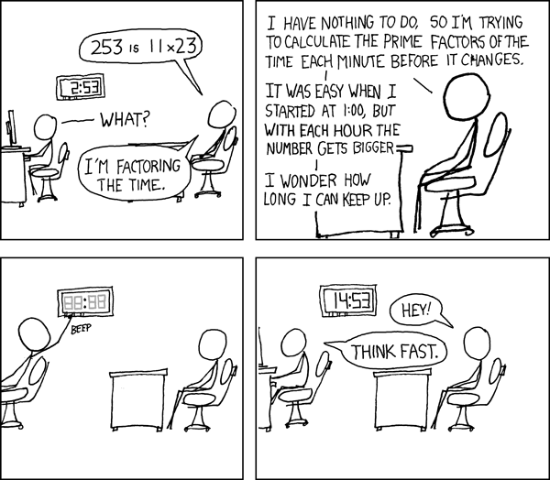
More Number Theory
xkcd.com/247
CSE 311 Spring 2022
Lecture 12

Slide 2
Modular Arithmetic
We need a definition! We can’t just say “it’s like a clock”
Pause what do you expect the definition to be?
Let $a∈ℤ, b∈ℤ, n∈ℤ$ and $n>0$.
We say $a≡b (mod n)$ if and only if $n|(b−a)$
Equivalence in modular arithmetic
Huh?

Slide 3
Long Pause
It’s easy to read something with a bunch of symbols and say “yep, those are symbols.” and keep going
STOP Go Back.
You have to fight the symbols they’re probably trying to pull a fast one on you.
Same goes for when I’m presenting a proof – you shouldn’t just believe me – I’m wrong all the time!
You should be trying to do the proof with me. Where do you think we’re going next?

Slide 4
Why?
We’ll post an optional (15-minute-ish) video over the weekend with why.
Here’s the short version:
It really is equivalent to ”what we expected” a%n=b%n if and only if $n|(b−a)$
The divides version is much easier to use in proofs…
$$27$$
When you subtract, the remainders cancel. What you’re left with is a multiple of 12.
$$15$$
$$27−15=12$$

Slide 5
Claim: for all $a,b,c,n∈ℤ,n>0:$ $a≡b \left(mod n\right)→a+c≡b+c (mod n)$
Before we start, we must know:
1. What every word in the statement means.
2. What the statement as a whole means.
3. Where to start.
4. What your target is.
For integers $x,y$ we say $x|y$ (“$x$ divides $y$”) iff there is an integer $z$ such that $xz=y.$
Divides
Pollev.com/uwcse311
Let $a∈ℤ, b∈ℤ, n∈ℤ$ and $n>0$.
We say $a≡b (mod n)$ if and only if $n|(b−a)$
Equivalence in modular arithmetic

Slide 6
Claim: $a,b,c,n∈ℤ,n>0:$ $a≡b \left(mod n\right)→a+c≡b+c (mod n)$
Proof:
Let $a,b,c,n$ be arbitrary integers with $n≥0$, and suppose $a≡b(mod n)$.
$a+c≡b+c (mod n)$
For integers $x,y$ we say $x|y$ (“$x$ divides $y$”) iff there is an integer $z$ such that $xz=y.$
Divides
Let $a∈ℤ, b∈ℤ, n∈ℤ$ and $n>0$.
We say $a≡b (mod n)$ if and only if $n|(b−a)$
Equivalence in modular arithmetic

Slide 7
A proof
Claim: $a,b,c,n∈ℤ,n>0:$ $a≡b \left(mod n\right)→a+c≡b+c (mod n)$
Proof:
Let $a,b,c,n$ be arbitrary integers with $n>0$, and suppose $a≡b(mod n)$.
By definition of mod, $n|(b−a)$
By definition of divides, $nk=(b−a)$ for some integer $k$.
Adding and subtracting $c,$we have $nk=(\left[b+c\right]−\left[a+c\right])$.
Since $k$ is an integer $n|(\left[b+c\right]−\left[a+c\right])$
By definition of mod, $a+c≡b+c (mod n)$

Slide 8
You Try!
Claim: for all $a,b,c,n∈ℤ, n>0:$If $a≡b (mod n)$ then $ac≡bc (mod n)$
Before we start we must know:
1. What every word in the statement means.
2. What the statement as a whole means.
3. Where to start.
4. What your target is.
For integers $x,y$ we say $x|y$ (“$x$ divides $y$”) iff there is an integer $z$ such that $xz=y.$
Divides
Let $a∈ℤ, b∈ℤ, n∈ℤ$ and $n>0$.
We say $a≡b (mod n)$ if and only if $n|(b−a)$
Equivalence in modular arithmetic

Slide 9
Claim: for all $a,b,c,n∈ℤ, n>0:$If $a≡b (mod n)$ then $ac≡bc (mod n)$
Proof:
Let $a,b,c,n$ be arbitrary integers with $n>0$ and suppose $a≡b(mod n)$.
$ac≡bc (mod n)$

Slide 10
Claim: for all $a,b,c,n∈ℤ, n>0:$If $a≡b (mod n)$ then $ac≡bc (mod n)$
Proof:
Let $a,b,c,n$ be arbitrary integers with $n>0$ and suppose $a≡b(mod n)$.
By definition of mod $n|(b−a)$
By definition of divides, $nk=b−a$ for some integer $k$
Multiplying both sides by $c$, we have $n\left(ck\right)=bc−ac$.
Since $c$ and $k$ are integers, $n|(bc−ac)$ by definition of divides.
So, $ac≡bc (mod n)$, by the definition of mod.

Slide 11
Don’t lose your intuition!
Let’s check that we understand “intuitively” what mod means:
$x≡0 (mod 2)$
$−1≡19 (mod 5)$
$y≡2 (mod 7)$
“$x$is even” Note that negative (even) $x$ values also make this true.
This is true! They both have remainder $4$ when divided by $5$.
This is true as long as $y=2+7k$ for some integer $k$

Slide 12
Warm-up
Show that if $a≡b(mod n)$ then $b≡a (mod n)$.
Now that we’ve proven this, we aren’t going to care whether you write $n|(b−a)$ or $n|(a−b)$ when you write the definition.
We can’t remember the right order either.

Slide 13
Warm-up
Show that if $a≡b(mod n)$ then $b≡a (mod n)$.
Let $a,b$ be arbitrary integers and let $n$ be an arbitrary integer $>0,$ and suppose $a≡b(mod n)$.
By definition of equivalence mod $n$, $n|\left(b−a\right)$. By definition of divides, $nk=b−a$ for some integer $k$. Multiplying by $−1$, we get $n\left(−k\right)=a−b$
Since $k$ was an integer, so is $−k$. Thus $n|(a−b)$, and by definition of mod, $b≡a(mod n)$.

Slide 14
Another Proof
For all integers, $a,b,c:$Show that if $a∤(bc)$ then $a∤b$ or $a∤c$.
Proof:
Let $a,b,c$be arbitrary integers, and suppose $a∤\left(bc\right).$
Then there is not an integer $z$ such that $az=bc$
…
So $a∤b$ or $a∤c$

Slide 15
Another Proof
For all integers, $a,b,c:$Show that if $a∤(bc)$ then $a∤b$ or $a∤c$.
Proof:
Let $a,b,c$be arbitrary integers, and suppose $a∤\left(bc\right).$
Then there is not an integer $z$ such that $az=bc$
…
So $a∤b$ or $a∤c$
There has to be a better way!

Slide 16
Another Proof
For all integers, $a,b,c:$Show that if $a∤(bc)$ then $a∤b$ or $a∤c$.
There has to be a better way!
If only there were some equivalent implication…
One where we could negate everything…
Take the contrapositive of the statement:
For all integers, $a,b,c:$ Show if $a|b$ and $a|c$ then $a|(bc)$.

Slide 17
By contrapositive
Claim: For all integers, $a,b,c:$Show that if $a∤(bc)$ then $a∤b$ or $a∤c$.
We argue by contrapositive.
Let $a,b,c$be arbitrary integers, and suppose $a|b$ and $a|c$.
Therefore $a|bc$

Slide 18
By contrapositive
Claim: For all integers, $a,b,c:$Show that if $a∤(bc)$ then $a∤b$ or $a∤c$.
We argue by contrapositive.
Let $a,b,c$be arbitrary integers, and suppose $a|b$ and $a|c$.
By definition of divides, $ax=b$ and $ay=c$ for integers $x$ and $y$.
Multiplying the two equations, we get $axay=bc$
Since $a,x,y$ are all integers, $xay$ is an integer. Applying the definition of divides, we have $a|bc$.

Slide 19
More Mod proofs

Slide 20
More proofs
Show that if $a≡b\left(mod n\right)$ and $c≡d (mod n)$ then $ac≡bd (mod n)$.
Step 1: What do the words mean?
Step 2: What does the statement as a whole say?
Step 3: Where do we start?
Step 4: What’s our target?
Step 5: Now prove it.

Slide 21
Another Proof
Show that if $a≡b\left(mod n\right)$ and $c≡d (mod n)$ then $ac≡bd (mod n)$.
Let $a,b,c,d,n∈ℤ, n≥0$ and suppose $a≡b\left(mod n\right)$ and $c≡d (mod n)$.
$ac≡bd(mod n)$

Slide 22
Another Proof
Show that if $a≡b\left(mod n\right)$ and $c≡d (mod n)$ then $ac≡bd (mod n)$.
Let $a,b,c,d,n∈ℤ, n≥0$ and suppose $a≡b\left(mod n\right)$ and $c≡d (mod n)$.
$n|(b−a)$ and $n|(d−c)$ by definition of mod.
$nk=(b−a)$ and $nj=(d−c)$ for integers $j,k$ by definition of divides.
$n??=bd−ac$
$n|(bd−ac)$
$ac≡bd(mod n)$

Slide 23
Another Proof
Show that if $a≡b\left(mod n\right)$ and $c≡d (mod n)$ then $ac≡bd (mod n)$.
Let $a,b,c,d,n∈ℤ, n≥0$ and suppose $a≡b\left(mod n\right)$ and $c≡d (mod n)$.
$n|(b−a)$ and $n|(d−c)$ by definition of mod.
$nk=(b−a)$ and $nj=(d−c)$ for integers $j,k$ by definition of divides.
$nknj=(d−c)(b−a)$ by multiplying the two equations
$nknj=(bd−bc−ad+ac)$
…
$n??=bd−ac$
$n|(bd−ac)$
$ac≡bd(mod n)$

Slide 24
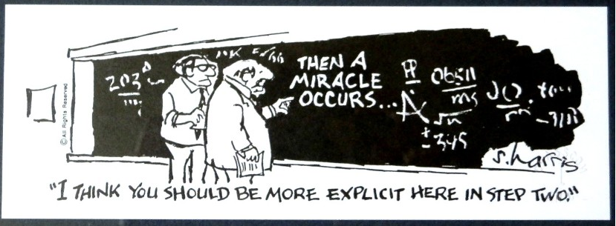
Another Proof
Show that if $a≡b\left(mod n\right)$ and $c≡d (mod n)$ then $ac≡bd (mod n)$.
Let $a,b,c,d,n∈ℤ, n≥0$ and suppose $a≡b\left(mod n\right)$ and $c≡d (mod n)$.
$n|(b−a)$ and $n|(d−c)$ by definition of mod.
$nk=(b−a)$ and $nj=(d−c)$ for integers $j,k$ by definition of divides.
$nknj=(d−c)(b−a)$ by multiplying the two equations
$nknj=(bd−bc−ad+ac)$
And then a miracle occurs
$n??=bd−ac$
$n|(bd−ac)$
$ac≡bd(mod n)$

Slide 25
Uh-Oh
We hit (what looks like) a dead end.
But how did I know we hit a dead end? Because I knew exactly where we needed to go. If you didn’t, you’d have been staring at that for ages trying to figure out the magic step.
(or worse, assumed you lost a minus sign somewhere, and just “fixed” it….)
Let’s try again. This time, let’s separate $b$ from $a$ and $d$ from $c$ before combining.

Slide 26
Another Approach
Show that if $a≡b\left(mod n\right)$ and $c≡d (mod n)$ then $ac≡bd (mod n)$.
Let $a,b,c,d,n∈ℤ, n≥0$ and suppose $a≡b\left(mod n\right)$ and $c≡d (mod n)$.
$n|(b−a)$ and $n|(d−c)$ by definition of mod.
$nk=(b−a)$ and $nj=(d−c)$ for integers $j,k$ by definition of divides.
$b=nk+a, d=nj+c$
$n??=bd−ac$
$n|(bd−ac)$
$ac≡bd(mod n)$

Slide 27
Another Approach
Show that if $a≡b\left(mod n\right)$ and $c≡d (mod n)$ then $ac≡bd (mod n)$.
Let $a,b,c,d,n∈ℤ, n≥0$ and suppose $a≡b\left(mod n\right)$ and $c≡d (mod n)$.
$n|(b−a)$ and $n|(d−c)$ by definition of mod.
$nk=(b−a)$ and $nj=(d−c)$ for integers $j,k$ by definition of divides.
$b=nk+a, d=nj+c$,
$bd=\left(nk+a\right)\left(nj+c\right)=n^{2}kj+anj+cnk+ac$
$bd−ac=n^{2}kj+anj+cnk=n(nkj+aj+ck)$
$n??=bd−ac$
$n|(bd−ac)$
$ac≡bd(mod n)$

Slide 28
Another Approach
Show that if $a≡b\left(mod n\right)$ and $c≡d (mod n)$ then $ac≡bd (mod n)$.
Let $a,b,c,d,n∈ℤ, n≥0$ and suppose $a≡b\left(mod n\right)$ and $c≡d (mod n)$.
$n|(b−a)$ and $n|(d−c)$ by definition of mod.
$nk=(b−a)$ and $nj=(d−c)$ for integers $j,k$ by definition of divides.
Isolating,$b$ and $d,$ we have: $b=nk+a, d=nj+c$
Multiplying the equations, and factoring, $bd=\left(nk+a\right)\left(nj+c\right)=n^{2}kj+anj+cnk+ac$
Rearranging, and facoring out $n: bd−ac=n^{2}kj+anj+cnk=n(nkj+aj+ck)$
Since all of $n,j,k,a,$ and $c$ are integers, we have that $bd−ac$ is $n$ times an integer, so
$n|(bd−ac)$, and by definition of mod
$ac≡bd(mod n)$

Slide 29
Logical Ordering
When doing a proof, we often work from both sides…
But we have to be careful!
When you read from top to bottom, every step has to follow only from what’s before it, not after it.
Suppose our target is $q$ and I know $q→p$ and $r→q$.
What can I put as a “new target?”

Slide 30
Logical Ordering
So why have all our prior steps been ok backward?
They’ve all been either:
A definition (which is always an “if and only if”)
An algebra step that is an “if and only if”
Even if your steps are “if and only if” you still have to put everything in order – start from your assumptions, and only assert something once it can be shown.

Slide 31
A bad proof
Claim: i$f x$ is positive then $x+5=−x−5$.
$x+5=−x−5$
$\left|x+5\right|=\left|−x−5\right|$
$|x+5|=|−(x+5)|$
$\left|x+5\right|=|x+5|$
$0=0$
This claim is false – if you’re trying to do algebra, you need to start with an equation you know (say $x=x$ or $2=2$ or $0=0$) and expand to the equation you want.

Slide 32
Divisors and Primes

Slide 33
Primes and FTA
An integer $p>1$ is prime iff its only positive divisors are $1$ and $p.$ Otherwise it is “composite”
Prime
Every positive integer greater than 1 has a unique
prime factorization.
Fundamental Theorem of Arithmetic

Slide 34
GCD and LCM
The Greatest Common Divisor of $a$ and $b$ (gcd(a,b)) is the largest integer $c$ such that $c|a$ and $c|b$
Greatest Common Divisor
The Least Common Multiple of $a$ and $b$ (lcm(a,b)) is the smallest positive integer $c$ such that $a|c$ and $b|c$.
Least Common Multiple

Slide 35
Try a few values…
gcd(100,125)
gcd(17,49)
gcd(17,34)
gcd(13,0)
lcm(7,11)
lcm(6,10)

