Slide 1
Even More Number Theory
CSE 311 Spring 2022
Lecture 13

Slide 2
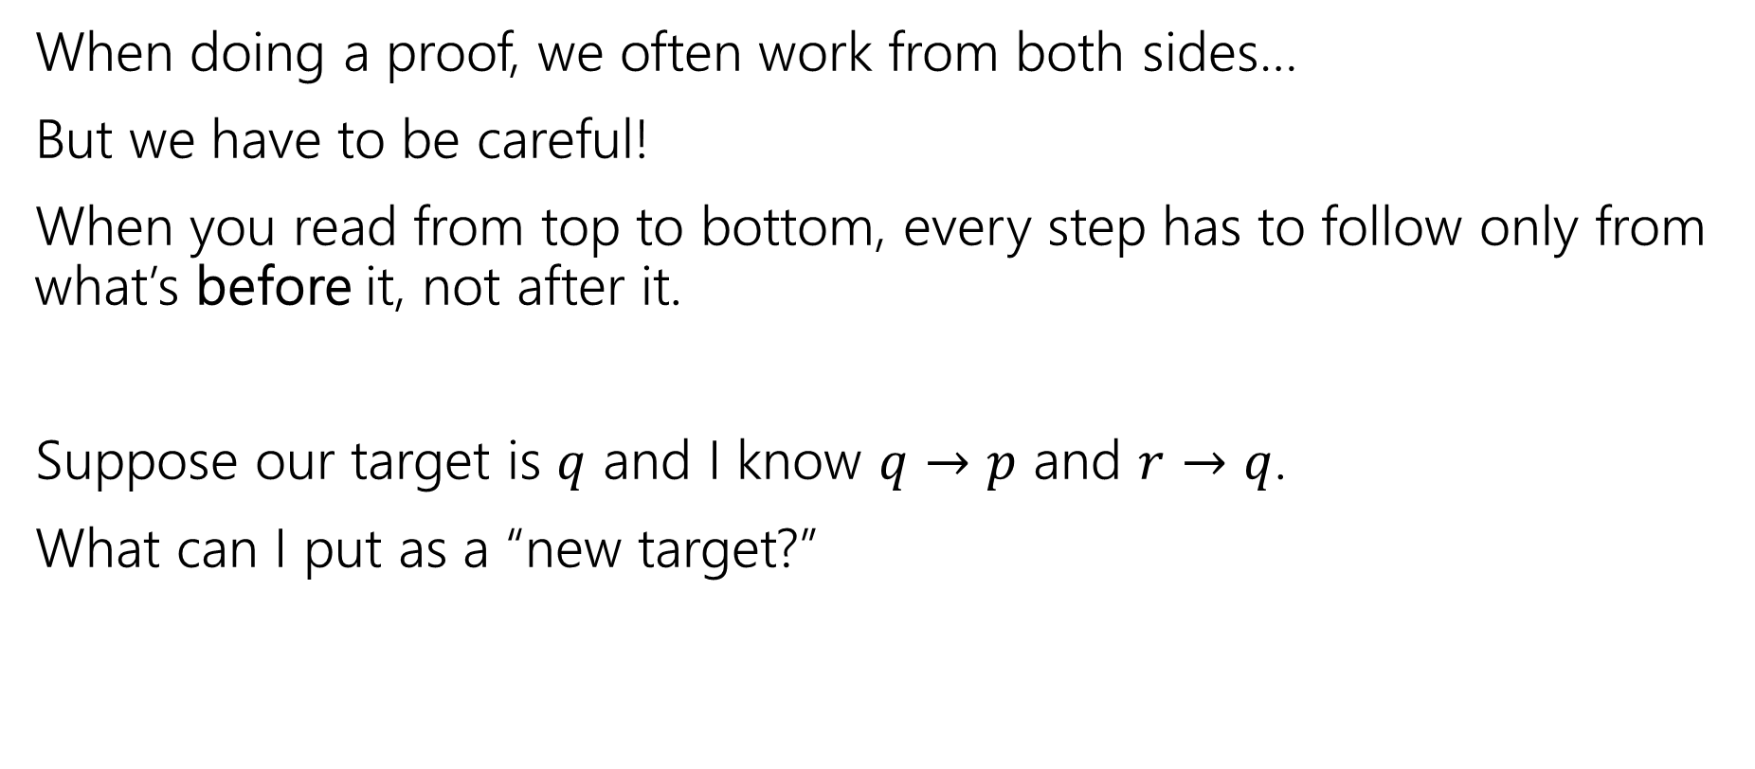
Logical Ordering
When doing a proof, we often work from both sides…
But we have to be careful!
When you read from top to bottom, every step has to follow only from what’s before it, not after it.
Suppose our target is $q$ and I know $q→p$ and $r→q$.
What can I put as a “new target?”

Slide 3
Logical Ordering
So why have all our prior steps been ok backward?
They’ve all been either:
A definition (which is always an “if and only if”)
An algebra step that is an “if and only if”
Even if your steps are “if and only if” you still have to put everything in order – start from your assumptions, and only assert something once it can be shown.

Slide 4
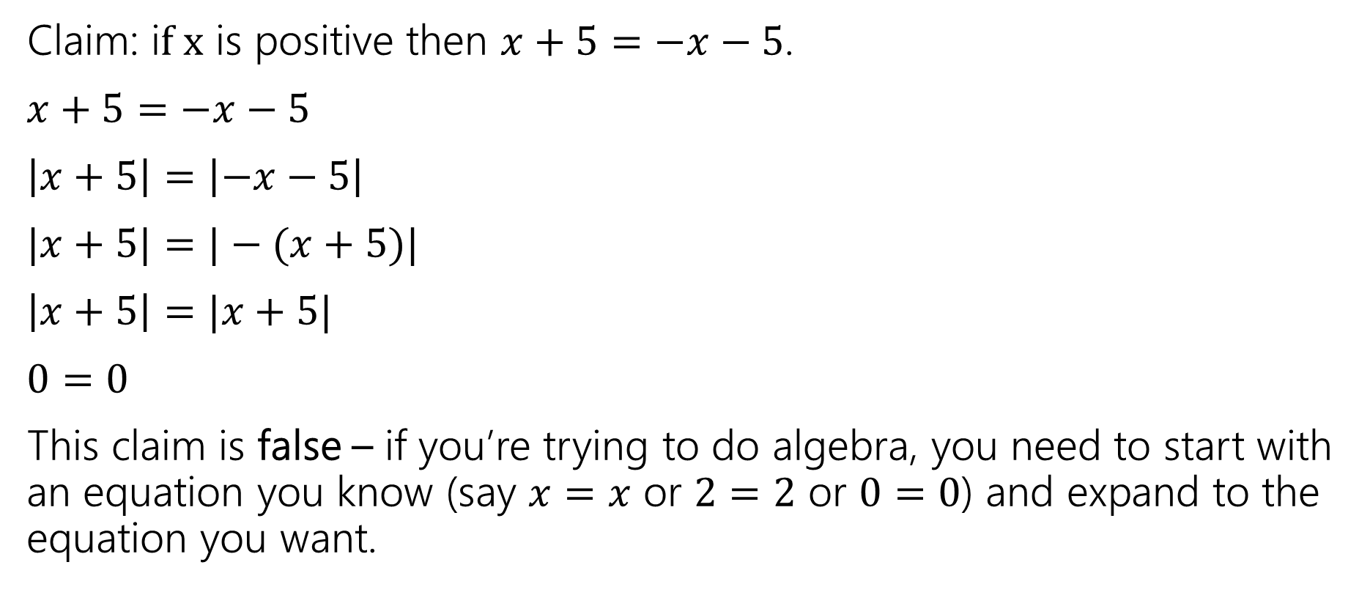
A bad proof
Claim: i$f x$ is positive then $x+5=−x−5$.
$x+5=−x−5$
$\left|x+5\right|=\left|−x−5\right|$
$|x+5|=|−(x+5)|$
$\left|x+5\right|=|x+5|$
$0=0$
This claim is false – if you’re trying to do algebra, you need to start with an equation you know (say $x=x$ or $2=2$ or $0=0$) and expand to the equation you want.

Slide 5

Primes and FTA
An integer $p>1$ is prime iff its only positive divisors are $1$ and $p.$ Otherwise it is “composite”
Prime
Every positive integer greater than 1 has a unique
prime factorization.
Fundamental Theorem of Arithmetic

Slide 6
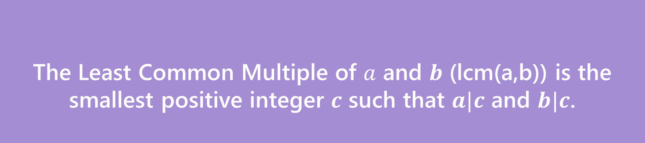
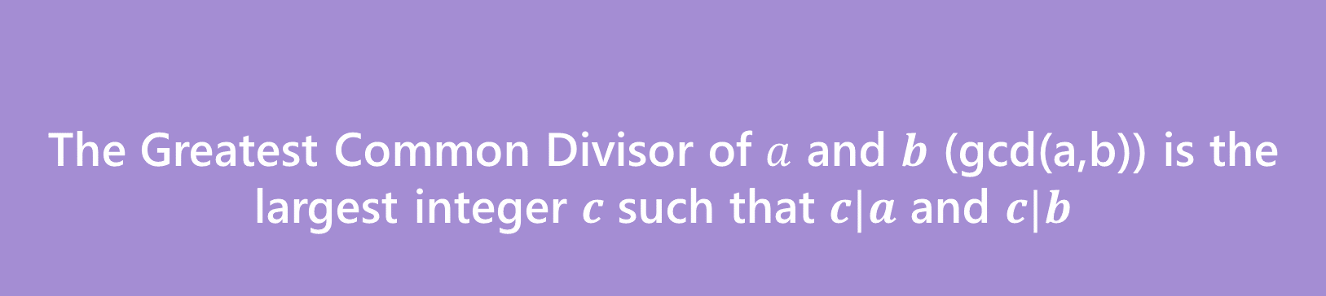
GCD and LCM
The Greatest Common Divisor of $a$ and $b$ (gcd(a,b)) is the largest integer $c$ such that $c|a$ and $c|b$
Greatest Common Divisor
The Least Common Multiple of $a$ and $b$ (lcm(a,b)) is the smallest positive integer $c$ such that $a|c$ and $b|c$.
Least Common Multiple

Slide 7
Try a few values…
gcd(100,125)
gcd(17,49)
gcd(17,34)
gcd(13,0)
lcm(7,11)
lcm(6,10)

Slide 8
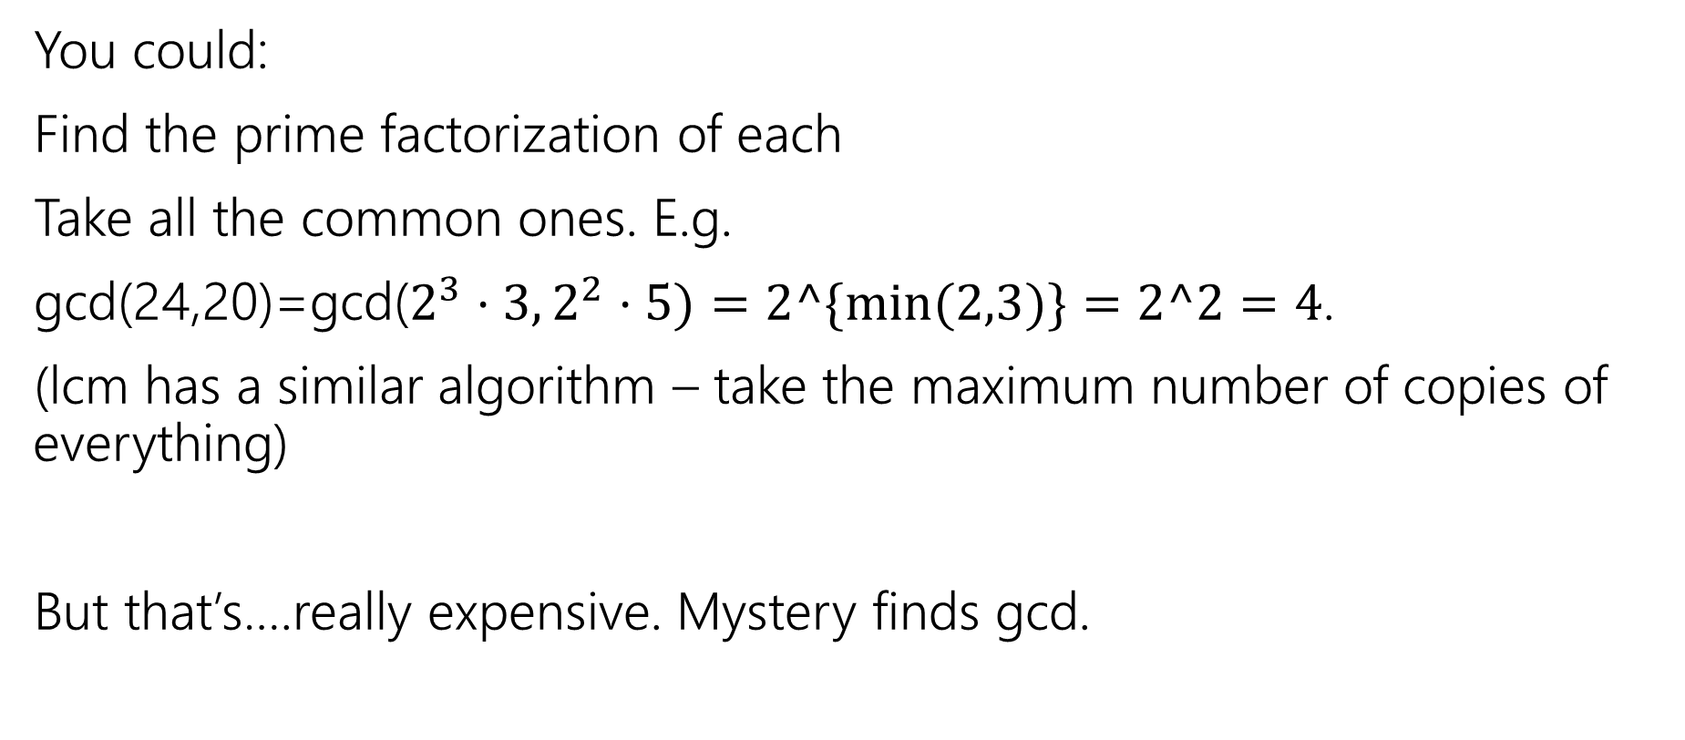
How do you calculate a gcd?
You could:
Find the prime factorization of each
Take all the common ones. E.g.
gcd(24,20)=gcd($2^{3}⋅3, 2^{2}⋅5)=2^\{min⁡(2,3)\}=2^2=4$.
(lcm has a similar algorithm – take the maximum number of copies of everything)
But that’s….really expensive. Mystery finds gcd.

Slide 9
public int Mystery(int m, int n){
if(m<n){
int temp = m;
m=n;
n=temp;
}
while(n != 0) {
int rem = m % n;
m=n;
n=temp;
}
return m;
}

Slide 10

GCD fact
If $a$ and $b$ are positive integers, then gcd(a,b) = gcd(b, a % b)
Why is this true? The proof isn’t easy, we’ll do it next week.
Why should you care?

Slide 11
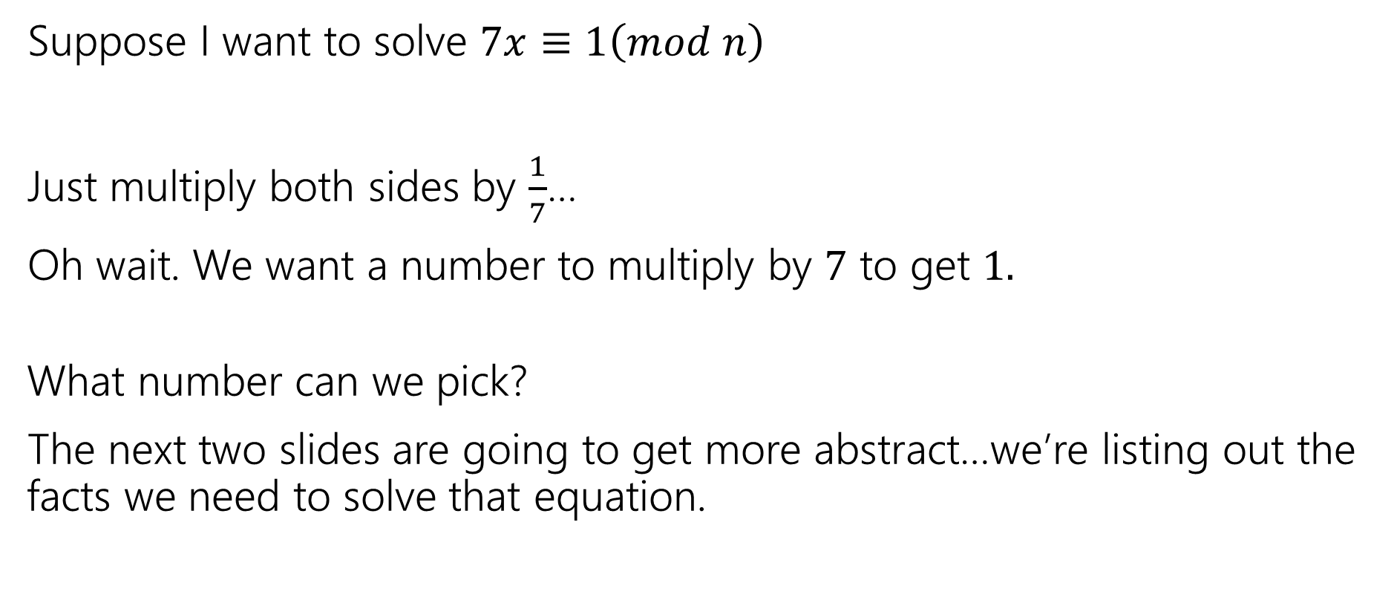
So…what’s it good for?
Remember everything we’re learning contributes to us eventually understanding RSA.
This is a key step in generating keys.
Suppose I want to solve $7x≡1\left(mod n\right)$
Just multiply both sides by $\frac{1}{7}$…
Oh wait. We want a number to multiply by $7$ to get $1.$
What number can we pick?
The next two slides are going to get more abstract…we’re listing out the facts we need to solve that equation.

Slide 12
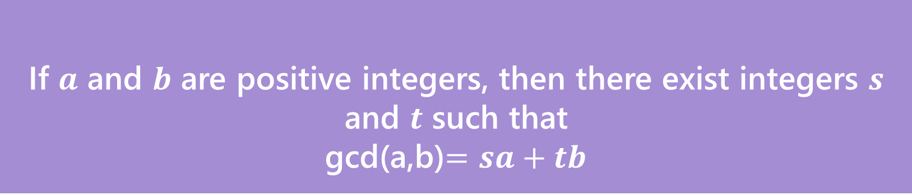
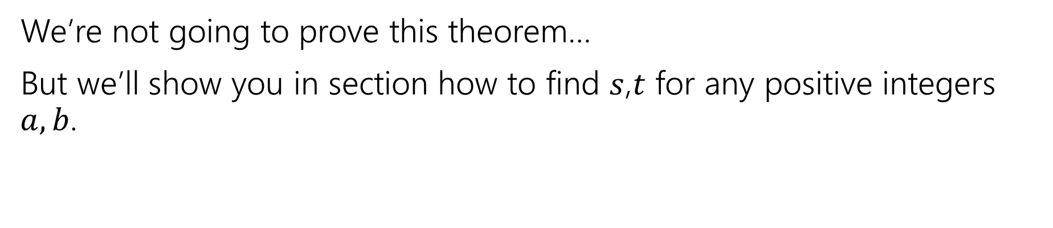
Bézout’s Theorem
If $a$ and $b$ are positive integers, then there exist integers $s$ and $t$ such that
gcd(a,b)$=sa+tb$
Bézout’s Theorem
We’re not going to prove this theorem…
But we’ll show you in section how to find $s$,$t$ for any positive integers $a,b$.

Slide 13
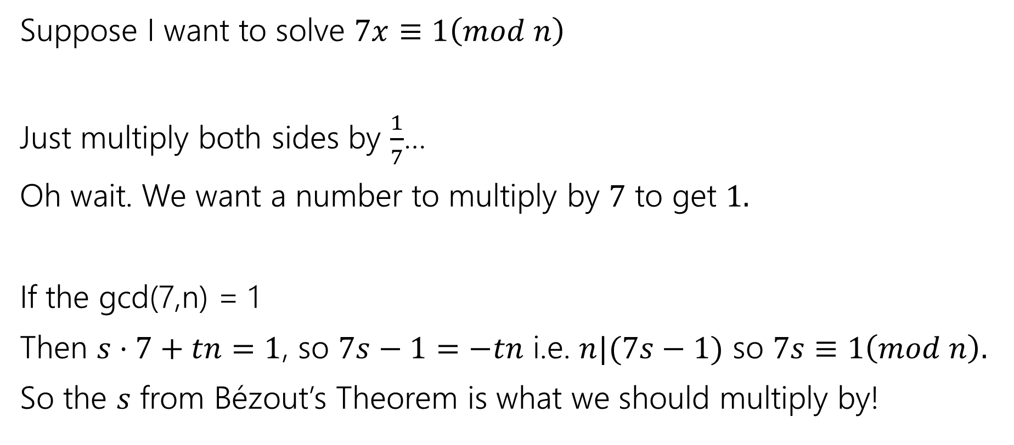
So…what’s it good for?
Suppose I want to solve $7x≡1\left(mod n\right)$
Just multiply both sides by $\frac{1}{7}$…
Oh wait. We want a number to multiply by $7$ to get $1.$
If the gcd(7,n) = 1
Then $s⋅7+tn=1$, so $7s−1=−tn$ i.e. $n|(7s−1)$ so $7s≡1\left(mod n\right).$
So the $s$ from Bézout’s Theorem is what we should multiply by!

Slide 14
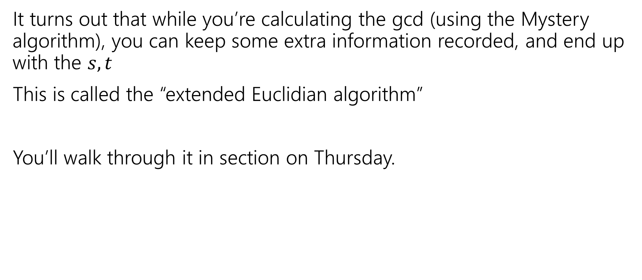

Ok…how am I supposed to find $s,t$?
It turns out that while you’re calculating the gcd (using the Mystery algorithm), you can keep some extra information recorded, and end up with the $s,t$
This is called the “extended Euclidian algorithm”
You’ll walk through it in section on Thursday.

Slide 15
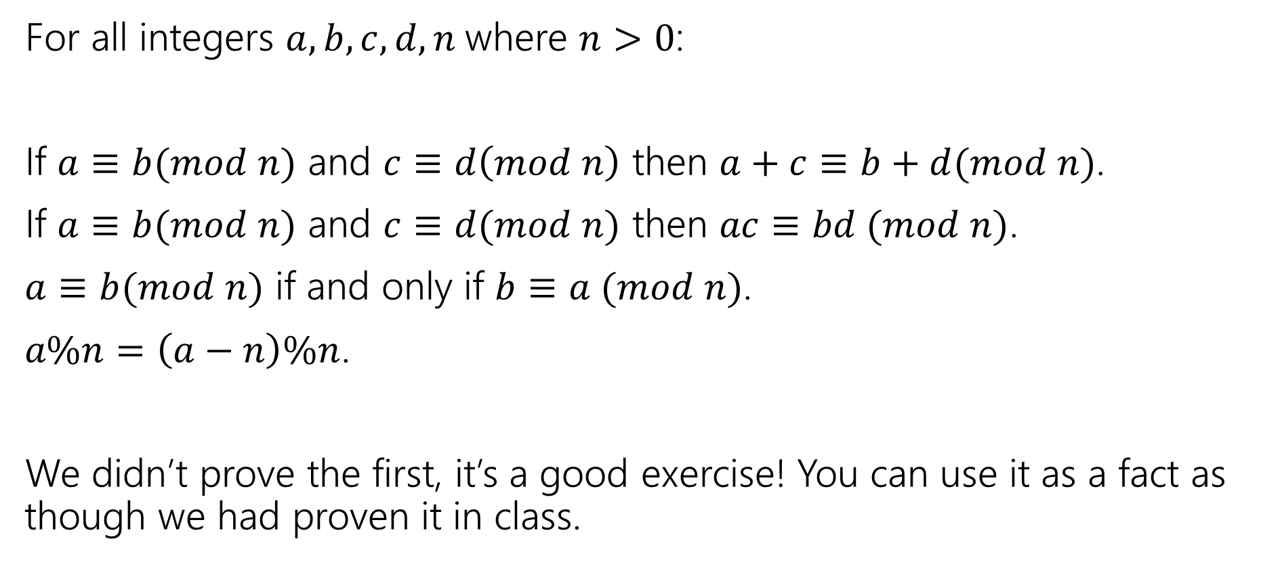
Facts about modular arithmetic
For all integers $a,b,c,d,n$where $n>0$:
If $a≡b(mod n)$ and $c≡d\left(mod n\right)$ then $a+c≡b+d(mod n)$.
If $a≡b(mod n)$ and $c≡d(mod n)$ then $ac≡bd (mod n)$.
$a≡b(mod n)$ if and only if $b≡a (mod n)$.
$a\%n=\left(a−n\right)\%n$.
We didn’t prove the first, it’s a good exercise! You can use it as a fact as though we had proven it in class.

Slide 16
Proving the key fact about gcds

Slide 17
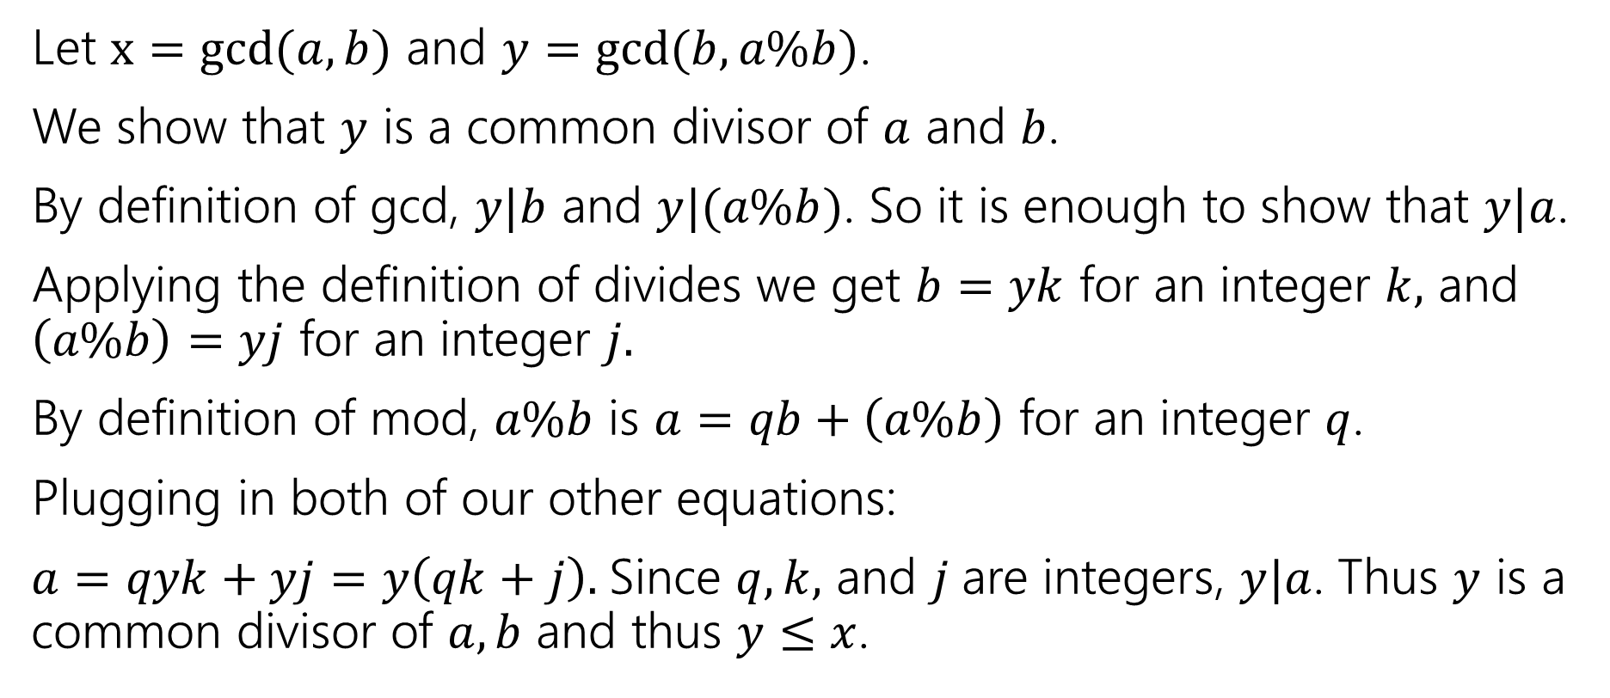
gcd(a,b) = gcd(b, a % b)
Let $x=gcd⁡(a,b)$ and $y=gcd⁡(b,a\%b)$.
We show that $y$ is a common divisor of $a$ and $b$.
By definition of gcd, $y|b$ and $y|(a\%b)$. So it is enough to show that $y|a$.
Applying the definition of divides we get $b=yk$ for an integer $k,$ and $\left(a\%b\right)=yj$ for an integer $j.$
By definition of mod, $a\%b$ is $a=qb+\left(a\%b\right)$ for an integer $q$.
Plugging in both of our other equations:
$a=qyk+yj=y\left(qk+j\right).$Since $q,k,$ and $j$are integers, $y|a$. Thus $y$ is a common divisor of $a,b$ and thus $y≤x$.

Slide 18
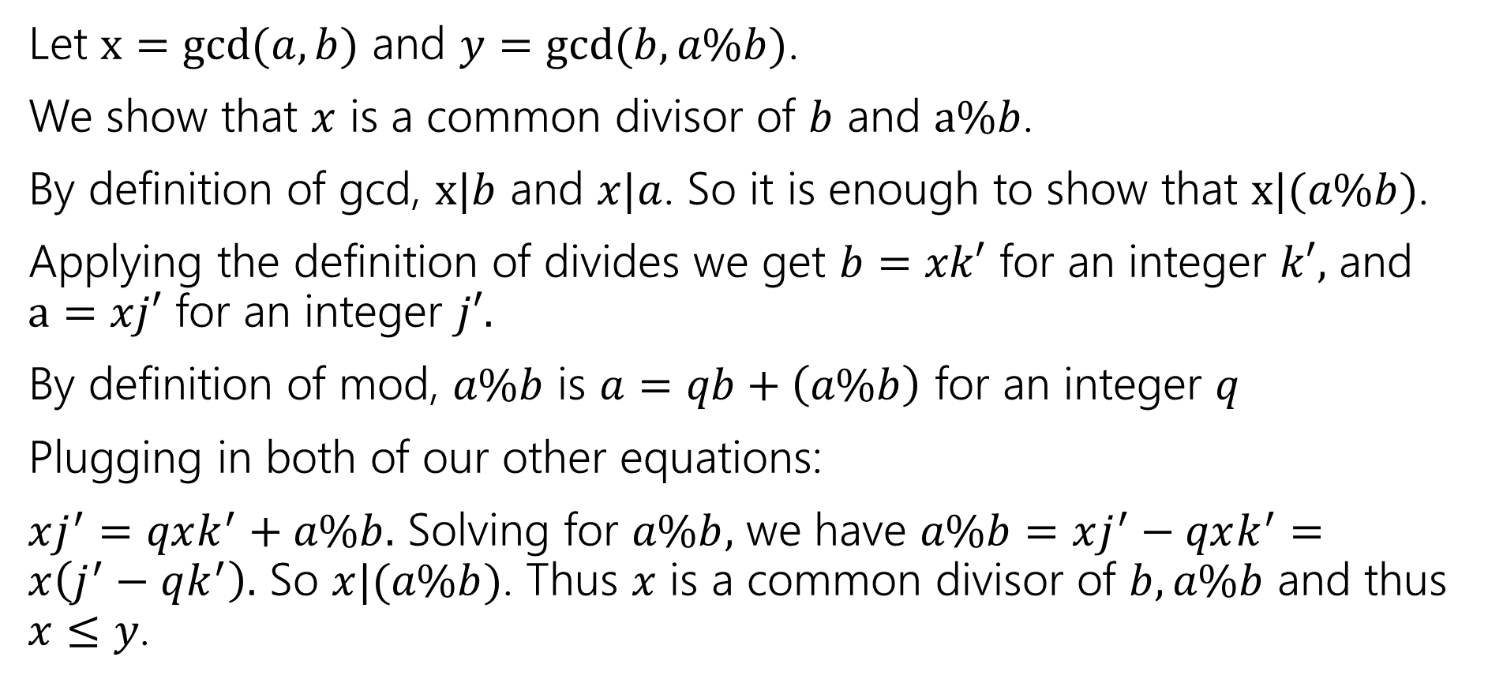
gcd(a,b) = gcd(b, a % b)
Let $x=gcd⁡(a,b)$ and $y=gcd⁡(b,a\%b)$.
We show that $x$ is a common divisor of $b$ and $a\%b$.
By definition of gcd, $x|b$ and $x|a$. So it is enough to show that $x|(a\%b)$.
Applying the definition of divides we get $b=xk′$ for an integer $k′,$ and $a=xj′$ for an integer $j′.$
By definition of mod, $a\%b$ is $a=qb+\left(a\%b\right)$ for an integer $q$
Plugging in both of our other equations:
$xj^{′}=qxk^{′}+a\%b.$ Solving for $a\%b,$ we have $a\%b=xj^{′}−qxk^{′}=x\left(j^{′}−qk^{′}\right).$ So $x|(a\%b)$. Thus $x$ is a common divisor of $b,a\%b$ and thus $x≤y$.

Slide 19

gcd(a,b) = gcd(b, a % b)
Let $x=gcd⁡(a,b)$ and $y=gcd⁡(b,a\%b)$.
We show that $x$ is a common divisor of $b$ and $a\%b$.
We have shown $x≤y$ and $y≤x$.
Thus $x=y,$ and $\gcd\left(a,b\right)=\gcd\left(b,a\%b\right).$

Slide 20
Extra Practice!

Slide 21
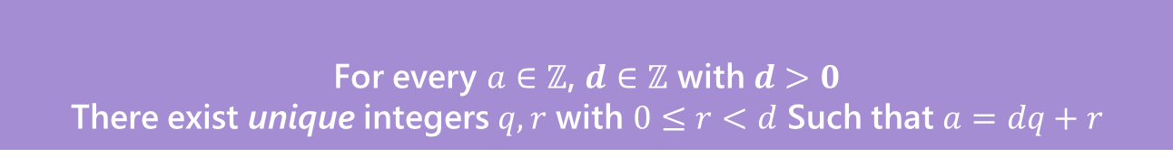


Warm up
Let $a∈ℤ, b∈ℤ, n∈ℤ$ and $n>0$.
We say $a≡b (mod n)$ if and only if $n|(b−a)$
Equivalence in modular arithmetic
Show that $a≡b \left(mod n\right)$ if and only if $b≡a(mod n)$
Show that $a\%n$=($a−n)\%n$ Where $b\%c$ is the unique $r$ such that $b=kc+r$ for some integer $k$.
For every $a∈ℤ$, $d∈ℤ$ with $d>0$
There exist unique integers $q,r$ with $0≤r<d$ Such that $a=dq+r$
The Division Theorem

Slide 22
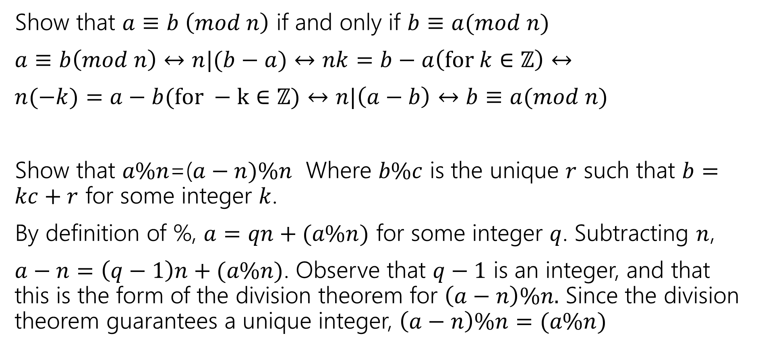
Warm up
Show that $a≡b \left(mod n\right)$ if and only if $b≡a(mod n)$
$a≡b\left(mod n\right)↔n|(b−a)↔nk=b−a\left(for k∈ℤ\right)↔$
$n(−k)=a−b(for −k∈ℤ)↔n|\left(a−b\right)↔b≡a(mod n)$
Show that $a\%n$=($a−n)\%n$ Where $b\%c$ is the unique $r$ such that $b=kc+r$ for some integer $k$.
By definition of %, $a=qn+(a\%n)$ for some integer $q$. Subtracting $n$,
$a−n=\left(q−1\right)n+(a\%n)$. Observe that $q−1$ is an integer, and that this is the form of the division theorem for $\left(a−n\right)\%n.$ Since the division theorem guarantees a unique integer, $\left(a−n\right)\%n=(a\%n)$

Slide 23
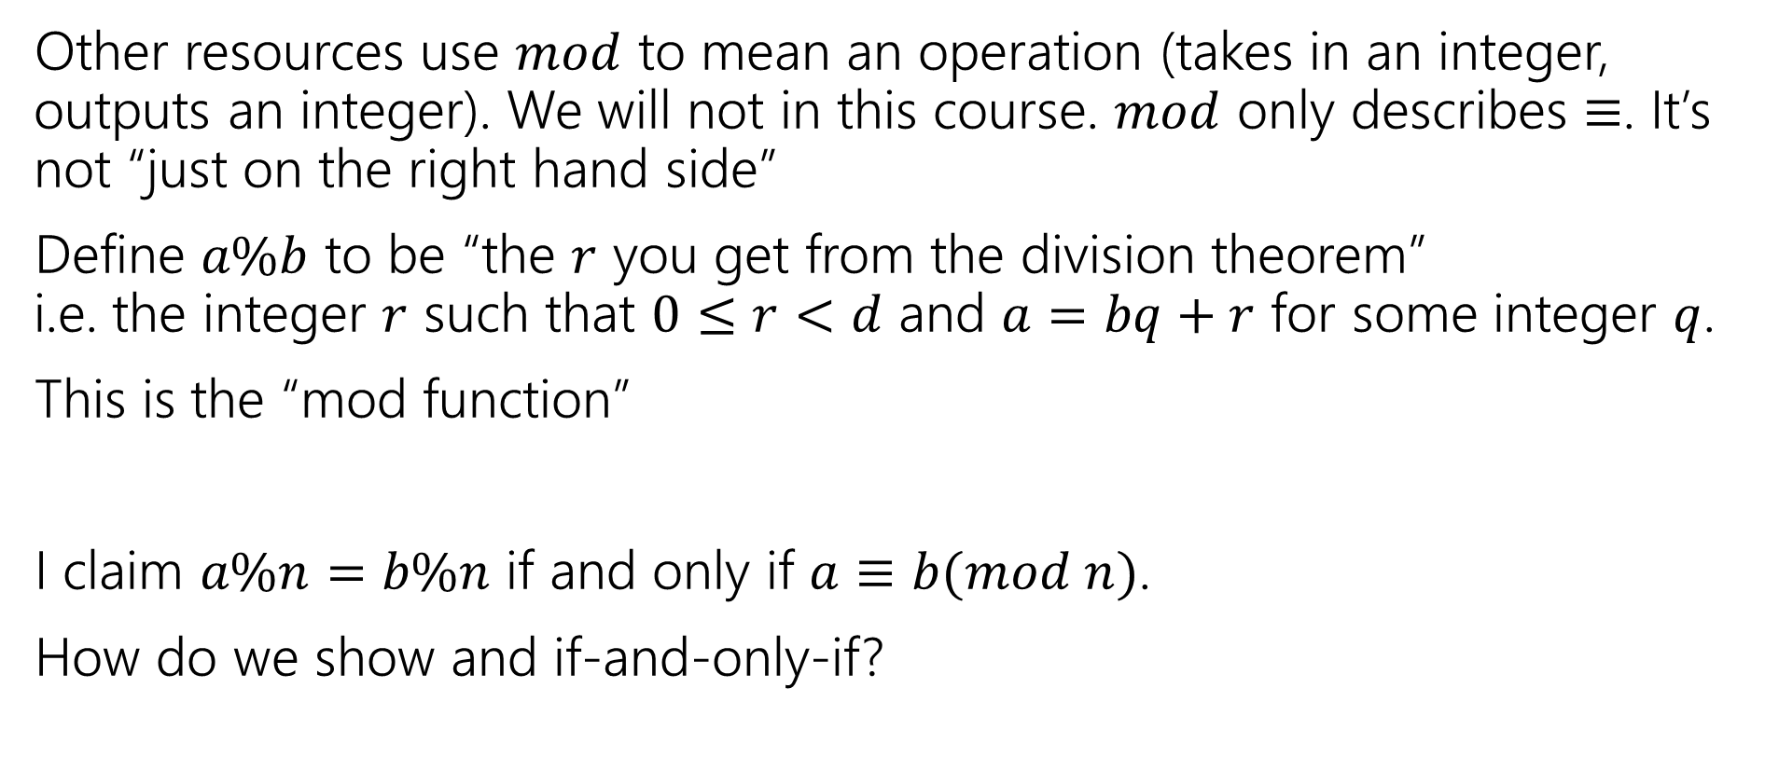
% and Mod
Other resources use $mod$ to mean an operation (takes in an integer, outputs an integer). We will not in this course. $mod$ only describes $≡$. It’s not “just on the right hand side”
Define $a\%b$ to be “the $r$ you get from the division theorem”
i.e. the integer $r$ such that $0≤r<d$ and $a=bq+r$ for some integer $q$.
This is the “mod function”
I claim $a\%n=b\%n$ if and only if $a≡b(mod n)$.
How do we show and if-and-only-if?

Slide 24

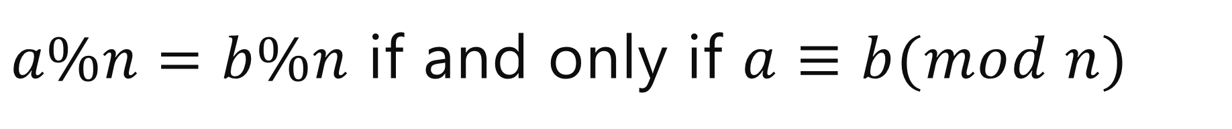
$a\%n=b\%n$ if and only if $a≡b(mod n)$
Backward direction:
Suppose $a≡b(mod n)$
$a\%n=\left(b−nk\right)\%n=b\%n$

Slide 25
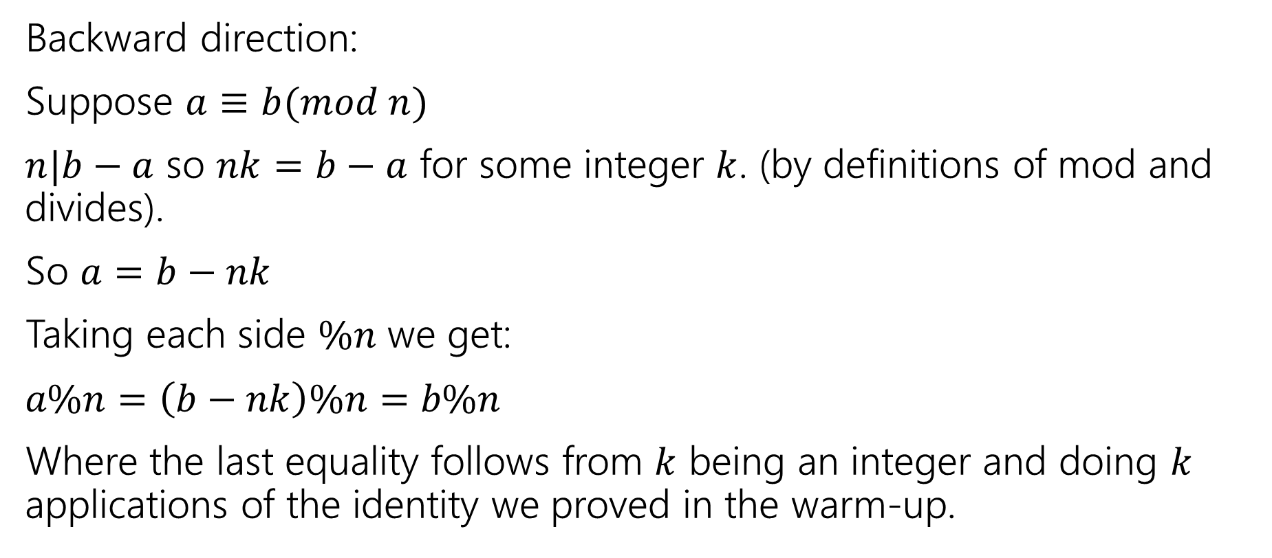
$a\%n=b\%n$ if and only if $a≡b(mod n)$
Backward direction:
Suppose $a≡b(mod n)$
$n|b−a$ so $nk=b−a$ for some integer $k$. (by definitions of mod and divides).
So $a=b−nk$
Taking each side $\%n$ we get:
$a\%n=\left(b−nk\right)\%n=b\%n$
Where the last equality follows from $k$ being an integer and doing $k$ applications of the identity we proved in the warm-up.

Slide 26


$a\%n=b\%n$ if and only if $a≡b(mod n)$
Show the forward direction:
If $a\%n=b\%n$ then $a≡b(mod n)$.
This proof is a bit different than the other direction.
Remember to work from top and bottom!!
Let $a∈ℤ, b∈ℤ, n∈ℤ$ and $n>0$.
We say $a≡b (mod n)$ if and only if $n|(b−a)$
Equivalence in modular arithmetic
For every $a∈ℤ$, $d∈ℤ$ with $d>0$
There exist unique integers $q,r$ with $0≤r<d$ Such that $a=dq+r$
The Division Theorem

Slide 27
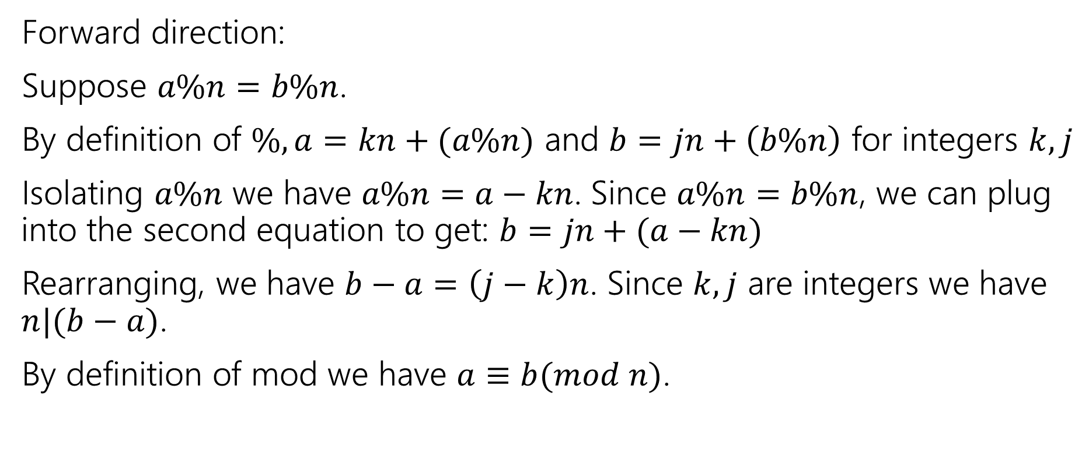
$a\%n=b\%n$ if and only if $a≡b(mod n)$
Forward direction:
Suppose $a\%n=b\%n$.
By definition of $\%, a=kn+(a\%n)$ and $b=jn+\left(b\%n\right)$ for integers $k,j$
Isolating $a\%n$ we have $a\%n=a−kn$. Since $a\%n=b\%n$, we can plug into the second equation to get: $b=jn+(a−kn)$
Rearranging, we have $b−a=\left(j−k\right)n$. Since $k,j$ are integers we have $n|(b−a)$.
By definition of mod we have $a≡b(mod n)$.

Slide 28
Euclidian Algorithm

Slide 29
Euclid’s Algorithm
while(n != 0) {
int rem = m % n;
m=n;
n=rem;
}
gcd(660,126)

Slide 30
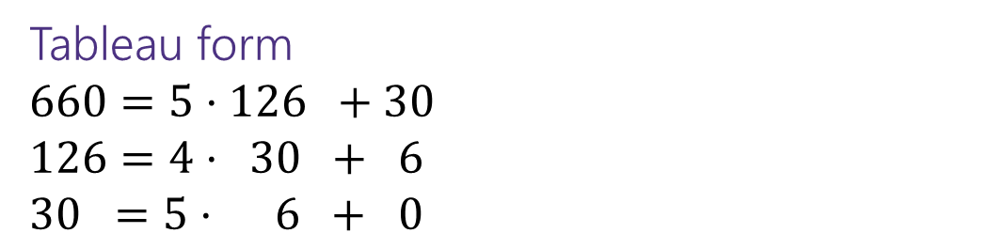
Euclid’s Algorithm
while(n != 0) {
int rem = m % n;
m=n;
n=rem;
}
gcd(660,126)
= gcd(126, 660 mod 126) = gcd(126, 30)
= gcd(30, 126 mod 30) = gcd(30, 6)
= gcd(6, 30 mod 6) = gcd(6, 0)
= 6
Tableau form
$660=5⋅126 +30$
$126=4⋅ 30 + 6$
$30 =5⋅ 6 + 0$
Starting Numbers
Final answer

Slide 31
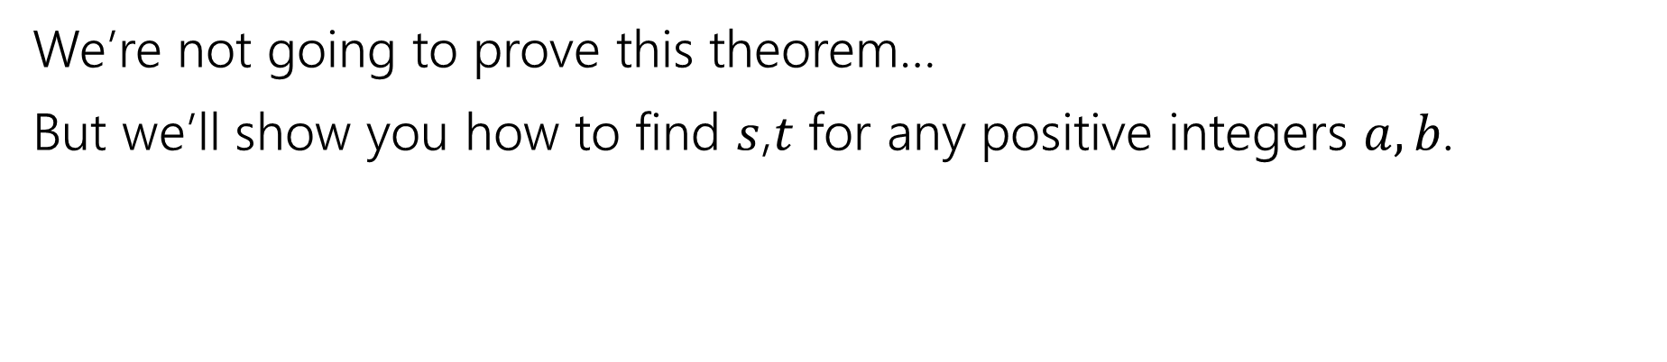
Bézout’s Theorem
If $a$ and $b$ are positive integers, then there exist integers $s$ and $t$ such that
gcd(a,b)$=sa+tb$
Bézout’s Theorem
We’re not going to prove this theorem…
But we’ll show you how to find $s$,$t$ for any positive integers $a,b$.

Slide 32
Extended Euclidian Algorithm
Step 1 compute gcd(a,b); keep tableau information.
Step 2 solve all equations for the remainder.
Step 3 substitute backward
gcd(35,27)

Slide 33

Extended Euclidian Algorithm
Step 1 compute gcd(a,b); keep tableau information.
Step 2 solve all equations for the remainder.
Step 3 substitute backward
gcd(35,27) = gcd(27, 35%27) = gcd(27,8)
= gcd(8, 27%8) = gcd(8, 3)
= gcd(3, 8%3) = gcd(3, 2)
= gcd(2, 3%2) = gcd(2,1)
= gcd(1, 2%1) = gcd(1,0)
$35=1⋅ 27 +8$
$27=3⋅ 8 +3$
$8 =2⋅ 3 +2$
$3 =$ $1⋅ 2 +1$

Slide 34

Extended Euclidian Algorithm
Step 1 compute gcd(a,b); keep tableau information.
Step 2 solve all equations for the remainder.
Step 3 substitute backward
$35=1⋅ 27 +8$
$27=3⋅ 8 +3$
$8 =2⋅ 3 +2$
$3 =$ $1⋅ 2 +1$

Slide 35

Extended Euclidian Algorithm
Step 1 compute gcd(a,b); keep tableau information.
Step 2 solve all equations for the remainder.
Step 3 substitute backward
$35=1⋅ 27 +8$
$27=3⋅ 8 +3$
$8 =2⋅ 3 +2$
$3 =$ $1⋅ 2 +1$
$8=35 − 1⋅ 27$
$$3=27 − 3⋅ 8$$
$2 =8 − 2⋅ 3$
$1 =$ $3 − 1⋅ 2$

Slide 36

Extended Euclidian Algorithm
Step 1 compute gcd(a,b); keep tableau information.
Step 2 solve all equations for the remainder.
Step 3 substitute backward
$8=35 − 1⋅ 27$
$$3=27 − 3⋅ 8$$
$2 =8 − 2⋅ 3$
$1 =$ $3 − 1⋅ 2$

Slide 37
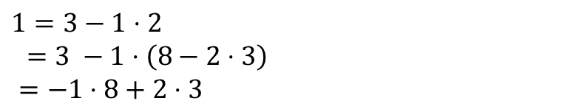
Extended Euclidian Algorithm
Step 1 compute gcd(a,b); keep tableau information.
Step 2 solve all equations for the remainder.
Step 3 substitute backward
$1=3−1⋅2$
$=3 −1⋅\left(8−2⋅3\right)$
$=−1⋅8+2⋅3$
$8=35 − 1⋅ 27$
$$3=27 − 3⋅ 8$$
$2 =8 − 2⋅ 3$
$1 =$ $3 − 1⋅ 2$

Slide 38


Extended Euclidian Algorithm
Step 1 compute gcd(a,b); keep tableau information.
Step 2 solve all equations for the remainder.
Step 3 substitute backward
When substituting back, you keep the larger of $m,n$ and the number you just substituted.
Don’t simplify further! (or you lose the form you need)
$1=3−1⋅2$
$=3 −1⋅\left(8−2⋅3\right)$
$=−1⋅8+3⋅3$
$=−1⋅8+3\left(27−3⋅8\right)$
$=3⋅27−10⋅8$
$=3⋅27−10(35−1⋅27)$
$=13⋅27−10⋅35$
$8=35 − 1⋅ 27$
$$3=27 − 3⋅ 8$$
$2 =8 − 2⋅ 3$
$1 =$ $3 − 1⋅ 2$
gcd(27,35) = $13⋅27+\left(−10\right)⋅35$

Slide 39

Try it
Solve the equation $7y≡3(mod 26)$
What do we need to find?
The multiplicative inverse of $7(mod 26)$

Slide 40
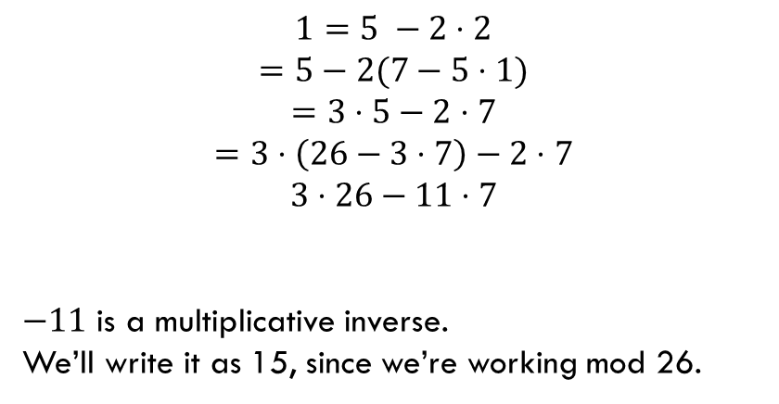
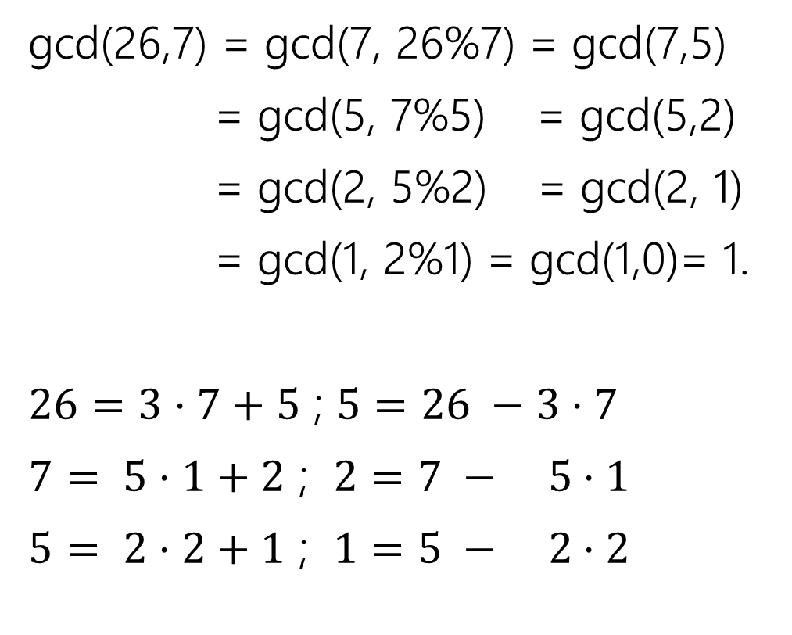
Finding the inverse…
gcd(26,7) = gcd(7, 26%7) = gcd(7,5)
= gcd(5, 7%5) = gcd(5,2)
= gcd(2, 5%2) = gcd(2, 1)
= gcd(1, 2%1) = gcd(1,0)= 1.
$26=3⋅7+5$ ; $5=26 −3⋅7$
$7= 5⋅1+2$ ; $2=7 − 5⋅1$
$5= 2⋅2+1$ ; $1=5 − 2⋅2$
$$1=5 −2⋅2$$
$$=5−2(7−5⋅1)$$
$$=3⋅5−2⋅7$$
$$=3⋅\left(26−3⋅7\right)−2⋅7$$
$$3⋅26−11⋅7$$
$−11$ is a multiplicative inverse.
We’ll write it as 15, since we’re working mod 26.

Slide 41
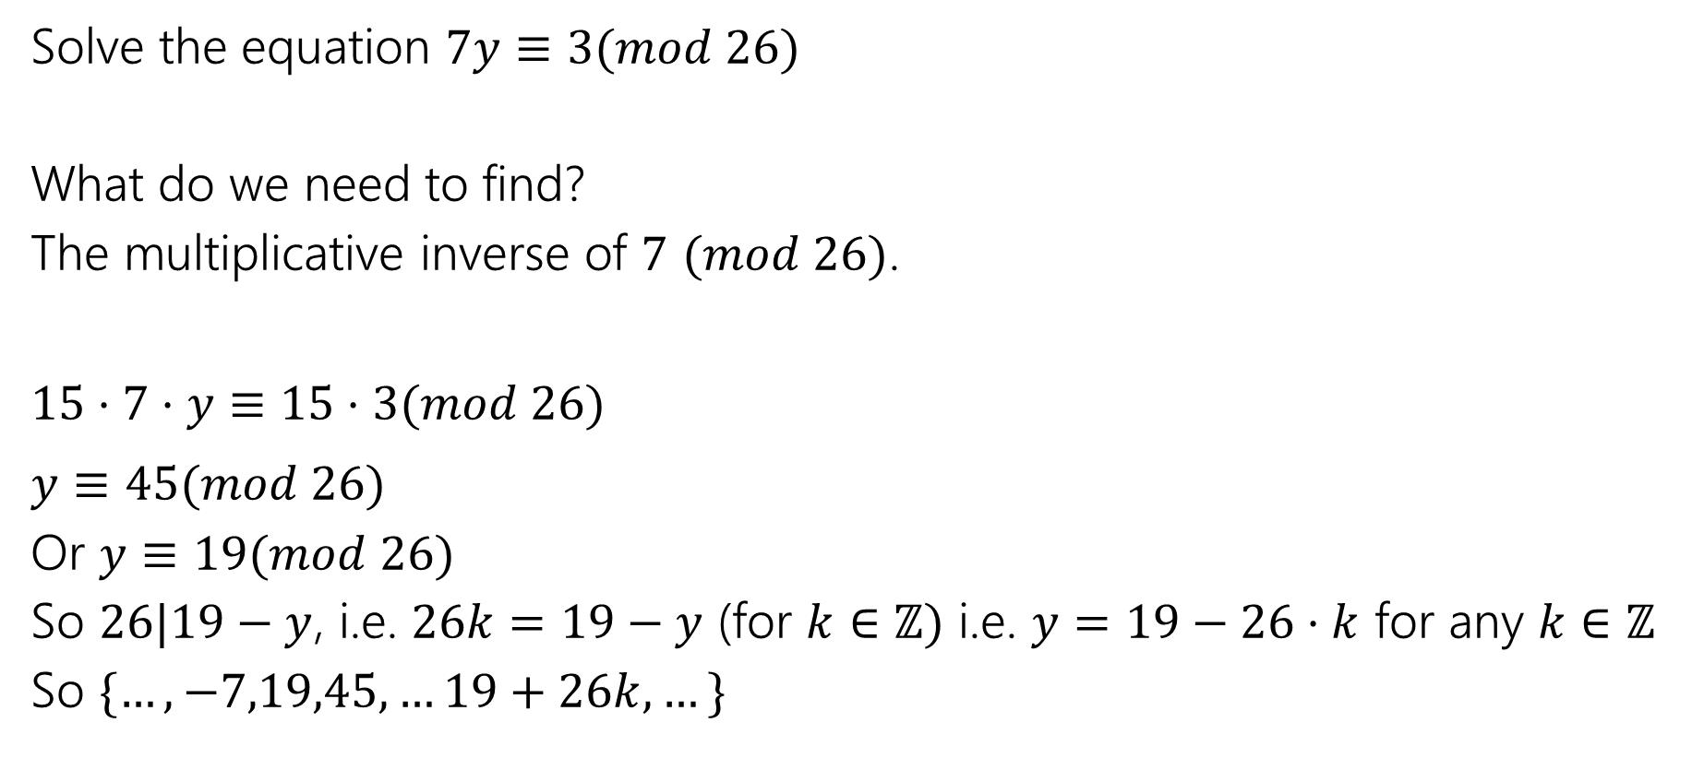
Try it
Solve the equation $7y≡3(mod 26)$
What do we need to find?
The multiplicative inverse of $7$ $(mod 26)$.
$15⋅7⋅y≡15⋅3(mod 26)$
$y≡45(mod 26)$
Or $y≡19(mod 26)$
So $26|19−y$, i.e. $26k=19−y$ (for $k∈ℤ)$ i.e. $y=19−26⋅k$ for any $k∈ℤ$
So $\{…,−7,19,45,…19+26k,…\}$

