Slide 1
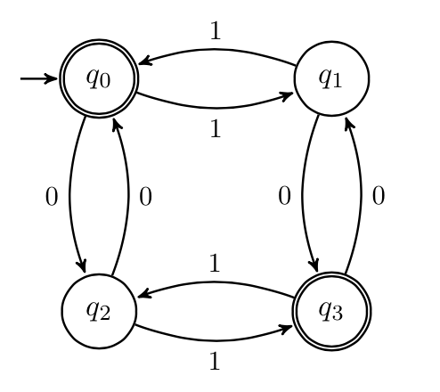
Finite State Machines
CSE 311 Spring 2022
Lecture 24

Slide 2
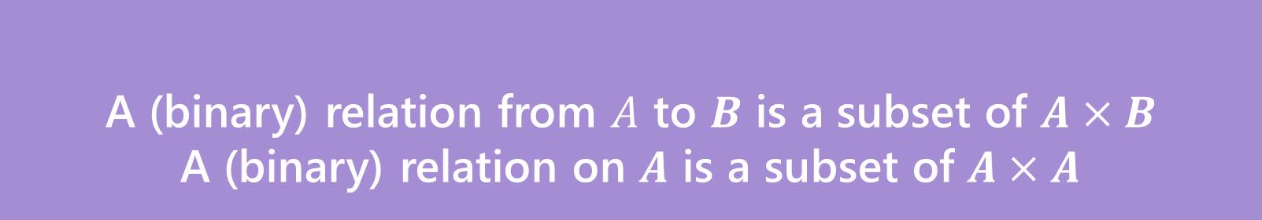

Relations
A (binary) relation from $A$ to $B$ is a subset of $A×B$
A (binary) relation on $A$ is a subset of $A×A$
Wait what?
$≤$ is a relation on $ℤ$.
“$3≤4“$ is a way of saying “3 relates to 4” (for the $≤$ relation)
$(3,4)$ is an element of the set that defines the relation.
Relations

Slide 3
Graphs

Slide 4

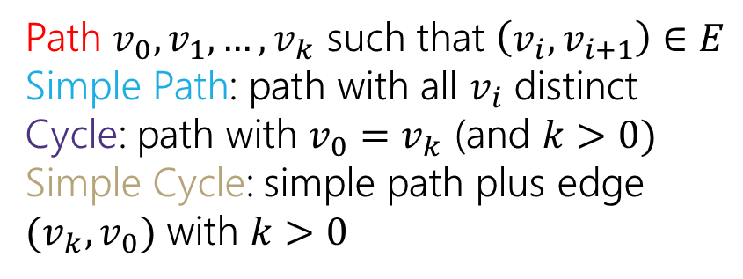
Directed Graphs
$G=(V,E)$
$V$is a set of vertices (an underlying set of elements)
$E$ is a set of edges (ordered pairs of vertices; i.e. connections from one to the next).
Path $v_{0},v_{1},…,v_{k}$ such that $\left(v_{i},v_{i+1}\right)∈E$
Simple Path: path with all $v_{i}$ distinct
Cycle: path with $v_{0}=v_{k}$ (and $k>0)$
Simple Cycle: simple path plus edge ${(v}_{k},v_{0})$ with $k>0$

Slide 5
Directed Graphs
$G=(V,E)$
$V$is a set of vertices (an underlying set of elements)
$E$ is a set of edges (ordered pairs of vertices; i.e. connections from one to the next).
Path $v_{0},v_{1},…,v_{k}$ such that $\left(v_{i},v_{i+1}\right)∈E$
Simple Path: path with all $v_{i}$ distinct
Cycle: path with $v_{0}=v_{k}$ (and $k>0)$
Simple Cycle: simple path plus edge ${(v}_{k},v_{0})$ with $k>0$

Slide 6
Directed Graphs
$G=(V,E)$
$V$is a set of vertices (an underlying set of elements)
$E$ is a set of edges (ordered pairs of vertices; i.e. connections from one to the next).
Path $v_{0},v_{1},…,v_{k}$ such that $\left(v_{i},v_{i+1}\right)∈E$
Simple Path: path with all $v_{i}$ distinct
Cycle: path with $v_{0}=v_{k}$ (and $k>0)$
Simple Cycle: simple path plus edge ${(v}_{k},v_{0})$ with $k>0$

Slide 7
Directed Graphs
$G=(V,E)$
$V$is a set of vertices (an underlying set of elements)
$E$ is a set of edges (ordered pairs of vertices; i.e. connections from one to the next).
Path $v_{0},v_{1},…,v_{k}$ such that $\left(v_{i},v_{i+1}\right)∈E$
Simple Path: path with all $v_{i}$ distinct
Cycle: path with $v_{0}=v_{k}$ (and $k>0)$
Simple Cycle: simple path plus edge ${(v}_{k},v_{0})$ with $k>0$

Slide 8
Lecture-Only Content
Relations and Graphs

Slide 9
More Relations and Graphs
The rest of this deck is a little more on:
Relations, specifically combining them together
Graphs, specifically representing relations as graphs.
We’re going to go through it very fast. We won’t have homework or exam questions on anything in this section of the deck.
But it is stuff you should see at least once because it might come back in future classes.

Slide 10
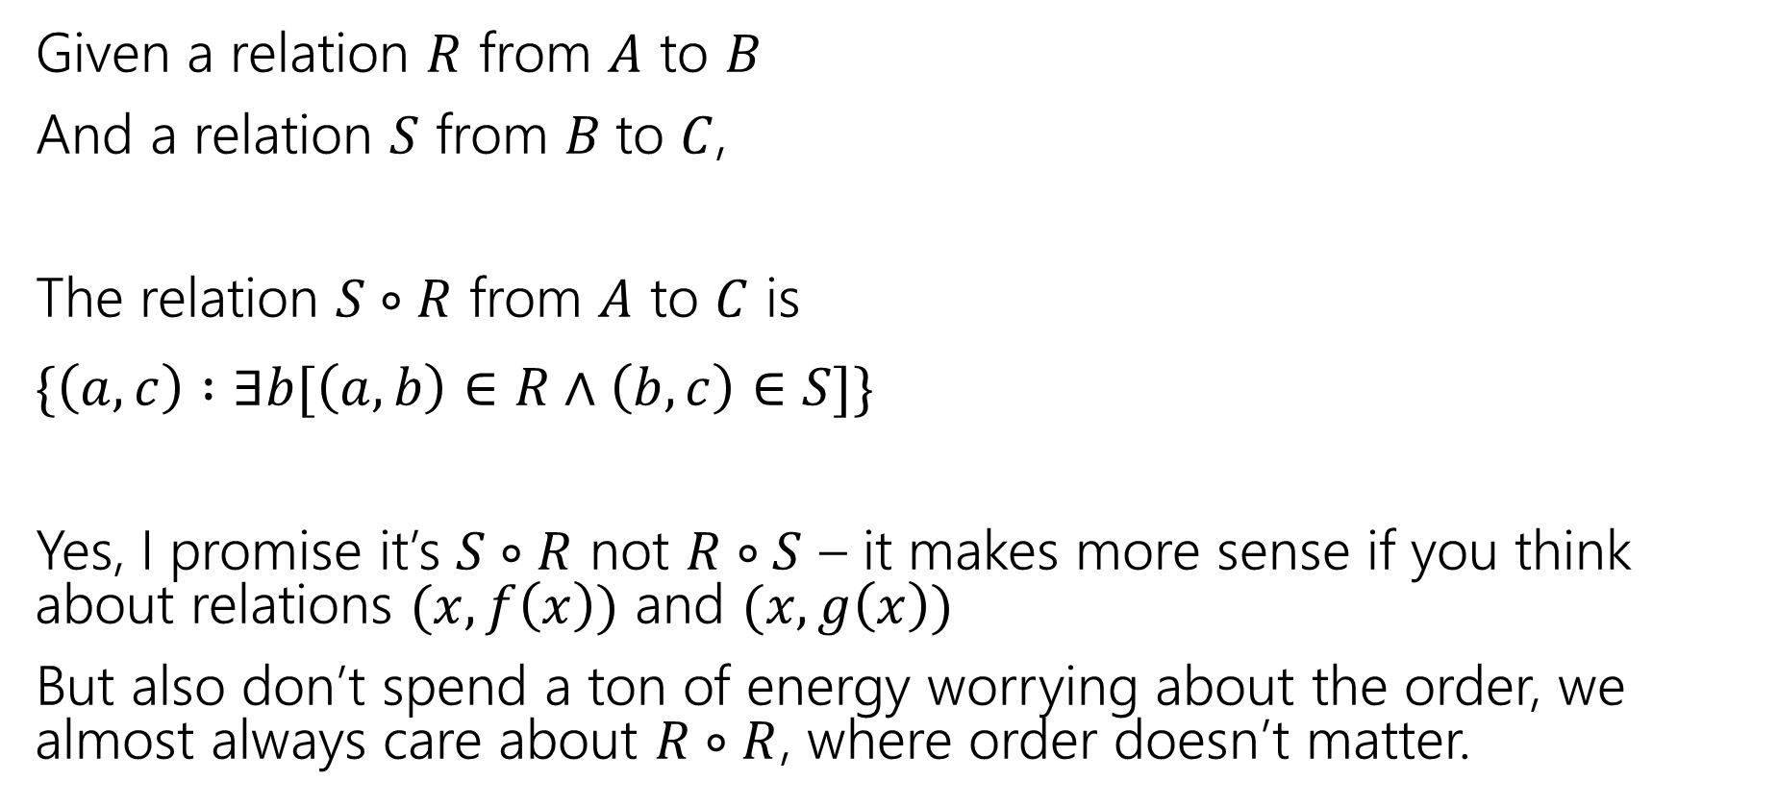
Combining Relations
Given a relation $R$ from $A$ to $B$
And a relation $S$ from $B$to $C$,
The relation $S∘R$ from $A$ to $C$ is
$\{\left(a,c\right) :∃b[\left(a,b\right)∈R∧\left(b,c\right)∈S]\}$
Yes, I promise it’s $S∘R$ not $R∘S$ – it makes more sense if you think about relations $(x,f\left(x\right))$ and $(x,g\left(x\right))$
But also don’t spend a ton of energy worrying about the order, we almost always care about $R∘R$, where order doesn’t matter.

Slide 11
Combining Relations
To combine relations, it’s a lot easier if we can see what’s happening.
We’ll use a representation of a directed graph

Slide 12
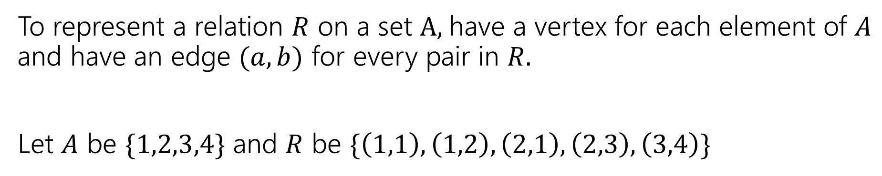
Representing Relations
To represent a relation $R$ on a set $A,$have a vertex for each element of $A$ and have an edge $(a,b)$ for every pair in $R.$
Let $A$ be $\{1,2,3,4\}$ and $R$ be $\{\left(1,1\right),\left(1,2\right),\left(2,1\right),\left(2,3\right),\left(3,4\right)\}$
1
2
3
4

Slide 13
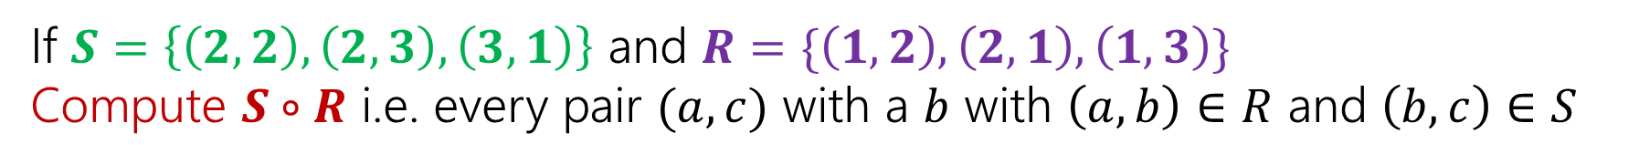
Combining Relations
If $S=\left\{\left(2,2\right), \left(2,3\right), \left(3,1\right)\right\}$ and $R=\{\left(1,2\right),\left(2,1\right),\left(1,3\right)\}$
Compute $S∘R$ i.e. every pair $(a,c)$ with a $b$ with $\left(a,b\right)∈R$ and $\left(b,c\right)∈S$
2
2
1
1
3
3

Slide 14
Combining Relations
If $S=\left\{\left(2,2\right), \left(2,3\right), \left(3,1\right)\right\}$ and $R=\{\left(1,2\right),\left(2,1\right),\left(1,3\right)\}$
Compute $S∘R$ i.e. every pair $(a,c)$ with a $b$ with $\left(a,b\right)∈R$ and $\left(b,c\right)∈S$
2
2
1
1
3
3

Slide 15

Combining Relations
Let $R$ be a relation on $A$.
Define $R^{0}$ as $\{\left(a,a\right) :a∈A\}$
$R^{k}=R^{k−1}∘R$
$\left(a,b\right)∈R^{k}$ if and only if there is a path of length $k$ from $a$ to $b$ in $R$.
We can find that on the graph!

Slide 16
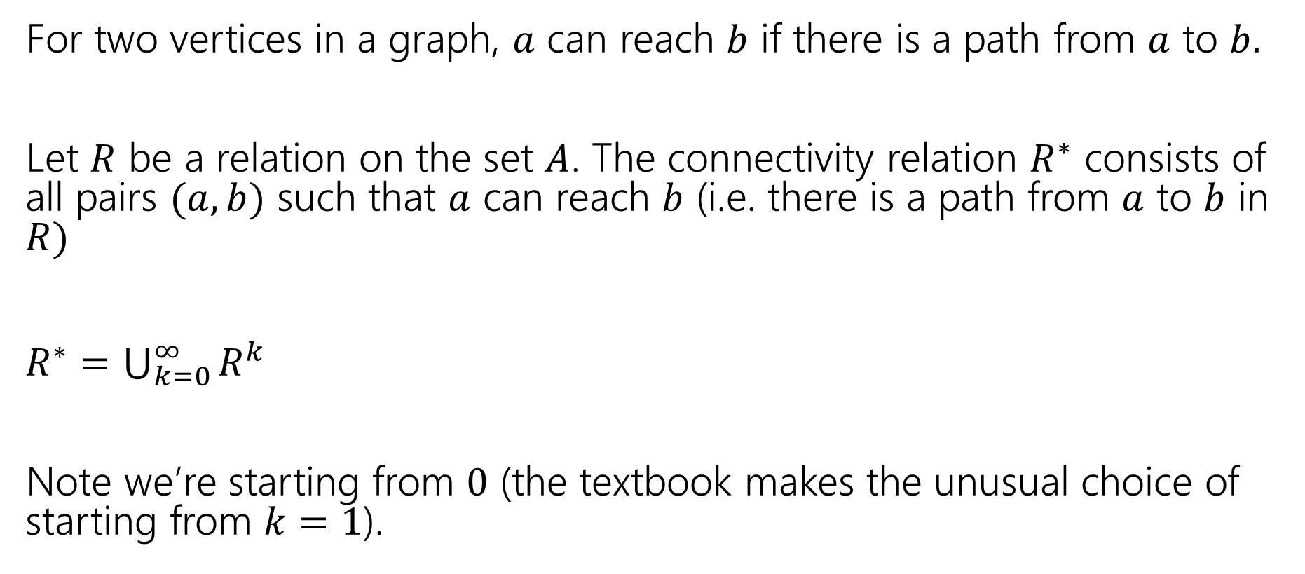

More Powers of $R.$
For two vertices in a graph, $a$ can reach $b$ if there is a path from $a$ to $b.$
Let $R$ be a relation on the set $A$. The connectivity relation $R^{∗}$ consists of all pairs $(a,b)$ such that $a$ can reach $b$ (i.e. there is a path from $a$ to $b$ in $R)$
$R^{∗}=\bigcup_{k=0}^{∞}{R^{k}}$
Note we’re starting from $0$ (the textbook makes the unusual choice of starting from $k=1$).

Slide 17
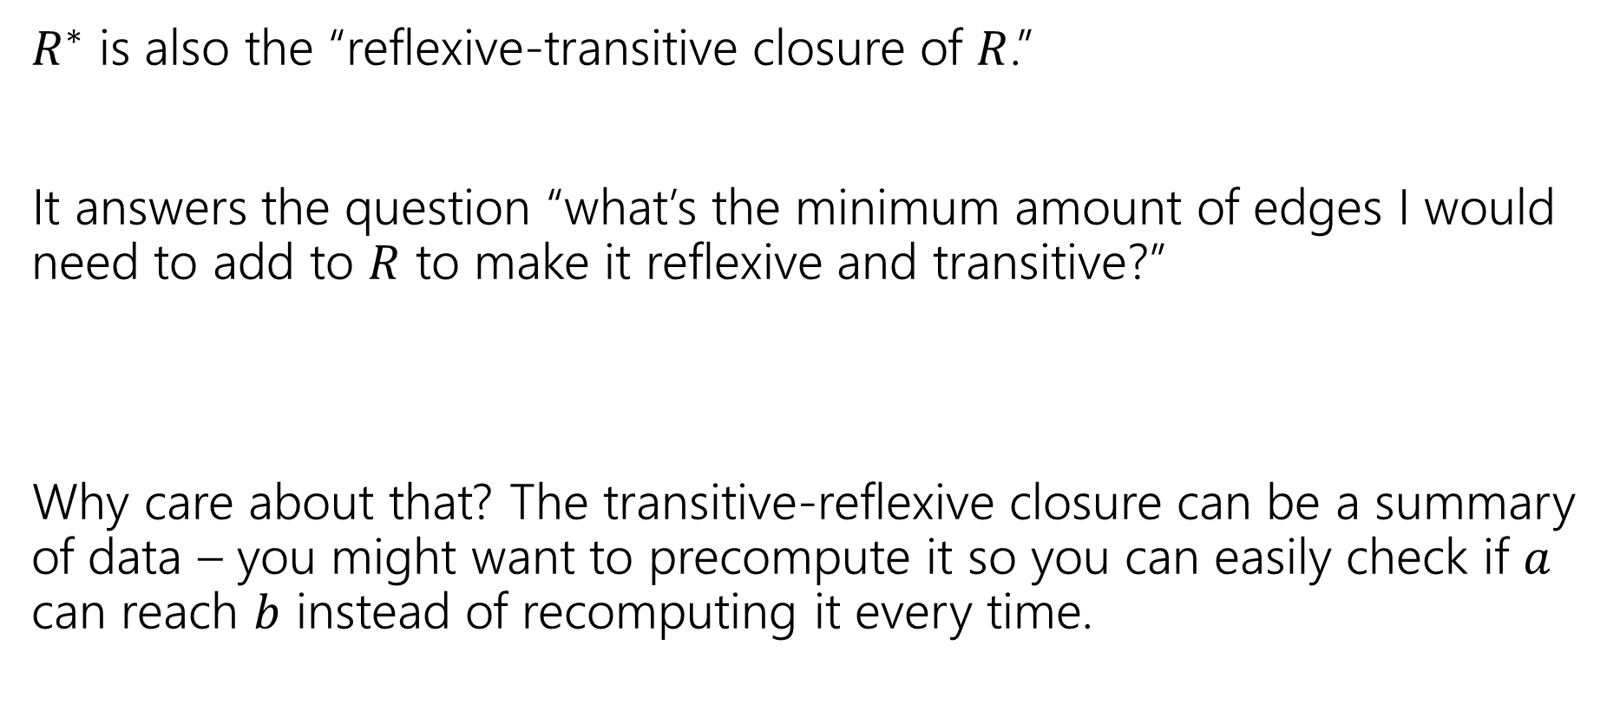

What’s the point of $R^{∗}$
$R^{∗}$ is also the “reflexive-transitive closure of $R$.”
It answers the question “what’s the minimum amount of edges I would need to add to $R$ to make it reflexive and transitive?”
Why care about that? The transitive-reflexive closure can be a summary of data – you might want to precompute it so you can easily check if $a$ can reach $b$ instead of recomputing it every time.

Slide 18
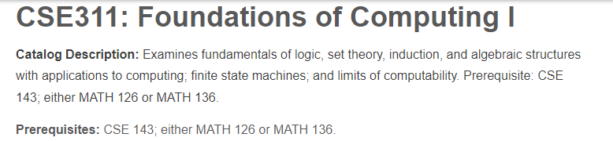
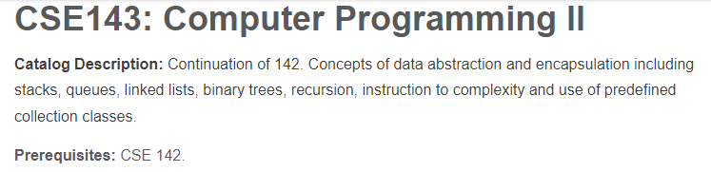

What’s the point of $R^{∗}$?
Do you need to take 142 before you take 311?

Slide 19
Relations and Graphs
Describe how each property will show up in the graph of a relation.
Reflexive
Symmetric
Antisymmetric
Transitive

Slide 20
Relations and Graphs
Describe how each property will show up in the graph of a relation.
Reflexive
Symmetric
Antisymmetric
Transitive
Every vertex has a “self-loop” (an edge from the vertex to itself)
Every edge has its “reverse edge” (going the other way) also in the graph.
No edge has its “reverse edge” (going the other way) also in the graph.
If there’s a length-2 path from $a$ to $b$ then there’s a direct edge from $a$ to $b$

Slide 21
Finite State Machines
The rest of this deck is “fair game” for homework and exams.

Slide 22
Last Two Weeks
What computers can and can’t do…
  Given any finite amount of time.
We’ll start with a simple model of a computer – finite state machines.
What do we want computers to do? Let’s start very simple.
We’ll give them an input (in a string format), and we want them to say “yes” or “no” for that string on a certain question.
Example questions one might want to answer.
  Does this input java code compile to a valid program?
  Does this input string match a particular regular expression?
  Is this input list sorted?
  Depending on the “computer” some questions might be out of reach.

Slide 23
Deterministic Finite Automaton
Our machine is going to get a string as input.
It will read one character at a time and update “its state.”
At every step, the machine thinks of itself as in one of the (finite number) vertices.
When it reads the character it follows the arrow labeled with that character to its next state.
Start at the “start state” (unlabeled, incoming arrow).
After you’ve read the last character, accept the string if and only if you’re in a “final state” (double circle).

Slide 24
Let’s see an example
Input string:
011
1010

Slide 25
Let’s see an example
Input string:
011
1010

Slide 26
Let’s see an example
Input string:
011
1010

Slide 27
Let’s see an example
Input string:
011
1010

Slide 28
Let’s see an example
Input string:
011
1010

Slide 29
Let’s see an example
Input string:
011
1010

Slide 30
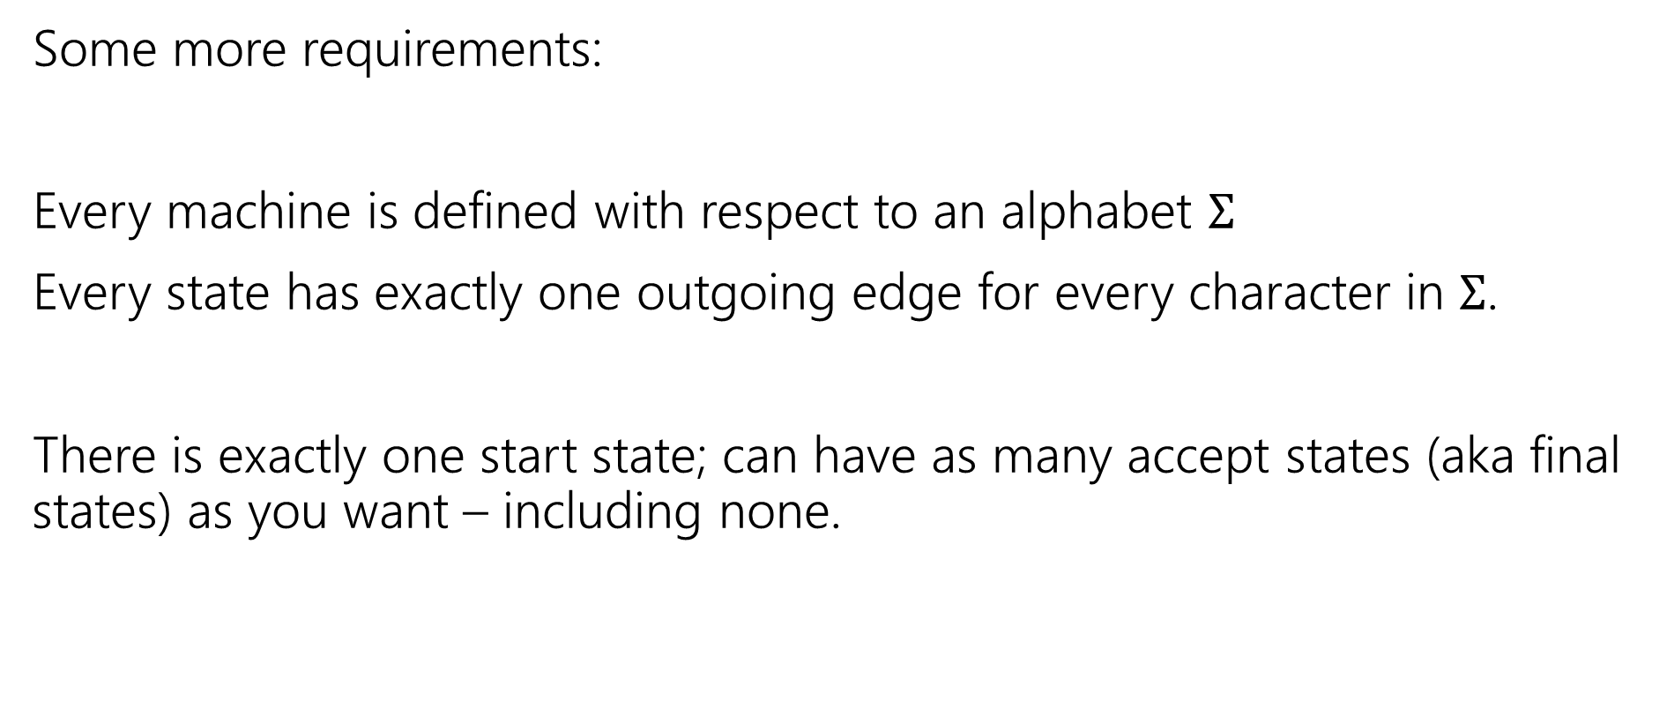
Deterministic Finite Automata
Some more requirements:
Every machine is defined with respect to an alphabet $Σ$
Every state has exactly one outgoing edge for every character in $Σ$.
There is exactly one start state; can have as many accept states (aka final states) as you want – including none.

Slide 31
Deterministic Finite Automata
Can also represent transitions with a table.
Old State | 0 | 1
s₀ | s₀ | s₁
s₁ | s₀ | s₂
s₂ | s₀ | s₃
s₃ | s₃ | s₃
0
0
1
1
1
s₀
s₁
s₂
s₃
0
0,1

Slide 32
Deterministic Finite Automata
What is the language of this DFA?
I.e. the set of all strings it accepts?
Old State | 0 | 1
s₀ | s₀ | s₁
s₁ | s₀ | s₂
s₂ | s₀ | s₃
s₃ | s₃ | s₃
0
0
1
1
1
s₀
s₁
s₂
s₃
0
0,1

Slide 33

Deterministic Finite Automata
If the string has $111$, then you’ll end up in $s_{3}$ and never leave.
If you end with a $0$ you’re back in $s_{0}$ which also accepts.
And…$ε$ is also accepted
$\left[{\left(0∪1\right)}^{∗}111{\left(0∪1\right)}^{∗}\right]∪{\left[{\left(0∪1\right)}^{∗}0\right]}^{∗}$
Old State | 0 | 1
s₀ | s₀ | s₁
s₁ | s₀ | s₂
s₂ | s₀ | s₃
s₃ | s₃ | s₃
0
0
1
1
1
s₀
s₁
s₂
s₃
0
0,1

Slide 34
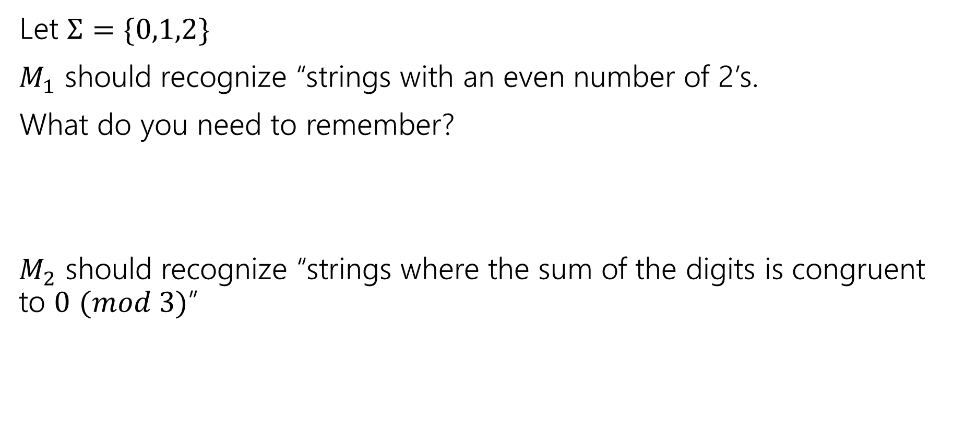
Design some DFAs
Let $Σ=\{0,1,2\}$
$M_{1}$ should recognize “strings with an even number of 2’s.
What do you need to remember?
$M_{2}$ should recognize “strings where the sum of the digits is congruent to $0$ $(mod 3)$”

Slide 35




Design some DFAs
Let $Σ=\{0,1,2\}$
$M_{1}$ should recognize “strings with an even number of 2’s.
$M_{2}$ should recognize “strings where the sum of the digits is congruent to $0$ $(mod 3)"$
2
s₁
s₀
2
0,1
0,1
1
$$t_{2}$$
1
2
2
$$t_{1}$$
2
$$t_{0}$$
0
1
0

Slide 36
Designing DFAs notes
DFAs can’t “count arbitrarily high”
For example, we could not make a DFA that remembers the overall sum of all the digits (not taken % 3)
That would have infinitely many states! We’re only allowed a finite number.

Slide 37
Strings over {0,1,2} w/ even number of 2’s and sum%3=0
s₀t₁
s₁t₂
s₀t₀
s₁t₀
s₀t₂
s₁t₁

Slide 38
Strings over {0,1,2} w/ even number of 2’s and sum%3=0
0
0
s₀t₁
2
s₁t₂
2
1
1
1
0
0
s₀t₀
2
s₁t₀
2
1
1
1
2
s₀t₂
s₁t₁
0
2
0

Slide 39
Strings over {0,1,2} w/ even number of 2’s and sum%3=0
s₀t₀
s₁t₀
s₀t₁
s₁t₁
s₀t₂
s₁t₂

Slide 40
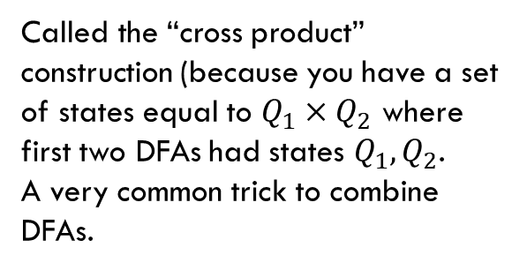
Strings over {0,1,2} w/ even number of 2’s and sum%3=0
Changed notation – final states with bold outlines.
0
0
s₀t₀
s₁t₀
2
2
1
1
0
0
s₀t₁
2
2
s₁t₁
1
1
1
1
Called the “cross product” construction (because you have a set of states equal to $Q_{1}×Q_{2}$ where first two DFAs had states $Q_{1},Q_{2}$.
A very common trick to combine DFAs.
2
2
s₀t₂
s₁t₂
0
0

Slide 41
Strings over {0,1,2} w/ even number of 2’s and sum%3=0
Changed notation – final states with bold outlines.
0
0
s₀t₀
s₁t₀
2
2
1
1
0
0
s₀t₁
2
2
s₁t₁
1
1
1
1
Called the “cross product” construction (because you have a set of states equal to $Q_{1}×Q_{2}$ where first two DFAs had states $Q_{1},Q_{2}$.
A very common trick to combine DFAs.
2
2
s₀t₂
s₁t₂
0
0
“even # 2’s”
“odd # 2’s”

Slide 42
Strings over {0,1,2} w/ even number of 2’s and sum%3=0
Changed notation – final states with bold outlines.
0
0
s₀t₀
s₁t₀
2
2
“sum%3 = 0”
1
1
0
0
s₀t₁
2
2
s₁t₁
1
1
“sum%3 = 1”
1
1
Called the “cross product” construction (because you have a set of states equal to $Q_{1}×Q_{2}$ where first two DFAs had states $Q_{1},Q_{2}$.
A very common trick to combine DFAs.
2
2
s₀t₂
s₁t₂
0
0
“sum%3 = 2”

Slide 43
Strings over {0,1,2} w/ even number of 2’s OR sum%3=0
0
0
s₀t₀
s₁t₀
Want to change the and to or – don’t need to change states or transitions…
2
2
1
1
0
0
s₀t₁
2
2
s₁t₁
1
1
1
1
2
2
s₀t₂
s₁t₂
0
0

Slide 44
Strings over {0,1,2} w/ even number of 2’s OR sum%3=0
0
0
s₀t₀
s₁t₀
Want to change the and to or – don’t need to change states or transitions…
Just which accept.
2
2
1
1
0
0
s₀t₁
2
2
s₁t₁
1
1
1
1
2
2
s₀t₂
s₁t₂
0
0

Slide 45
The set of binary strings with a 1 in the 3rd position from the start

Slide 46

The set of binary strings with a 1 in the 3rd position from the start
R
0,1
0
s₀
0,1
s₁
0,1
s₂
1
A
0,1

Slide 47
The set of binary strings with a 1 in the 3rd position from the end
What do we need to remember?
We can’t know what string was third from the end until we have read the last character.
So we’ll need to keep track of “the character that was 3 ago” in case this was the end of the string.
But if it’s not…we’ll need the character 2 ago, to update what the character 3 ago becomes. Same with the last character.

Slide 48
3 bit shift register
“Remember the last three bits”
001
1
011
1
0
1
1
1
0
000
1
010
101
0
111
1
0
0
1
0
0
100
0
110

Slide 49
The set of binary strings with a 1 in the 3rd position from the end
0
1
0
1
0
1
0
1
00
01
10
11
1
1
1
1
0
0
0
0
001
1
011
1
0
1
1
1
0
000
1
010
101
0
111
1
0
0
1
0
0
100
0
110

Slide 50
The set of binary strings with a 1 in the 3rd position from the end
001
1
011
1
0
1
1
1
0
000
1
010
101
0
111
1
0
0
1
0
0
100
0
110

Slide 51
The beginning versus the end
R
0
0,1
s₀
0,1
s₁
0,1
s₂
1
A
0,1
001
1
011
1
0
1
1
1
0
000
1
010
101
0
111
1
0
0
0
1
0
100
0
110

Slide 52
From the beginning was “easier” than “from the end”
At least in the sense that we needed fewer states.
That might be surprising since a java program wouldn’t be much different for those two.
Not being able to access the full input at once limits your abilities somewhat and makes some jobs harder than others.

Slide 53
What language does this machine recognize?
1
s₀
s₁
1
0
0
0
0
1
s₂
s₃
1

Slide 54
What language does this machine recognize?
1
s₀
s₁
1
0
0
0
0
1
s₂
s₃
1
#1s even
#1s odd

Slide 55
What language does this machine recognize?
1
s₀
s₁
#0s even
1
0
0
0
0
1
s₂
s₃
#0s odd
1

Slide 56
What language does this machine recognize?
1
s₀
s₁
1
0
0
#0s is congruent to #1s (mod 2)
Wait…there’s an easier way to describe that….
0
0
1
s₂
s₃
1

Slide 57
What language does this machine recognize?
1
s₀
s₁
That’s all binary strings of even length.
1
0
0
0,1
0
0
s₀
s₁
1
0,1
s₂
s₃
1

Slide 58
Takeaways
The first DFA might not be the simplest.
Try to think of other descriptions – you might realize you can keep track of fewer things than you thought.
Boy…it’d be nice if we could know that we have the smallest possible DFA for a given language…

Slide 59
DFA Minimization
We can know!
Fun fact: there is a unique minimum DFA for every language (up to renaming the states)
High level idea – final states and non-final states must be different.
Otherwise, hope that states can be the same, and iteratively separate when they have to go to different spots.
In some quarters, we cover it in detail. But…we ran out of time.
Optional slides will be posted – won’t be required in HW or final but you might find it useful/interesting for your own learning.

Slide 60

Next Time
Some (historic and modern) applications of DFAs
There are some languages DFAs can’t recognize (say, {$0^{k}1^{k}|k≥0\}$)
What if we give the DFAs a little more power…try to get them to do more things.

