Slide 1
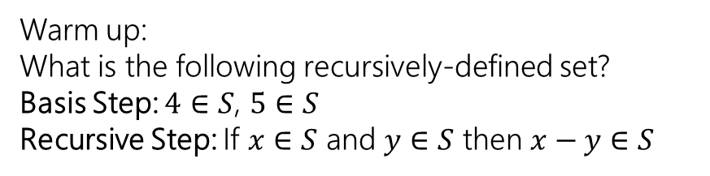
Structural Induction and Regular Expressions
Warm up:
What is the following recursively-defined set?
Basis Step: $4∈S$, $5∈S$
Recursive Step: If $x∈S$ and $y∈S$ then $x−y∈S$
CSE 311 Autumn 2023
Lecture 19

Slide 2
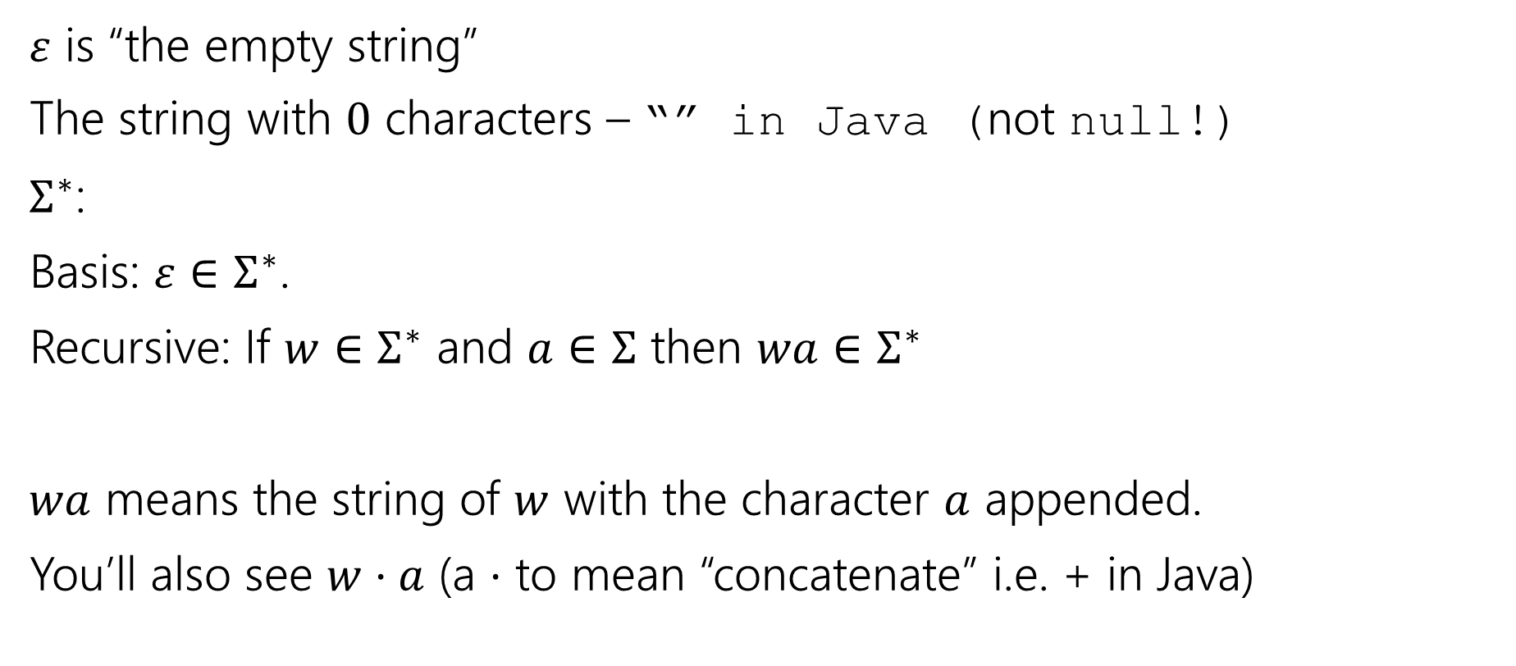
Strings
$ε$ is “the empty string”
The string with $0$ characters – “” in Java (not null!)
$Σ^{∗}$:
Basis: $ε∈Σ^{∗}$.
Recursive: If $w∈Σ^{∗}$ and $a∈Σ$ then $wa∈Σ^{∗}$
$wa$ means the string of $w$ with the character $a$ appended.
You’ll also see $w⋅a$ (a $⋅$ to mean “concatenate” i.e. + in Java)

Slide 3
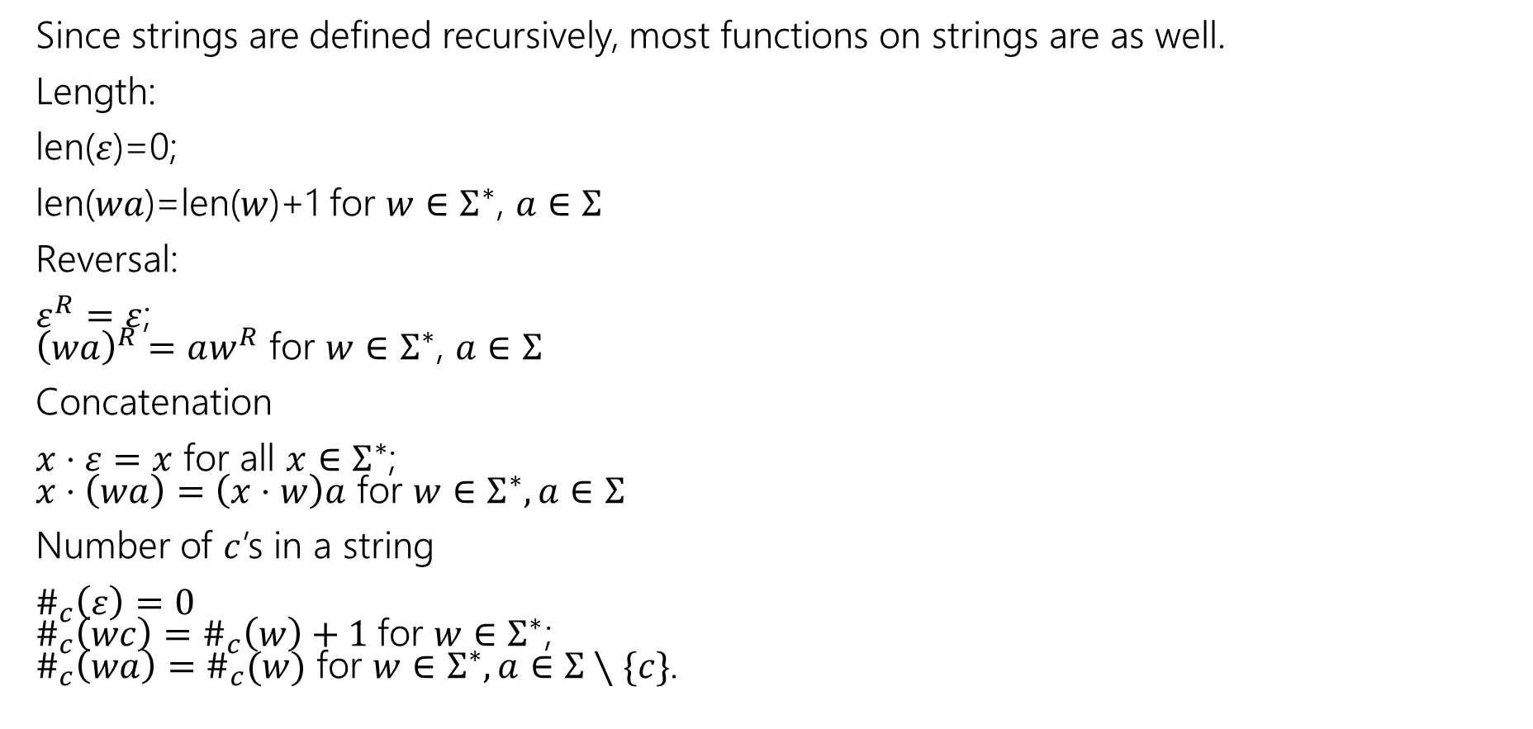
Functions on Strings
Since strings are defined recursively, most functions on strings are as well.
Length:
len($ε$)=0;
len($wa$)=len($w$)+1 for $w∈Σ^{∗}$, $a∈Σ$
Reversal:
$ε^{R}=ε$;
${\left(wa\right)}^{R}=aw^{R}$ for $w∈Σ^{∗}$, $a∈Σ$
Concatenation
$x⋅ε=x$ for all $x∈Σ^{∗}$;
$x⋅\left(wa\right)=\left(x⋅w\right)a$ for $w∈Σ^{∗},a∈Σ$
Number of $c$’s in a string
$\#_{c}\left(ε\right)=0$
$\#_{c}\left(wc\right)=\#_{c}\left(w\right)+1$for $w∈Σ^{∗}$;
$\#_{c}\left(wa\right)=\#_{c}(w)$ for $w∈Σ^{∗},a∈Σ∖\{c\}$.

Slide 4
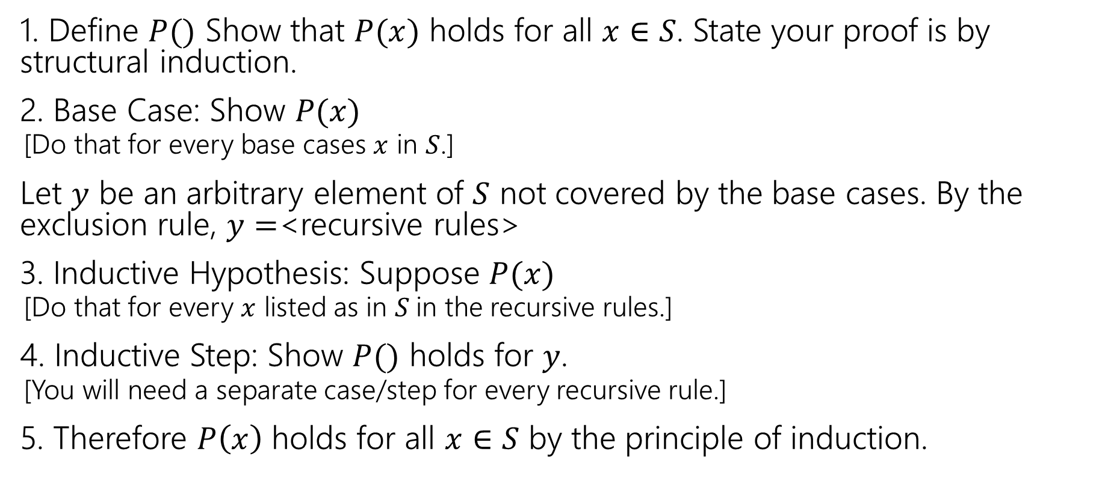
Structural Induction Template
1. Define $P()$ Show that $P(x)$ holds for all $x∈S$. State your proof is by structural induction.
2. Base Case: Show $P(x)$
  [Do that for every base cases $x$ in $S$.]
Let $y$ be an arbitrary element of $S$ not covered by the base cases. By the exclusion rule, $y=$<recursive rules>
3. Inductive Hypothesis: Suppose $P(x)$
  [Do that for every $x$ listed as in $S$in the recursive rules.]
4. Inductive Step: Show $P()$ holds for $y$.
  [You will need a separate case/step for every recursive rule.]
5. Therefore $P\left(x\right)$ holds for all $x∈S$ by the principle of induction.

Slide 5
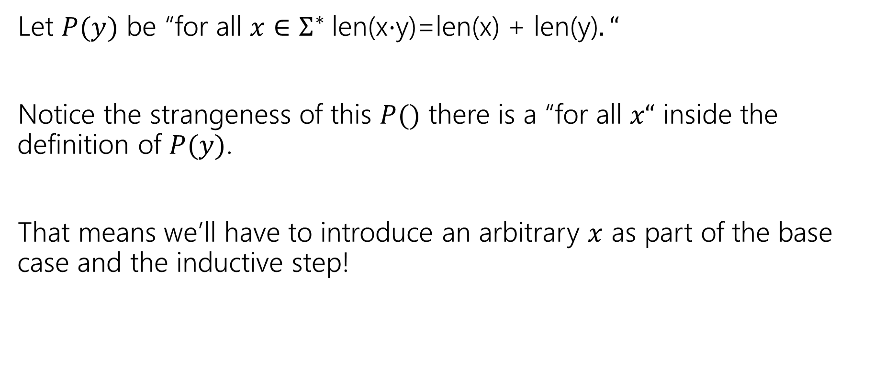
Claim for all $x,y∈Σ^{∗}$len(x$⋅$y)=len(x) + len(y).
Let $P(y)$ be “for all $x∈Σ^{∗}$len(x$⋅$y)=len(x) + len(y)$.“$
Notice the strangeness of this $P()$ there is a “for all $x“$ inside the definition of $P(y)$.
That means we’ll have to introduce an arbitrary $x$ as part of the base case and the inductive step!

Slide 6

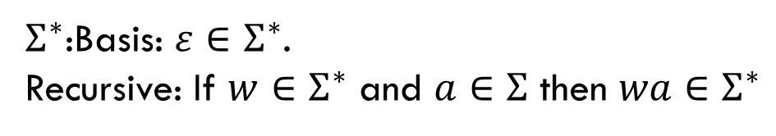
Claim for all $x,y∈Σ^{∗}$len(x$⋅$y)=len(x) + len(y).
Define Let $P(y)$ be “for all $x∈Σ^{∗}$len(x$⋅$y)=len(x) + len(y)$.“$
We prove $P(y)$ for all $y∈Σ^{∗}$ by structural induction.
Base Case:
Inductive Hypothesis:
Inductive Step:
$Σ^{∗}$:Basis: $ε∈Σ^{∗}$.
Recursive: If $w∈Σ^{∗}$ and $a∈Σ$ then $wa∈Σ^{∗}$

Slide 7
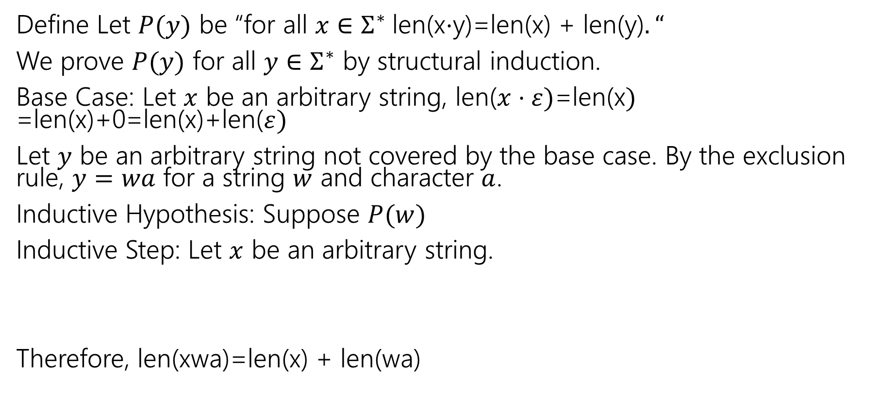
Claim for all $x,y∈Σ^{∗}$len(x$⋅$y)=len(x) + len(y).
Define Let $P(y)$ be “for all $x∈Σ^{∗}$len(x$⋅$y)=len(x) + len(y)$.“$
We prove $P(y)$ for all $y∈Σ^{∗}$ by structural induction.
Base Case: Let $x$ be an arbitrary string, len($x⋅ε)$=len(x$)$
=len(x)+0=len(x)+len($ε)$
Let $y$ be an arbitrary string not covered by the base case. By the exclusion rule, $y=wa$ for a string $w$ and character $a$.
Inductive Hypothesis: Suppose $P(w)$
Inductive Step: Let $x$ be an arbitrary string.
Therefore, len(xwa)=len(x) + len(wa)
$Σ^{∗}$:Basis: $ε∈Σ^{∗}$.
Recursive: If $w∈Σ^{∗}$ and $a∈Σ$ then $wa∈Σ^{∗}$

Slide 8
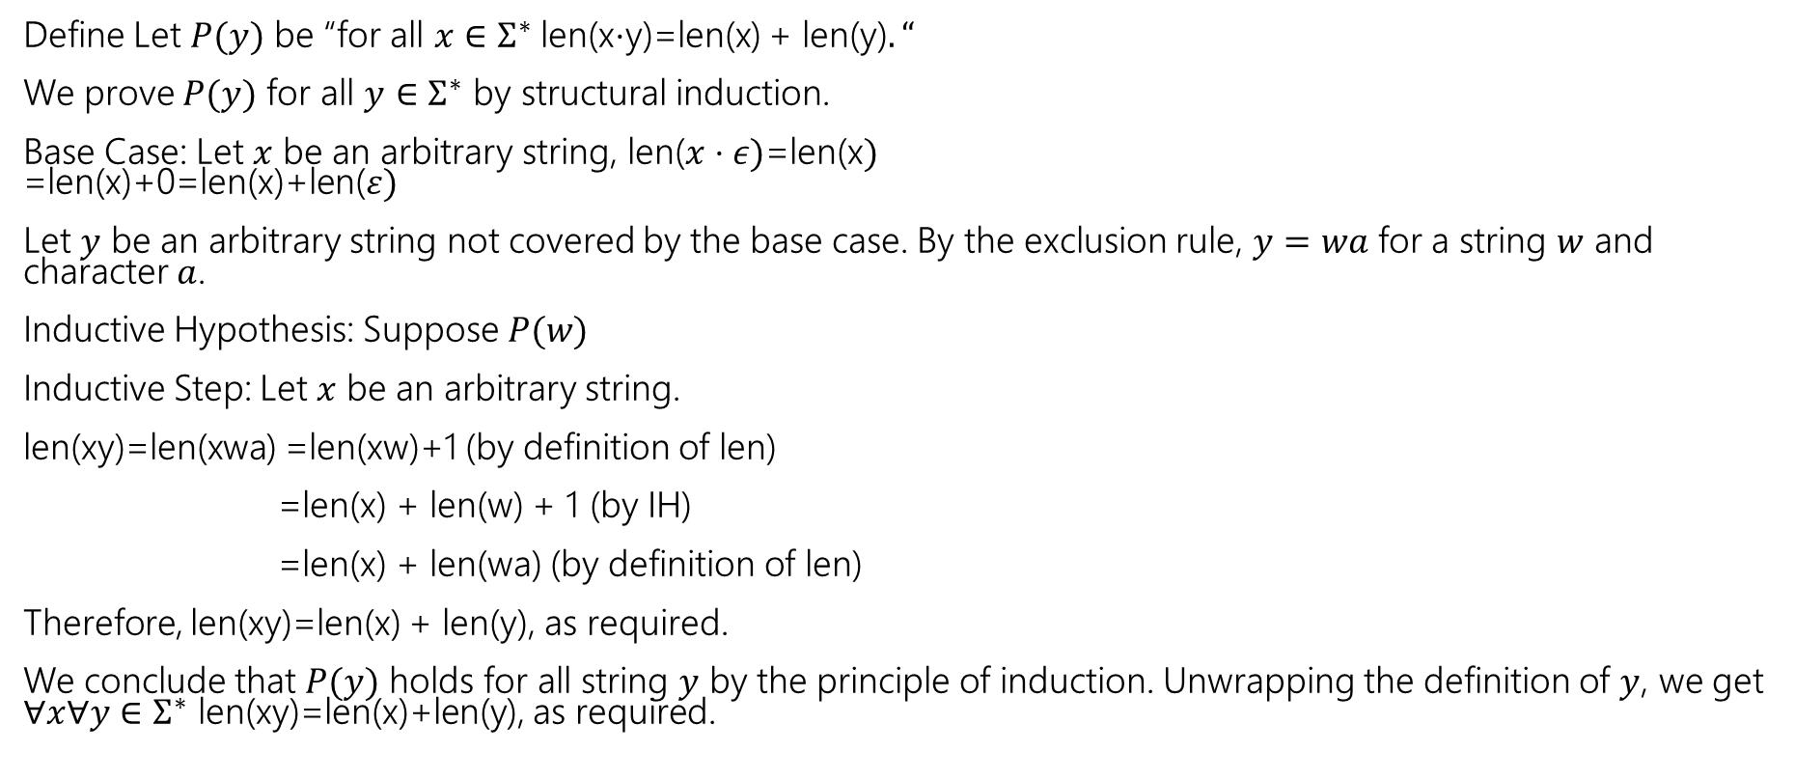
Claim for all $x,y∈Σ^{∗}$len(x$⋅$y)=len(x) + len(y).
Define Let $P(y)$ be “for all $x∈Σ^{∗}$len(x$⋅$y)=len(x) + len(y)$.“$
We prove $P(y)$ for all $y∈Σ^{∗}$ by structural induction.
Base Case: Let $x$ be an arbitrary string, len($x⋅ε)$=len(x$)$
=len(x)+0=len(x)+len($ε)$
Let $y$ be an arbitrary string not covered by the base case. By the exclusion rule, $y=wa$ for a string $w$ and character $a$.
Inductive Hypothesis: Suppose $P(w)$
Inductive Step: Let $x$ be an arbitrary string.
len(xy)=len(xwa) =len(xw)+1 (by definition of len)
=len(x) + len(w) + 1 (by IH)
=len(x) + len(wa) (by definition of len)
Therefore, len(xy)=len(x) + len(y), as required.
We conclude that $P(y)$ holds for all string $y$ by the principle of induction. Unwrapping the definition of $y$, we get $∀x∀y∈Σ^{∗}$ len(xy)=len(x)+len(y), as required.
$Σ^{∗}$:Basis: $ε∈Σ^{∗}$.
Recursive: If $w∈Σ^{∗}$ and $a∈Σ$ then $wa∈Σ^{∗}$

Slide 9

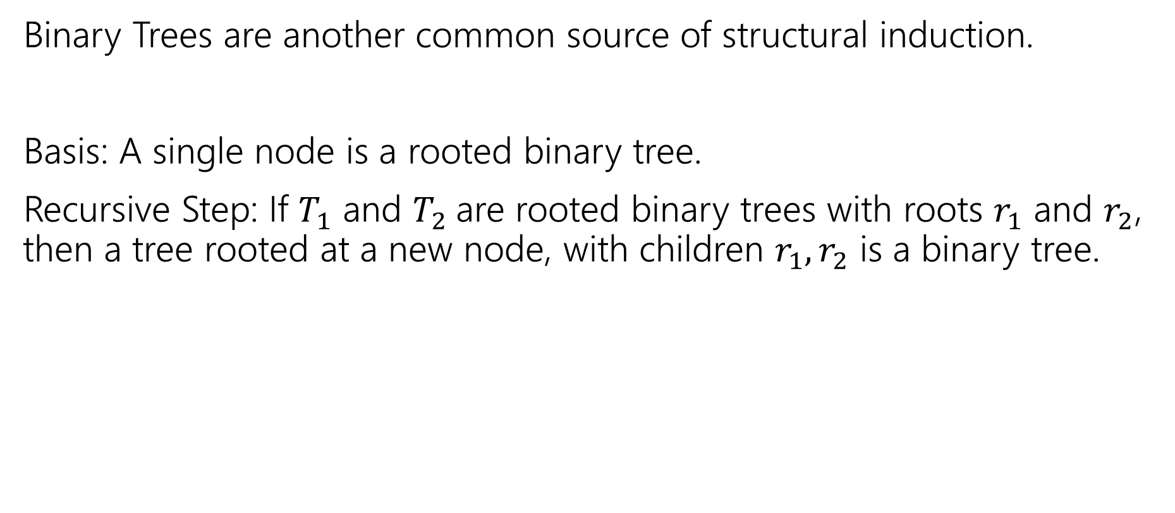

More Structural Sets
Binary Trees are another common source of structural induction.
Basis: A single node is a rooted binary tree.
Recursive Step: If $T_{1}$ and $T_{2}$are rooted binary trees with roots $r_{1}$ and $r_{2}$, then a tree rooted at a new node, with children $r_{1},r_{2}$ is a binary tree.
$$T_{1}$$
$$T_{2}$$

Slide 10





Functions on Binary Trees
size( )=1
size( ) = size($T_{1}$) + size($T_{2}$) + 1
height( ) = 0
height( ) = 1+$max⁡($height($T_{1}$),height($T_{2}$)$)$
$$T_{1}$$
$$T_{2}$$
$$T_{1}$$
$$T_{2}$$

Slide 11
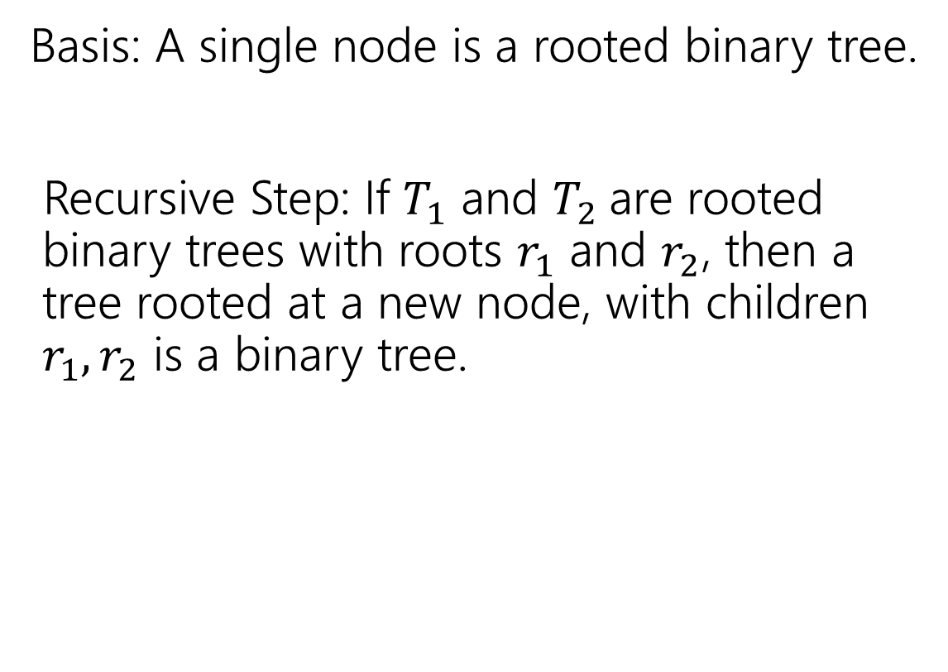
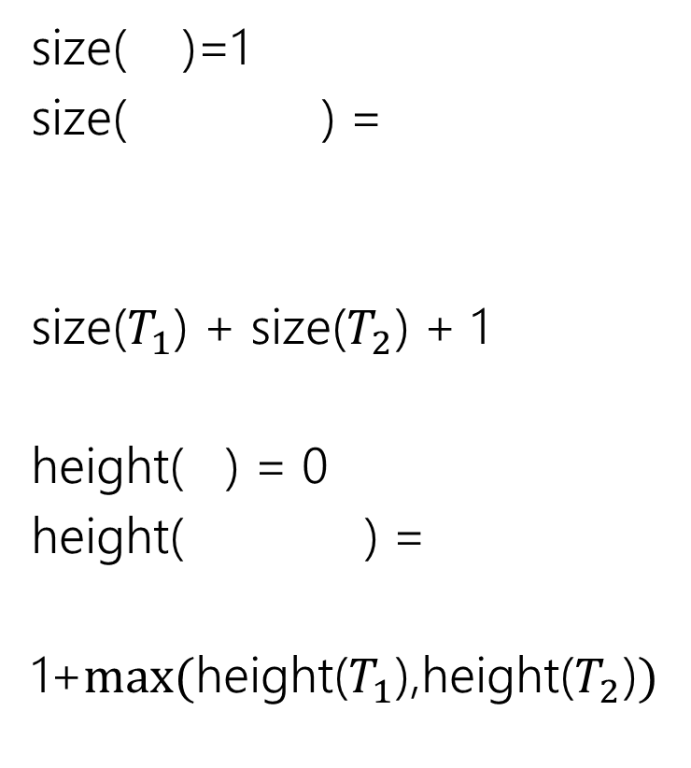
Binary Trees
size( )=1
size( ) =
size($T_{1}$) + size($T_{2}$) + 1
height( ) = 0
height( ) =
1+$max⁡($height($T_{1}$),height($T_{2}$)$)$
Basis: A single node is a rooted binary tree.
Recursive Step: If $T_{1}$ and $T_{2}$are rooted binary trees with roots $r_{1}$ and $r_{2}$, then a tree rooted at a new node, with children $r_{1},r_{2}$ is a binary tree.
$$T_{1}$$
$$T_{2}$$
$$T_{1}$$
$$T_{2}$$
$$T_{1}$$
$$T_{2}$$

Slide 12

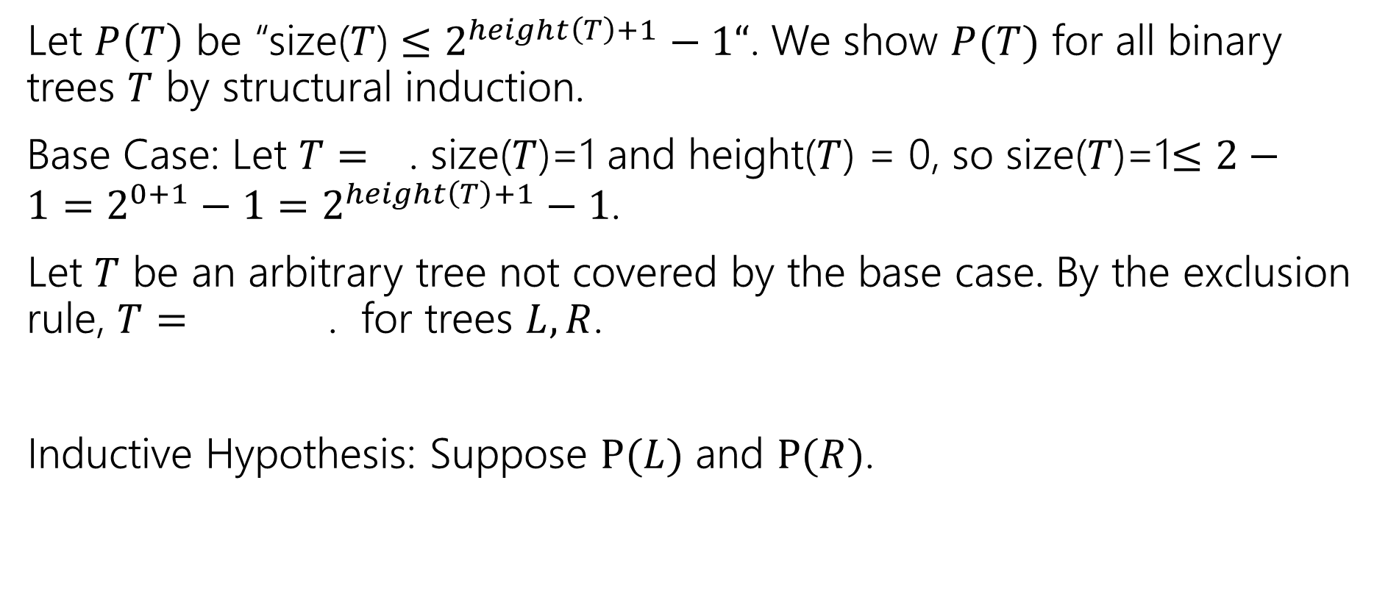

Structural Induction on Binary Trees
Let $P\left(T\right)$ be “size($T$) $≤2^{height\left(T\right)+1}−1“$. We show $P(T)$ for all binary trees $T$ by structural induction.
Base Case: Let $T=$ . size($T$)=1 and height($T$) = 0, so size($T$)=1$≤2−1=2^{0+1}−1=2^{height\left(T\right)+1}−1$.
Let $T$ be an arbitrary tree not covered by the base case. By the exclusion rule, $T=$ . for trees $L,R$.
Inductive Hypothesis: Suppose $P(L)$ and $P(R)$.
$$L$$
$$R$$

Slide 13

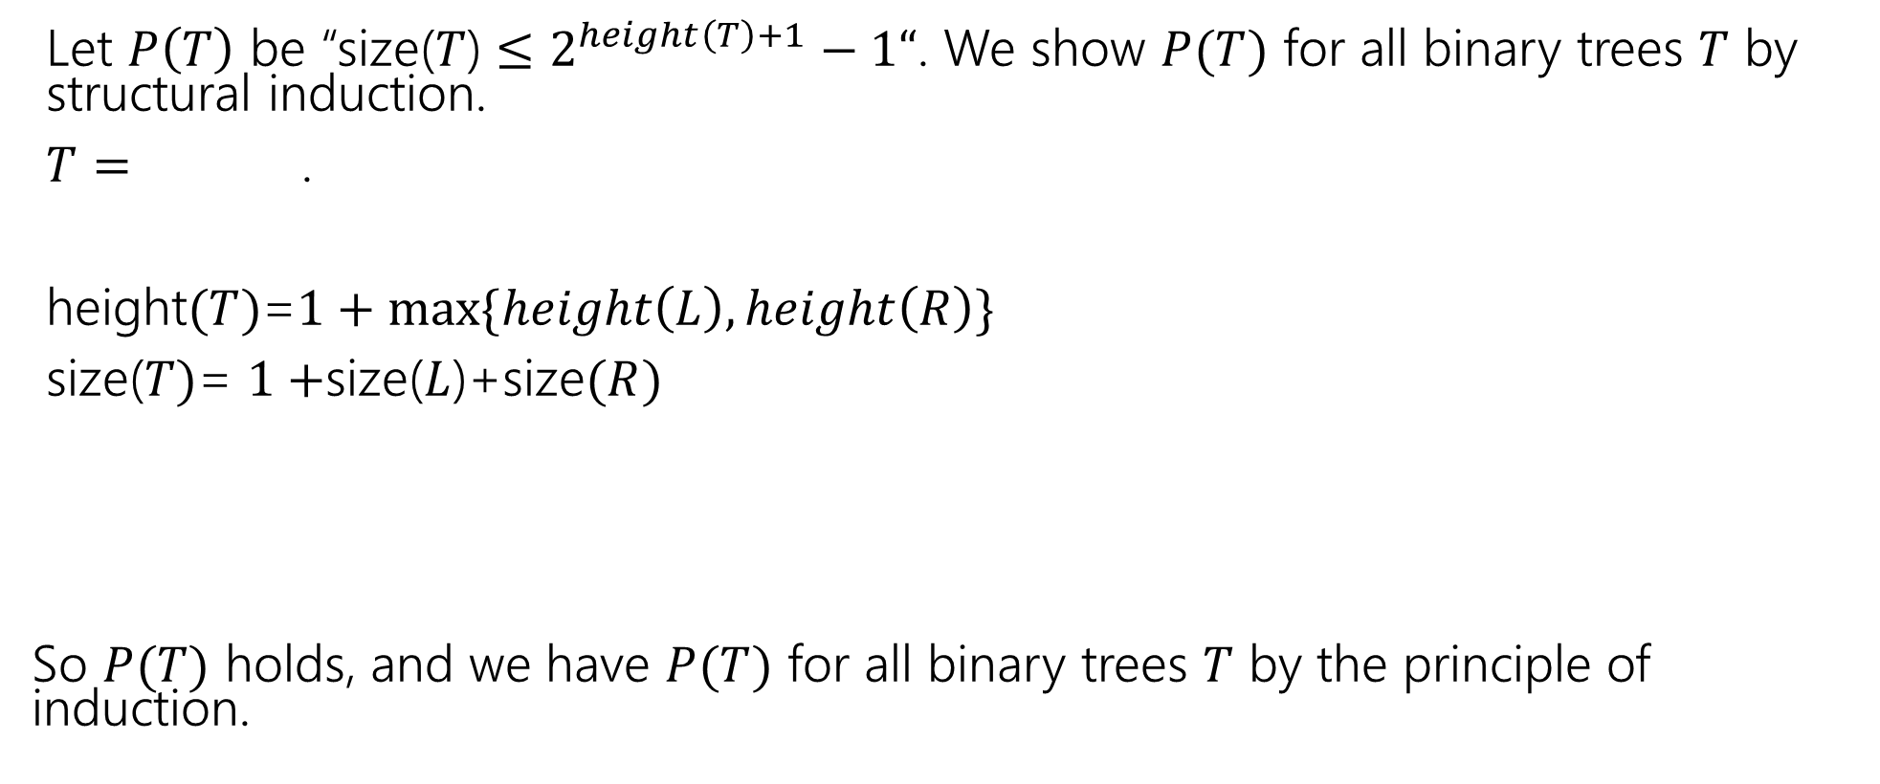

Structural Induction on Binary Trees (cont.)
Let $P\left(T\right)$ be “size($T$) $≤2^{height\left(T\right)+1}−1“$. We show $P(T)$ for all binary trees $T$ by structural induction.
$T=$ .
height$(T)$=$1+max⁡\{height\left(L\right),height\left(R\right)\}$
size($T)$= $1+$size($L$)+size$(R)$
So $P(T)$ holds, and we have $P(T)$ for all binary trees $T$ by the principle of induction.
$$L$$
$$R$$

Slide 14
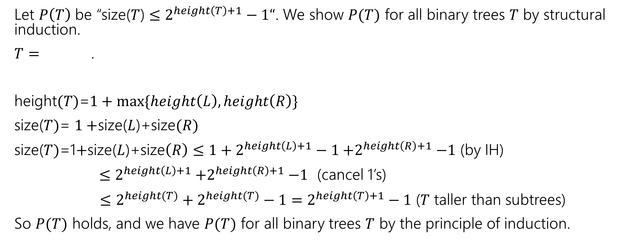
Structural Induction on Binary Trees (cont.)
Let $P\left(T\right)$ be “size($T$) $≤2^{height\left(T\right)+1}−1“$. We show $P(T)$ for all binary trees $T$ by structural induction.
$T=$ .
height$(T)$=$1+max⁡\{height\left(L\right),height\left(R\right)\}$
size($T)$= $1+$size($L$)+size$(R)$
size($T)$=1$+$size($L$)+size$\left(R\right)≤{1+2}^{height\left(L\right)+1}−1{+2}^{height\left(R\right)+1}−1$ (by IH)
$≤2^{height\left(L\right)+1}{+2}^{height\left(R\right)+1}−1$ (cancel 1’s)
$≤$ $2^{height(T)}+2^{height(T)}−1=2^{height\left(T\right)+1}−1$ ($T$ taller than subtrees)
So $P(T)$ holds, and we have $P(T)$ for all binary trees $T$ by the principle of induction.
$$L$$
$$R$$

Slide 15
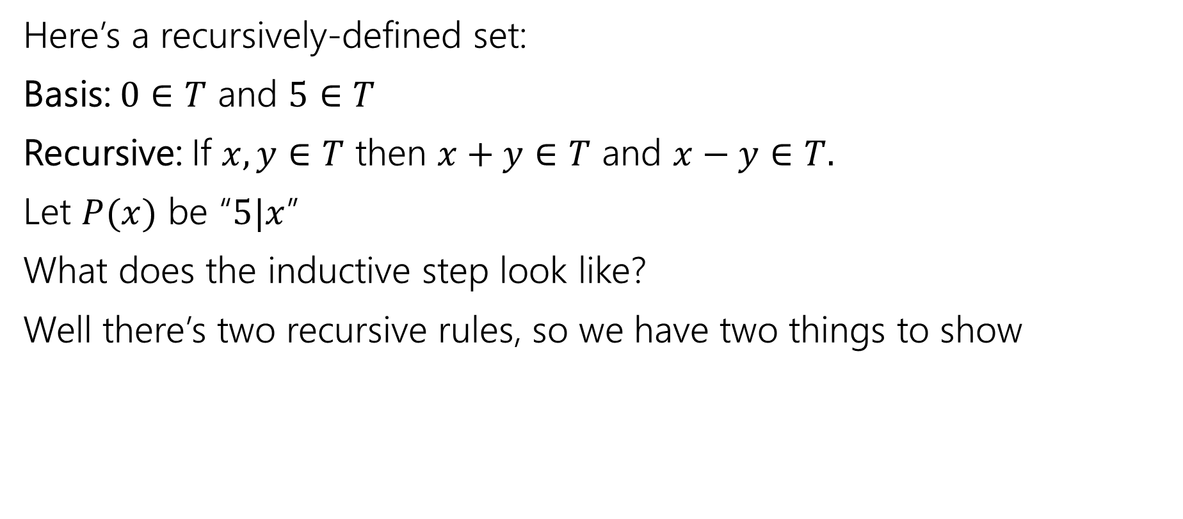
What does the inductive step look like?
Here’s a recursively-defined set:
Basis: $0∈T$ and $5∈T$
Recursive: If $x,y∈T$ then $x+y∈T$ and $x−y∈T.$
Let $P(x)$ be “$5|x$”
What does the inductive step look like?
Well there’s two recursive rules, so we have two things to show

Slide 16
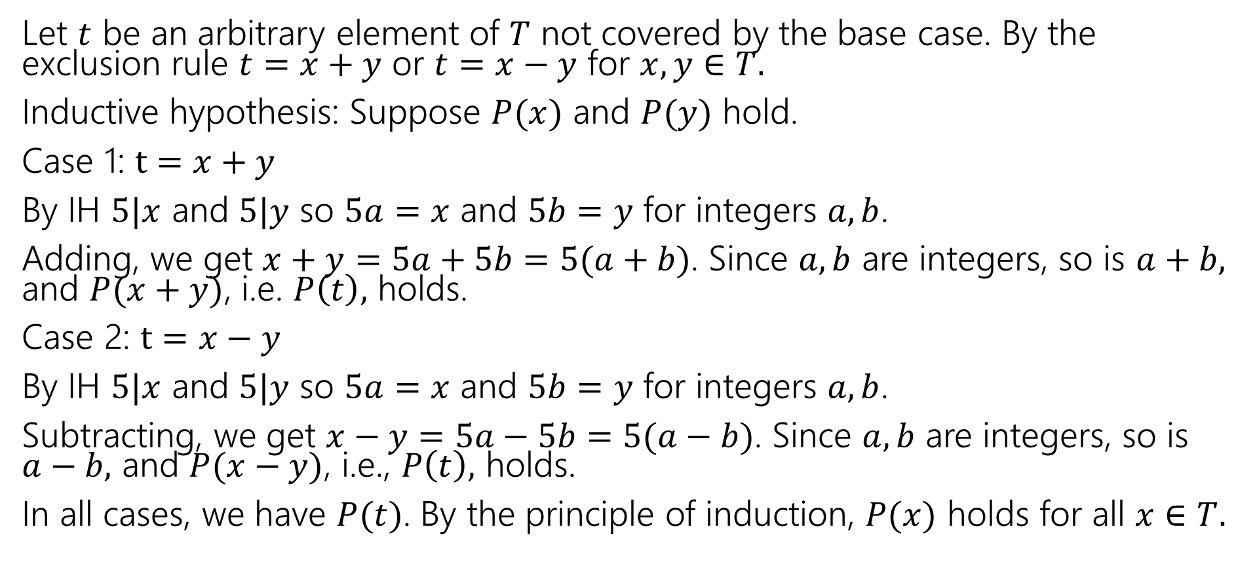
Just the IS (you still need the other steps)
Let $t$ be an arbitrary element of $T$ not covered by the base case. By the exclusion rule $t=x+y$ or $t=x−y$ for $x,y∈T.$
Inductive hypothesis: Suppose $P(x)$ and $P(y)$ hold.
Case 1: $t=x+y$
By IH $5|x$ and $5|y$ so $5a=x$ and $5b=y$ for integers $a,b$.
Adding, we get $x+y=5a+5b=5(a+b)$. Since $a,b$ are integers, so is $a+b,$ and $P(x+y)$, i.e. $P\left(t\right),$ holds.
Case 2: $t=x−y$
By IH $5|x$ and $5|y$ so $5a=x$ and $5b=y$ for integers $a,b$.
Subtracting, we get $x−y=5a−5b=5(a−b)$. Since $a,b$ are integers, so is $a−b,$ and $P(x−y)$, i.e., $P\left(t\right),$ holds.
In all cases, we have $P(t)$. By the principle of induction, $P(x)$ holds for all $x∈T.$

Slide 17
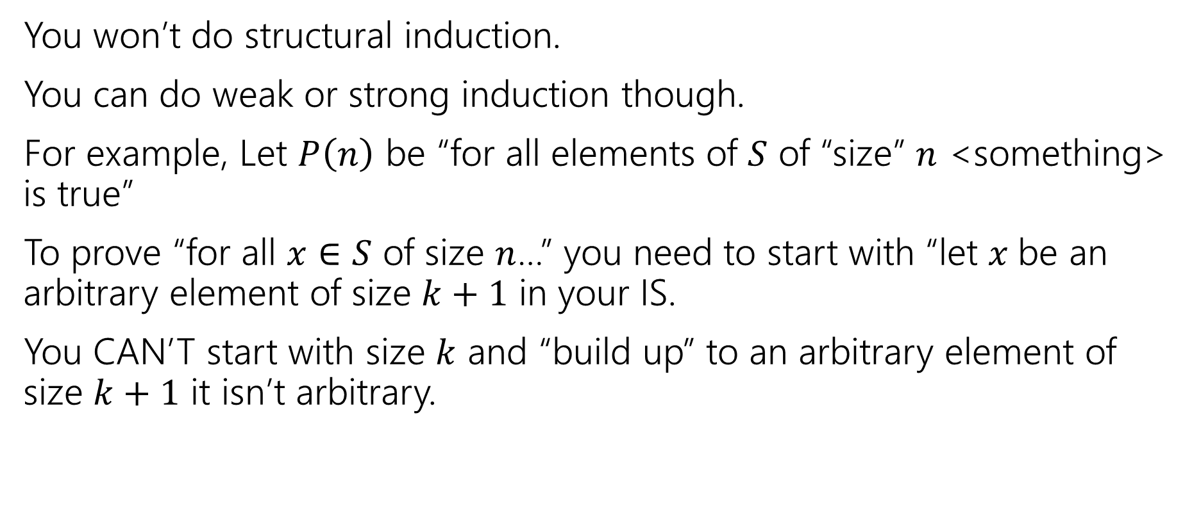
If you don’t have a recursively-defined set
You won’t do structural induction.
You can do weak or strong induction though.
For example, Let $P\left(n\right)$ be “for all elements of $S$ of “size” $n$ <something> is true”
To prove “for all $x∈S$ of size $n$…” you need to start with “let $x$be an arbitrary element of size $k+1$ in your IS.
You CAN’T start with size $k$ and “build up” to an arbitrary element of size $k+1$ it isn’t arbitrary.

Slide 18
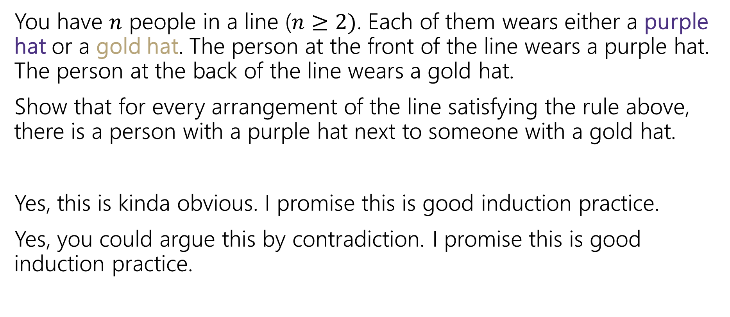
Induction: Hats!
You have $n$ people in a line ($n≥2)$. Each of them wears either a purple hat or a gold hat. The person at the front of the line wears a purple hat. The person at the back of the line wears a gold hat.
Show that for every arrangement of the line satisfying the rule above, there is a person with a purple hat next to someone with a gold hat.
Yes, this is kinda obvious. I promise this is good induction practice.
Yes, you could argue this by contradiction. I promise this is good induction practice.

Slide 19
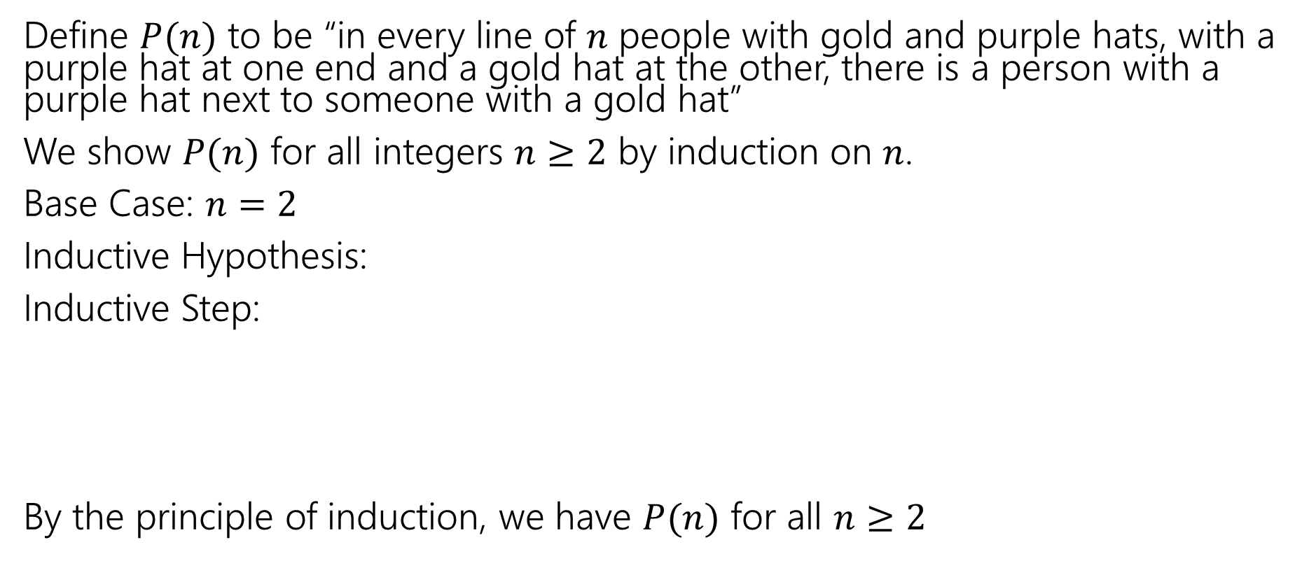
Induction: Hats!
Define $P(n)$ to be “in every line of $n$ people with gold and purple hats, with a purple hat at one end and a gold hat at the other, there is a person with a purple hat next to someone with a gold hat”
We show $P(n)$ for all integers $n≥2$ by induction on $n$.
Base Case: $n=2$
Inductive Hypothesis:
Inductive Step:
By the principle of induction, we have $P(n)$ for all $n≥2$

Slide 20
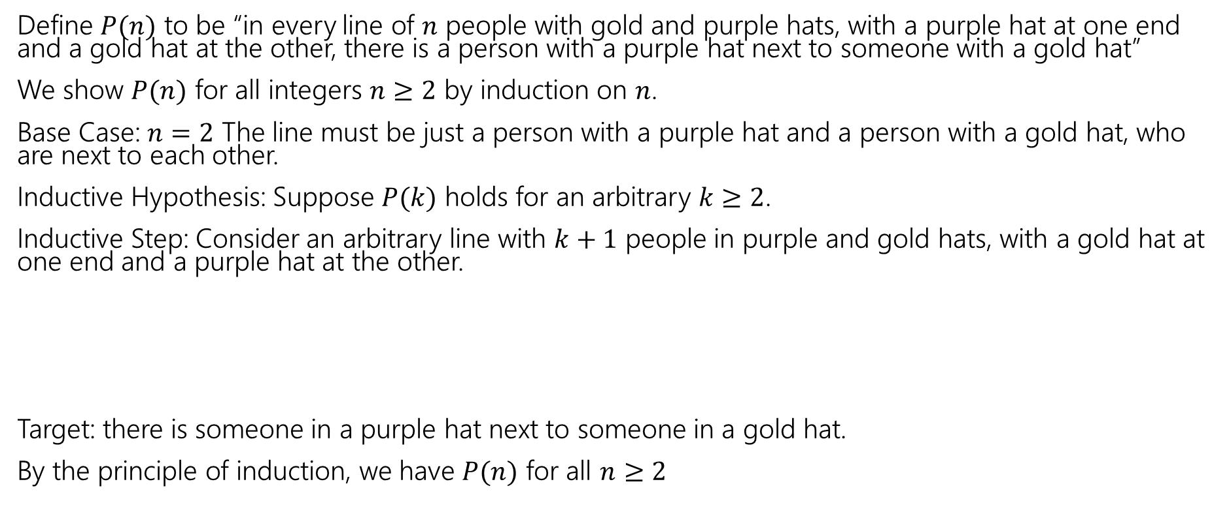
Induction: Hats!
Define $P(n)$ to be “in every line of $n$ people with gold and purple hats, with a purple hat at one end and a gold hat at the other, there is a person with a purple hat next to someone with a gold hat”
We show $P(n)$ for all integers $n≥2$ by induction on $n$.
Base Case: $n=2$ The line must be just a person with a purple hat and a person with a gold hat, who are next to each other.
Inductive Hypothesis: Suppose $P(k)$ holds for an arbitrary $k≥2$.
Inductive Step: Consider an arbitrary line with $k+1$ people in purple and gold hats, with a gold hat at one end and a purple hat at the other.
Target: there is someone in a purple hat next to someone in a gold hat.
By the principle of induction, we have $P(n)$ for all $n≥2$

Slide 21
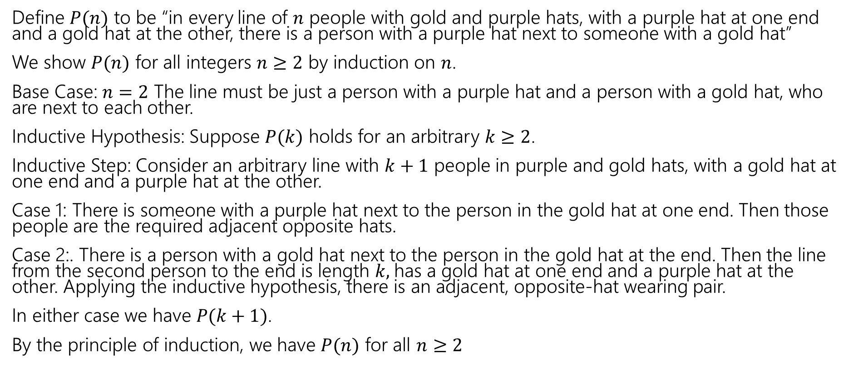
Induction: Hats!
Define $P(n)$ to be “in every line of $n$ people with gold and purple hats, with a purple hat at one end and a gold hat at the other, there is a person with a purple hat next to someone with a gold hat”
We show $P(n)$ for all integers $n≥2$ by induction on $n$.
Base Case: $n=2$ The line must be just a person with a purple hat and a person with a gold hat, who are next to each other.
Inductive Hypothesis: Suppose $P(k)$ holds for an arbitrary $k≥2$.
Inductive Step: Consider an arbitrary line with $k+1$ people in purple and gold hats, with a gold hat at one end and a purple hat at the other.
Case 1: There is someone with a purple hat next to the person in the gold hat at one end. Then those people are the required adjacent opposite hats.
Case 2:. There is a person with a gold hat next to the person in the gold hat at the end. Then the line from the second person to the end is length $k,$has a gold hat at one end and a purple hat at the other. Applying the inductive hypothesis, there is an adjacent, opposite-hat wearing pair.
In either case we have $P(k+1)$.
By the principle of induction, we have $P(n)$ for all $n≥2$

Slide 22
Part 3 of the course!

Slide 23
Course Outline
Symbolic Logic (training wheels)
  Just make arguments in mechanical ways.
Set Theory/Number Theory (bike in your backyard)
Models of computation (biking in your neighborhood)
  Still make and communicate rigorous arguments
  But now with objects you haven’t used before.
    A first taste of how we can argue rigorously about computers.
  Next week: regular expressions and context free grammars – understand these “simpler computers”
  Soon: what these simple computers can do
  Then: what simple computers can’t do.
  Last week: A problem our computers cannot solve.

