Slide 1
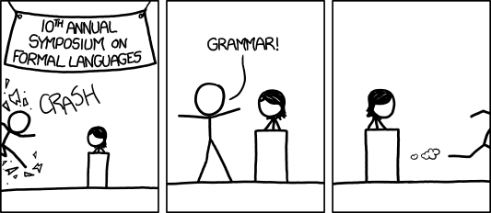
CFGs Relations
[Audience looks around] “What just happened?” “There must be some context we’re missing.”
xkcd.com/1090
CSE 311 Autumn 2023
Lecture 22

Slide 2
Announcements
Don’t forget about HW6 (due Wednesday, but remember late days are different; see the homework pdf).
Today, CSE 403 6PM Jacob will have “how to get started” OH.
CC22 out tonight
Slides for Wednesday, CC23 will be available tomorrow morning; if you’re traveling early, you can work ahead.
OH are changed this week (none Thurs/Fri; some Wed switched to zoom)
HW7 will be available Wednesday if you want to work ahead.

Slide 3
Context Free Grammars

Slide 4
Examples
$S→0S0\left|1S1\right|0|1|ε$
The set of all binary palindromes
$S→0S|S1|ε$
The set of all strings with any 0’s coming before any 1’s (i.e. $0^{∗}1^{∗}$)
$S→\left(S\right)\left|SS\right|ε$
Balanced parentheses
$S→AB$
$A→0A1|ε$
$B→1B0|ε$ $\{0^{j}1^{j+k}0^{k}:j,k≥0\}$

Slide 5
Multiple ways of generating strings
Generate $2+3∗4$in two different ways
$E⇒E+E⇒E+E∗E⇒2+E∗E⇒2+3∗E⇒2+3∗4$
$E⇒E∗E⇒E+E∗E⇒2+E∗E⇒2+3∗E⇒2+3∗4$
What did we mean by these being different? They represent different meanings mathematically.
One says “you’re adding together two numbers: 2 and (whatever 3*4 is)”
The other says “you’re multiplying two numbers: (whatever 2+3 is) and 4”
Those have different meanings!

Slide 6
Parse Trees—remember where parentheses go
Suppose a context free grammar $G$ generates a string $x$
A parse tree of $x$ for $G$ has
Rooted at $S$ (start symbol)
Children of every $A$ node are labeled with the characters of $w$ for some $A→w$
Reading the leaves from left to right gives $x$.
$S→0S0\left|1S1\right|0\left|1\right|ε$
S
0
S
0
1
S
1
1

Slide 7
Back to the arithmetic
$E→E+E\left|E∗E\right|\left(E\right)\left|x\right|y\left|z\right|0\left|1\right|2\left|3\right|4\left|5\right|6\left|7\right|8|9$
Two parse trees for $2+3∗4$
E
E
E
+
E
E
$$∗$$
E
E
$$∗$$
E
+
E
4
2
E
3
4
2
3

Slide 8
Why do we care about parsing?
$2+3∗4$ can only mean one thing!
If I write these symbols in a program, we need to make sure we know which one to do.
The first grammar we saw was “ambiguous” it allows the same string to “mean” two different things.
Sometimes you can fix that!

Slide 9
How do we encode order of operations
If we want to keep “in order” we want there to be only one possible parse tree.
Differentiate between “things to add” and “things to multiply”
Only introduce a * sign after you’ve eliminated the possibility of introducing another + sign in that area.
$E→T|E+T$
$T→F|T∗F$
$F→\left(E\right)|N$
$N→x\left|y\right|z\left|0\right|1\left|2\right|3\left|4\right|5\left|6\right|7|8|9$
E
E
+
T
T
T
$$∗$$
F
F
N
F
N
4
N
3
2

Slide 10
How do Computer Scientists use CFGs?
Most programming languages define valid programs as “strings that fit a CFG” That makes sure Java breaks down math expressions correctly! And also code like this:
if(i>0)
if(j>0)
System.out.println(“hi”);
else(k>1)
System.out.println(“bye”);
if(i>0)
if(j>0)
System.out.println(“hi”);
else(k>1)
System.out.println(“bye”);
The else could be attached to either “if”! Java needs a rule to decide which it goes with.
Java’s convention makes the one on the left the intuitive whitespace.
(You as a programmer should put braces so the humans reading your code don’t have to wonder!)

Slide 11
CFGs in practice
Used to define programming languages.
Often written in Backus-Naur Form – just different notation
Variables are <names-in-brackets> (or sometimes without)
like <if-then-else-statement>, <condition>, <identifier>
$→$is replaced with $∷=$ or $:$

Slide 12
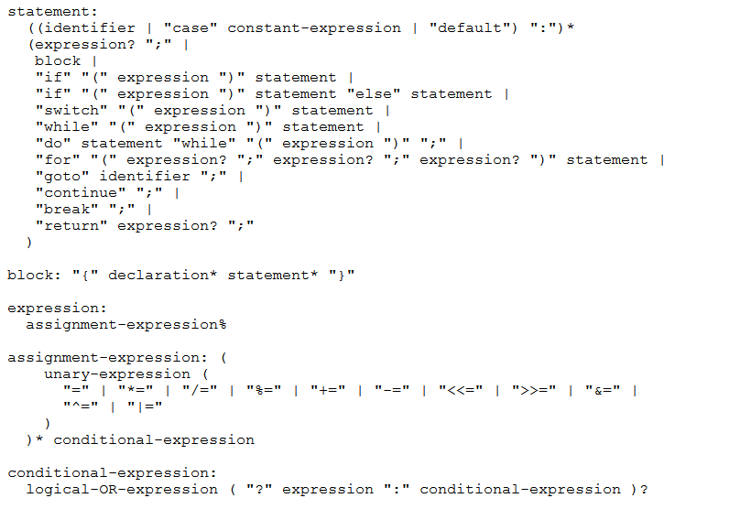
BNF for C (no <...> and uses : instead of ::=)

Slide 13
Some fun CFG applications
If we have time

Slide 14
Parse Trees
Remember diagramming sentences in middle school?
<sentence>::=<noun phrase><verb phrase>
<noun phrase>::=<determiner><adjective><noun>
<verb phrase>::=<verb><adverb>|<verb><object>
<object>::=<noun phrase>

Slide 15
Parse Trees
<sentence>::=<noun phrase><verb phrase>
<noun phrase>::=<determiner><adjective><noun>
<verb phrase>::=<verb><adverb>|<verb><object>
<object>::=<noun phrase>
The old man the boat.

Slide 16
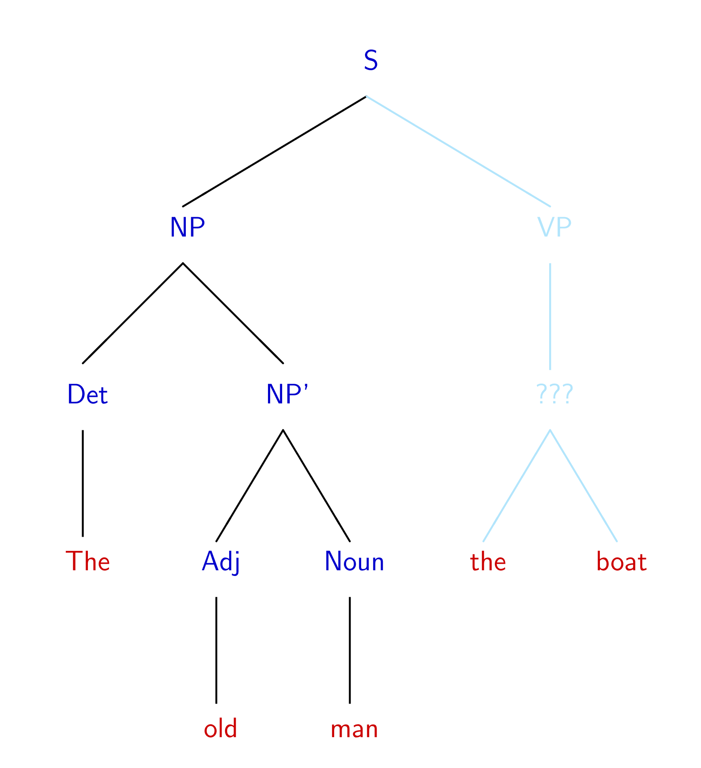
The old man the boat
By Jochen Burghardt - Own work, CC BY-SA 4.0, https://commons.wikimedia.org/w/index.php?curid=92742400

Slide 17
English is ambiguous
(Most of ‘standard’) English can be represented as a context free grammar.
It’s not perfect (ask Robbie details later).
The grammar is ambiguous! That is, there are sentences which have multiple valid parsings (multiple meanings).
Can you find multiple meanings of this sentence: “Place these 3 exercise balls on the mat at the top of the hill.”
See this video

Slide 18
The Important Takeaways

Slide 19
Power of Context Free Languages
There are languages CFGs can express that regular expressions can’t
e.g. palindromes
What about vice versa – is there a language that a regular expression can represent that a CFG can’t?
No!
Are there languages even CFGs cannot represent?
Yes!
$\{0^{k}1^{j}2^{k}3^{j}|j,k≥0\}$ cannot be written with a context free grammar.

Slide 20
Takeaways
CFGs and regular expressions gave us ways of succinctly representing sets of strings
Regular expressions super useful for representing things you need to search for
CFGs represent complicated languages like “java code with valid syntax”
This week, two more tools for our toolbox (relations, graphs)
After Thanksgiving, (mathematical representations of) Tiny computers! And how they relate to regular expressions and CFGs.

Slide 21
Relations and Graphs

Slide 22
Relations
A (binary) relation from $A$ to $B$ is a subset of $A×B$
A (binary) relation on $A$ is a subset of $A×A$
Wait what?
$≤$ is a relation on $ℤ$.
“$3≤4“$ is a way of saying “3 relates to 4” (for the $≤$ relation)
$(3,4)$ is an element of the set that defines the relation.
Relations

Slide 23
Relations, Examples
It turns out, they’ve been here the whole time
$<$ on $ℝ$ is a relation
I.e. $\{\left(x,y\right) :x<y$ and $x,y∈ℝ\}$.
$=$ on $Σ^{∗}$ is a relation
i.e. $\{\left(x,y\right) :x=y$ and $x,y∈Σ^{∗}\}$
For your favorite function $f,$you can define a relation from its domain to its co-domain
i.e. $\{\left(x,y\right) :f\left(x\right)=y\}$
“$x$ when squared gives $y$” is a relation
i.e. $\{\left(x,y\right):x^{2}=y, x,y∈ℝ\}$

Slide 24
Relations, Examples
Fix a universal set $𝒰$.
$⊆$ is a relation. What’s it on?
$𝒫(𝒰)$
The set of all subsets of $𝒰$

Slide 25
More Relations
$R_{1}=\{\left(a,1\right), \left(a,2\right), \left(b,1\right),\left(b,3\right),\left(c,3\right)\}$
Is a relation (you can define one just by listing what relates to what)
Equivalence mod $5$ is a relation.
$\{\left(x,y\right) :x≡y\left(mod 5\right)\}$
We’ll also say “x relates to y if and only if they’re congruent mod 5”

Slide 26
Properties of relations
What do we do with relations? Usually we prove properties about them.
Symmetry
A binary relation $R$ on a set $S$ is “symmetric” iff
for all $a,b∈S$, $[\left(a,b\right)∈R→\left(b,a\right)∈R]$
$=$ on $Σ^{∗}$ is symmetric, for all $a,b∈Σ^{∗}$ if $a=b$ then $b=a.$
$⊆$ is not symmetric on $𝒫(𝒰)$ – $\left\{1,2,3\right\}⊆\{1,2,3,4\}$ but $\left\{1,2,3,4\right\}⊈\{1,2,3\}$
Transitivity
A binary relation $R$ on a set $S$ is “transitive” iff
for all $a,b,c∈S$, $[\left(a,b\right)∈R∧\left(b,c\right)∈R→\left(a,c\right)∈R]$
$=$ on $Σ^{∗}$ is transitive, for all $a,b,c∈Σ^{∗}$ if $a=b$ and $b=c$ then $a=c$.
$⊆$ is transitive on $𝒫(𝒰)$ – for any sets $A,B,C$ if $A⊆B$ and $B⊆C$ then $A⊆C$.
$∈$ is not a transitive relation – $1∈\{1,2,3\}$, $\left\{1,2,3\right\}∈𝒫(\left\{1,2,3\right\})$ but $1∉𝒫\left(\left\{1,2,3\right\}\right).$

Slide 27
Warm up
Show that $a≡b \left(mod n\right)$ if and only if $b≡a(mod n)$
$a≡b\left(mod n\right)↔n|(b−a)↔nk=b−a\left(for k∈ℤ\right)↔$
$n(−k)=a−b(for −k∈ℤ)↔n|\left(a−b\right)↔b≡a(mod n)$
Show that $a\%n$=($a−n)\%n$ Where $b\%c$ is the unique $r$ such that $b=kc+r$ for some integer $k$.
By definition of %, $a=qn+(a\%n)$ for some integer $q$. Subtracting $n$,
$a−n=\left(q−1\right)n+(a\%n)$. Observe that $q−1$ is an integer, and that this is the form of the division theorem for $\left(a−n\right)\%n.$ Since the division theorem guarantees a unique integer, $\left(a−n\right)\%n=(a\%n)$
This was a proof that the relation $\{\left(a,b\right) :a≡b\left(mod n\right)\}$ is symmetric!
It was actually overkill to show if and only if. Showing just one direction turns out to be enough!

Slide 28
What about transitivity?
You did this as a homework problem!
Divides is a transitive relation!
If $p|q$ and $q|r$ then $p|r$.

Slide 29
More Properties of relations
What do we do with relations? Usually we prove properties about them.
Antisymmetry
A binary relation $R$ on a set $S$ is “antisymmetric” iff
for all $a,b∈S$, $[\left(a,b\right)∈R∧a≠b→\left(b,a\right)∉R]$
$≤$ is antisymmetric on $ℤ$
Reflexivity
A binary relation $R$ on a set $S$ is “reflexive” iff
for all $a∈S$, $[\left(a,a\right)∈R]$
$$≤$$
$≤$ is reflexive on $ℤ$

Slide 30
You’ve proven antisymmetry too!
Antisymmetry
A binary relation $R$ on a set $S$ is “antisymmetric” iff
for all $a,b∈S$, $[\left(a,b\right)∈R∧a≠b→\left(b,a\right)∉R]$
You showed $|$ is antisymmetric on $ℤ^{+}$ in section 5.
for all $a,b∈S$, $[\left(a,b\right)∈R∧\left(b,a\right)∈R→a=b]$ is equivalent to the definition in the box above
The box version is easier to understand, the other version is usually easier to prove.

Slide 31
Try a few of your own
Decide whether each of these relations are
Reflexive, symmetric, antisymmetric, and transitive.
$⊆$ on $𝒫(𝒰)$
$≥$ on $ℤ$
$>$ on $ℝ$
$|$ on $ℤ^{+}$
$|$ on $ℤ$
$≡(mod 3)$ on $ℤ$
Symmetry: for all $a,b∈S$, $[\left(a,b\right)∈R→\left(b,a\right)∈R]$
Antisymmetry: for all $a,b∈S$, $[\left(a,b\right)∈R∧a≠b→\left(b,a\right)∉R]$
Transitivity: for all $a,b,c∈S$, $[\left(a,b\right)∈R∧\left(b,c\right)∈R→\left(a,c\right)∈R]$
Reflexivity: for all $a∈S$, $[\left(a,a\right)∈R]$

Slide 32
Try a few of your own
Symmetry: for all $a,b∈S$, $[\left(a,b\right)∈R→\left(b,a\right)∈R]$
Antisymmetry: for all $a,b∈S$, $[\left(a,b\right)∈R∧a≠b→\left(b,a\right)∉R]$
Decide whether each of these relations are
Reflexive, symmetric, antisymmetric, and transitive.
$⊆$ on $𝒫\left(𝒰\right)$ reflexive, antisymmetric, transitive
$≥$ on $ℤ$ reflexive, antisymmetric, transitive
$>$ on $ℝ$ antisymmetric, transitive
$|$ on $ℤ^{+}$ reflexive, antisymmetric, transitive
$|$ on $ℤ$ reflexive, transitive
$≡(mod 3)$ on $ℤ$ reflexive, symmetric, transitive
Transitivity: for all $a,b,c∈S$,
$$[\left(a,b\right)∈R∧\left(b,c\right)∈R→\left(a,c\right)∈R]$$
Reflexivity: for all $a∈S$, $[\left(a,a\right)∈R]$

