Slide 1
More English Proofs
CSE 311 Winter 24
Lecture 8

Slide 2
Regrades
TAs make mistakes!
When I was a TA, I made errors on 1 or 2% of my grading that needed to be corrected. If we made a mistake, file a regrade request on gradescope.
But those are only for mistakes, not for whether “-1 would be more fair”
If you are confused, please talk to us!
  My favorite office hours questions are “can we talk about the best way to do something on the homework we just got back?”
  If after you do a regrade request on gradescope, you still think a grading was incorrect, send email to Robbie.
  Regrade requests will close about 1 week after homework is returned.

Slide 3


Integer
We need a basic starting point to be able to prove things.
Objects to work with.
Some definitions to analyze
An integer: is any real number with no fractional part.
Even(x) := An integer, $x,$ is even if and only if there is an integer $k$such that $x=2k.$
Odd(x) := An integer, $x,$ is odd
if and only if there is an integer $k$such that $x=2k+1.$
Even
Odd
Notes:
This isn’t the “real” definition of integer---it relies on real numbers! Which we haven’t defined (go visit the math department)
For our purposes, there’s no need to dig deeper

Slide 4
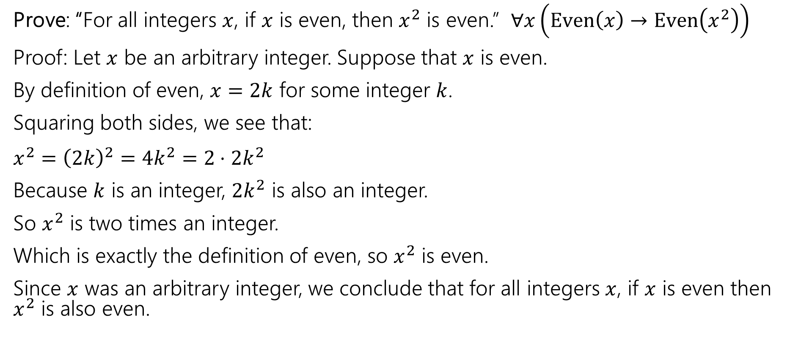
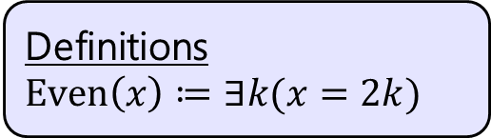
Our First Direct Proof
Definitions
$Even\left(x\right)≔∃k(x=2k)$
Prove: “For all integers $x$, if $x$ is even, then $x^{2}$ is even.” $∀x\left(Even\left(x\right)→Even\left(x^{2}\right)\right)$
Proof: Let $x$ be an arbitrary integer. Suppose that $x$ is even.
By definition of even, $x=2k$ for some integer $k$.
Squaring both sides, we see that:
$x^{2}={\left(2k\right)}^{2}=4k^{2}=2⋅2k^{2}$
Because $k$ is an integer, $2k^{2}$ is also an integer.
So $x^{2}$ is two times an integer.
Which is exactly the definition of even, so $x^{2}$ is even.
Since $x$ was an arbitrary integer, we conclude that for all integers $x$, if $x$ is even then $x^{2}$ is also even.
Notes:
Let $x$ be an arbitrary integer. Suppose that $x$ is even. Then by definition of even, there exists some integer $k$ such that $x=2k$. Squaring both sides, we see that:
$$x^{2}={\left(2k\right)}^{2}=4k^{2}=2⋅2k^{2}$$
Because $k$ is an integer, then $2k^{2}$ is also an integer. So $x^{2}$ is two times an integer.
So by definition of even, $x^{2}$ is even.
Since $x$ was an arbitrary integer, we can conclude that for all integers $x$, if $x$ is even
then $x^{2}$ is even.
Run through with a number

Slide 5
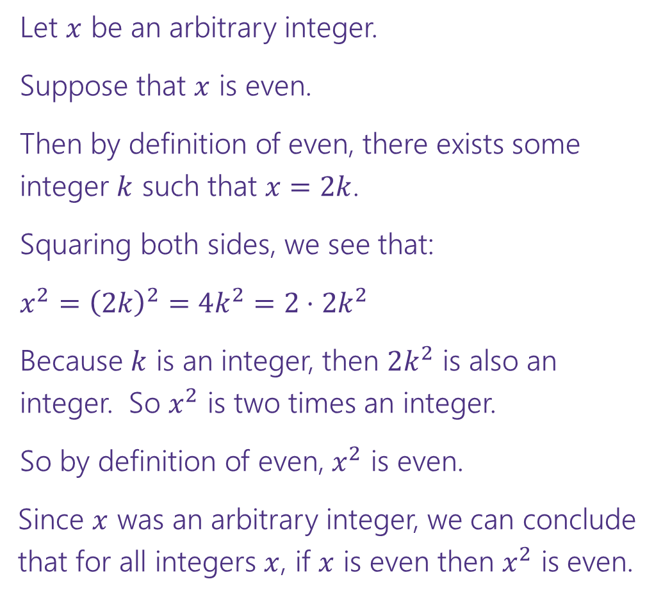


Direct Proof Template
Prove: $∀x\left(Even\left(x\right)→Even\left(x^{2}\right)\right)$
  Declare an arbitrary variable for each $∀$.
Let $x$ be an arbitrary integer.
Suppose that $x$ is even.
Then by definition of even, there exists some integer $k$ such that $x=2k$.
Squaring both sides, we see that:
$x^{2}={\left(2k\right)}^{2}=4k^{2}=2⋅2k^{2}$
Because $k$ is an integer, then $2k^{2}$ is also an integer. So $x^{2}$ is two times an integer.
So by definition of even, $x^{2}$ is even.
Since $x$ was an arbitrary integer, we can conclude
that for all integers $x$, if $x$ is even then $x^{2}$ is even.
  Assume the left side of the implication.
  Unroll the predicate definitions.
  Manipulate towards the goal.
  Reroll definitions into the right side of the implication.
  Conclude that you have proved the claim.

Slide 6
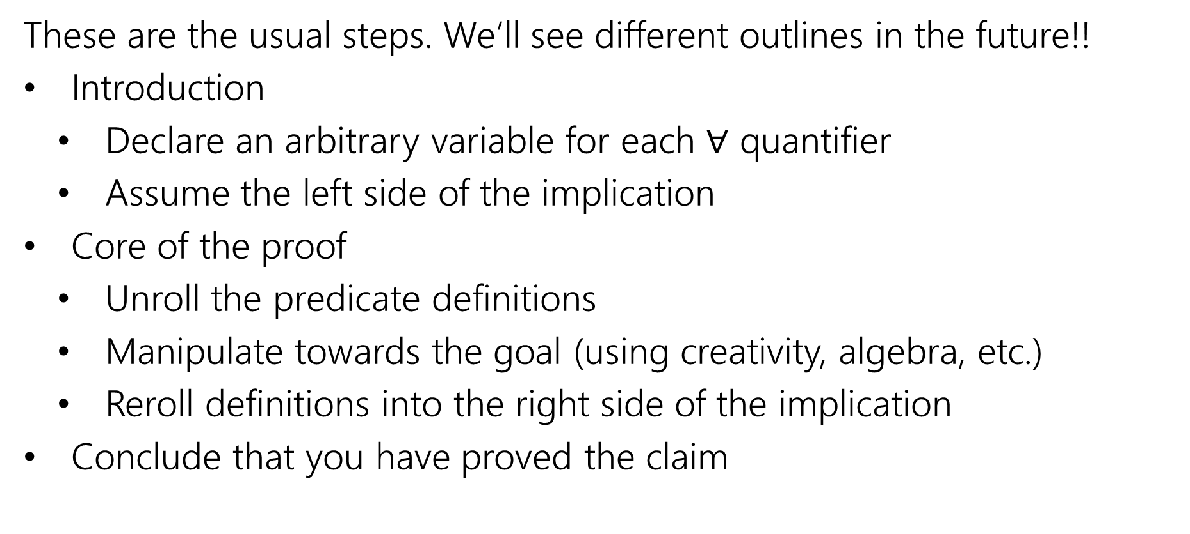
Direct Proof Steps
  These are the usual steps. We’ll see different outlines in the future!!
  Introduction
    Declare an arbitrary variable for each $∀$ quantifier
    Assume the left side of the implication
  Core of the proof
    Unroll the predicate definitions
    Manipulate towards the goal (using creativity, algebra, etc.)
    Reroll definitions into the right side of the implication
  Conclude that you have proved the claim

Slide 7
Another Direct Proof
  Prove: “The product of two odd integers is odd.”
  What’s the claim in logic?
  How would we prove this claim?
Notes:
Prove: “The product of two odd integers is odd.”
Intuition: is this true?
What’s the claim in logic? $∀x∀y \left(\left(Odd\left(x\right)∧Odd\left(y\right)\right)→Odd\left(xy\right)\right)$
How would we prove this claim?
Direct Proof. In particular, we’ll let $x,y$ be arbitrary integers. We’ll suppose $x,y$ are odd. We’ll show that $x⋅y$ is odd.

Slide 8

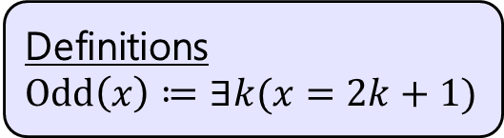
Another Direct Proof
Definitions
$Odd\left(x\right)≔∃k(x=2k+1)$
Prove: “The product of two odd integers is odd.”
$∀x∀y\left(\left(Odd\left(x\right)∧Odd\left(y\right)\right)→Odd\left(xy\right)\right)$
Notes:
At each step, reference the direct proof template. Discuss the role of the formal logic claim.
Let $x$ and $y$ be arbitrary integers. Suppose that $x$ and $y$ are odd. Then by definition of odd, there exists some integer $k$ such that $x=2k+1$, and some integer $j$ such that $y=2j+1$.
Then multiplying $x$ and $y$, we can see that:
$$xy=\left(2k+1\right)⋅\left(2j+1\right)=4kj+2j+2k+1=2\left(2kj+j+k\right)+1$$
Since $k,j$ are integers, $2kj+j+k$ is an integer. So by definition of odd, $xy$ is odd. Since $x,y$ were arbitrary, we have shown that the product of two odd integers is odd.

Slide 9
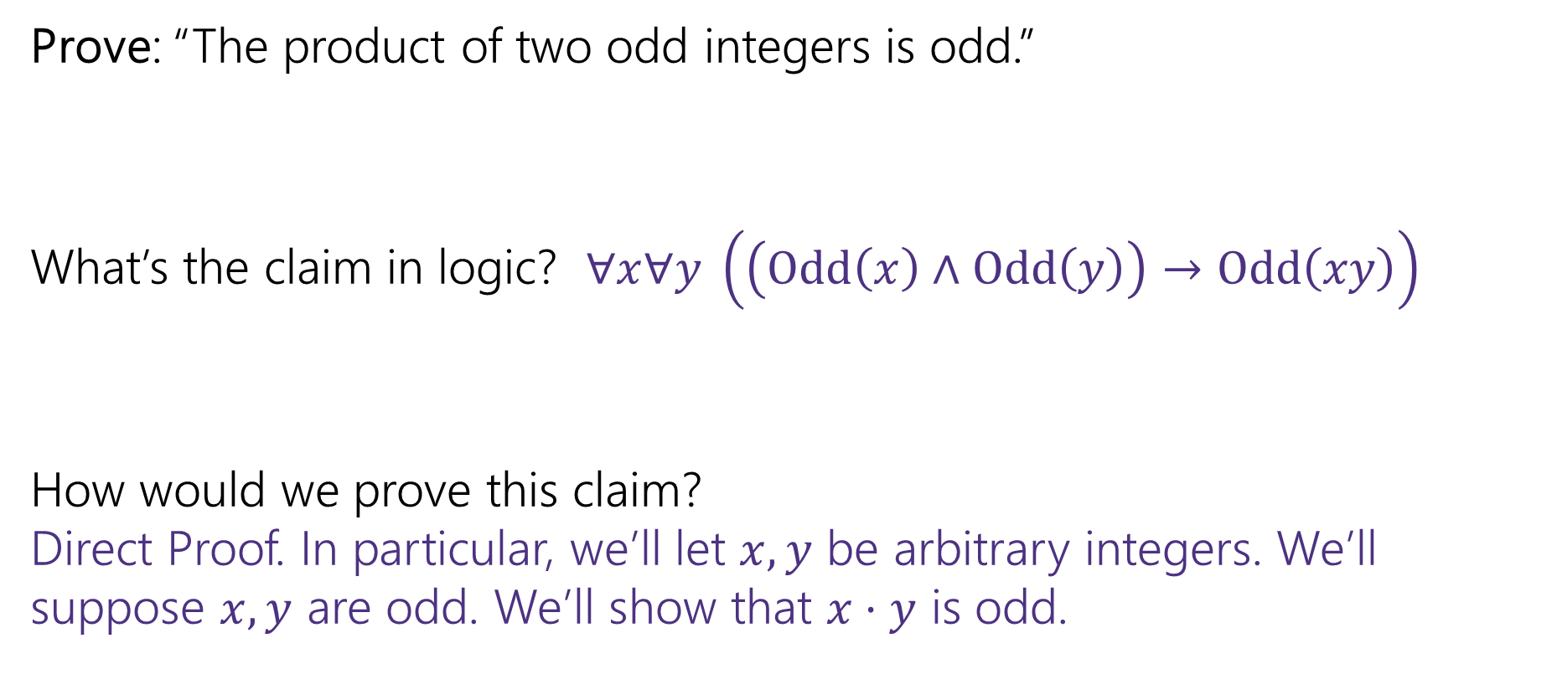
Another Direct Proof
  Prove: “The product of two odd integers is odd.”
  What’s the claim in logic? $∀x∀y \left(\left(Odd\left(x\right)∧Odd\left(y\right)\right)→Odd\left(xy\right)\right)$
  How would we prove this claim?
  Direct Proof. In particular, we’ll let $x,y$ be arbitrary integers. We’ll suppose $x,y$ are odd. We’ll show that $x⋅y$ is odd.

Slide 10
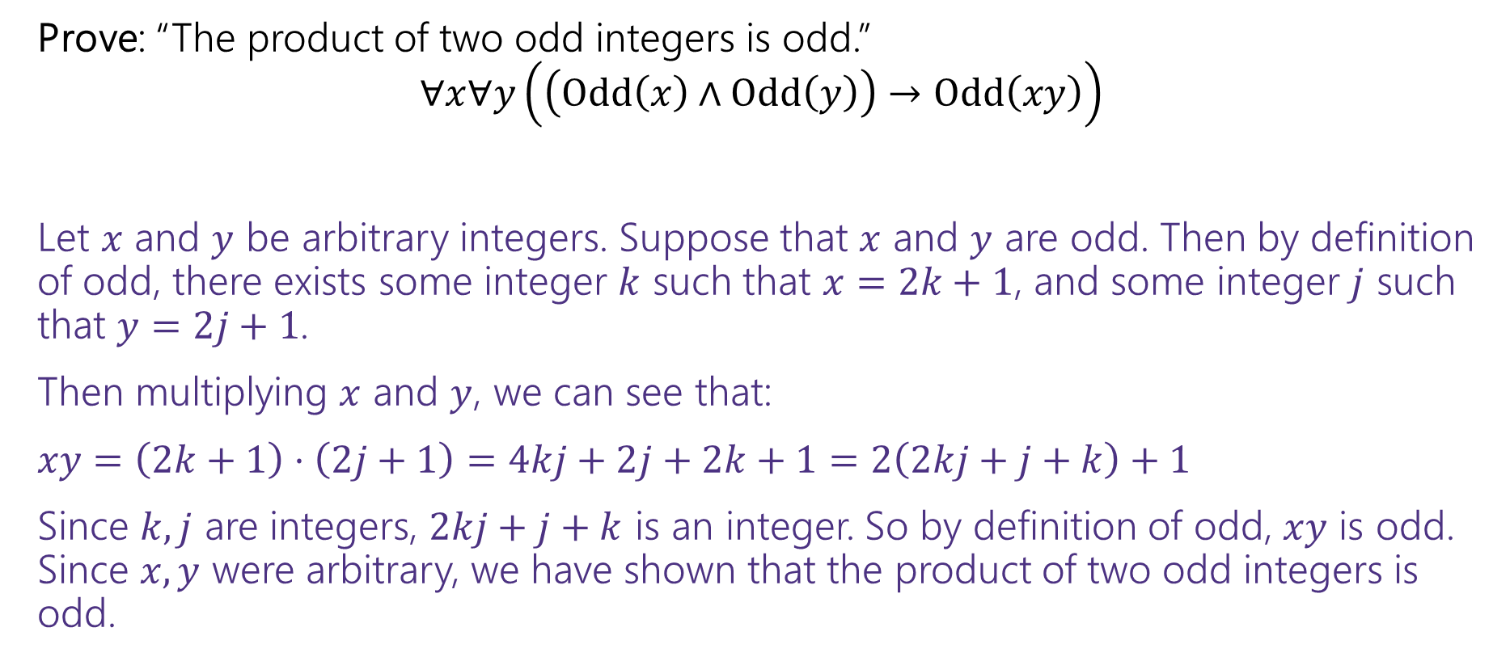
Another Direct Proof
Definitions
$Odd\left(x\right)≔∃k(x=2k+1)$
Prove: “The product of two odd integers is odd.”
$∀x∀y\left(\left(Odd\left(x\right)∧Odd\left(y\right)\right)→Odd\left(xy\right)\right)$
Let $x$ and $y$ be arbitrary integers. Suppose that $x$ and $y$ are odd. Then by definition of odd, there exists some integer $k$ such that $x=2k+1$, and some integer $j$ such that $y=2j+1$.
Then multiplying $x$ and $y$, we can see that:
$xy=\left(2k+1\right)⋅\left(2j+1\right)=4kj+2j+2k+1=2\left(2kj+j+k\right)+1$
Since $k,j$ are integers, $2kj+j+k$ is an integer. So by definition of odd, $xy$ is odd. Since $x,y$ were arbitrary, we have shown that the product of two odd integers is odd.

Slide 11
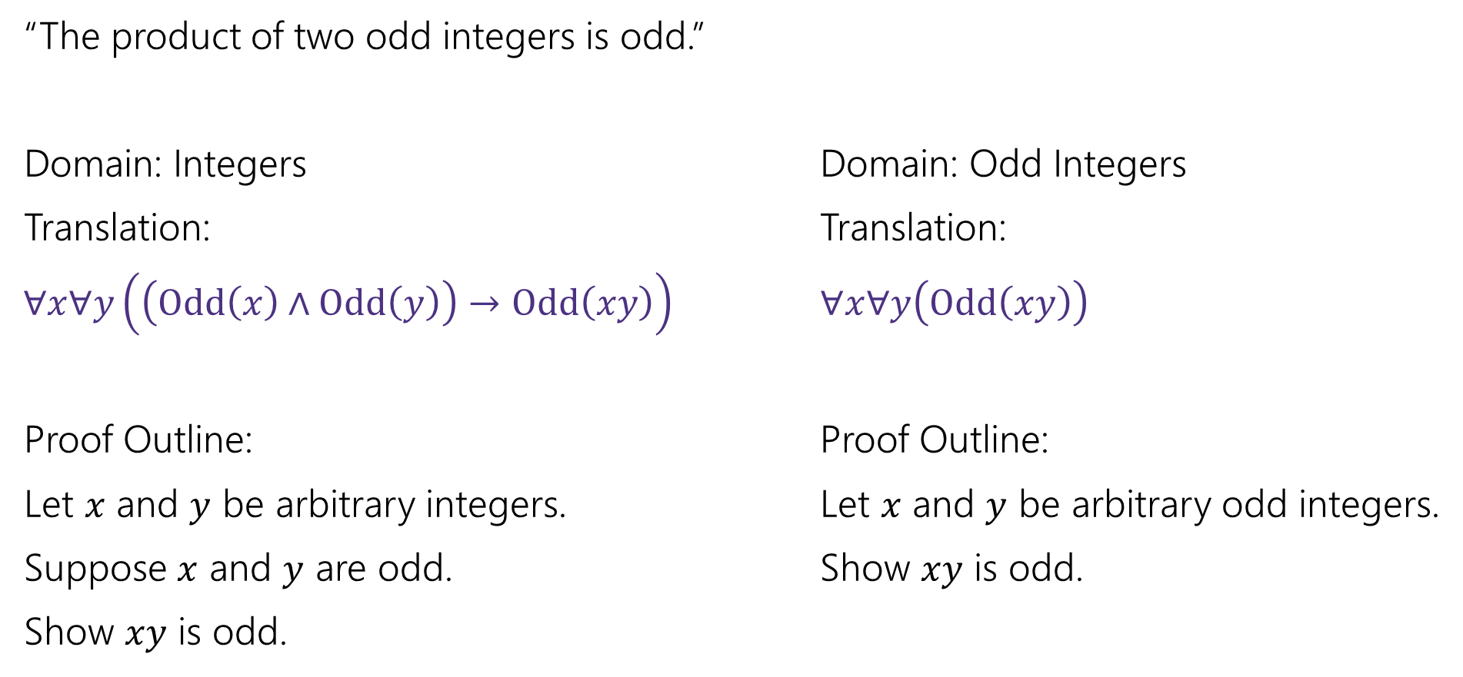
A note on Domain of Discourse
“The product of two odd integers is odd.”
Domain: Integers Domain: Odd Integers
Translation: Translation:
$∀x∀y\left(\left(Odd\left(x\right)∧Odd\left(y\right)\right)→Odd\left(xy\right)\right)$ $∀x∀y\left(Odd\left(xy\right)\right)$
Proof Outline: Proof Outline:
Let $x$ and $y$ be arbitrary integers. Let $x$ and $y$ be arbitrary odd integers.
Suppose $x$ and $y$ are odd. Show $xy$ is odd.
Show $xy$ is odd.

Slide 12
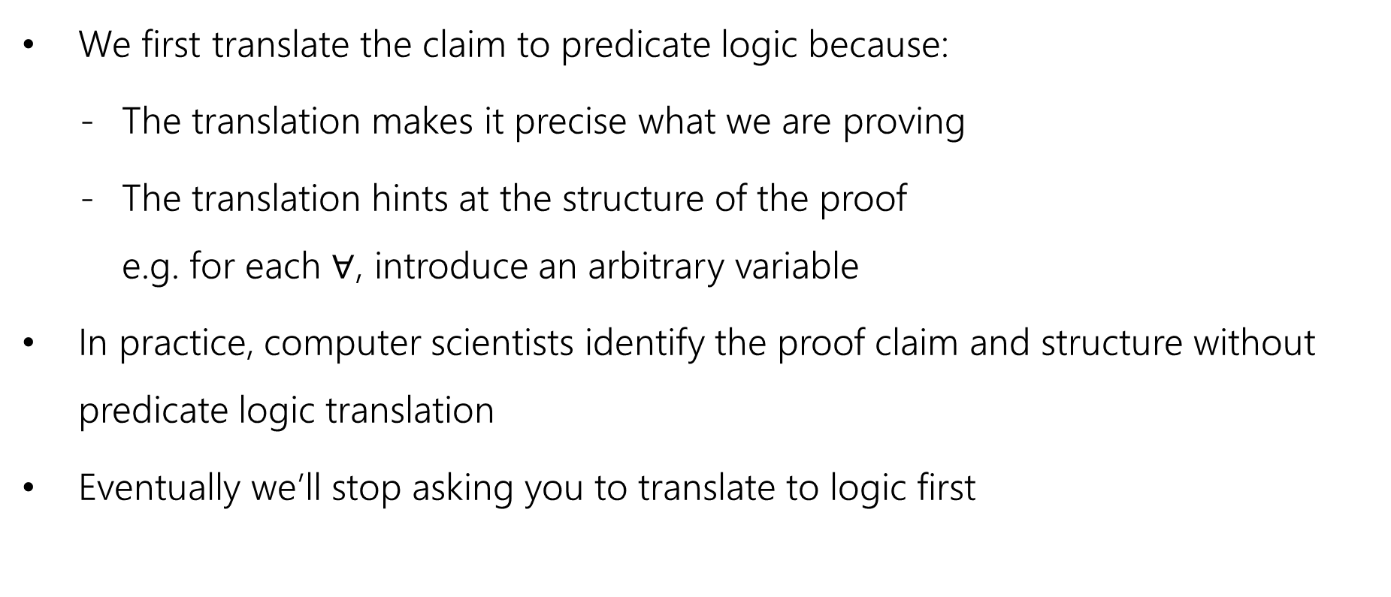
A note on Translation to Logic
  We first translate the claim to predicate logic because:
      The translation makes it precise what we are proving
      The translation hints at the structure of the proof
      e.g. for each $∀$, introduce an arbitrary variable
  In practice, computer scientists identify the proof claim and structure without predicate logic translation
  Eventually we’ll stop asking you to translate to logic first

Slide 13

Square
  Definition:
  An integer $x$ is square iff there exists an integer $k$ such that $x=k^{2}$.
  $Square\left(x\right)≔∃k \left(x=k^{2}\right)$

Slide 14

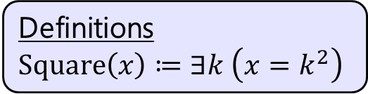
Yet Another Direct Proof
Definitions
$Square\left(x\right)≔∃k \left(x=k^{2}\right)$
Prove: The product of two square integers is square.
  What’s the claim in logic?
  $$∀n∀m\left(\left(Square\left(n\right)∧Square\left(m\right)\right)→Square\left(nm\right)\right)$$
  Prove this claim.

Slide 15

Yet Another Direct Proof
Definitions
$Square\left(x\right)≔∃k \left(x=k^{2}\right)$
Prove: “The product of two square integers is square.”
$$∀n∀m\left(\left(Square\left(n\right)∧Square\left(m\right)\right)→Square\left(nm\right)\right)$$

Slide 16
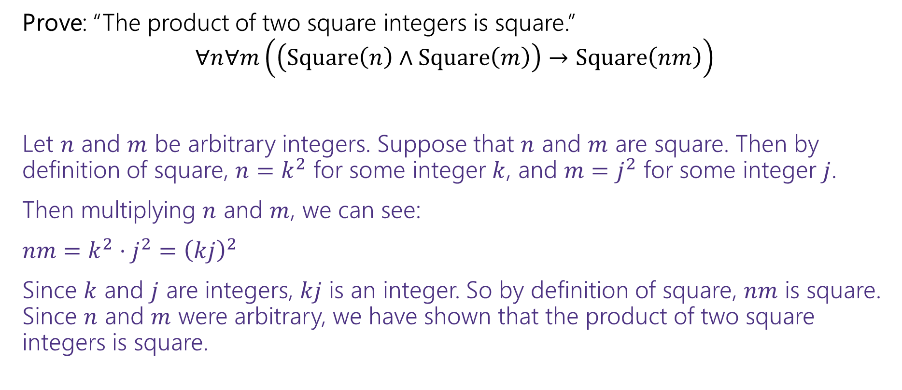
Yet Another Direct Proof
Definitions
$Square\left(x\right)≔∃k \left(x=k^{2}\right)$
Prove: “The product of two square integers is square.”
$$∀n∀m\left(\left(Square\left(n\right)∧Square\left(m\right)\right)→Square\left(nm\right)\right)$$
Let $n$ and $m$ be arbitrary integers. Suppose that $n$ and $m$ are square. Then by definition of square, $n=k^{2}$ for some integer $k$, and $m=j^{2}$ for some integer $j$.
Then multiplying $n$ and $m$, we can see:
$nm=k^{2}⋅j^{2}={\left(kj\right)}^{2}$
Since $k$ and $j$ are integers, $kj$ is an integer. So by definition of square, $nm$ is square. Since $n$ and $m$ were arbitrary, we have shown that the product of two square integers is square.

Slide 17
More Proof Techniques

Slide 18
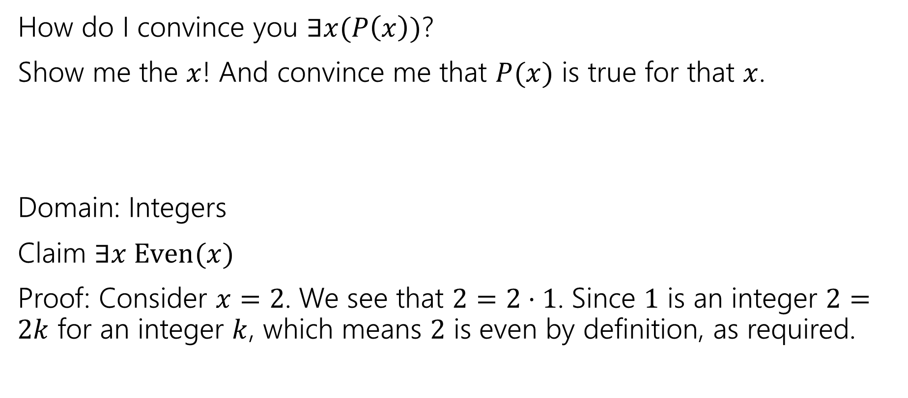
Proving an exists statement
How do I convince you $∃x(P\left(x\right))$?
Show me the $x$! And convince me that $P(x)$ is true for that $x$.
Domain: Integers
Claim $∃x Even(x)$
Proof: Consider $x=2$. We see that $2=2⋅1$. Since $1$ is an integer $2=2k$ for an integer $k$, which means $2$ is even by definition, as required.

Slide 19
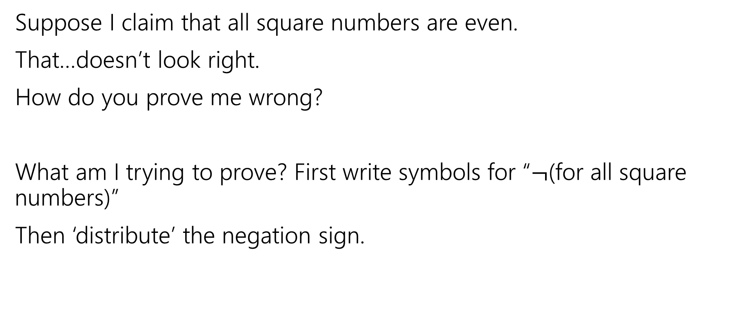
Two claims, two proof techniques
Suppose I claim that all square numbers are even.
That…doesn’t look right.
How do you prove me wrong?
What am I trying to prove? First write symbols for “$¬$(for all square numbers)”
Then ‘distribute’ the negation sign.

Slide 20
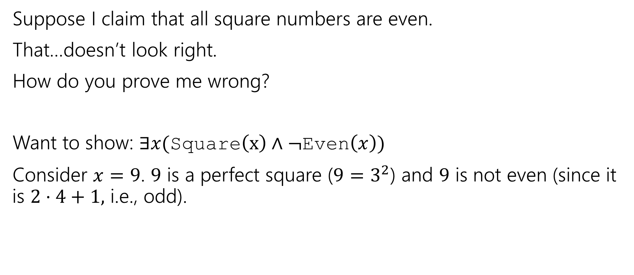
Two claims, two proof techniques
Suppose I claim that all square numbers are even.
That…doesn’t look right.
How do you prove me wrong?
Want to show: $∃x($Square$\left(x\right)∧¬$Even$\left(x\right))$
Consider $x=9$. $9$ is a perfect square ($9=3^{2}$) and $9$ is not even (since it is $2⋅4+1,$ i.e., odd).

Slide 21
Proof By [Counter]Example
To prove an existential statement (or disprove a universal statement), provide an example, and demonstrate that it is the needed example.
You don’t have to explain where it came from! (In fact, you shouldn’t)
Computer scientists and mathematicians like to keep an air of mystery around our proofs.
  (or more charitably, we want to focus on just enough to believe the claim)

Slide 22
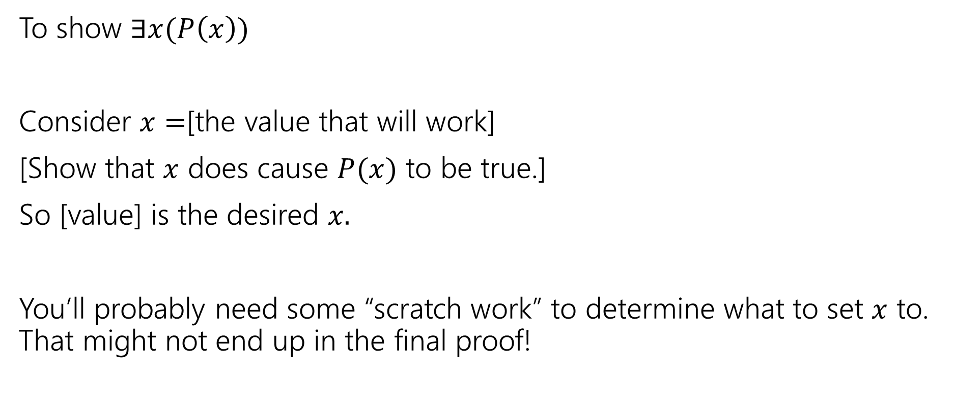
Skeleton of an Exists Proof
To show $∃x(P\left(x\right))$
Consider $x=$[the value that will work]
[Show that $x$ does cause $P(x)$ to be true.]
So [value] is the desired $x.$
You’ll probably need some “scratch work” to determine what to set $x$ to. That might not end up in the final proof!

Slide 23
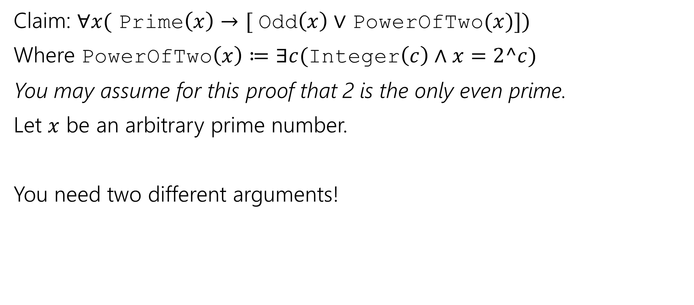
Proof By Cases
Claim: $∀x($ Prime$\left(x\right)→[$ Odd$\left(x\right)∨$ PowerOfTwo$(x)])$
Where PowerOfTwo$\left(x\right)≔∃c($Integer$\left(c\right)∧x=2^c)$
You may assume for this proof that 2 is the only even prime.
Let $x$ be an arbitrary prime number.
You need two different arguments!

Slide 24
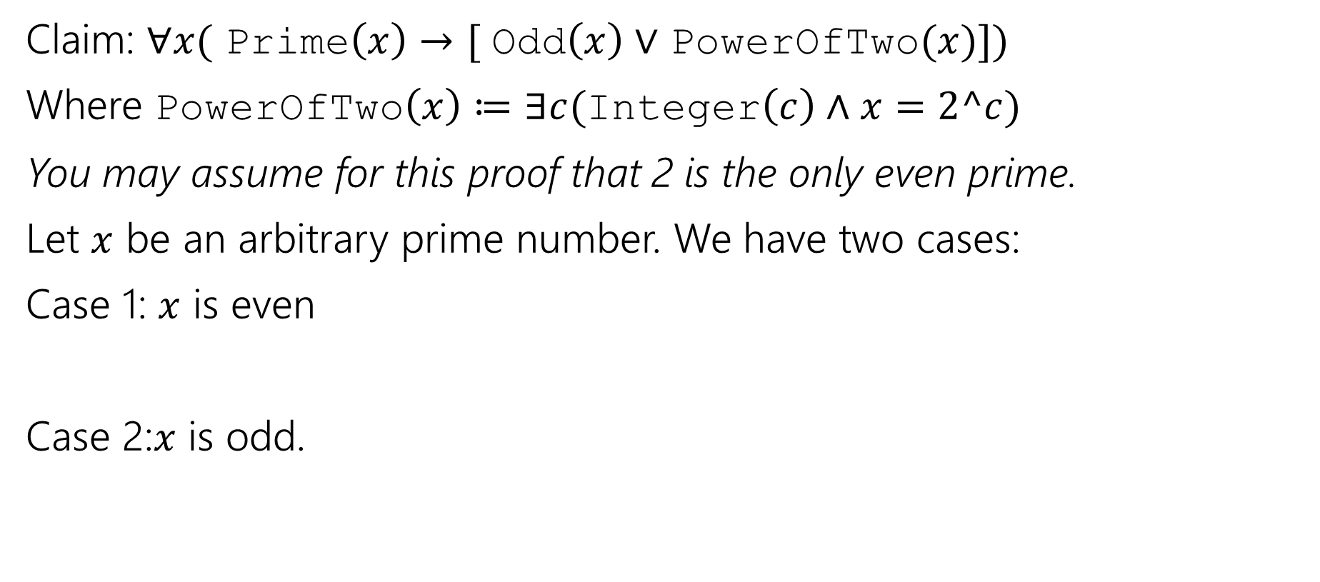
Proof By Cases
Claim: $∀x($ Prime$\left(x\right)→[$ Odd$\left(x\right)∨$ PowerOfTwo$(x)])$
Where PowerOfTwo$\left(x\right)≔∃c($Integer$\left(c\right)∧x=2^c)$
You may assume for this proof that 2 is the only even prime.
Let $x$ be an arbitrary prime number. We have two cases:
Case 1: $x$ is even
Case 2:$x$ is odd.

Slide 25
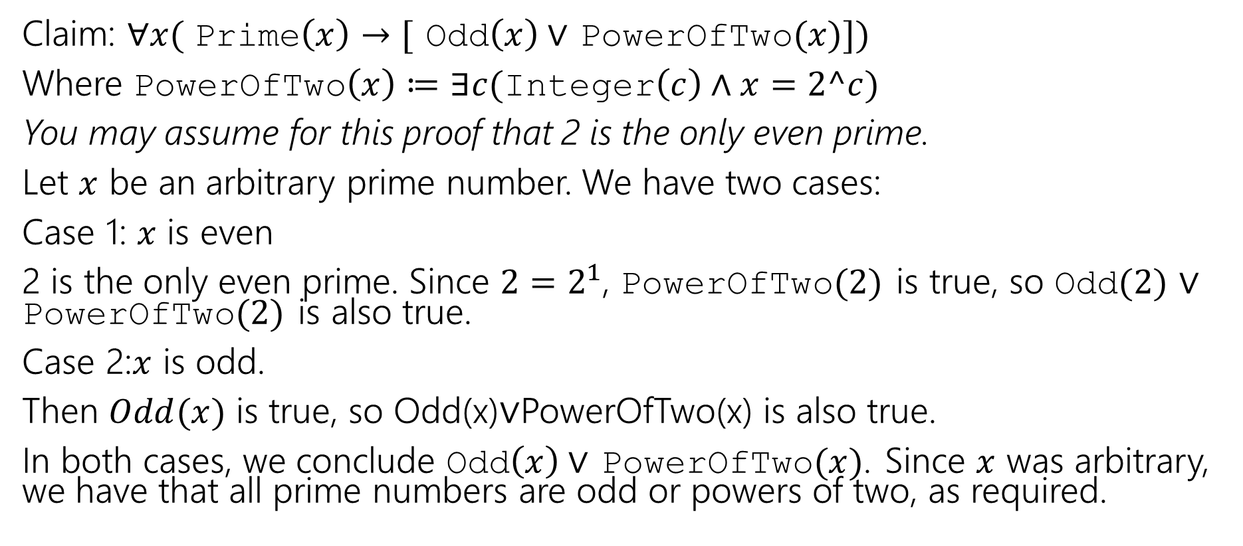
Proof By Cases
Claim: $∀x($ Prime$\left(x\right)→[$ Odd$\left(x\right)∨$ PowerOfTwo$(x)])$
Where PowerOfTwo$\left(x\right)≔∃c($Integer$\left(c\right)∧x=2^c)$
You may assume for this proof that 2 is the only even prime.
Let $x$ be an arbitrary prime number. We have two cases:
Case 1: $x$ is even
2 is the only even prime. Since $2=2^{1}$, PowerOfTwo$(2)$ is true, so Odd$(2)$ $∨$ PowerOfTwo$(2)$ is also true.
Case 2:$x$ is odd.
Then $Odd(x)$ is true, so Odd(x)$∨$PowerOfTwo(x) is also true.
In both cases, we conclude Odd$\left(x\right)∨$ PowerOfTwo$(x)$. Since $x$ was arbitrary, we have that all prime numbers are odd or powers of two, as required.

Slide 26
Proof By Cases
Make it clear how you decide which case your in.
It should be obvious your cases are “exhaustive”
Reach the same conclusion in each of the cases, and you can say you’ve got that conclusion no matter what (outside the cases).
Advanced version: sometimes you end up arguing a certain case “can’t happen”

