Slide 1
Context Free Grammars
CSE 311 Winter 2024
Lecture 19

Slide 2
Where Are We?
We’re working our way up to proving theorems about computation
A statement like “there is no Java program that solves this problem”
Before we get there, we’ve got a grab bag of background topics.
The mathematical model for programs is defining a language, so we’re seeing different tools computer scientists use to do that.
The set of all inputs that will cause the program to return true.
Last time: Regular expressions: a common practical tool
Today: CFGs: a key to defining a programming language

Slide 3
Context Free Grammars
Another way of defining a language

Slide 4
What Can’t Regular Expressions Do?
Some easy things Things where you could say whether a string matches with just a loop
$\{0^{k}1^{k}:k≥0\}$
The set of all palindromes.
And some harder things
Expressions with matched parentheses
Properly formed arithmetic expressions
Context Free Grammars can solve all of these problems!

Slide 5
Context Free Grammars
A context free grammar (CFG) is a finite set of production rules over:
An alphabet $Σ$ of “terminal symbols”
A finite set $V$ of “nonterminal symbols”
A start symbol (one of the elements of $V$) usually denoted $S$.
A production rule for a nonterminal $A∈V$ takes the form
$A→w_{1}\left|w_{2}\right|⋯|w_{k}$
Where each $w_{i}∈{\left(V∪Σ\right)}^{∗}$ is a string of nonterminals and terminals.

Slide 6
Context Free Grammars
We think of context free grammars as generating strings.
1. Start from the start symbol $S$.
2. Choose a nonterminal in the string, and a production rule $A→w_{1}\left|w_{2}\right|…|w_{k}$ replace that copy of the nonterminal with $w_{i}$.
3. If no nonterminals remain, you’re done! Otherwise, goto step 2.
A string is in the language of the CFG iff it can be generated starting from $S$.

Slide 7
Examples
$S→0S0\left|1S1\right|0|1|ε$
$S→0S|S1|ε$
$S→\left(S\right)\left|SS\right|ε$
$S→AB$
$A→0A1|ε$
$B→1B0|ε$
The alphabet here is {(,)} i.e. parentheses are the characters.

Slide 8
Examples
$S→0S0\left|1S1\right|0|1|ε$
The set of all binary palindromes
$S→0S|S1|ε$
The set of all strings with any 0’s coming before any 1’s (i.e. $0^{∗}1^{∗}$)
$S→\left(S\right)\left|SS\right|ε$
Balanced parentheses
$S→AB$
$A→0A1|ε$
$B→1B0|ε$ $\{0^{j}1^{j+k}0^{k}:j,k≥0\}$

Slide 9
Arithmetic
$E→E+E\left|E∗E\right|\left(E\right)\left|x\right|y\left|z\right|0\left|1\right|2\left|3\right|4\left|5\right|6\left|7\right|8|9$
Generate $\left(2∗x\right)+y$
Generate $2+3∗4$ in two different ways

Slide 10
Arithmetic
$E→E+E\left|E∗E\right|\left(E\right)\left|x\right|y\left|z\right|0\left|1\right|2\left|3\right|4\left|5\right|6\left|7\right|8|9$
Generate $\left(2∗x\right)+y$
$E⇒E+E⇒\left(E\right)+E⇒\left(E∗E\right)+E⇒\left(2∗E\right)+E⇒\left(2∗x\right)+E⇒(2∗x)+y$
Generate $2+3∗4$in two different ways
$E⇒E+E⇒E+E∗E⇒2+E∗E⇒2+3∗E⇒2+3∗4$
$E⇒E∗E⇒E+E∗E⇒2+E∗E⇒2+3∗E⇒2+3∗4$

Slide 11
Multiple ways of generating strings
Generate $2+3∗4$in two different ways
$E⇒E+E⇒E+E∗E⇒2+E∗E⇒2+3∗E⇒2+3∗4$
$E⇒E∗E⇒E+E∗E⇒2+E∗E⇒2+3∗E⇒2+3∗4$
What did we mean by these being different? They represent different meanings mathematically.
One says “you’re adding together two numbers: 2 and (whatever 3*4 is)”
The other says “you’re multiplying two numbers: (whatever 2+3 is) and 4”
Those have different meanings!

Slide 12
Parse Trees—remember where parentheses go
Suppose a context free grammar $G$ generates a string $x$
A parse tree of $x$ for $G$ has
Rooted at $S$ (start symbol)
Children of every $A$ node are labeled with the characters of $w$ for some $A→w$
Reading the leaves from left to right gives $x$.
$S→0S0\left|1S1\right|0\left|1\right|ε$
S
0
S
0
1
S
1
1

Slide 13
Back to the arithmetic
$E→E+E\left|E∗E\right|\left(E\right)\left|x\right|y\left|z\right|0\left|1\right|2\left|3\right|4\left|5\right|6\left|7\right|8|9$
Two parse trees for $2+3∗4$
E
E
E
+
E
E
$$∗$$
E
E
$$∗$$
E
+
E
4
2
E
3
4
2
3

Slide 14
Why do we care about parsing?
$2+3∗4$ can only mean one thing!
If I write these symbols in a program, we need to make sure we know which one to do.
The first grammar we saw was “ambiguous” it allows the same string to “mean” two different things.
Sometimes you can fix that!

Slide 15
How do we encode order of operations
If we want to keep “in order” we want there to be only one possible parse tree.
Differentiate between “things to add” and “things to multiply”
Only introduce a * sign after you’ve eliminated the possibility of introducing another + sign in that area.
$E→T|E+T$
$T→F|T∗F$
$F→\left(E\right)|N$
$N→x\left|y\right|z\left|0\right|1\left|2\right|3\left|4\right|5\left|6\right|7|8|9$
E
E
+
T
T
T
$$∗$$
F
F
N
F
N
4
N
3
2

Slide 16
How do Computer Scientists use CFGs?
Most programming languages define valid programs as “strings that fit a CFG” That makes sure Java breaks down math expressions correctly! And also code like this:
if(i>0)
if(j>0)
System.out.println(“hi”);
else
System.out.println(“bye”);
if(i>0)
if(j>0)
System.out.println(“hi”);
else
System.out.println(“bye”);
The else could be attached to either “if”! Java needs a rule to decide which it goes with.
Java’s convention makes the one on the left the intuitive whitespace.
(You as a programmer should put braces so the humans reading your code don’t have to wonder!)

Slide 17
CFGs in practice
Used to define programming languages.
Often written in Backus-Naur Form – just different notation
Variables are <names-in-brackets> (or sometimes without)
like <if-then-else-statement>, <condition>, <identifier>
$→$is replaced with $∷=$ or $:$

Slide 18
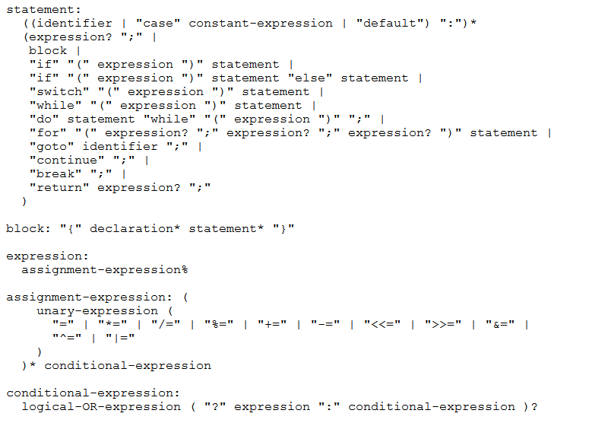
BNF for C (no <...> and uses : instead of ::=)

Slide 19
Some fun CFG applications
If we have time

Slide 20
Parse Trees
Remember diagramming sentences in middle school?
<sentence>::=<noun phrase><verb phrase>
<noun phrase>::=<determiner><adjective><noun>
<verb phrase>::=<verb><adverb>|<verb><object>
<object>::=<noun phrase>

Slide 21
Parse Trees
<sentence>::=<noun phrase><verb phrase>
<noun phrase>::=<determiner><adjective><noun>
<verb phrase>::=<verb><adverb>|<verb><object>
<object>::=<noun phrase>
The old man the boat.

Slide 22
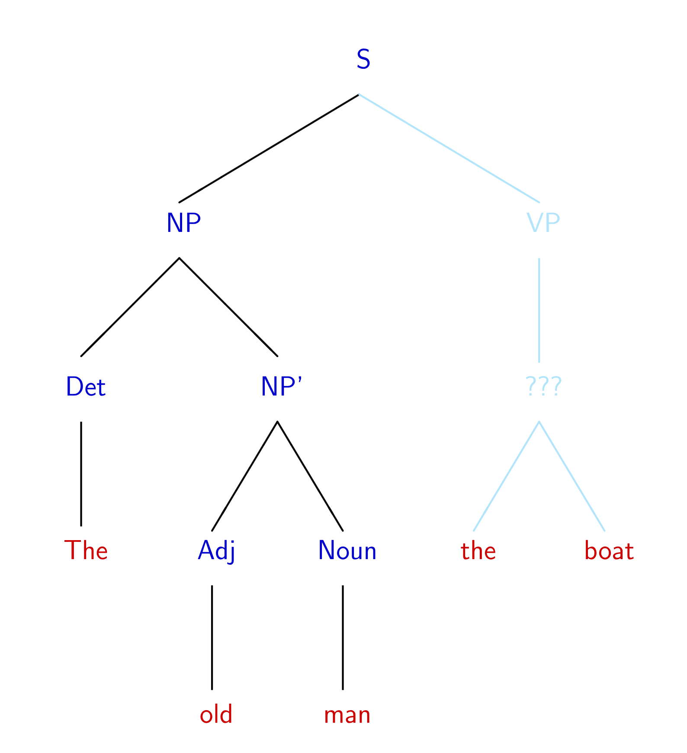
The old man the boat
By Jochen Burghardt - Own work, CC BY-SA 4.0, https://commons.wikimedia.org/w/index.php?curid=92742400

Slide 23
English is ambiguous
(Most of ‘standard’) English can be represented as a context free grammar.
It’s not perfect (ask Robbie details later).
The grammar is ambiguous! That is, there are sentences which have multiple valid parsings (multiple meanings).
Can you find multiple meanings of this sentence: “Place these 3 exercise balls on the mat at the top of the hill.”
See this video

Slide 24
The Important Takeaways

Slide 25
Power of Context Free Languages
There are languages CFGs can express that regular expressions can’t
e.g. palindromes
What about vice versa – is there a language that a regular expression can represent that a CFG can’t?
No!
Are there languages even CFGs cannot represent?
Yes!
$\{0^{k}1^{j}2^{k}3^{j}|j,k≥0\}$ cannot be written with a context free grammar.

Slide 26
Takeaways
CFGs and regular expressions gave us ways of succinctly representing sets of strings
Regular expressions super useful for representing things you need to search for
CFGs represent complicated languages like “java code with valid syntax”
Tomorrow, two more tools for our toolbox (function properties, graphs)
Next week, (mathematical representations of) Tiny computers! And how they relate to regular expressions and CFGs.

