Slide 1
Functions And Graphs
CSE 311 Winter 2024
Lecture 20

Slide 2

Today
Some definitions that will help us over the next few weeks
Function definitions
Graphs and some terms
Finally start on “computation”
Computers with $O(1)$ memory

Slide 3
Functions

Slide 4
Some types of functions
Why?
We’ll want to talk about sizes of infinite sets during the last week of classes. It’ll help us find problems our computers can’t solve.
Ok, but why now?
It’ll let us practice set proofs a bit more over the next few weeks!

Slide 5


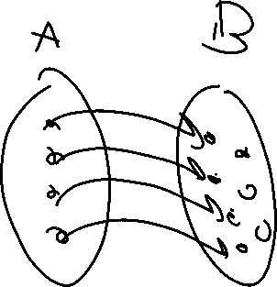
Two Requirements for a Bijection
A function $f:A→B$ maps every element of $A$ to one element of $B$
$A$ is the “domain”, $B$ is the “co-domain”
That is, every output has at most one possible input.
A function $f$ is one-to-one iff
$$∀a∀b(f\left(a\right)=f\left(b\right)→a=b)$$
One-to-one (aka injection)

Slide 6
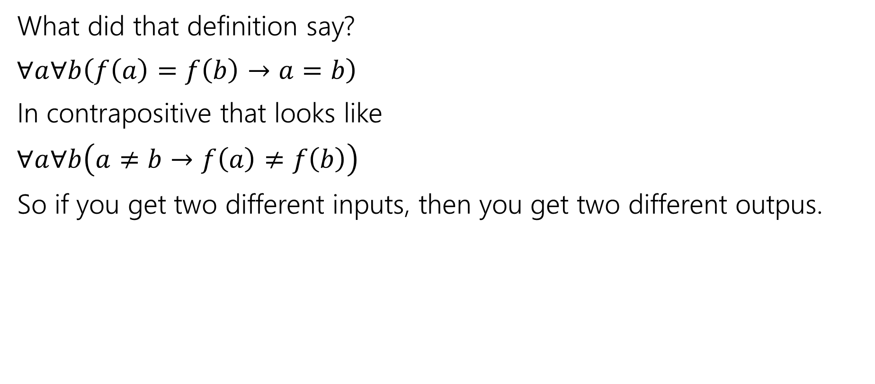
One-to-one (injection)
What did that definition say?
$∀a∀b\left(f\left(a\right)=f\left(b\right)→a=b\right)$
In contrapositive that looks like
$∀a∀b\left(a≠b→f\left(a\right)≠f\left(b\right)\right)$
So if you get two different inputs, then you get two different outpus.

Slide 7
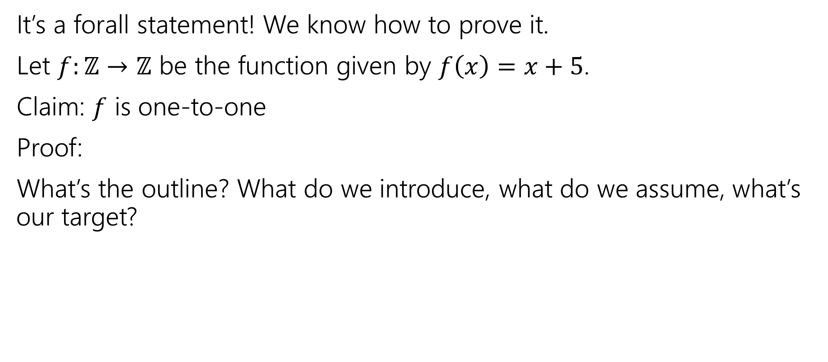
One-to-one proofs
It’s a forall statement! We know how to prove it.
Let $f:ℤ→ℤ$ be the function given by $f\left(x\right)=x+5$.
Claim: $f$ is one-to-one
Proof:
What’s the outline? What do we introduce, what do we assume, what’s our target?

Slide 8
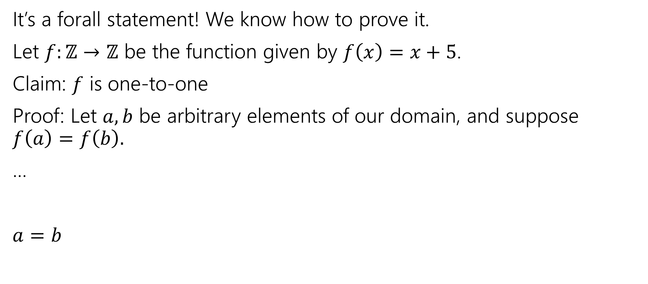
One-to-one proofs
It’s a forall statement! We know how to prove it.
Let $f:ℤ→ℤ$ be the function given by $f\left(x\right)=x+5$.
Claim: $f$ is one-to-one
Proof: Let $a,b$ be arbitrary elements of our domain, and suppose $f\left(a\right)=f\left(b\right).$
…
$a=b$

Slide 9
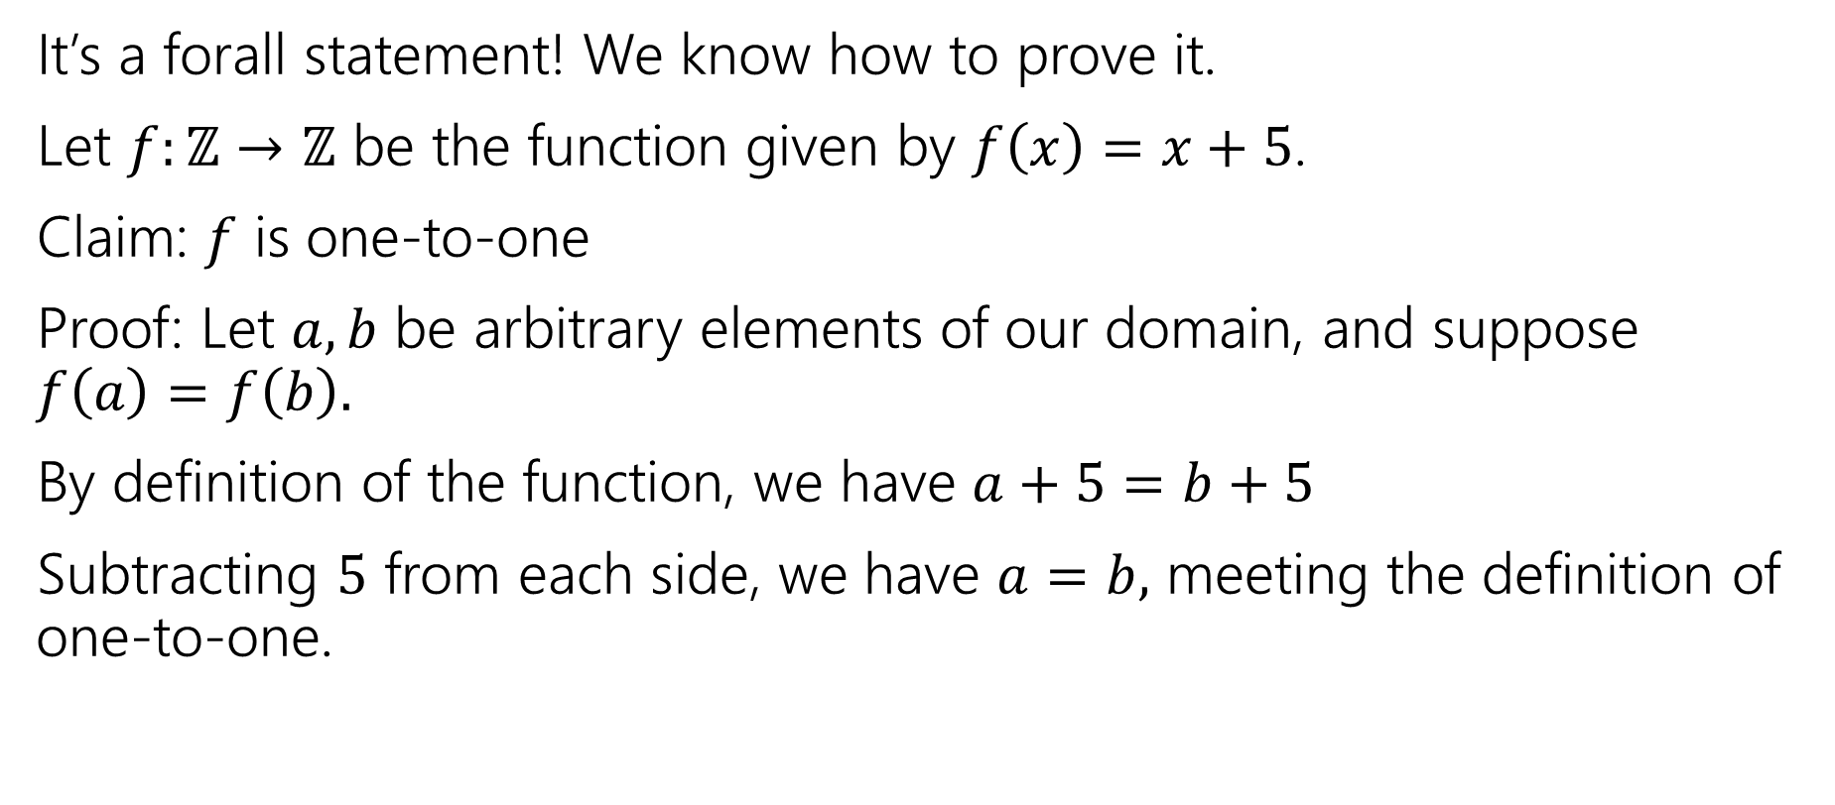
One-to-one proofs
It’s a forall statement! We know how to prove it.
Let $f:ℤ→ℤ$ be the function given by $f\left(x\right)=x+5$.
Claim: $f$ is one-to-one
Proof: Let $a,b$ be arbitrary elements of our domain, and suppose $f\left(a\right)=f\left(b\right).$
By definition of the function, we have $a+5=b+5$
Subtracting $5$ from each side, we have $a=b,$ meeting the definition of one-to-one.

Slide 10


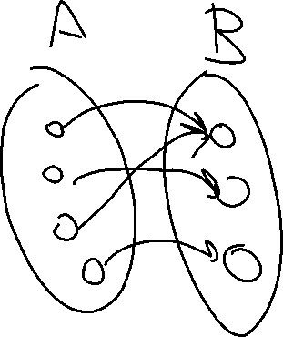
Two Requirements for a Bijection
A function $f:A→B$ maps every element of $A$ to one element of $B$
$A$ is the “domain”, $B$ is the “co-domain”
Every output has at least one input that maps to it.
A function $f:A→B$ is onto iff
$$∀b∈B∃a∈A(b=f(a))$$
Onto (aka surjection)

Slide 11
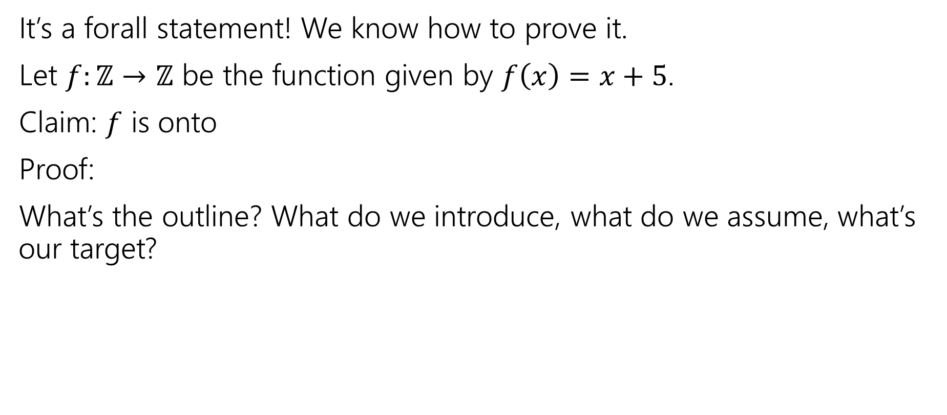
One-to-one proofs
It’s a forall statement! We know how to prove it.
Let $f:ℤ→ℤ$ be the function given by $f\left(x\right)=x+5$.
Claim: $f$ is onto
Proof:
What’s the outline? What do we introduce, what do we assume, what’s our target?

Slide 12
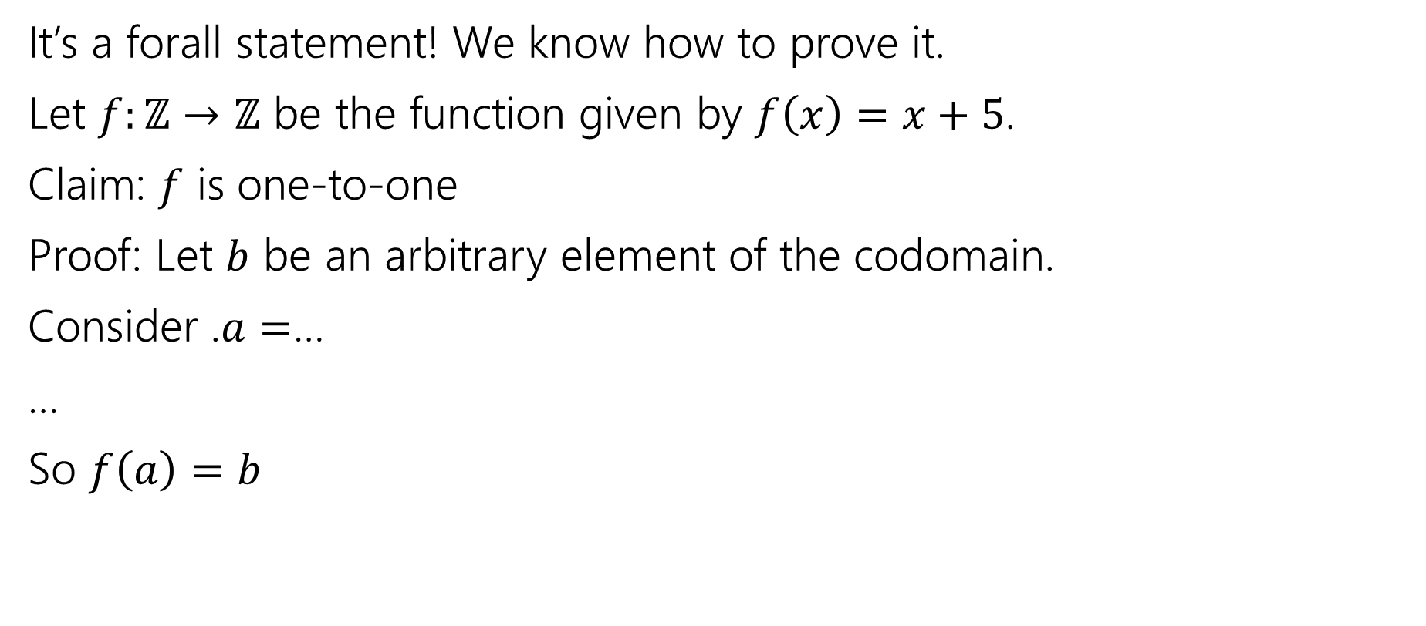
One-to-one proofs
It’s a forall statement! We know how to prove it.
Let $f:ℤ→ℤ$ be the function given by $f\left(x\right)=x+5$.
Claim: $f$ is one-to-one
Proof: Let $b$ be an arbitrary element of the codomain.
Consider .$a=$…
…
So $f\left(a\right)=b$

Slide 13
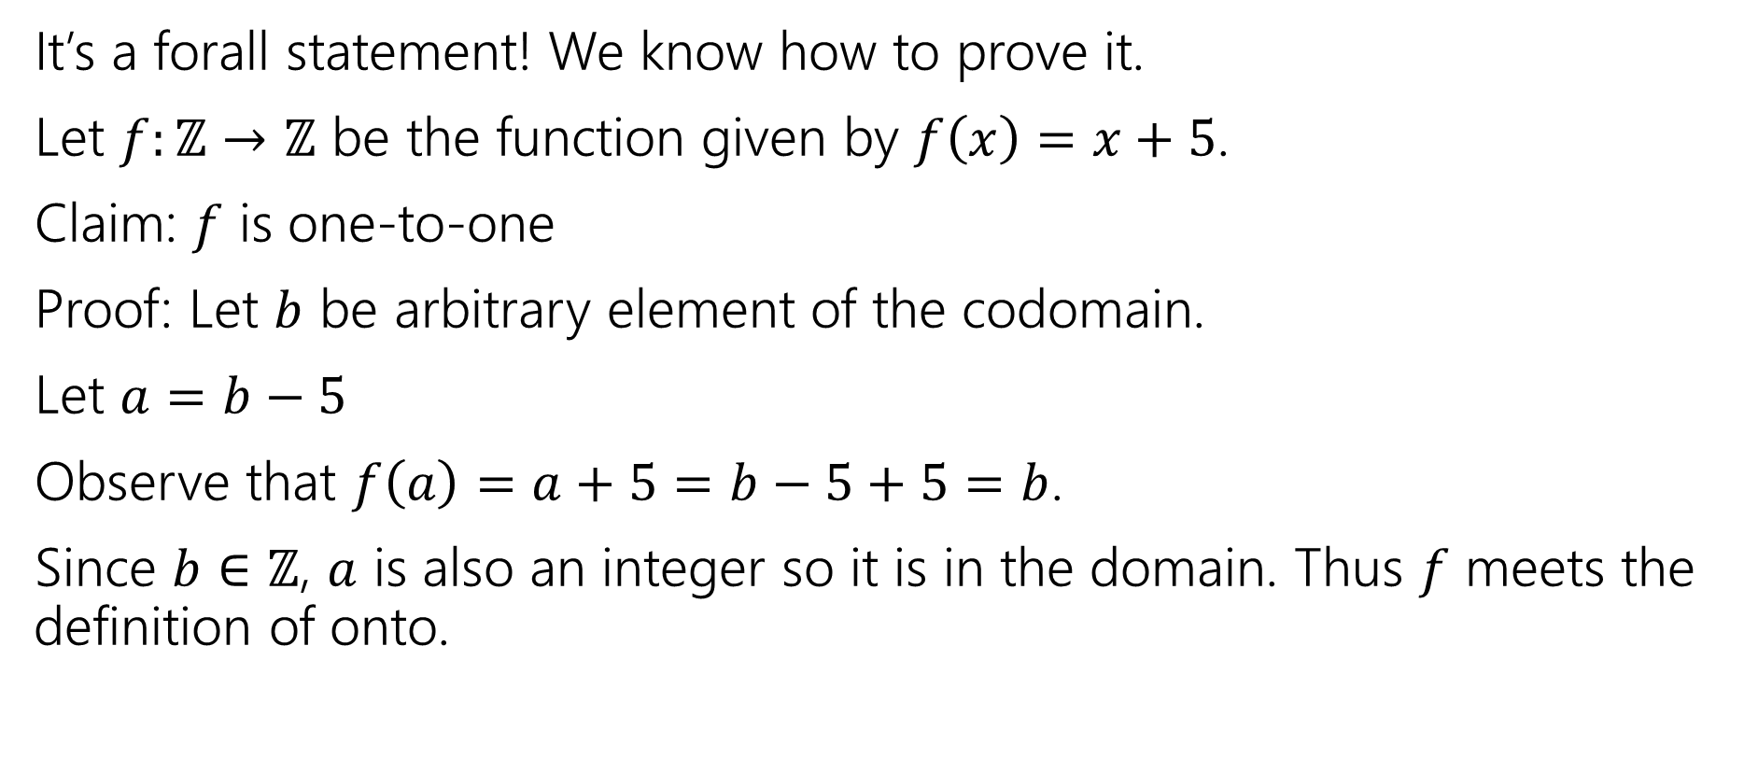
One-to-one proofs
It’s a forall statement! We know how to prove it.
Let $f:ℤ→ℤ$ be the function given by $f\left(x\right)=x+5$.
Claim: $f$ is one-to-one
Proof: Let $b$ be arbitrary element of the codomain.
Let $a=b−5$
Observe that $f\left(a\right)=a+5=b−5+5=b$.
Since $b∈ℤ$, $a$ is also an integer so it is in the domain. Thus $f$ meets the definition of onto.

Slide 14
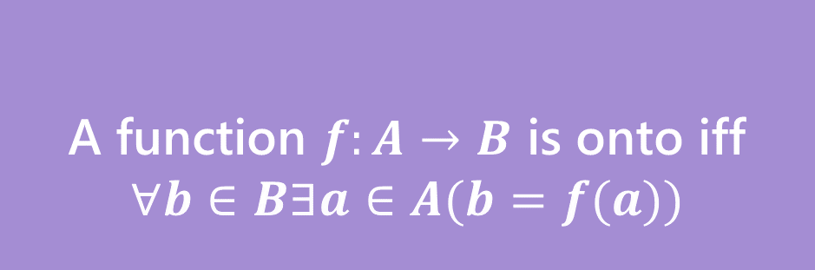


Bijection
A function $f$ is one-to-one iff
$$∀a∀b(f\left(a\right)=f\left(b\right)→a=b)$$
A function $f:A→B$ is onto iff
$$∀b∈B∃a∈A(b=f(a))$$
One-to-one (aka injection)
Onto (aka surjection)
A function $f:A→B$ is a bijection iff
$f$ is one-to-one and onto
Bijection
A bijection maps every element of the domain to exactly one element of the co-domain, and every element of the domain to exactly one element of the domain.

Slide 15
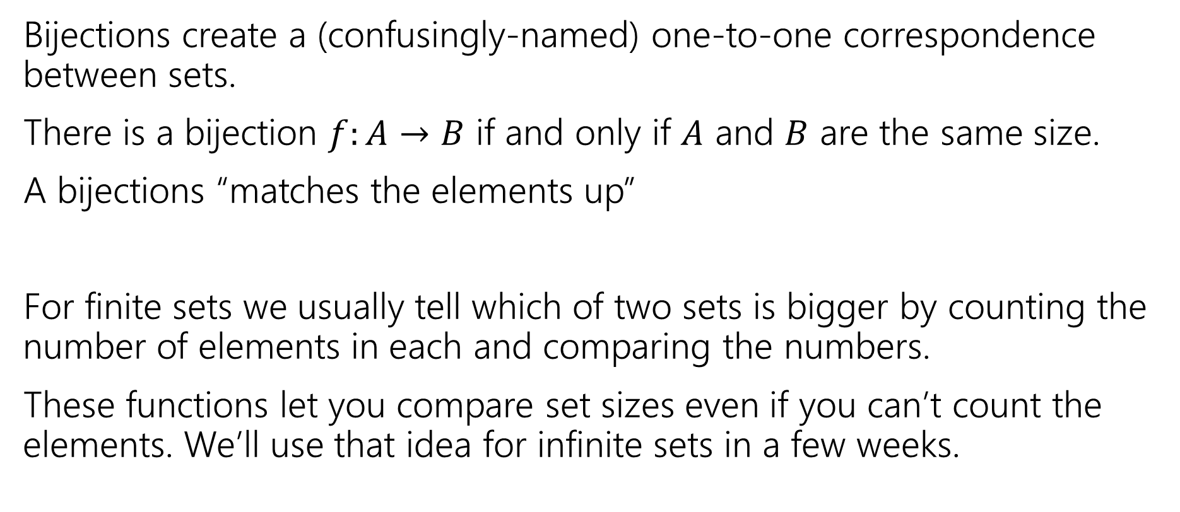
Why do we care about bijections?
Bijections create a (confusingly-named) one-to-one correspondence between sets.
There is a bijection $f:A→B$ if and only if $A$ and $B$ are the same size.
A bijections “matches the elements up”
For finite sets we usually tell which of two sets is bigger by counting the number of elements in each and comparing the numbers.
These functions let you compare set sizes even if you can’t count the elements. We’ll use that idea for infinite sets in a few weeks.

Slide 16
Graphs

Slide 17

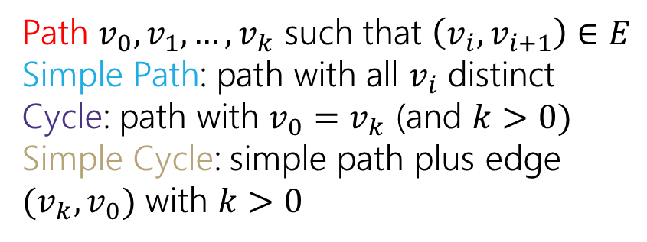
Directed Graphs
$G=(V,E)$
$V$is a set of vertices (an underlying set of elements)
$E$ is a set of edges (ordered pairs of vertices; i.e. connections from one to the next).
Path $v_{0},v_{1},…,v_{k}$ such that $\left(v_{i},v_{i+1}\right)∈E$
Simple Path: path with all $v_{i}$ distinct
Cycle: path with $v_{0}=v_{k}$ (and $k>0)$
Simple Cycle: simple path plus edge ${(v}_{k},v_{0})$ with $k>0$

Slide 18
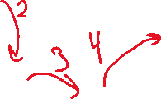


Directed Graphs
$G=(V,E)$
$V$is a set of vertices (an underlying set of elements)
$E$ is a set of edges (ordered pairs of vertices; i.e. connections from one to the next).
Path $v_{0},v_{1},…,v_{k}$ such that $\left(v_{i},v_{i+1}\right)∈E$
Simple Path: path with all $v_{i}$ distinct
Cycle: path with $v_{0}=v_{k}$ (and $k>0)$
Simple Cycle: simple path plus edge ${(v}_{k},v_{0})$ with $k>0$

Slide 19
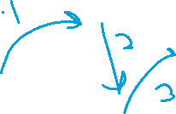
Directed Graphs
$G=(V,E)$
$V$is a set of vertices (an underlying set of elements)
$E$ is a set of edges (ordered pairs of vertices; i.e. connections from one to the next).
Path $v_{0},v_{1},…,v_{k}$ such that $\left(v_{i},v_{i+1}\right)∈E$
Simple Path: path with all $v_{i}$ distinct
Cycle: path with $v_{0}=v_{k}$ (and $k>0)$
Simple Cycle: simple path plus edge ${(v}_{k},v_{0})$ with $k>0$

Slide 20
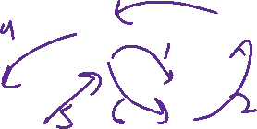
Directed Graphs
$G=(V,E)$
$V$is a set of vertices (an underlying set of elements)
$E$ is a set of edges (ordered pairs of vertices; i.e. connections from one to the next).
Path $v_{0},v_{1},…,v_{k}$ such that $\left(v_{i},v_{i+1}\right)∈E$
Simple Path: path with all $v_{i}$ distinct
Cycle: path with $v_{0}=v_{k}$ (and $k>0)$
Simple Cycle: simple path plus edge ${(v}_{k},v_{0})$ with $k>0$

Slide 21


Directed Graphs
$G=(V,E)$
$V$is a set of vertices (an underlying set of elements)
$E$ is a set of edges (ordered pairs of vertices; i.e. connections from one to the next).
Path $v_{0},v_{1},…,v_{k}$ such that $\left(v_{i},v_{i+1}\right)∈E$
Simple Path: path with all $v_{i}$ distinct
Cycle: path with $v_{0}=v_{k}$ (and $k>0)$
Simple Cycle: simple path plus edge ${(v}_{k},v_{0})$ with $k>0$

Slide 22
Finite State Machines
(Tiny little computers)

Slide 23
Last Two Weeks
What computers can and can’t do…
  Given any finite amount of time.
We’ll start with a simple model of a computer – finite state machines.
What do we want computers to do? Let’s start very simple.
We’ll give them an input (in a string format), and we want them to say “yes” or “no” for that string on a certain question.
Example questions one might want to answer.
  Does this input java code compile to a valid program?
  Does this input string match a particular regular expression?
  Is this input list sorted?
  Depending on the “computer” some questions might be out of reach.

Slide 24
Deterministic Finite Automaton
Our machine is going to get a string as input.
It will read one character at a time and update “its state.”
At every step, the machine thinks of itself as in one of the (finite number) vertices.
When it reads the character it follows the arrow labeled with that character to its next state.
Start at the “start state” (unlabeled, incoming arrow).
After you’ve read the last character, accept the string if and only if you’re in a “final state” (double circle).

Slide 25
Let’s see an example
Input string:
011
1010

Slide 26
Let’s see an example
Input string:
011
1010

Slide 27
Let’s see an example
Input string:
011
1010

Slide 28
Let’s see an example
Input string:
011
1010

Slide 29
Let’s see an example
Input string:
011
1010

Slide 30
Let’s see an example
Input string:
011
1010

Slide 31
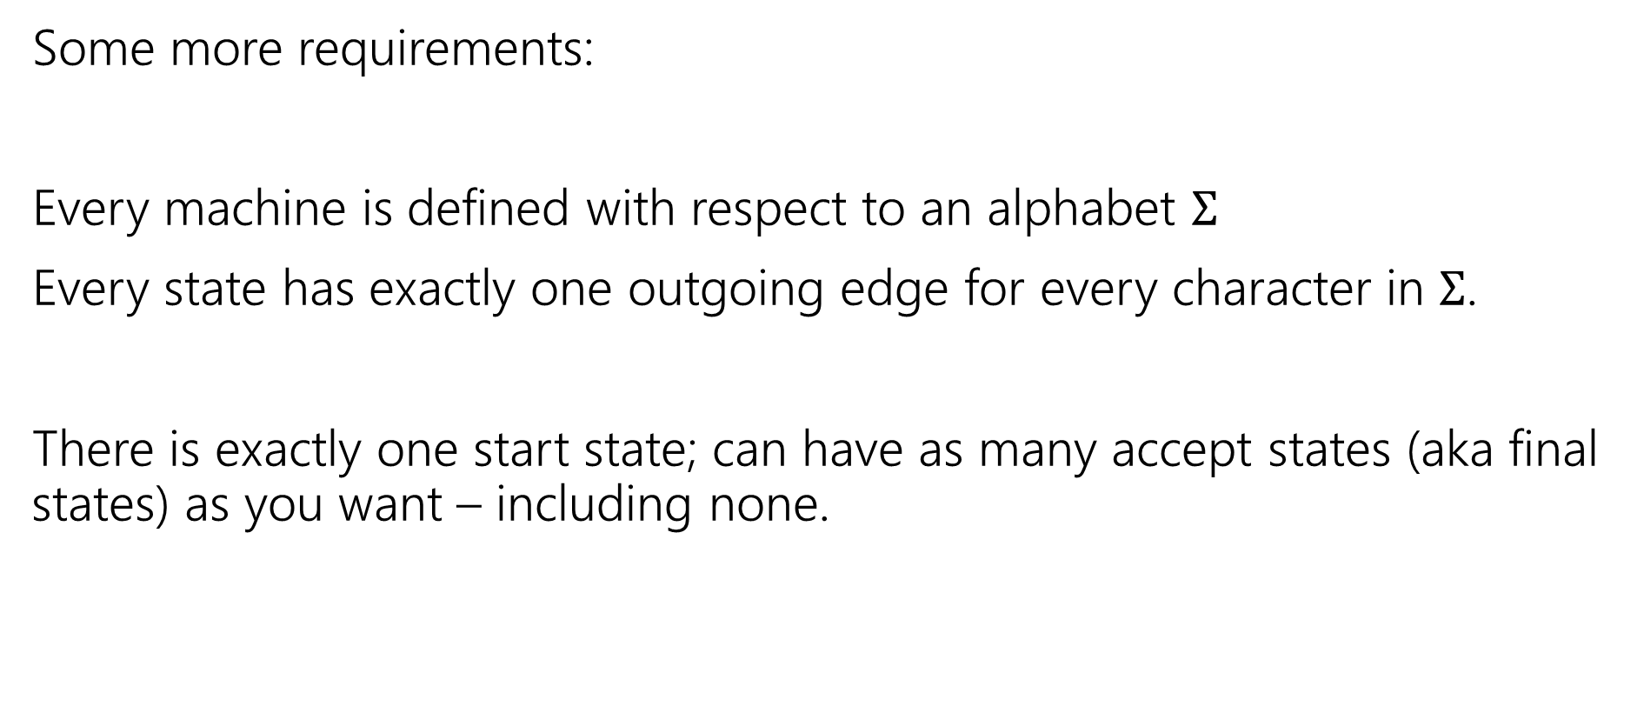
Deterministic Finite Automata
Some more requirements:
Every machine is defined with respect to an alphabet $Σ$
Every state has exactly one outgoing edge for every character in $Σ$.
There is exactly one start state; can have as many accept states (aka final states) as you want – including none.

Slide 32
Deterministic Finite Automata
Can also represent transitions with a table.
Old State | 0 | 1
s₀ | s₀ | s₁
s₁ | s₀ | s₂
s₂ | s₀ | s₃
s₃ | s₃ | s₃
0
0
1
1
1
s₀
s₁
s₂
s₃
0
0,1

Slide 33
Deterministic Finite Automata
What is the language of this DFA?
I.e. the set of all strings it accepts?
Old State | 0 | 1
s₀ | s₀ | s₁
s₁ | s₀ | s₂
s₂ | s₀ | s₃
s₃ | s₃ | s₃
0
0
1
1
1
s₀
s₁
s₂
s₃
0
0,1

Slide 34

Deterministic Finite Automata
If the string has $111$, then you’ll end up in $s_{3}$ and never leave.
If you end with a $0$ you’re back in $s_{0}$ which also accepts.
And…$ε$ is also accepted
$\left[{\left(0∪1\right)}^{∗}111{\left(0∪1\right)}^{∗}\right]∪{\left[{\left(0∪1\right)}^{∗}0\right]}^{∗}$
Old State | 0 | 1
s₀ | s₀ | s₁
s₁ | s₀ | s₂
s₂ | s₀ | s₃
s₃ | s₃ | s₃
0
0
1
1
1
s₀
s₁
s₂
s₃
0
0,1

Slide 35
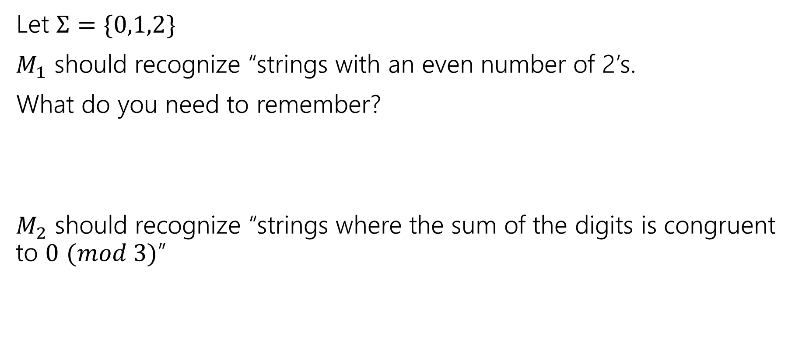
Design some DFAs
Let $Σ=\{0,1,2\}$
$M_{1}$ should recognize “strings with an even number of 2’s.
What do you need to remember?
$M_{2}$ should recognize “strings where the sum of the digits is congruent to $0$ $(mod 3)$”

Slide 36




Design some DFAs
Let $Σ=\{0,1,2\}$
$M_{1}$ should recognize “strings with an even number of 2’s.
$M_{2}$ should recognize “strings where the sum of the digits is congruent to $0$ $(mod 3)"$
2
s₁
s₀
2
0,1
0,1
1
$$t_{2}$$
1
2
2
$$t_{1}$$
2
$$t_{0}$$
0
1
0

Slide 37
Designing DFAs notes
DFAs can’t “count arbitrarily high”
For example, we could not make a DFA that remembers the overall sum of all the digits (not taken % 3)
That would have infinitely many states! We’re only allowed a finite number.

Slide 38


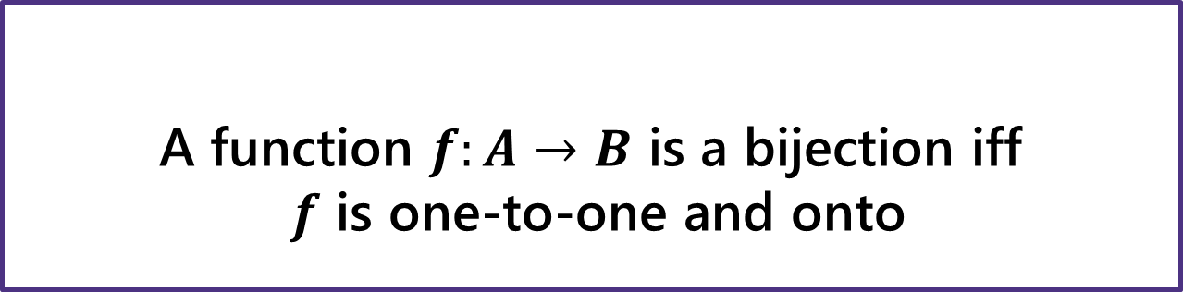
Bijection
A function $f$ is one-to-one iff
$$∀a∀b(f\left(a\right)=f\left(b\right)→a=b)$$
A function $f:A→B$ is onto iff
$$∀b∈B∃a∈A(b=f(a))$$
One-to-one (aka injection)
Onto (aka surjection)
A function $f:A→B$ is a bijection iff
$f$ is one-to-one and onto
Bijection
A bijection maps every element of the domain to exactly one element of the co-domain, and every element of the domain to exactly one element of the domain.

