Slide 1
CSE 331 Software Design & Implementation
Alan Perlis  Epigrams 
It is easier to write an incorrect program than understand a correct one.
Most people find the concept of programming obvious, but the doing impossible.
It is easier to change the specification to fit the program than vice versa.
There are two ways to write error-free programs; only the third one works.
To understand a program you must become both the machine and the program.
Autumn 2011

Slide 2
Who are we?
Staff
Students
Women | 3
Men | 1
Undergraduate students | 1
Graduate students | 1
Alumni | 1
Faculty | 1
Beards | 1
No beards | 3
Women | 12
Men | 43
Sophomores | 7
Juniors | 30
Seniors♣ | 18
CS major | 33
CompE major | 15
Other major | 7
♣Only three with any 400-level CSE courses

Slide 3
Two goals of software system building Barry Boehm 
Building the right system
Does the program meet the users’ needs?
Determining if this is true is usually called validation
Building the system right
Does the program meet the specification?
Determining if this is true is usually called verification
In CSE331, the second goal is the focus – that is, we focus (almost) only on creating a correctly functioning artifact
It can be surprisingly hard to specify, design, implement, test, debug and maintain even a simple program

Slide 4
“Does the program meet the specification?”
You know what a program is – we’ll focus on Java programs, but the ideas are much more general
What is a specification?
“a detailed description or assessment of requirements, dimensions, materials, etc., as of a proposed building, machine, bridge, etc.” [Dictionary.com Unabridged. Retrieved May 25, 2011]
It’s the basis for a contract: “if you build something that does X [then we will ‘pay you $19.55,’ ‘give you a 4.0,’ etc.]” – X is the specification, defining how we can tell if something (for us, a program) meets the specification
Ambiguity in specifications is common, often inadvertent, sometimes necessary, and keeps lawyers wealthy

Slide 5
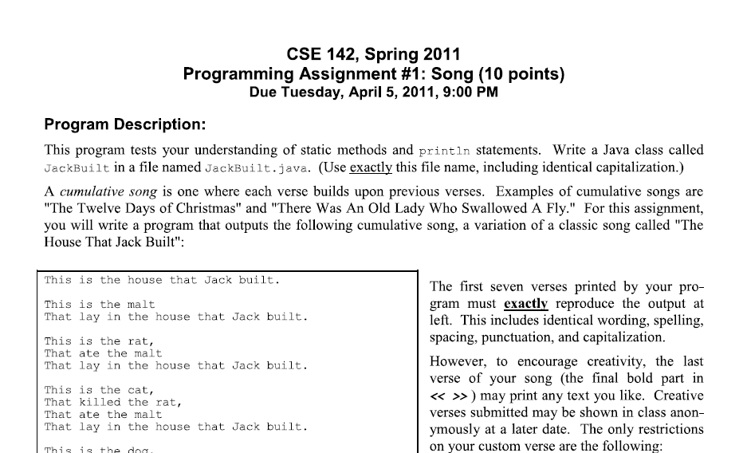
A familiar kind of specification

Slide 6
Another familiar kind of spec A CSE 143 assignment
// Interface Queue defines a set of operations for manipulating a FIFO
// (First In First Out) structure that can be used to store elements
// of type E.
public interface Queue<E> {
// post: given value inserted at the end of the queue
public void enqueue(E value);
// pre : !isEmpty()
// post: removes and returns the value at the front of the queue
public E dequeue();
// post: returns true if the queue is empty, false otherwise
public boolean isEmpty();
// post: returns the current number of elements in the queue
public int size();
}
pre-condition holds before execution
post-condition holds after execution

Slide 7
Specification Jeopardy: Hello World
Prints “Hello, World”
Prints “Hello, World” without quotation marks
Prints any string starting with “H”
Prints any string with 12 characters in it
Does anything
Does anything as long as it terminates
…
public static void main(String[] args) {
System.out.println("Hello, World");
}
This and many later code examples will be partial – in this case, the class is omitted – but the full context should be clear.
Every program meets (we’ll usually say satisfies) an unbounded number of specifications
It can be tricky to accurately specify the “right” amount of information – it takes experience

Slide 8
Specification Jeopardy: Double
public static void main(String[] args) {
System.out.print(Integer.parseInt(args[0])*2);
}
// post: prints twice the first input argument
// post: prints any integer
// pre: input argument ≥ 0 // post: prints any non-negative integer
// post: prints twice the first input argument OR throws java.lang.NumberFormatException
// pre: input argument * 2 ≤ java.lang.integer.MAX_VALUE // post: prints twice the first input argument
// post: if input argument * 2 ≤ java.lang.integer.MAX_VALUE // prints twice the first input argument otherwise // throws java.lang.NumberFormatException
…don’t forget MIN_VALUE …

Slide 9
And more
public static void main(String[] args) {
System.out.print(Integer.parseInt(args[0])*2);
}
// … no input argument?
Should it throw java.lang.ArrayIndexOutOfBoundsException
// … non-integer input argument?
Should it throw java.lang.NumberFormatException
// … more than one input argument?
Again, it’s tricky, requiring careful case analysis – imaginable inputs? desired outputs? what is really intended? how is it intended to be used? … ?
And, again, it takes experience (which should not be mistaken for intelligence)

Slide 10
Specifications: Q&A instead of A&Q
Is it easier to simply write down specifications before the program exists?
What would a post-condition be for a method that sorts an integer array of length N in non-decreasing order?
How do you precisely describe when an array is sorted?
In small groups, spend 2-3 minutes sketching a sorting post-condition (any syntax is OK)

Slide 11
A flaw
Most groups probably found a post-condition like
That is, for any two elements in the array, the one with the lower index must not be greater than the one with the higher index
But “undesired” satisfying programs are also allowed
Sorting means reordering the original elements, not simply creating a sorted array
So, we need to add a clause to the post-condition that says
∀i,j∈[0,N-1] • i<j ⇒ A[i] ≤ A[j]
for(int i=0; i<N; i++){ A[i] := i; }
A is a permutation of A_orig

Slide 12
“Incomplete” specifications: sqrt
double sqrt(double x, double epsilon) pre: x ≥ 0 post: abs(return*return–x) < epsilon
Perhaps this is the desired specification; perhaps not
What would sqrt(81.0d,0.001d)return?
Might want the positive square root to be returned
Or might want a non-deterministic specification that
allows a satisfying program to return different values for different invocations or
allows different satisfying programs to return different values

Slide 13
Getting to “correct”
There is no precise notion of a “correct” specification
However, there can be incorrect specifications – ones that cannot be implemented, ones that are inconsistent, and ones that are just bad …
This is really a validation question, “Does the specification meet the needs of the users?”
This is because there is no precise way to assess user needs – although there is a lot known about this, it is far beyond what we can cover in 331
So we will focus on a precise notion – does a given program (implementation) satisfy a given specification?

Slide 14
Why is writing satisfying programs hard?
Many ways to satisfy a specification – have to find and choose a “good” way?
“Goodness” is an ill-defined mix of customer needs, business needs, technologies, etc.
Software systems are complex
Many difficult decisions and structures
Requires teams that effectively communicate and coordinate
Customer needs evolve
Programs must change to meet spec changes
…and more, much more…!
“Software entities are more complex for their size than perhaps any other human construct, because no two parts are alike… If they are, we make the two similar parts into one... In this respect software systems differ profoundly from computers, buildings, or automobiles, where repeated elements abound.” Fred Brooks  "No Silver Bullet — Essence and Accidents of Software Engineering". IEEE Computer 20 (4): 10–19 (1987) 

Slide 15
The Tao (道) of CSE331
CSE142/143
CSE331
Programming (in Java)
Control (loops, conditionals, methods, parameter passing, recursion, etc.)
Variables
Abstract data types (ADTs):
Stacks, linked lists, …
Interfaces, inheritance and encapsulation
Basics of complexity and performance tradeoffs
Using off-the-shelf components from Java Collections
Designing and implementing more realistic software (in Java, but more general)
Abstraction and specification
Writing, understanding and reasoning about code
Program design and documentation: process and tools
What makes a design good or bad?
Pragmatic considerations
Testing
Debugging and defensive programming
Software management issues

Slide 16
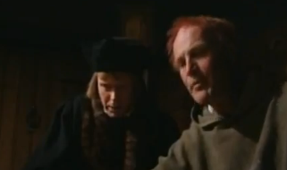
An observation
Some of you are eyeballing others, worrying that “they know stuff I don’t know”
This is likely true but
You also know stuff they don’t and
Nobody was born knowing about Java generics or version control or Eclipse or such … everybody (who knows it) had to learn it sometime
See Medieval Helpdesk video … watch it on your own 2:46 minutes!
“Open it? If it’s that simple, I wouldn’t have called helpdesk, would I?”
“But this has the same problem. I can’t seem to open it.”
“Have you read the manual?”

Slide 17
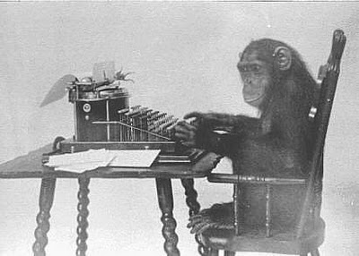
If you are having trouble…
“Ask” yourself what’s going on – programming by permutation rarely succeeds, so think first!
Look for information – it can be hard, but learning how to do this effectively is a great investment
Ask others for help – course staff, friends, students in the class, etc.
The one epic fail is to stay stuck on something for a long time
In one of my first jobs, I had some bugs I simply couldn’t find. After far too many hours (days), the president of the company sat me down and said, “OK, David, tell me why these bugs can’t happen.” I found them really quickly!
DON’T DO THIS! Really. I’m totally serious. Really.

Slide 18
Performance
How fast a program runs can be important – and we may at times talk about performance
But it is not even close to the primary focus of 331 – correctness is much more important
These quotations about performance are from people with extraordinary experience and insight
Michael Jackson 
Rule 1: Don't do it.
Rule 2 (for experts only): Don't do it yet.
Bill Wulf 
More computing sins are committed in the name of efficiency (without necessarily achieving it) than for any other single reason – including blind stupidity.
Don Knuth 
We should forget about small efficiencies, say about 97% of the time: premature optimization is the root of all evil.

Slide 19
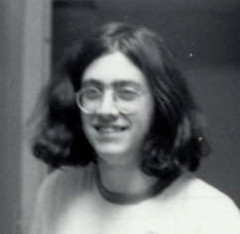
An old conversation, oft-repeated
You lost points because the program isn’t correct
But it’s fast!
If it doesn’t have to be correct, I can write a much faster program!
Extra credit if you can identify either or both of these people

Slide 20
Prerequisite: Java at the 142/143 level Examples
Sharing
Distinction between == and equals()
Are two objects the same object, or do they have equal values?
And what does “equal” mean?
Aliasing (multiple references to the same object)
Subtyping
Varieties: classes, interfaces
Inheritance and overriding
Object-oriented dispatch
Expressions have a compile-time type
Objects/values have a run-time type
The first two assignments will largely focus on making sure you’re (back) up to speed on this kind of material

Slide 21
Logistics
http://www.cs.washington.edu/cse331
There’s useful information in there … if you can’t find what you’re looking for, make sure to ask!
Especially the calendar http://www.cs.washington.edu/education/courses/cse331/11au/calendar/calendar.html
We’ll also be using piazza.com for information and Q&A threads, etc.
And Catalyst as well, although not for posting

Slide 22
Collaboration policy
Discussion is permitted … indeed, encouraged!
Representing someone else’s work as your own is not permitted
Familiarize yourselves with the CSE, COE and UW policies on academic honesty – we rely on them heavily – we will pursue cases of academic dishonesty
If you have a question about what is allowed, ask!
Please apply the Gilligan’s rule
if you watch mindless TV (Hulu?) for 30-60 minutes after a discussion with classmates, and
you can still reproduce the materials from memory (no notes, no email, etc.), then
you can consider it your work/knowledge
Loopholes are not loopholes – spirit of the law applies over the letter of the law

Slide 23
Next steps
Assignment 0: on the web now, due Friday 11:59PM
Objective: get your Java environment configured and running, get a couple of tiny Java programs running, a survey, etc.
Warning: this can be quite complicated, with different operating systems (variants of Linux, Windows, Mac OS), different versions of Java, different versions of Eclipse, and more – we have some expertise, but sometimes it’s hard for us, too
Sections tomorrow: in the lab, with the staff there, bouncing from student-to-student to help you do this
TODAY: Make sure you can login to UW CSE machines! Both Linux and Windows (which can have different passwords!)
Forgot CSENetID? Email support@cs (they reset it, you retrieve it at reception)
Forgot Windows password (but remember CSENetID)? Click here
Assignment 1: on the web before Friday lecture; due next Wednesday 11:59PM
Lectures: Specifications (F), testing/JUnit (M), equality (W)

Slide 24
?

