Slide 1
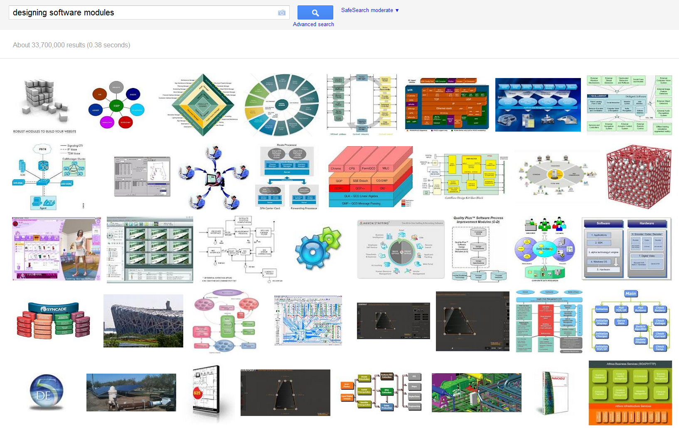
CSE 331 Software Design & Implementation Modular design principles
Google image search on “designing software modules”
Autumn 2011

Slide 2
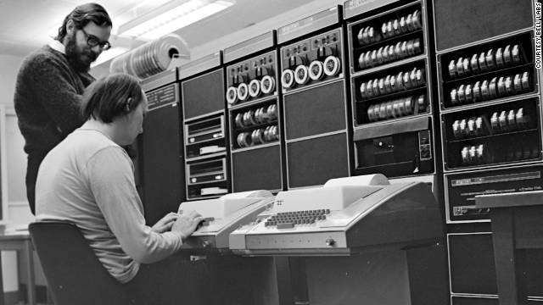
Dennis Ritchie (1941-2011) 
“’Pretty much everything on the web uses those two things: C and UNIX,’ Pike tells Wired. ‘The browsers are written in C. The UNIX kernel — that pretty much the entire Internet runs on — is written in C. Web servers are written in C, and if they're not, they're written in Java or C++, which are C derivatives, or Python or Ruby, which are implemented in C.’”
“’Jobs was the king of the visible, and Ritchie is the king of what is largely invisible,’” says Martin Rinard, professor of electrical engineering and computer science at MIT.”
[Both quotations from CNN]
Above: Ritchie standing, Ken Thompson sitting, PDP-11 in background
Turing Award. National Medal of Technology. Japan Prize, …

Slide 3
Modules
A module is a relatively general term for a class or a type or any kind of design unit in software
A modular design focuses on what modules are defined, what their specifications are, how they relate to each other, but not usually on the implementation of the modules themselves
Overall, you’ve been given the modular design so far – and now you have to learn more about how to do the design
That’s the focus of Assignment #3, and it’s why we’re using pairs

Slide 4
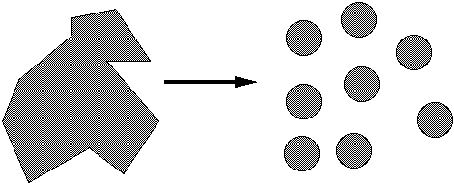
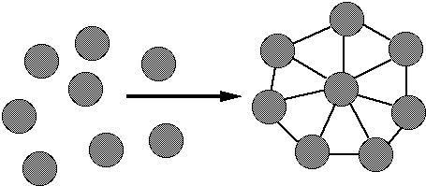
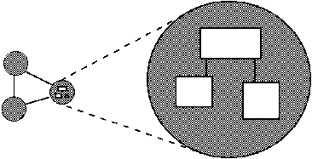
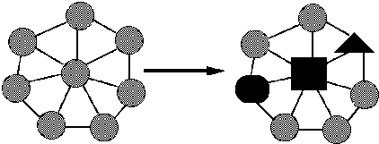
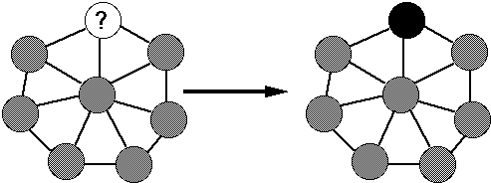
Ideals of modular software
Decomposable – can be broken down into modules to reduce complexity and allow teamwork
Composable – “Having divided to conquer, we must reunite to rule [M. Jackson].”
Understandable – one module can be examined, reasoned about, developed, etc. in isolation
Continuity – a small change in the requirements should affect a small number of modules
Isolation – an error in one module should be as contained as possible

Slide 5
Two general design issues
Cohesion – why are units (like methods) placed in the same module? Usually to collectively form an ADT
Coupling – what is the dependence between modules? Reducing the dependences (which come in many forms) is desirable

Slide 6
Cohesion
The most common reason to put elements – data and behavior – together is to form an ADT
There are, at least historically, other reasons to place elements together – for example, for performance reasons it was sometimes good to place together all code to be run upon initialization of a program
The common design objective of separation of concerns suggests a module should address a single set of concerns Example considerations
Should Item/DiscountItem know about added discount for purchasing 20+ items? Should ShoppingCart know about bulk pricing?
Should BinarySearch know the type of the objects it is sorting?
This kind of questions help make more effective cohesion decisions

Slide 7
Coupling
Roughly, the more coupled k modules are, the more one needs to think of them as a single, larger module
How are modules dependent on one another?
Statically (in the code)? Dynamically (at run-time)? And more
Ideally, split design into parts that don't interact much
An artist’s rendition – to really assess coupling one needs to know what the arrows are, etc.
MY
FINAL
PROJECT
MY
MY
FINAL
PROJECT
FINECT
PROJAL
An application
A poor decomposition
(parts strongly coupled)
A better decomposition
(parts weakly coupled)

Slide 8
Different kinds of dependences
Aggregation – “is part of” is a field that is a sub-part
Ex: A car has an engine
Composition – “is entirely made of” has the parts live and die with the whole
Ex: A book has pages (but perhaps the book cannot exist without the pages, and the pages cannot exist without the book)
Subtyping – “is-a” is for substitutability
Invokes – “executes” is for having a computation performed
In other words, there are lots of different kinds of arrows (dependences) and clarifying them is crucial

Slide 9
Law of Demeter Karl Lieberherr  and colleagues
Law of Demeter: An object should know as little as possible about the internal structure of other objects with which it interacts – a question of coupling
Or… “only talk to your immediate friends”
Closely related to representation exposure and (im)mutability
Bad example – too-tight chain of coupling between classes general.getColonel().getMajor(m).getCaptain(cap) .getSergeant(ser).getPrivate(name).digFoxHole();
Better example general.superviseFoxHole(m, cap, ser, name);

Slide 10
An object should only send messages to … (More Demeter)
itself (this)
its instance variables
its method's parameters
any object it creates
any object returned by a call to one of this's methods
any objects in a collection of the above
notably absent: objects returned by messages sent to other objects
Guidelines: not strict rules! But thinking about them will generally help you produce better designs

Slide 11
Coupling is the path to the dark side
Coupling leads to complexity
Complexity leads to confusion
Confusion leads to suffering
Once you start down the dark path, forever will it dominate your destiny, consume you it will

Slide 12
God classes
god class: a class that hoards too much of the data or functionality of a system
Poor cohesion – little thought about why all of the elements are placed together
Only reduces coupling by collapsing multiple modules into one (and thus reducing the dependences between the modules to dependences within a module)
A god class is an example of an anti-pattern – it is a known bad way of doing things

Slide 13
Design exercise
Write a typing break reminder program
Offer the hard-working user occasional reminders of the perils of Repetitive Strain Injury, and encourage the user to take a break from typing
Naive design
Make a method to display messages and offer exercises
Make a loop to call that method from time to time
(Let's ignore multi-threaded solutions for this discussion)‏

Slide 14
TimeToStretch suggests exercises
public class TimeToStretch {
public void run() {
System.out.println("Stop typing!");
suggestExercise();
}
public void suggestExercise() {
...
}
}

Slide 15
Timer calls run() periodically
public class Timer {
private TimeToStretch tts = new TimeToStretch();
public void start() {
while (true) {
...
if (enoughTimeHasPassed) {
tts.run();
}
...
}
}
}

Slide 16
Main class puts it together
class Main {
public static void main(String[] args) {
Timer t = new Timer();
t.start();
}
}

Slide 17
Module dependency diagram
An arrow in a module dependency diagram indicates “depends on” or “knows about” – simplistically, “any name mentioned in the source code”
Does Timer really need to depend on TimeToStretch?
Is Timer re-usable in a new context?
Main
Main class depends on Timer
Timer
TimeToStretch
Timer depends on TimeToStretch

Slide 18
Decoupling
Timer needs to call the run method
Timer doesn't need to know what the run method does
Weaken the dependency of Timer on TimeToStretch
Introduce a weaker specification, in the form of an interface or abstract class public abstract class TimerTask {
public abstract void run(); }
Timer only needs to know that something (e.g., TimeToStretch) meets the TimerTask specification

Slide 19
TimeToStretch (version 2)‏
public class TimeToStretch extends TimerTask {
public void run() {
System.out.println("Stop typing!");
suggestExercise();
}
public void suggestExercise() {
...
}
}

Slide 20
Timer v2
public class Timer {
private TimerTask task;
public Timer(TimerTask task) { this.task = task; }
public void start() {
while (true) {
...
task.run();
}
}
}
Main creates the TimeToStretch object and passes it to Timer Timer t = new Timer(new TimeToStretch()); t.start();

Slide 21
Module dependency diagram
Main still depends on Timer (is this necessary?)‏
Main depends on the constructor for TimeToStretch
Timer depends on TimerTask, not TimeToStretch
Unaffected by implementation details of TimeToStretch
Now Timer is much easier to reuse
Main
TimerTask
Timer
Dependence
TimeToStretch
Subclassing

Slide 22
callbacks
TimeToStretch creates a Timer, and passes in a reference to itself so the Timer can call it back
This is a callback – a method call from a module to a client that notifies about some condition
Use a callback to invert a dependency
Inverted dependency: TimeToStretch depends on Timer (not vice versa)
Side benefit: Main does not depend on Timer

Slide 23
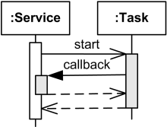
Callbacks
Synchronous callbacks
Ex: HashMap calls its client’s hashCode, equals
Useful when the callback result is needed immediately by the module
Asynchronous callbacks
Examples: GUI listeners
Register to indicate interest and where to call back
Useful when the callback should be performed later, when some interesting event occurs
A synchronous callback.
Time increases downward.
Solid lines: calls
Dotted lines: returns

Slide 24
TimeToStretch v3
public class TimeToStretch extends TimerTask {
private Timer timer;
public TimeToStretch() {
timer = new Timer(this);
}
public void start() {
timer.start();
}
public void run() {
System.out.println("Stop typing!");
suggestExercise();
}
...
}
Register interest with the timer
Callback entry point

Slide 25
Main v3
TimeToStretch tts = new TimeToStretch(); tts.start();
Use a callback to invert a dependency
This diagram shows the inversion of the dependency between Timer and TimeToStretch (compared to v1)
Main does not depend on Timer
TimeToStretch depends on Timer
Main
TimerTask
Timer
TimeToStretch

Slide 26
How do we design classes?
One common approach to class identification is to consider the specifications
In particular, it is often the case that
nouns are potential classes, objects, fields
verbs are potential methods or responsibilities of a class

Slide 27
Design exercise
Suppose we are writing a birthday-reminder application that tracks a set of people and their birthdays, providing reminders of whose birthdays are on a given day
What classes are we likely to want to have? Why?
Class shout-out about classes

Slide 28
More detail for those classes
What fields do they have?
What constructors do they have?
What methods do they provide?
What invariants should we guarantee?
In small groups, ~5 minutes

Slide 29
Next steps
Assignment 2: part B due today 11:59PM
Assignment 3: out on the weekend – choose pairs!
See http://www.cs.washington.edu/education/courses/cse331/11sp/homework.shtml (HW3, Restaurant) for a preview to get started (2 weeks)
Assignment 4 and 5: closer to being selected
Lectures: M – was going to be design patterns… I’ve had a request for more testing first
Upcoming: Friday 10/28, in class midterm – open book, open note, closed neighbor, closed electronic devices

Slide 30
?

