Slide 1
CSE 331 Software Design & Implementation GUI & (a little on) design patterns iII
Autumn 2011

Slide 2
Why learn GUIs?
Learn about event-driven programming techniques – perhaps the most-used version of inversion-of-control
Practice learning and using a large, complex API
A chance to see how it is designed and learn from it (design pattern usage, etc.)
Caution: There is a ton of information for GUI programming – huge APIs
You won't memorize it all; you will look things up as you need them
But you have to learn the fundamental concepts and general ideas

Slide 3
Don’t mistake…
… how to build a GUI well with …
… what is a good UI for people
Just another version of “building the system right vs. building the right system”
We’ll come back to some usability issues – much more related to “building the right system” later in the term

Slide 4
Java GUI History
Abstract Windowing Toolkit (AWT): Sun's initial effort to create a set of cross-platform GUI classes (JDK 1.0 - 1.1)
Maps general Java code to each operating system's real GUI system
Limited to lowest common denominator; clunky to use
Swing: A newer GUI library written from the ground up that allows much more powerful graphics and GUI construction (JDK 1.2+)
Paints GUI controls itself pixel-by-pixel rather than handing off to OS
Better features, better compatibility, better design
Warning: Both exist in Java now; easy to get them mixed up; still have to use both in various places

Slide 5
GUI terminology
window: A first-class citizen of the graphical desktop
Also called a top-level container
Ex: frame, dialog box, applet
component: A GUI widget that resides in a window
Also called controls in many other languages
Ex: button, text box, label
container: A logical grouping for storing components
Ex: panel, box

Slide 6
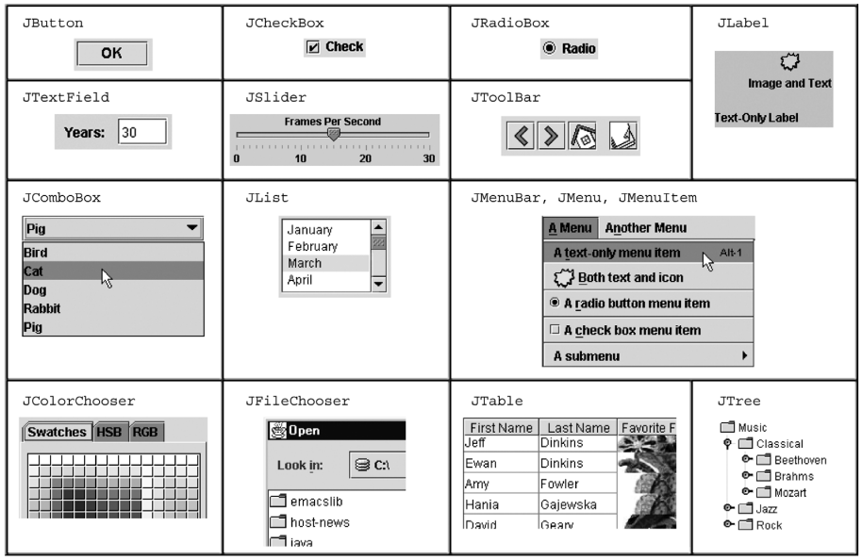
Swing components (partial)

Slide 7
Swing inheritance hierarchy
Component (AWT)
Window
Frame
JFrame (Swing)
JDialog
Container
JComponent (Swing)
JButton JColorChooser JFileChooser
JComboBox JLabel JList
JMenuBar JOptionPane JPanel
JPopupMenu JProgressBar JScrollbar
JScrollPane JSlider JSpinner
JSplitPane JTabbedPane JTable
JToolbar JTree JTextArea
JTextField ...
import java.awt.*;
import javax.swing.*;

Slide 8
Component properties
Each has a get/is accessor and a set modifier
Ex: getColor, setFont, setEnabled, isVisible
name | type | description
background | Color | background color behind component
border | Border | border line around component
enabled | boolean | whether it can be interacted with
focusable | boolean | whether key text can be typed on it
font | Font | font used for text in component
foreground | Color | foreground color of component
height, width | int | component's current size in pixels
visible | boolean | whether component can be seen
tooltip text | String | text shown when hovering mouse
size, minimum / maximum / preferred size | Dimension | various sizes, size limits, or desired sizes that the component may take

Slide 9
JFrame A window holding components
Constructors with an optional title public JFrame() public JFrame(String title)
Make a frame f appear on the screen f.setVisible(true) public void
Place the given component or container inside the frame f f.add(Component comp)
Make the frame perform a given action when it closes public void setDefaultCloseOperation(int op)
Common value passed: JFrame.EXIT_ON_CLOSE
If not set, the program will never exit even if the frame is closed
Give the frame a fixed size in pixels public void setSize(int width, int height)
Resize the frame to fit the components tightly public void pack()

Slide 10
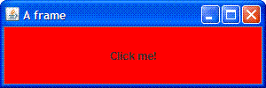
GUI example
import java.awt.*; import javax.swing.*;
public class GuiExample1 { public static void main(String[] args) { JFrame frame = new JFrame(); frame.setDefaultCloseOperation(JFrame.EXIT_ON_CLOSE); frame.setSize(new Dimension(300, 100)); frame.setTitle("A frame"); JButton button1 = new JButton(); button1.setText("I'm a button."); button1.setBackground(Color.BLUE); frame.add(button1); JButton button2 = new JButton(); button2.setText("Click me!"); button2.setBackground(Color.RED); frame.add(button2); frame.setVisible(true); } }
We defined two buttons, but only one is visible. Why?
What happens when we click button2?

Slide 11
It’s tedious… and there is more …
Size and positioning
Preferred/minimum sizes, absolute/relative positioning
…
Containers and layout
Flow layout – laying out components in a container
Border layout – NORTH, SOUTH, EAST, WEST, CENTER
Grid layout
…
And more, lots more…
…

Slide 12
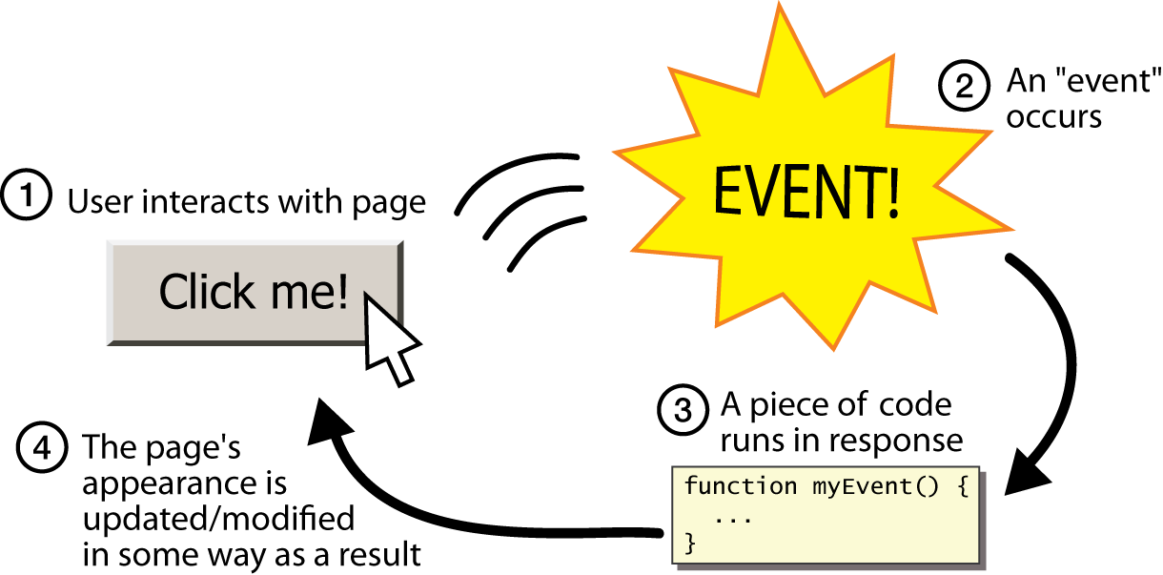
GUI control structure inversion-of-control
event: An object representing a user's interaction with a GUI component
listener: An object responding to events
To handle an event, attach a listener to a component (such as a button)
The listener will be notified when the event occurs (such as a button click)

Slide 13
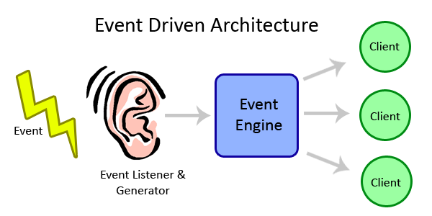
Event-driven programming
A programming style where the overall flow of execution is dictated by events
The program defines a set of listeners that wait for specific events
As each event happens due to a user action, the program runs specific code
The overall flow of execution is determined by the series of events that occur, not a pre-determined order
The events invoke client code (through the listeners) without knowing which client code is invoked
The invokes relation (in part) no longer matches the names relation

Slide 14
Action events
action event: An action on a GUI component
The most common, general event type in Swing, caused by
button or menu clicks,
check box checking / unchecking,
pressing Enter in a text field, ...
Represented by a class named ActionEvent
Handled by objects that implement interface ActionListener

Slide 15
Implementing a listener
public class name implements ActionListener { public void actionPerformed(ActionEventevent) { code to handle the event; } }
public void addActionListener(ActionListener al)
Attaches the given listener to be notified of clicks and events that occur on this component
JButton and other graphical components have this method

Slide 16
Event hierarchy
EventObject
AWTEvent (AWT)
ActionEvent
TextEvent
ComponentEvent
FocusEvent
WindowEvent
InputEvent
KeyEvent
MouseEvent
EventListener
AWTEventListener
ActionListener
TextListener
ComponentListener
FocusListener
WindowListener
KeyListener
MouseListener
import java.awt.event.*;

Slide 17
Nested classes
nested class: A class defined inside of another class
Nested classes are hidden from other classes
Nested objects can access/modify the fields of their outer object
If necessary, can refer to outer object as OuterClassName.this
Only the outer class can see the nested class or make objects of it
Event listeners are often defined as nested classes inside a GUI

Slide 18
GUI event example
public class MyGUI { private JFrame frame; private JButton stutter; private JTextField textfield;
public MyGUI() { ... stutter.addActionListener(new StutterListener()); } ...
// When button is clicked, doubles the field's text private class StutterListener implements ActionListener { public void actionPerformed(ActionEvent event) { String text = textfield.getText(); textfield.setText(text + text); } } }

Slide 19
Mouse and keyboard events
Low-level events – close to the hardware – to listen for and respond to mouse clicks/movements and keyboard entry/echoing

Slide 20
MouseListener interface
public interface MouseListener {
public void mouseClicked(MouseEvent event);
public void mouseEntered(MouseEvent event);
public void mouseExited(MouseEvent event);
public void mousePressed(MouseEvent event);
public void mouseReleased(MouseEvent event);
}
Most AWT/Swing components have this method public void addMouseListener(MouseListener ml)

Slide 21
Implementing listener
public class MyMouseListener implements MouseListener { public void mouseClicked(MouseEvent event) {} public void mouseEntered(MouseEvent event) {} public void mouseExited(MouseEvent event) {} public void mousePressed(MouseEvent event) { System.out.println("You pressed the button!"); } public void mouseReleased(MouseEvent event) {} }
// elsewhere,
myComponent.addMouseListener(new MyMouseListener());
Tedious to define the empty method for the events you are not interested in

Slide 22
Adapter pattern to the rescue
Provide an adapter class that connects to GUI components but exposes to us the interface we prefer – only a method or two
event adapter: A class with empty implementations of all of a given listener interface's methods
Ex: MouseAdapter, KeyAdapter, FocusAdapter
Ex: To extend MouseAdapter only override methods you want to implement
Don't have to type in empty methods for the ones you don't want!

Slide 23
An abstract event adapter
// An empty implementation of all MouseListener methods // (from java.awt.event)
public abstract class MouseAdapter implements MouseListener { public void mousePressed(MouseEvent event) {} public void mouseReleased(MouseEvent event) {} public void mouseClicked(MouseEvent event) {} public void mouseEntered(MouseEvent event) {} public void mouseExited(MouseEvent event) {} }
Classes can extend MouseAdapter rather than implementing MouseListener
client gets the complete mouse listener interface it wants
implementer gets to write just the few mouse methods they want
public class MyMouseAdapter extends MouseAdapter { public void mousePressed(MouseEvent event) { System.out.println("You pressed the button!"); } } // elsewhere… myComponent.addMouseListener(new MyMouseAdapter());

Slide 24
Using MouseEvent
public class MyMouseAdapter extends MouseAdapter {
public void mousePressed(MouseEvent event) {
Object source = event.getSource();
if (source == button && event.getX() < 10) {
JOptionPane.showMessageDialog(null,
"You clicked the left edge!");
}
}
}

Slide 25
Mouse input listener
The MouseInputListener interface and the MouseInputAdapter class ease the development of an object that listens to mouse clicks, movement, and/or wheel events
public class MyMouseInputAdapter extends MouseInputAdapter { public void mousePressed(MouseEvent event) { System.out.println("Mouse was pressed"); } public void mouseDragged(MouseEvent event) { Point p = event.getPoint(); System.out.println("Mouse is at " + p); }
}
…
MyMouseInputAdapter adapter = new MyMouseInputAdapter(); myPanel.addMouseListener(adapter); myPanel.addMouseMotionListener(adapter);

Slide 26
Similar for keyboard events
public interface KeyListener { public void keyPressed(KeyEvent event); public void keyReleased(KeyEvent event); public void keyTyped(KeyEvent event); } … // what key code was pressed? (one for almost every key) public static int VK_A, VK_B, ..., VK_Z, VK_0, ... VK_9, VK_F1, ... VK_F10, VK_UP, VK_LEFT, ..., // Were any modifier keys held down? public static int CTRL_MASK, ALT_MASK, SHIFT_MASK public char getKeyChar() public int getKeyCode() // use VK_* with this public Object getSource() public int getModifiers() // use *_MASK with this
Equivalent adapters, too

Slide 27
Focus: current target of keyboard input
If a component doesn't have the focus, it will not receive events
By default, most components don't receive focus
Buttons, text fields, and some others default to on
JComponent methods for focus
public void setFocusable(boolean b)
Sets whether this component can receive keyboard focus
public void requestFocus()
Asks for this component to be given the current keyboard focus
FocusListener (focus gained or lost), focusAdapter, also available

Slide 28
Other events
Window events (closed, opened, iconified, ...)
Change events (state changed in a JSlider, …)
Component events (component hidden, resized, shown, …)
JList/JTree select events
Document events (for text fields)
…

Slide 29
Next steps
Assignment 3: due Sunday October 30, 11:59PM
Lectures
W (Midterm review, including example questions)
Upcoming: Friday 10/28, in class midterm – open book, open note, closed neighbor, closed electronic devices

Slide 30
?

