Slide 1
CSE 331 Software Design & Implementation midterm review
Autumn 2011

Slide 2
The other kind of testing…
Actually, it’s the same as software testing (mostly)
By picking effective subdomains, I hope to determine how likely it is that you understand the material – it’s inherently sampling, not proof
In this situation, a single test suite will be executed across 56 different processors

Slide 3
The form of the test: Subject to some (but limited) change
Part I: True/false with a brief justification
5-10 questions
Two examples from last year
“hashCode can be determined at most once – that is, only when it is first actually requested by a client and then it can be cached.”
“If an immutable object throws an exception, it is never left in an undesirable or indeterminate state.”
In small groups, spend two minutes discussing these

Slide 4
Part II: Testing
More than on last year’s exam – now about 20% of the total points
Don’t worry about white-box testing, as we haven’t yet covered it
Likely kinds of questions
In what ways is/is not unit testing like <some other kind of testing like system testing or acceptance testing or …>? You will not need a deep understanding of these other kinds of testing
Write some black-box tests for a given specification and describe what subdomains they are intended to address

Slide 5
Part III: Specifications
(Not entirely distinct from the next Part on ADTs)
Likely kinds of questions
Infer a likely specification (requires/modifies/etc.) from a piece of code
Given a specification, provide an implementation that is almost surely not what the specification intended
??

Slide 6
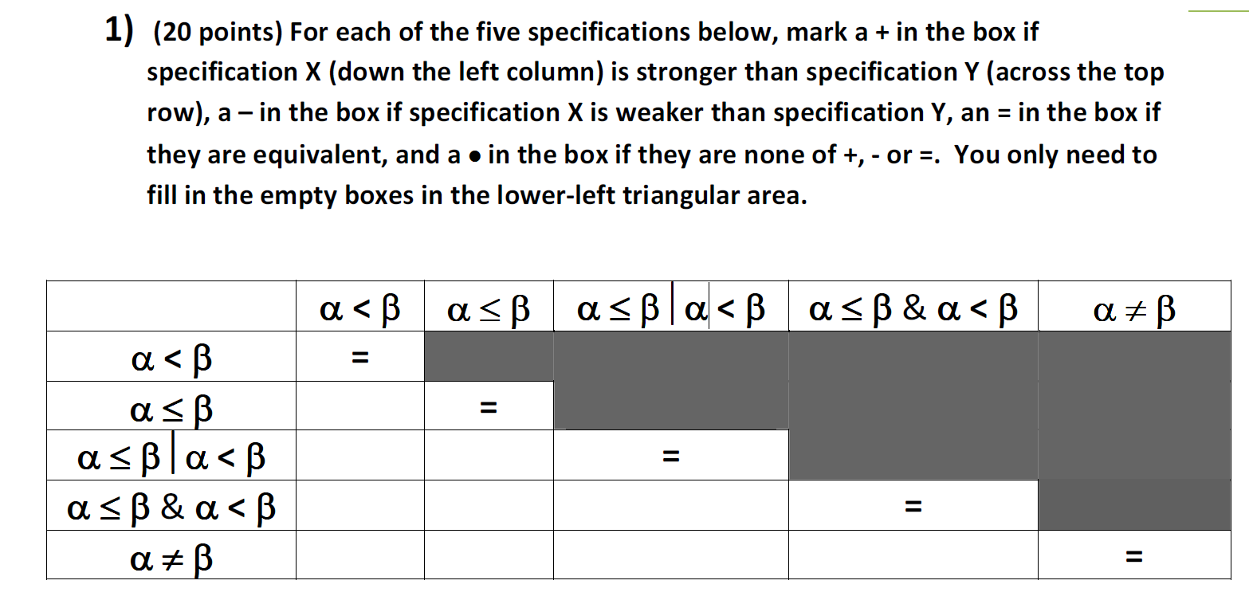
Part IV: ADTs
Likely kinds of concepts to be tested
Is one ADT specification a true subtype of another ADT specification? Some variant of the following question from last year
In small groups, spend two minutes discussing this example question

Slide 7
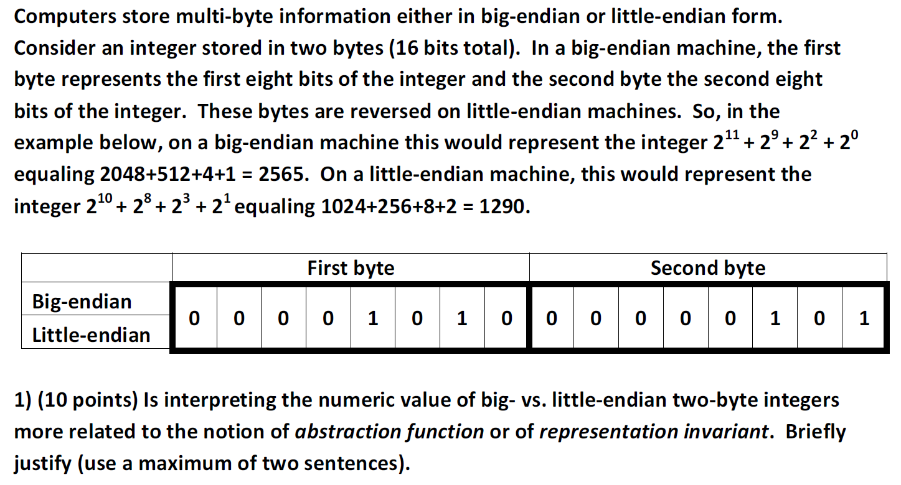
Part IV: ADTs continued
Likely kinds of concepts to be tested
What is, or is wrong with, a representation invariant for a given class?
Is there representation exposure? How might you fix it?
Relationship of representation invariants and abstraction functions
In small groups, spend two minutes discussing this example question

Slide 8
Part V: Miscellaneous
This part might not be included
And if included, I’m not yet sure what it will be

Slide 9
Per lecture: points to focus upon But others are fair game still
Lecture 1 – introduction
Programs (implementation) satisfying specifications
It’s tricky business
It’s a many-to-many mapping
No notion of a “correct” specification
Some can surely admit implementations that are highly unlikely to be desired

Slide 10
Lecture 2 – specifications
The value of specifications in addressing complexity in software
The dual roles of client and implementer
What does the client depend upon?
What does the implementer need to provide?
Why is a specification useful for this?
Why not just read code? Just use documentation? Just use Java interfaces? Etc.?
Javadoc and the 331 extensions to it

Slide 11
Lecture 3 – testing
Testing is one form of quality assurance for software
Testing terminology – pass, fail, test case, test suite, …
General notion of kinds of testing
Subdomains
JUnit’s role – what can it help you do and not do?

Slide 12
Lecture 4 – equality
Different notions of equality
Key underlying properties of (any useful) equality
Relationship of equals and hashCode
Overriding vs. overloading

Slide 13
Lectures 5 and 6 – ADTs
Motivations for the use of ADTs
Primary focus on ADT operations rather than representations
Different kinds of ADT operations (observers, mutators, etc.) and differences between mutable and immutable ADTs
Hide the implementation decisions to allow change
Abstraction function – what is it, why is it important, how is it used?
Representation invariant – what is it, why is it important, how is it used?
The relationship between the AF and RI, the ADT and its implementation (that diagram)
Representation exposure – what is it, how to eliminate it?

Slide 14
Lecture 7 – subtyping & subclassing
A way to share behaviors and/or code
Weaker and stronger specifications – and the relationship to satisfying implementations
True subtyping vs. Java subtyping – allowing substitutability
Subtyping is over specifications; subclassing is over implementations – both use similar mechanisms in Java
Mutability can be useful, but can confuse the issue of true subtyping

Slide 15
Lecture 8 – modular design principles
Cohesion (why together?) and coupling (how do modules interact?)
Different kinds of dependences – invokes, names, extends, etc.
Ways to manage dependences – e.g., Law of Demeter
Module dependence diagrams (largely to identify coupling)

Slide 16
Lecture 9 – design style
Long list of good things to do in coding
Method, field, constructor design
Naming
Class design ideals (cohesion, coupling, clarity, etc.)
Documentation
Invariants
static vs. non-static; public vs. private; etc.
Selecting types
Independence of views

Slide 17
Lectures 10-12
Design patterns, basic GUI
Not a focus of this test – will be fair game on the final

Slide 18
?

