Slide 1
CSE 331 Software Design & Implementation Exceptions and assertions
Everybody plays the fool …
…there’s no exception to the rule
Autumn 2011

Slide 2
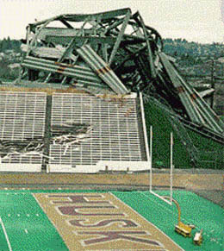
Failure: String.reverse(“sneppah tihs”)
Galloping Gurdy
Industrial: Chernobyl, Three Mile Island, Bhopal, Fukushima Daiichi, …
Aerospace: Challenger, Columbia, Soyuz I, Apollo I, Ariane 5
Aviation: AF4590 (Concorde), AA587
Construction: Hyatt Regency walkway (KC, 1981), the last Husky Stadium remodel (1987)
And many, many more
Henry Petroski  has written broadly on the role of failure in engineering
Notes:
Actually, you don’t use or call a specification directly: you use or call an implementation.
And it’s possible that the upgrade from S2 to S1 does not work. Why?
Because of details of the implementation that were incorrectly relied upon.
Because of an underdetermined spec, and the implementation didn’t correctly deal with all possibilities.

Slide 3
Software errors are inevitable, too
Not famous software failures, but how to think more about reducing the chances of failure and the consequences of failure
Reducing the chances of failure is usually considered software reliability
Reducing the consequences of failure is usually considered software safety
“A car that doesn’t start is unreliable; a car that doesn’t stop is unsafe.:
Software failure causes include
Misuse of your code (e.g., precondition violation)
Errors in your code (e.g., bugs, representation exposure, …re)
Unpredicted/unpredictable external problems (e.g., out of memory, missing file, memory corruption, …)
How would you categorize these?
Failure of a subcomponent
No return value (e.g., list element not found, division by zero)
Notes:
Actually, you don’t use or call a specification directly: you use or call an implementation.
And it’s possible that the upgrade from S2 to S1 does not work. Why?
Because of details of the implementation that were incorrectly relied upon.
Because of an underdetermined spec, and the implementation didn’t correctly deal with all possibilities.

Slide 4
Avoiding errors
A precondition prohibits misuse of your code
Adding a precondition weakens the spec
This ducks the problem
Does not address errors in your own code
Does not help others who are misusing your code
Removing the precondition requires specifying the behavior
Strengthens the spec
Example: specify that an exception is thrown

Slide 5
Defensive programming
Check
precondition
postcondition
representation invariant
other properties that you know to be true
Check statically via reasoning and possibly tools
Check dynamically at run time via assertions
assert index >= 0;
assert size % 2 == 0 : “Bad size for ” + toString();
Write the assertions as you write the code

Slide 6
When not to use assertions
Don’t clutter the code
x = y + 1;
assert x == y + 1; // useless,distracting
Don’t perform side effects
assert list.remove(x); // modifies behavior if // assertion checking disabled
// Better:
boolean found = list.remove(x);
assert found;
Turn them off in rare circumstances (e.g., production code)
Eclipse: set in compiler preferences
Command line
java –ea runs Java with assertions enabled
java runs Java with assertions disabled (default)
Most assertions should always be enabled

Slide 7
When something goes wrong
Something goes wrong: an assertion fails (or would have failed if it were there)
Fail early, fail friendly
Goal 1: Give information about the problem
To the programmer: a good error message is key!
To the client code
Goal 2: Prevent harm from occurring
Abort: inform a human (and perform or make it easier for them to perform cleanup actions, loging the error, etc.)
Re-try: problem might be transient
Skip a subcomputation: permit rest of program to continue
Fix the problem during execution (usually infeasible)
External problem: no hope; just be informative
Internal problem: if you can fix, you can prevent

Slide 8
Square root without exceptions
// requires: x ≥ 0
// returns: approximation to square root of x
public double sqrt(double x) {
...
}

Slide 9
Square root with assertion
// requires: x ≥ 0
// returns: approximation to square root of x
public double sqrt(double x) {
double result;
... // compute result
assert (Math.abs(result*result – x) < .0001);
return result;
}

Slide 10
Square root, specified for all inputs
// throws: IllegalArgumentException if x < 0
// returns: approximation to square root of x
public double sqrt(double x) throws IllegalArgumentException
{
if (x < 0)
throw new IllegalArgumentException();
...
}
// Client code
try {
y = sqrt(-1);
} catch (IllegalArgumentException e) {
e.printStackTrace(); // or take some other action
}
Exception caught by catch associated with nearest dynamically enclosing try
Top-level default handler: stack trace, program terminates
Note: this is really a form of inversion-of-control

Slide 11
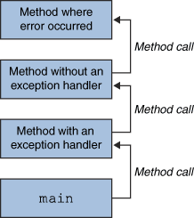
Throwing and catching
At any time, your program has an active call stack of methods
The call stack is not the same as nesting of classes or packages or such – it reflects which methods called which methods during this specific execution
When an exception is thrown, the JVM looks up the call stack until it finds a method with a matching catch block for it
If one is found, control jumps back to that method
If none is found, the program crashes
Exceptions allow non-local error handling
A method many levels up the stack can handle a deep error

Slide 12
Propagating an exception
// returns: x such that ax^2 + bx + c = 0
// throws: IllegalArgumentException if no real soln exists
double solveQuad(double a, double b, double c) throws IllegalArgumentException
{
// No need to catch exception thrown by sqrt
return (-b + sqrt(b*b - 4*a*c)) / (2*a);
}
How can clients know whether a set of arguments to solveQuad is illegal?

Slide 13
Exception translation
// returns: x such that ax^2 + bx + c = 0 // throws: NotRealException if no real solution exists double solveQuad(double a, double b, double c) throws NotRealException { try { return (-b + sqrt(b*b - 4*a*c)) / (2*a); } catch (IllegalArgumentException e) { throw new NotRealException(); } }
Exception chaining
class NotRealException extends Exception {
NotRealException() { super(); }
NotRealException(String message) { super(message); }
NotRealException(Throwable cause) { super(cause); }
NotRealException(String msg, Throwable c) { super(msg, c); }
}

Slide 14
Special values
Special values are often used to inform a client of a problem
null Map.get
-1 indexOf
NaN sqrt of negative number
Problems with using special value
Hard to distinguish from real results
Error-prone
The programmer may forget to check the result?
The value should not be legal – should cause a failure later
Ugly
Often inefficient

Slide 15
Can use exceptions instead
Special results through exceptions
Expected
Unpredictable or unpreventable by client
Take special action and continue computing
Should always check for this condition
Should handle locally

Slide 16
Exceptions for failure
Different from use for special values
Failures are
Unexpected
Should be rare with well-written client and library
Can be the client’s fault or the library’s
Usually unrecoverable
Usually can’t recover
If the condition is not checked, the exception propagates up the stack
The top-level handler prints the stack trace

Slide 17
The finally block
try { code… } catch (type name) { code… to handle the exception } finally { code… to run after the try or catch finishes }
finally is often used for common “clean-up” code
try { // ... read from out; might throw } catch (IOException e) { System.out.println("Caught IOException: “ + e.getMessage()); } finally { out.close(); }

Slide 18
Why catch exceptions locally?
Failure to catch exceptions violates modularity
Call chain: A→IntegerSet.insert→IntegerList.insert
IntegerList.insert throws an exception
Implementer of IntegerSet.insert knows how list is being used
Implementer of A may not even know that IntegerList exists
Procedure on the stack may think that it is handling an exception raised by a different call
Better alternative: catch it and throw it again
“chaining” or “translation” – show earlier
Do this even if the exception is better handled up a level
Makes it clear to reader of code that it was not an omission

Slide 19
Java throwable hierarchy
Checked exceptions for special cases
Library: must declare in signature
Client: must either catch or declare
Even if you can prove it will never happen at run time
There is guaranteed to be a dynamically enclosing catch
Unchecked exceptions for failures
Library: no need to declare
Client: no need to catch
RuntimeException and Error
and their subclasses
Throwable
Exception
Error
…
checked exceptions
Runtime- Exception

Slide 20
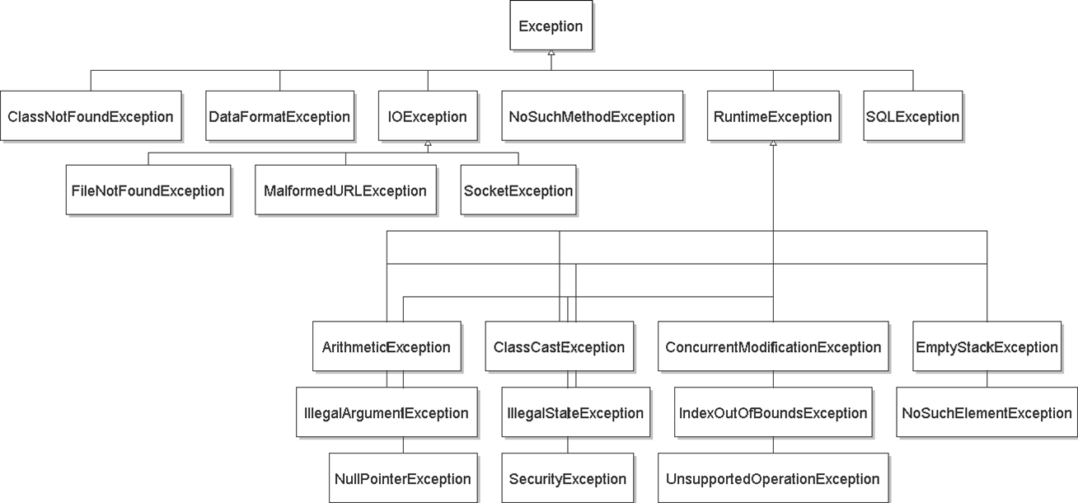
exception hierarchy

Slide 21
Catching with inheritance
try { code… } catch (FileNotFoundException fnfe) { code… to handle the file not found exception } catch (IOException ioe) { code… to handle any other I/O exception } catch (Exception e) { code to handle any other exception }
a SocketException would match the second block
an ArithmeticException would match the third block

Slide 22
Avoid proliferation of checked exceptions
Unchecked exceptions are better if clients will usually write code that ensures the exception will not happen
There is a convenient and inexpensive way to avoid it
The exception reflects unanticipatable failures
Otherwise use a checked exception
Must be caught and handled – prevents program defects
Checked exceptions should be locally caught and handled
Checked exceptions that propagate long distances suggests bad design (failure of modularity)
Java sometimes uses null (or NaN, etc.) as a special value
Acceptable if used judiciously, carefully specified
But too easy to forget to check

Slide 23
Ignoring exceptions
Effective Java Tip #65: Don't ignore exceptions
An empty catch block is (a common) poor style – often done to get code to compile or hide an error
try { readFile(filename); } catch (IOException e) {} // do nothing on error
At a minimum, print out the exception so you know it happened } catch (IOException e) { e.printStackTrace(); // just in case }

Slide 24
Exceptions in review I
Use an exception when
Used in a broad or unpredictable context
Checking the condition is feasible
Use a precondition when
Checking would be prohibitive (e.g., requiring that a list be sorted)
Used in a narrow context in which calls can be checked
Avoid preconditions because
Caller may violate precondition
Program can fail in an uninformative or dangerous way
Want program to fail as early as possible
How do preconditions and exceptions differ, for the client?

Slide 25
Exceptions in review II
Use checked exceptions most of the time
Handle exceptions earlier rather than later
Not all exceptions are errors
A program structuring mechanism with non-local jumps
Used for exceptional (unpredictable) circumstances

Slide 26
Next steps
Assignment 4: out, due Wednesday November 9, 2011 at 11:59PM
Lectures: F, Polymorphism/generics; M, Debugging

Slide 27
?

