Slide 1
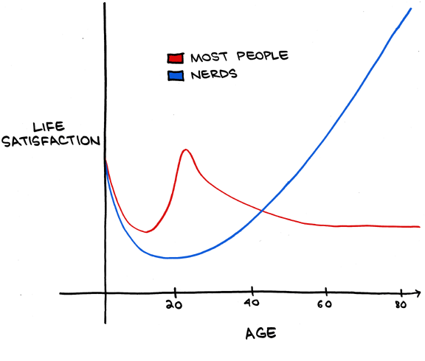
CSE 331 Software Design & Implementation unified modeling language (UML)
http://www.smbc-comics.com/index.php?db=comics&id=2436 via geeksaresexy.net
Autumn 2011

Slide 2
Announcement
A5 will be due Tuesday November 29 @ 11:59PM
There will be no A6 programming assignment
Instead, I will on Wednesday November 30 hand out a “work-sheet style” assignment
It will be graded, and it will focus some aspects of the course material that will be on the final
Especially material covered in class but not covered (well or at all) on the assignments
Due date TBA

Slide 3
Model: dictionary.com
1.a standard or example for imitation or comparison.
2.a representation, generally in miniature, to show the construction or appearance of something.
3.an image in clay, wax, or the like, to be reproduced in more durable material.
8.a pattern or mode of structure or formation.
10.a simplified representation of a system or phenomenon, as in the sciences or economics, with any hypotheses required to describe the system or explain the phenomenon, often mathematically.

Slide 4
Claim
There are dimensions of software systems that are not effectively described (describable) – or modeled – using programming languages (like Java)
Examples
A file must be opened before it can be read
In a basic calculator, entering a binary operator shifts modes from “entering number” to “start new number”
When an instance of X announces event E, each method M (invoked by a listener for E) is executed sequentially
That is, there are aspects of software that are – at best – described implicitly in a program: a language for modeling these aspects explicitly can help in these situations

Slide 5
UML
UML – the Unified Modeling Language – is by far the most widely known and used software modeling language
It is “owned” by OMG (Object Management Group), which advertises about this open-standard:
Modeling is the designing of software applications before coding. Modeling is an Essential Part of large software projects, and helpful to medium and even small projects as well. A model plays the analogous role in software development that blueprints and other plans (site maps, elevations, physical models) play in the building of a skyscraper. Using a model, those responsible for a software development project's success can assure themselves that business functionality is complete and correct, end-user needs are met, and program design supports requirements for scalability, robustness, security, extendibility, and other characteristics, before implementation in code renders changes difficult and expensive to make. Surveys show that large software projects have a huge probability of failure - in fact, it's more likely that a large software application will fail to meet all of its requirements on time and on budget than that it will succeed. If you're running one of these projects, you need to do all you can to increase the odds for success, and modeling is the only way to visualize your design and check it against requirements before your crew starts to code.

Slide 6
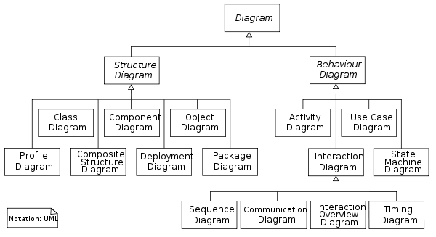
UML diagrams
At its heart, UML defines notations and meanings for a set of (object-oriented) software-related models
These naturally overlap with entities in programs, although UML is not language-specific

Slide 7
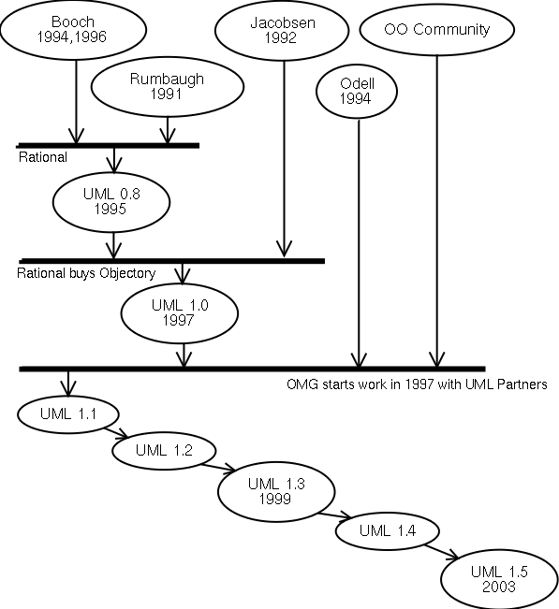
Whence “Unified?”
Booch , Jacobson and Rumbaugh  had similar but competing approaches
These were merged into a single approach represented by UML

Slide 8
UML class diagrams
What is a UML class diagram? What does it represent?
A picture of the classes in an OO system, their fields and methods, and connections between the classes that interact or inherit from each other
What are some things not represented in a class diagram?
details of how the classes interact
algorithmic details; how particular behavior is implemented
trivial methods (get/set)
classes that come from libraries (ArrayList, etc.)

Slide 9
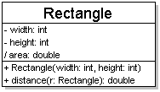
Diagram of one class
class name in top of box
write <<interface>> above interfaces' names
use italics for an abstract class name
attributes
should include all fields of the object
also includes derived “properties”
operations / methods
may omit trivial (get/set) methods
should not include inherited methods

Slide 10
Class attributes
attributes (fields, instance variables)
visibility: + public # protected - private ~ package (default) / derived
underline static attributes
derived attribute: not stored, but can be computed from other attribute values

Slide 11
Class operations / methods
operations / methods
visibility name (parameters ) : returnType
underline static methods
parameter types listed as (name: type)
omit returnType on constructors and when return is void

Slide 12
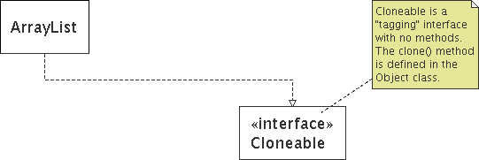
Comments
represented as a folded note, attached to the appropriate class/method/etc by a dashed line

Slide 13
Relationships between classes
generalization: an inheritance (is-a) relationship
inheritance between classes
interface implementation
association: a usage (is-part-of) relationship
dependency
aggregation
composition

Slide 14
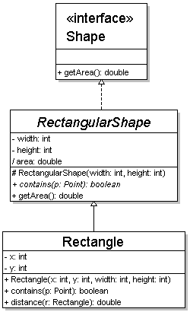
Generalization relationships
Hierarchies drawn top-down with arrows pointing upward to parent
Line/arrow styles differ based on parent
class : solid, black arrow
abstract class : solid, white arrow
interface : dashed, white arrow
Trivial / obvious relationships, such as drawing the class Object as a parent, are generally omitted

Slide 15
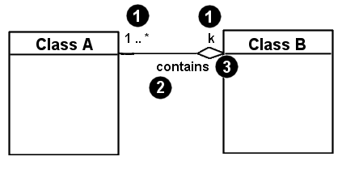
Associational relationships
1. multiplicity (how many are used)
* ⇒ 0, 1, or more
1 ⇒ 1 exactly
2..4 ⇒ between 2 and 4, inclusive
3..* ⇒ 3 or more
2. name (what relationship the objects have)
3. navigability (direction)

Slide 16
Multiplicity
one-to-one
Ex: each student must have exactly one ID card
one-to-many
a RectangleList can contain 0, 1, 2, ... rectangles

Slide 17
Association types
Car
1
aggregation: "is part of"
clear white diamond
composition: "is entirely made of"
stronger version of aggregation
the parts live and die with the whole
black diamond
dependency: "uses temporarily"
dotted line or arrow
often is an implementation detail, not an intrinsic part of that object's state
1
Engine
Book
1
*
Page
Lottery Ticket
Random

Slide 18
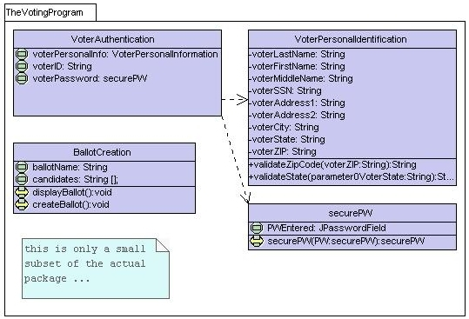

Slide 19
Multiplicity
Customer
1
Simple
Aggregation
Class
Abstract
Class
Rental Invoice
Rental Item
1..*
1
0..1
Composition
Simple
Association
Generalization
Checkout Screen
DVD Movie
VHS Movie
Video Game

Slide 20
StudentBody
Student
1
100
- firstName : String
- lastName : String
- homeAddress : Address
- schoolAddress : Address
+ main (args : String[])
+ toString() : String
Address
- streetAddress : String
- city : String
- state : String
- zipCode : long
+ toString() : String

Slide 21
Tools for creating UML
Violet (free)
http://sourceforge.net/projects/violet/
Rational Rose
http://www.rational.com/
Visual Paradigm UML Suite (trial)
http://www.visual-paradigm.com/
(nearly) direct download link: http://www.visual-paradigm.com/vp/download.jsp?product=vpuml&edition=ce
(there are many others, but many are commercial and cost money)

Slide 22
Class diagrams pros/cons
Class diagrams are good for
discovering related data and attributes
getting a quick picture of the important entities in a system
seeing whether you have too few/many classes
seeing whether the relationships between objects are too complex, too many in number, simple enough, etc.
spotting dependencies between one class/object and another
Not so great for
discovering algorithmic (not data-driven) behavior
finding the flow of steps for objects to solve a given problem
understanding the app's overall control flow (event-driven? web-based? sequential? etc.)

Slide 23
Related: Object diagrams
shows an individual object, rather than entire class
objectName : type
attribute = value
objects can be connected by lines that state the reason the two objects are talking

Slide 24
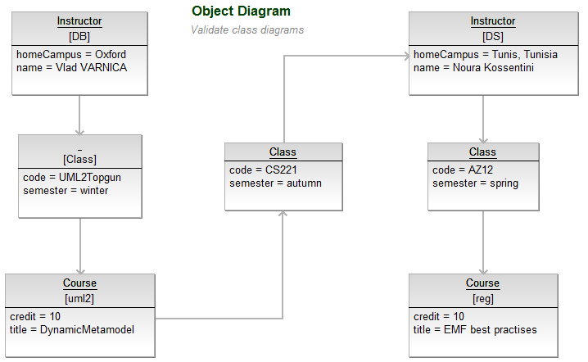
Object diagram example

Slide 25
UML sequence diagrams
sequence diagram: an “interaction diagram” that models a single scenario executing in the system
perhaps second most used UML diagram (behind class diagram)

Slide 26
Sequence diagram key parts
participant: object or entity that acts in the diagram
diagram starts with an unattached "found message" arrow
message: communication between participant objects
The axes in a sequence diagram
horizontal: which object/participant is acting
vertical: time (down -> forward in time)

Slide 27
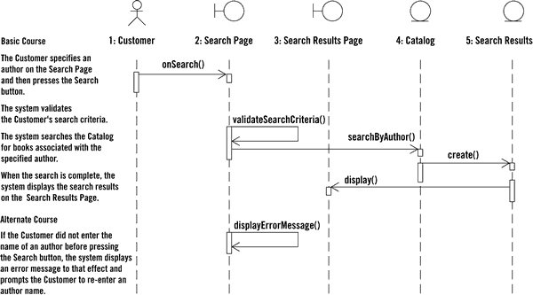

Slide 28
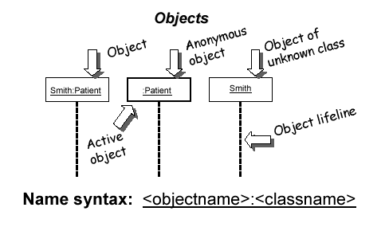
Representing objects
Squares with object type, optionally preceded by "name :“ (if it clarifies diagram)
object's "life line" represented by dashed vertical line

Slide 29
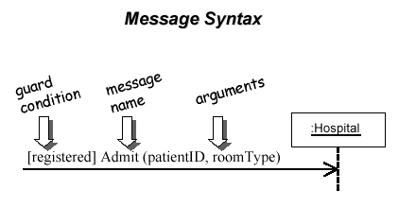
Messages between objects
messages (method calls) indicated by arrow to other object
write message name and arguments above arrow

Slide 30
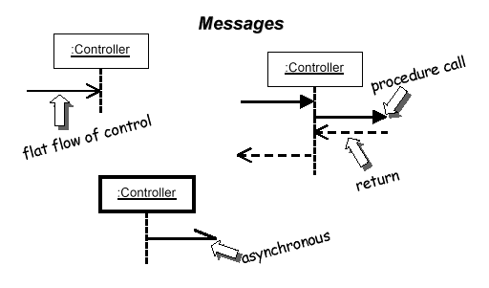
Messages
messages (method calls) indicated by arrow to other object
dashed arrow back indicates return
different arrowheads for normal / concurrent (asynchronous) calls

Slide 31
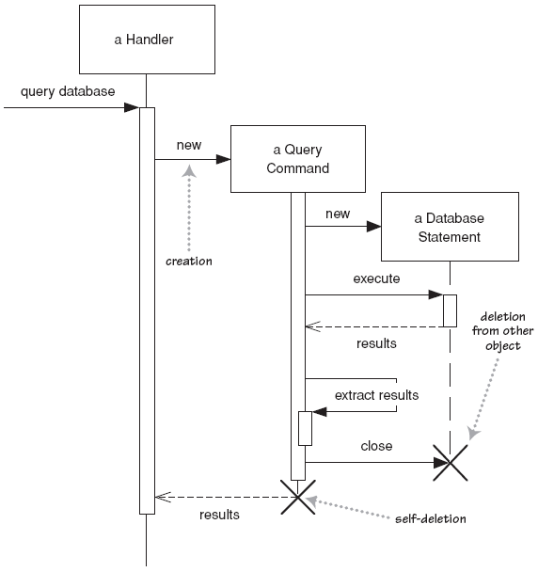
Lifetime of objects
creation: arrow with 'new' written above it
notice that an object created after the start of the scenario appears lower than the others
deletion: an X at bottom of object's lifeline
Java doesn't explicitly delete objects; they fall out of scope and are garbage-collected

Slide 32
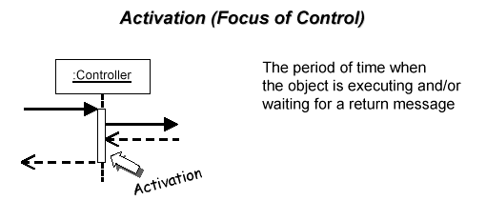
Indicating method calls
activation: thick box over object's life line; drawn when object's method is on the stack
either that object is running its code, or it is on the stack waiting for another object's method to finish
nest activations to indicate recursion
Activation
Nesting

Slide 33
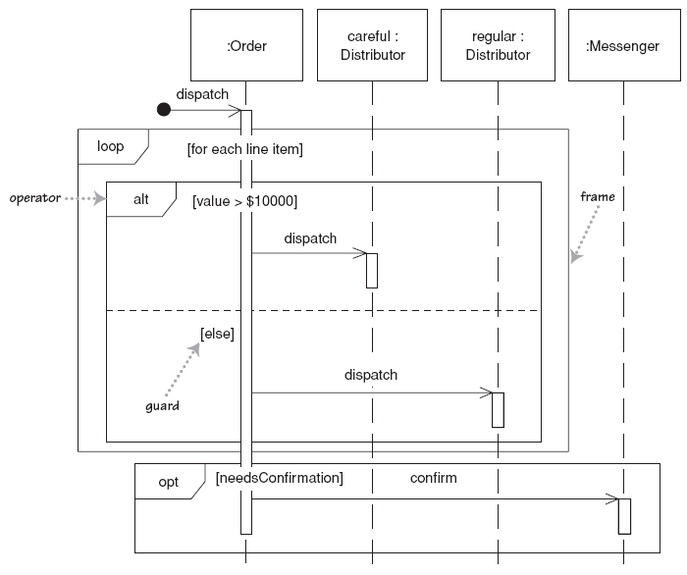
Selection and loops
frame: box around part of diagram to indicate if or loop
if -> (opt) [condition]
if/else -> (alt) [condition], separated by horizontal dashed line
Loop -> (loop) [condition or items to loop over]

Slide 35
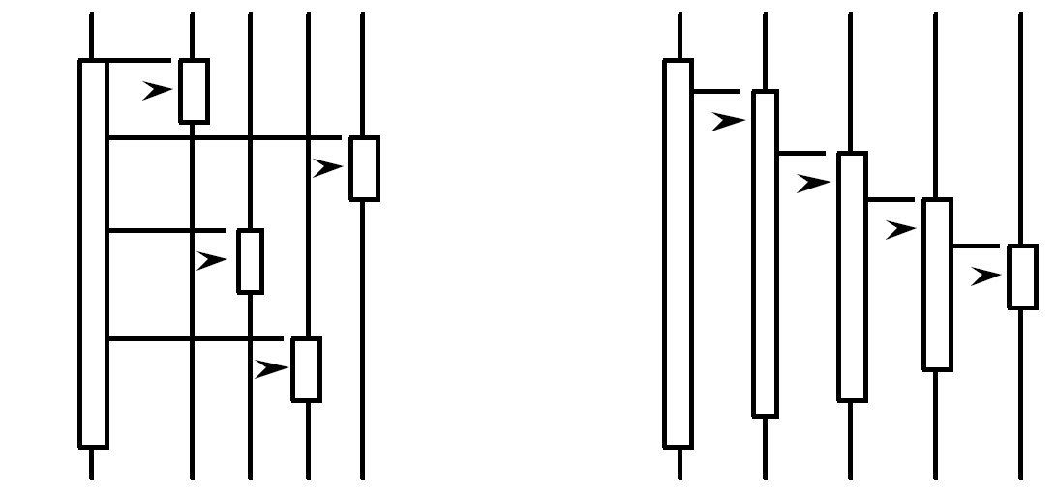
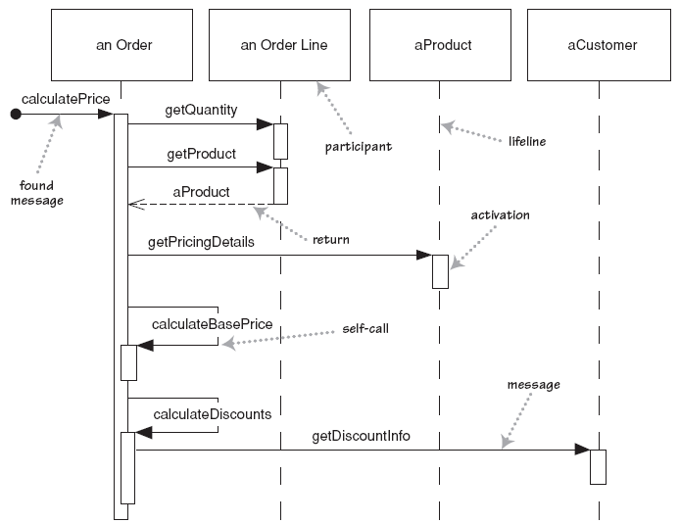
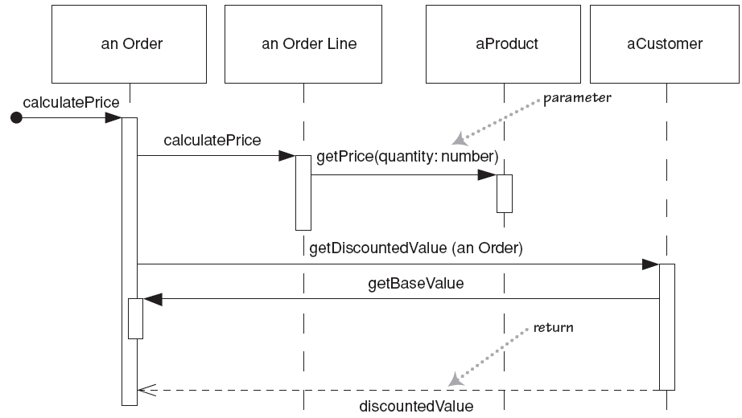
Forms of system control
What can you say about the control flow of each system?
Is it centralized?
Is it distributed?

Slide 36
Why not just code it?
Sequence diagrams can be somewhat close to the code level
So why not just code up that algorithm rather than drawing it as a sequence diagram?
a good sequence diagram is still a bit above the level of the real code (not all code is drawn on diagram)
sequence diagrams are language-agnostic (can be implemented in many different languages
non-coders can do sequence diagrams
easier to do sequence diagrams as a team
can see many objects/classes at a time on same page (visual bandwidth)

Slide 37
And many other UML diagram types…
The two not covered here that are perhaps most important are the state diagrams and the use case diagrams

Slide 38
Quotations http://www.step-10.com/SoftwareDesign/UML/UMLQuote.html
"The trouble comes when people feel compelled to convey the whole model or design through UML. A lot of object model diagrams are too complete and, simultaneously, leave too much out. ... Nor is UML a very satisfying programming language." Eric Evans, 2003, Domain-Driven Design: Tackling Complexity in the Heart of Software
"The vocabulary and rules of a language such as UML tell you how to create and read well-formed models, but they don't tell you what models you should build and when you should create them. That's the role of the software development process." Grady Booch, James Rumbaugh, Ivar Jacobson, 2005, The Unified Modeling Language User Guide
"The fundamental reason to use UML involves communication. … Natural language is too imprecise and gets tangled when it comes to complex concepts. Code is precise but too detailed. So I use UML when I want a certain amount of precision but I don't want to get lost in the details." Martin Fowler, Kendall Scott, 2000, UML Distilled: A Brief Guide to the Standard Object Modeling Language

Slide 39
So…
UML allows you to say some of the things that languages don’t allow you to say explicitly about software systems
It can be used effectively; it can be used horribly
Flon’s Law: Good programs can be written in any language; and bad programs can be written in any language
Knowing the basics is important – it’s a common lingo (and it sometimes shows up in interviews)

Slide 40
?

