Slide 1
CSE 331 Software Design & Implementation regression testing
Autumn 2011

Slide 2
Regression Testing First slides edited from: Ammann & Offutt
The process of re-testing software that has been modified
Most software today has relatively little new development
Correcting, perfecting, adapting, or preventing problems with existing software
Composing new programs from existing components
Applying existing software to new situations
Because of the deep interconnections among software components, changes in one method can cause problems in methods that seem to be unrelated
Regression testing is intended to reduce the chance that existing properties are harmed by a change
Large regression test suites may accumulate as programs age

Slide 3
Automation and Tool Support
Too many tests to be run by hand
Tests must be run and evaluated quickly
often overnight, or more frequently for web applications
Testers do not have time to view the results by inspection
Types of tools include
Capture / Replay – Capture values entered into a GUI and replay those values on new versions
Version control – Keeps track of collections of tests, expected results, where the tests came from, the criterion used, and their past effectiveness
Scripting software – Manages the process of obtaining test inputs, executing the software, obtaining the outputs, comparing the results, and generating test reports
Tools are plentiful and inexpensive (often free)

Slide 4
Managing Tests in a Regression Suite
Test suites accumulate new tests over time
Test suites are usually run in a fixed, short, period of time – often overnight, sometimes more frequently, sometimes less
At some point, the number of tests can become unmanageable
We cannot finish running the tests in the time allotted
We can always add more computer hardware
But is it worth it? Does it solve the problem? How many of these tests really need to be run ?

Slide 5
Another related situation
When security flaws are made public, companies are under immense pressure to provide a fix very quickly
Often full regression tests cannot be run in the given time – but running no regression tests isn’t reasonable either

Slide 6
Policies for Updating Test Suites
Which tests to keep can be based on several policies
Add a new test for every problem report
Ensure that a coverage criterion is always satisfied
Sometimes harder to choose tests to remove
Remove tests that do not contribute to satisfying coverage
Remove tests that have never found a fault (risky !)
Remove tests that have found the same fault as other tests (also risky !)
Reordering strategies
If a suite of N tests satisfies a coverage criterion, the tests can often be reordered so that the first N-k tests satisfies the criterion – so the remaining tests can be removed
This is often called test selection
If the criterion is approximated, not guaranteed, this is often called test prioritization

Slide 7
Aside
When we talked about white box testing, we talked about coverage criteria – statement, edge, path, etc.
Criterion coverage in regression testing is somewhat different – among other things, we have two programs and a test suite, rather than one program and a test suite
We’ll see examples of how these coverage criteria differ

Slide 8
When a Regression Test Fails
Regression tests are evaluated based on whether the result on the new program P’ is equivalent to the result on the previous version P
If they differ, the test is considered to have failed – this is called a regression
Regression test failures represent three possibilities :
The software has a fault – must fix the fix
The test values are no longer valid on the new version – must delete or modify the test
The expected output is no longer valid – must update the test
But which?

Slide 9
Choosing Which Regression Tests to Run
Change impact analysis: how does a change impact the rest of the software?
When a small change is made in the software, what portions of the software can be impacted by that change?
More directly, which tests need to be re-run?
Conservative approach : Run all tests
Cheap approach : Run only tests whose test requirements relate to the statements that were changed
Analytic approach : Consider how the changes propagate through the software
Clearly, tests that never reach the modified statements do not need to be run – is this true?
Lots of clever algorithms to perform change impact analysis have been invented

Slide 10
Rationales for Selecting Tests to Re-Run
Inclusive : A selection technique is inclusive if it includes tests that are “modification revealing”
Unsafe techniques have less than 100% inclusiveness
Precise : A selection technique is precise if it omits regression tests that are not modification revealing
Efficient : A selection technique is efficient if deciding what tests to omit is cheaper than running the omitted tests
This can depend on how much automation is available

Slide 11
Overview of a test selection method
These slides are copyrighted. They are for use with the Foundations of Software Testing book by Aditya Mathur. Please use the slides but do not remove the copyright notice.
Last update: December 23, 2009
Step 1: Given P and test set T, find the execution trace of P for each test in T.
Which statements in P are executed when T is run?
Step 2: Extract test vectors from the execution traces for each node in the CFG of P
Which tests execute which statements in P?
Step 3: Construct syntax trees for each node in the CFGs of P and P’. This step can be executed while constructing the CFGs of P and P’.
Control flow graph: “flow chart”
New idea: stay tuned…
Step 4: Traverse the CFGs and determine the a subset of T appropriate for regression testing of P’.

Slide 12
Execution Trace [1]
Let G=(N, E) denote the CFG of program P. N is a finite set of nodes and E a finite set of edges connecting the nodes. Suppose that nodes in N are numbered 1, 2, and so on and that Start and End are two special nodes as discussed in Chapter 1.
Let Tno be the set of all valid tests for P’. Thus Tno contains only tests valid for P’. It is obtained by discarding all tests that have become obsolete for some reason.

Slide 13
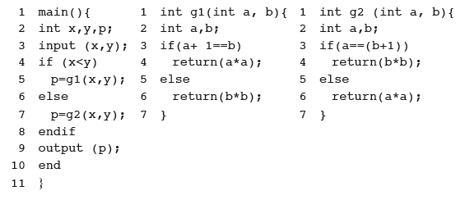
Execution Trace [2]
An execution trace of program P for some test t in Tno is the sequence of nodes in G traversed when P is executed against t. As an example, consider the following program.

Slide 14
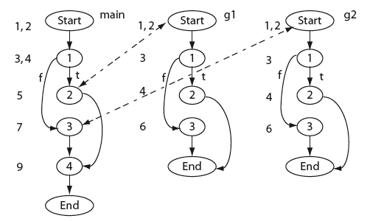
Execution Trace [3]
Here is a CFG for our example program.
Like for coverage, but with interprocedural call/return included

Slide 15
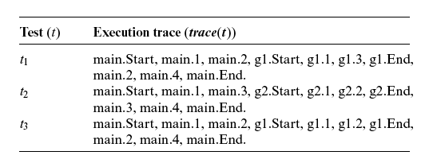
Execution Trace [4]
Now consider the following set of three tests and the corresponding trace.

Slide 16
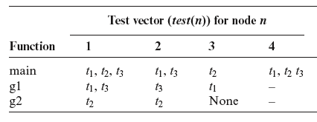
Test vector
A test vector for node n, denoted by test(n), is the set of tests that traverse node n in the CFG. For program P we obtain the following test vectors.
test 1 and test 3 execute main

Slide 17
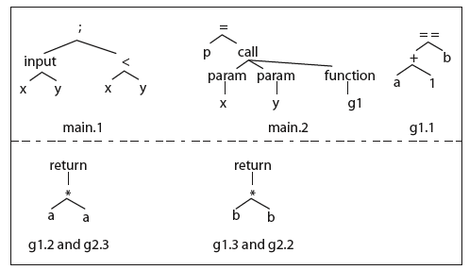
Syntax trees
Standard compiler representation: represent the program as a tree – produced by parsing the source code
A syntax tree is constructed for each node of CFG(P) and CFG(P’). Recall that each node represents a basic block. Here sample syntax trees for the example program.

Slide 18
Test selection [1]
Given the execution traces and the CFGs for P and P’, the following three steps are executed to obtain a subset T’ of T for regression testing of P’.

Slide 19
Test selection [2]
Top-down, recursive, pairwise analysis of the CFGs
The basic idea underlying the SelectTests procedure is to traverse the two CFGs from their respective START nodes using a recursive descent procedure.
The descent proceeds in parallel and the corresponding nodes are compared. If two two nodes N in CFG(P) and N’ in CFG( P’) are found to be syntactically different, all tests in test (N) are added to T’.

Slide 20
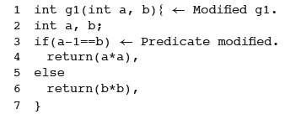
Test selection example
Suppose that function g1 in P is modified as follows.
Try the SelectTests algorithm and check if you get T’={t1, t3}.

Slide 21
Issues with SelectTests
Think:
What tests will be selected when only, say, one declarations is modified?
Can you think of a way to select only tests that correspond to variables in the modified declaration?

Slide 22
More clever algorithms…
Beyond the scope of 331
Prioritization – an example “greedy” approach
“Diff” P and P’ to identify the basic blocks (sequences of statements always executed together)
Identify the statements involved in new or modified paths
Use the test vectors to find the test that covers the largest number of these statements
Repeat until no more of the statements can be covered by remaining tests

Slide 23
Regression testing is real
But don’t forget that it specifically does not include tests of new aspects of a program – it is not common for test suites to get out of date in this regard

Slide 24
?

