Slide 1
CSE 331 Software Design & Implementation version control research @ UW
Autumn 2011

Slide 2
Version control: research @ UW
Two trailers…for a research talk and a research demo at the 2011 Joint European Software Engineering Conference and ACM SIGSOFT Symposium on the Foundations of Software Engineering (ESEC/FSE)
http://www.youtube.com/watch?v=qtWqU4ac-IM
http://www.youtube.com/watch?v=Iargb4vdEMo

Slide 3
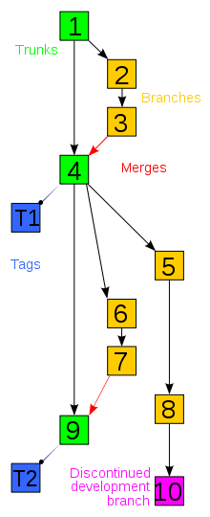
Version control
Tools intended to help teams of people work concurrently and on shared code – both are needed for a collaborative project to make genuine progress
Track multiple versions and variants
Help identify and manage conflicts
Reduces chances of data loss
wikipedia

Slide 4
Centralized version control
The standard client-server approach of the first decades of version control – SCCS, RCS, CVS, SVN, …
A server holds the “real” repository – it represents the core reality of the project
Team members check-out and work on copies of the repository
When they check-in those changes, they are checked against the repository and it is updated
Handling merges must be done if there are conflicts

Slide 5
Decentralized version control
Developed in the past decade, taking a more independent peer-to-peer approach for versioning
Every copy is a full-fledged repository – if there is a “main” repository it is only by agreement
There is an explicit separation between a repository and a working copy of that repository
Repositories are synchronized by exchanging change-sets
Allows fast operations (committing or reverting changes, for example), because they are done locally
Only need to interact with peers when synchronizing changes
Examples: git, mercurial (hg), bazaar, monotone, …

Slide 6
More differences
Code from disparate repositories can be merged in more flexible ways – often (especially in open source projects) based on a web-of-trust relationship – change-sets can be applied for a person without “committer” status
Participation in projects does not require permission
Local and remote repositories are synced using different commands
Private, revision-controlled work is allowed – this is hard in centralized version control
Users can use their revision control system even for exploratory work
No single machine remains as a point of failure

Slide 8
A UW research project: Crystal

Slide 9
Next steps
Worksheet A: due in class on Monday
5% extra credit if you have it in on time and grade with the class during Monday lecture
Worksheet B: available Monday PM
Wednesday: Brief final review; course evaluations
Friday: repeat of Monday, including extra credit, for Worksheet B
Final: 14:30-16:20 Wednesday December 14
Intended to be one hour, but you can take the whole time

Slide 10
?

