Slide 1
CSE 331 Software Design & Implementation worksheet B
Today’s Process
If you haven’t completed the solution sheet for Worksheet B, please leave (and go finish it)
Make sure your student ID (or name) is on your solution sheet
We’ll collect them all, shuffle them, and hand them out – if you get your own, let us know ASAP, since grading your own is not allowed
Then use a post-it to put your student ID (and name) on the sheet you are grading – otherwise we cannot give you the extra credit you should earn
Autumn 2011

Slide 2
True/False
A UML class diagram can be executed (just like a Java program can be executed).
Although some aspects of UML diagrams have great similarity to a programming language, it is not a programming language
2 points for false
0 points for true

Slide 3
True/False
Reducing the size of a test case is an important step in debugging.
The objective of this step is to narrow the part of the program that must be considered – and the program is usually much bigger than the size of the test case that failed
2 points for true
0 points for false

Slide 4
True/False
A good practice is to treat all Java exceptions -- both checked and unchecked exceptions -- in the same way.
Unchecked exceptions (like NullPointerException) can in principle occur anywhere; checked exceptions (defined for a given program) cannot
It’s essential to treat checked exceptions carefully, usually through exception chaining – but other approaches can be used for handling unchecked exceptions
2 points for false
0 points for true

Slide 5
True/False
An advantage of implementing repOK as a method instead of as an exception is that it allows the implementer of a class to re-establish a broken representation invariant.
Doesn’t always happen, but it’s certainly feasible
2 points for true
0 points for false

Slide 6
True/False
The singleton pattern and the ability to define multiplicity in UML provide the same power to a design/programmer.
Both relate to multiplicity, but UML allows much richer relationships than “precisely one instance.”
2 points for false
0 points for true

Slide 7
True/False
Representation invariants would be more appropriate to apply to a UML class diagram than in a UML sequence diagram.
Representation invariants address the question of “what are legal values of the representation” but do not directly address the question of the operations, their order of invocation, etc.
2 points for true
0 points for false

Slide 8
True/False
Regression testing in principle addresses the removal of tests that no longer apply to a program.
Regression testing can no longer run tests that apply to (for example) removed features
These tests are often not actually removed, but their failures are noted without concern
2 points for true
0 points for false

Slide 9
True/False
Covariance/contravariance are concepts used to define the type system of a programming language.
These terms refer to a relationship among types – they are used to define a languages notion of “stronger” and “weaker” types, allowing or disallowing substitution
2 points for true
0 points for false

Slide 10
True/False
2 points for true
0 points for false
At run-time, you cannot determine the precise value of a parameter of a generic class.

Slide 11
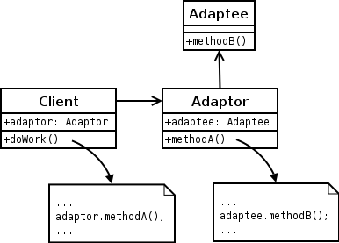
Consider the UML class diagram here of the adapter pattern. Does this diagram represent conventional call-return flow-of-control, or does it represent inversion-of-control? In one sentence, justify your answer.
-2 points for answering “inversion-of-control”
-1, -2, -3 points for missing, confusing or inaccurate justification.
Example: “This pattern uses standard flow-of-control: in each case, the caller explicitly knows the name of the class/interface that it is calling.”

Slide 12
Sketch a UML class diagram that describes the relationships among parties, tables, and the waiting list from A3 (Restaurant)
Key points
Waiting list: 0 or more parties (ordered)
Table: 0 or more parties
Party: Size, name, seated or on waiting list

Slide 13
True or false: The primary objective of design patterns is to make it easier to ensure correctness of an implementation. In one sentence, justify your answer.
-2 points for true
-1 for a justification not mentioning “change”
-1, -2 points for additional missing, confusing or inaccurate justification.
Example: “Although a few patterns (such as Singleton) constrain a program in a way that eases reasoning, most patterns (such as Visitor, MVC, etc.) provide ways to ease future program modifications.”

Slide 14
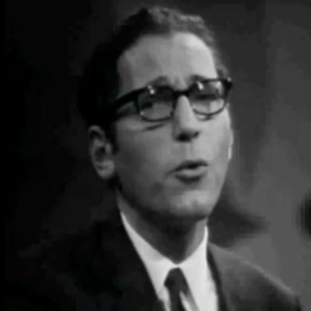
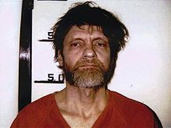
Willard Van Orman Quine 
Famous philosopher and logician (1908-2000)
Erdős number: 3
Same as me: Notkin→Beame→Saks→Erdős
Two students famous for reasons other than philosophy or logic

Slide 15
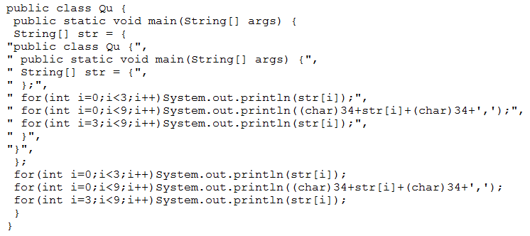
Quine: A program that prints itself

Slide 16
?

