Slide 1
CSE 331 Software Design & Implementation
Dan Grossman
Spring 2015
Course Victory Lap
(Based on slides by Mike Ernst, Dan Grossman, David Notkin, Hal Perkins)

Slide 2
Today
Reminder: Do your course evaluations (!)
Final-exam information
Last few topics in previous lecture as needed
Course “victory lap”
High-level overview of main ideas and goals
Connection to homeworks
Context
Also:
Thank-yous
Time permitting: Free-form Q&A

Slide 3
Final-exam information
Monday, 8:30-10:20AM
Very heavily weighted toward second half of course
See email from me and sample exams
As usual, “tough but fair and rewarding”

Slide 4
Victory Lap
A victory lap is an extra trip
around the track
By the exhausted victors
(that’s us) ☺
Review course goals
Slides from Lecture 1
What makes CSE331 special

Slide 5
Huge thanks to the folks who made it work
Infrastructure: Vinod, Chris
Sections: Kevin, Vinod
Grading: Uldarico, Naruto, Chris, Kevin, Vinod
Office hours, email questions, etc.: all
This course is itself a sophisticated system
requiring savvy design and implementation
Except for svn problems (“not our fault” ☹), everything has been eerily smooth.

Slide 6
3 slides from Lecture 1…

Slide 7
10 weeks ago: Welcome!
We have 10 weeks to move well beyond novice programmer:
Larger programs
Small programs are easy: “code it up”
Complexity changes everything: “design an artifact”
Analogy: using hammers and saws vs. making cabinets (but not yet building houses)
Principled, systematic software: What does “it’s right” mean? How do we know “it’s right”? What are best practices for “getting it right”?
Effective use of languages and tools: Java, IDEs, debuggers, JUnit, JavaDoc, Subversion, …
Principles are ultimately more important than details
You will forever learn details of new tools/versions

Slide 8
10 weeks ago: Goals
CSE 331 will teach you to how to write correct programs
What does it mean for a program to be correct?
Specifications
What are ways to achieve correctness?
Principled design and development
Abstraction and modularity
Documentation
What are ways to verify correctness?
Testing
Reasoning and verification

Slide 9
10 weeks ago: Managing complexity
Abstraction and specification
Procedural, data, and control flow abstractions
Why they are useful and how to use them
Writing, understanding, and reasoning about code
Will use Java, but the issues apply in all languages
Some focus on object-oriented programming
Program design and documentation
What makes a design good or bad (example: modularity)
Design processes and tools
Pragmatic considerations
Testing
Debugging and defensive programming
[more in CSE403: Managing software projects]

Slide 10
Some new slides to tie the pieces together…

Slide 11
Divide and conquer: Modularity, abstraction, specs
No one person can understand all of a realistic system
Modularity permits focusing on just one part
Abstraction enables ignoring detail
Specifications (and documentation) formally describe behavior
Reasoning relies on all three to understand/fix errors
Or avoid them in the first place
Proving, testing, debugging: all are intellectually challenging

Slide 12
How CSE 331 fits together
Lectures: ideas
⇒ Assignments: get practice
Specifications
Testing
Subtyping
Equality & identity
Generics
Design patterns
Reasoning, debugging
Events
Systems integration
Design classes
Write tests
Write subclasses
Override equals, use collections
Write generic classes
Larger designs; MVC
Correctness, testing
GUIs
N/A

Slide 13
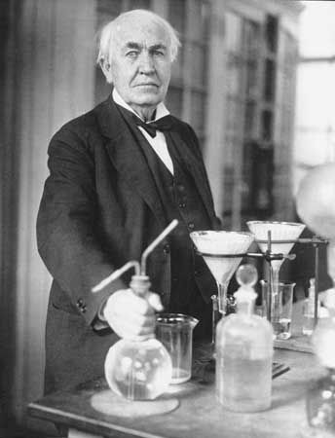
What you have learned in CSE 331
Compare your skills today to 10 weeks ago
Theory: abstraction, specification, design
Practice: implementation, testing
Theory & practice: correctness
Bottom line aspiration: Much of what we’ve done would be easy for you today
This is a measure of how much you have learned
There is no such thing as a “born” programmer!
Genius is 1% inspiration and 99% perspiration.
Thomas A. Edison
Notes:
Practice: also “teamwork” in some terms.

Slide 14
What you will learn later
Your next project can be much more ambitious
But beware of “second system” effect
Know your limits
Be humble (reality helps you with this)
You will continue to learn
Building interesting systems is never easy
Like any worthwhile endeavor
Practice is a good teacher
Requires thoughtful introspection
Don’t learn only by trial and error!
Voraciously consume ideas and tools

Slide 15
What comes next?
Courses
CSE 403 Software Engineering
Focuses more on requirements, software lifecycle, teamwork
Capstone projects
Any class that requires software design and implementation
Research
In software engineering & programming systems
In any topic that involves software
Having an impact on the world
Jobs (and job interviews)
Larger programming projects

Slide 16
Last slide
System building is fun!
It’s even more fun when you’re successful
Pay attention to what matters
Take advantage of the techniques and tools you’ve learned (and will learn!)
On a personal note:
Don’t be a stranger: I love to hear how you do in CSE and beyond as alumni
Time for “ask anything you want”?

