Slide 1
SECTION 2: HW3 Setup
cse331-staff@cs.washington.edu
slides borrowed and adapted from Alex Mariakis and CSE 390a

Slide 2
DEVELOPER TOOLS
Remote access
Eclipse and Java versions
Version Control

Slide 3
WHAT IS AN SSH CLIENT?
Uses the secure shell protocol (SSH) to connect to a remote computer
Enables you to work on a lab machine from home
Similar to remote desktop
Windows users: PuTTY and WinSCP
PuTTY: ssh connection
WinSCP: transfer or edit files
Mac/Linux users: Terminal application
Go to Applications/Utilities/Terminal
Type in “ssh cseNetID@attu.cs.washington.edu”
More Information: http://courses.cs.washington.edu/courses/cse331/15sp/tools/WorkingAtHome.html#remote-attu

Slide 4
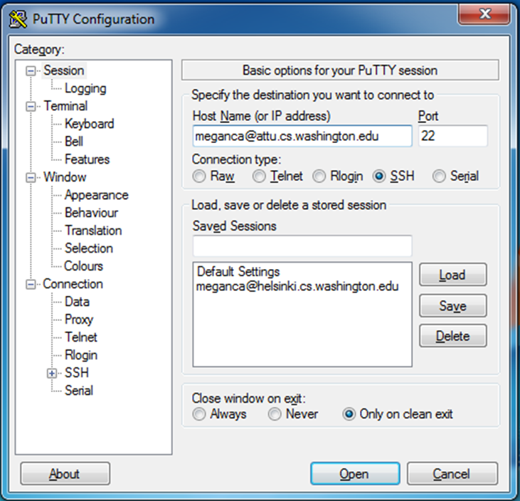
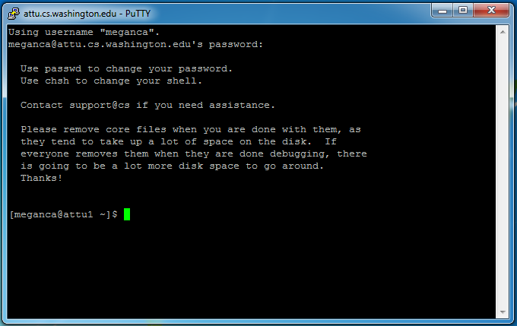
PUTTY

Slide 5
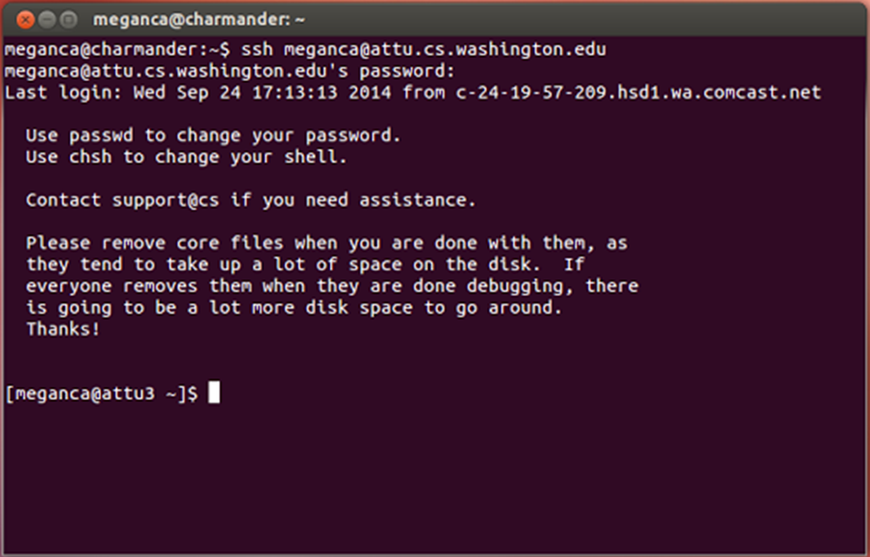
TERMINAL (LINUX, MAC)

Slide 6
ECLIPSE and Java
Get Java 7
Important: Java separates compile and execution, eg:
javac Example.java Example.class
Both compile and execute have to be the same Java!
Please use Eclipse 4.4
Instructions: http://courses.cs.washington.edu/courses/cse331/15sp/tools/WorkingAtHome.html#Step_1
produces

Slide 7
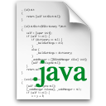
ECLIPSE and Java
.java files
Human readable ‘code’ file
.class files
Compiled version of .java files. Typically represented as Byte code to run on the Java
Virtual Machine (JVM)
.jar files
Packaged aggregate of
.class files and metadata

Slide 8
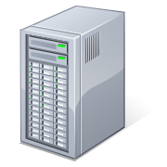
VERSION CONTROL REVIEW
Repository
commit
svn
update
Refer to Section 1 slides for more information on Version Control.
Working copy

Slide 9
331 VERSION CONTROL
create
Repository
check out
Working copy for grading
check out
commit
add
update
Working copy

Slide 10
VERSION CONTROL: COMMAND-LINE
command | description
svn co repo | check out
svn ci [files] | commit / check in changed files
svn add files | schedule files to be added at next commit
svn help [command] | get help info about a particular command
svn merge source1 source2 | merge changes
svn revert files | restore local copy to repo's version
svn resolve files | resolve merging conflicts
svn update [files] | update local copy to latest version
others: blame, changelist, cleanup, diff, export, ls/mv/rm/mkdir, lock/unlock, log, propset

Slide 11
THIS QUARTER
We distribute starter code by adding it to your repo
You will code in Eclipse
The version control system we will be using is subversion
You turn in your files by adding them to the repo and committing your changes
You will validate your homework by SSHing onto attu and running an Ant build file

Slide 12
331 VERSION CONTROL
Your main repository is at /projects/instr/15sp/cse331/YourCSENetID/REPOS/cse331
Only check out once (unless you’re working in a lot of places)
Don’t forget to add files!!
Check in your work!

Slide 13
HOW TO USE SUBVERSION
Eclipse plugin: Subclipse
Recommended!
GUI interface: TortoiseSVN
Command line: PuTTY

Slide 14
IMPORTANT DETAILS
Windows users
Need to download TortoiseSVN and Putty anyways, to avoid errors known to come up in the Eclipse plug-in, Subclipse
Mac users do not need to do this step.

Slide 15
CHECKING OUT YOUR REPO
To check out a local copy of your repository on Eclipse
First need to install Subclipse: http://courses.cs.washington.edu/courses/cse331/15sp/tools/WorkingAtHome.html#Step3Eclipse
Next, need to checkout a local copy of your repository through Subclipse: https://courses.cs.washington.edu/courses/cse331/15sp/tools/versioncontrol.html#SetUpEclipse

Slide 16
HW 3
Many small exercises to get you used to version control
More information on homework instructions: http://courses.cs.washington.edu/courses/cse331/15sp/hws/hw3/hw3.html
Committing changes: Instructions
How you turn in your assignments
Updating changes: Instructions
How you retrieve new assignments

Slide 17
Turning in HW3
Instructions
Done by simply committing your changes
Good to do this early and often
Most recent commit before the deadline will be used for grading
Before final commit, remember to run ant validate

Slide 18
Ant Validate
What will this do?
Checks out a fresh local copy of your repository with all your changes
Makes sure you have all the required files such as hw3/answers/problem6.txt
Make sure your homework builds without errors
Passes specification and implementation tests in the repository
Note: this does not include the additional tests we will use when grading
This is just a sanity check that your current tests pass

Slide 19
Ant Validate
How do you run ant validate?
Has to be done on attu from the command line since that is the environment your grading will be done on
Do not use the Eclipse ant validate build tool!

Slide 20
Ant Validate
How do you run ant validate?
Steps
Log into attu via SSH
In attu, checkout a local copy of your repository through the command-line if you have not already
Note: Now, you should have two local copies of your repository, one on your computer through Eclipse and one in attu
Go to the hw folder which you want to validate through the ‘cd’ command
For example: cd ~/cse331/src/hw3
Run ant validate

Slide 21
Ant Validate
How do you know it works?
If successful, will output Build Successful at the bottom
If unsuccessful, will output Build Failed at the bottom with information on why
If ant validate failed, fix and commit changes through eclipse, go to the copy of your repo on attu, and do ‘svn update’, and try ant validate again

Slide 22
Ant Validate
For the future
Now have two local copies of your repository
One on your computer through Eclipse
One on attu through the command-line
Code and commit changes through Eclipse
Afterwards, go to repo on attu and do a ‘svn update’ command to retrieve all the changes you made from Eclipse
Run ant validate

