Slide 1
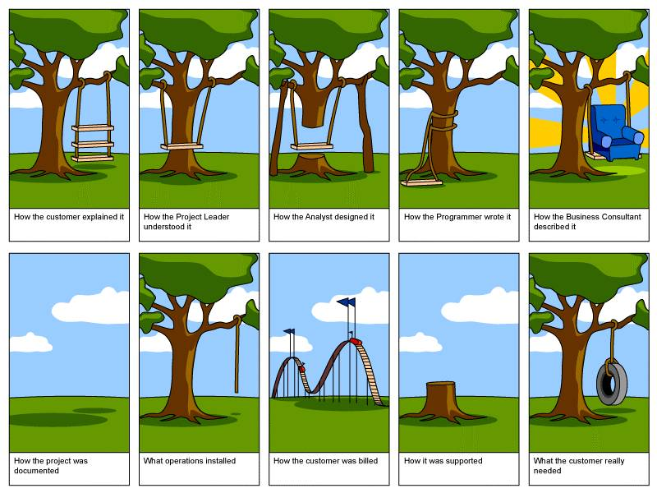

Slide 2
Section 9: Design Patterns
Slides by Alex Mariakakis
with material from David Mailhot,
Hal Perkins, Mike Ernst

Slide 3
What Is A Design Pattern
A standard solution to a common programming problem
A technique for making code more flexible
Shorthand for describing program design and how program components are connected

Slide 4
Creational Patterns
Problem: Constructors in Java are not flexible
Always return a fresh new object, never reuse one
Can’t return a subtype of the class they belong to
Solution: Creational patterns!
Sharing
Singleton
Interning
Flyweight
Factories
Factory method
Factory object
Builder

Slide 5
Creational Patterns: Sharing
The old way: Java constructors always return a new object
Singleton: only one object exists at runtime
Factory method returns the same object every time
Interning: only one object with a particular (abstract) value exists at runtime
Factory method returns an existing object, not a new one
Flyweight: separate intrinsic and extrinsic state, represents them separately, and interns the intrinsic state
Implicit representation uses no space
Not as common/important

Slide 6
Creational Patterns: Singleton
For a class where only one object of that class can ever exist
Two possible implementations
Eager instantiation: creates the instance when the class is loaded to guarantee availability
Lazy instantiation: only creates the instance once it’s needed to avoid unnecessary creation
Trade-off is very similar to push vs. pull in MVC model
Push is like an eager update, needs to happen right away
Pull Is like a lazy update, can wait until someone needs it

Slide 7
Creational Patterns: Singleton
Eager instantiation
public class Bank {
private static Bank INSTANCE = new Bank();
// private constructor
private Bank() { … }
// factory method
public static Bank getInstance() {
return INSTANCE;
}
}
Bank b = new Bank();
Bank b = Bank.getInstance();

Slide 8
Creational Patterns: Singleton
Lazy instantiation
public class Bank {
private static Bank INSTANCE;
// private constructor
private Bank() { … }
// factory method
public static Bank getInstance() {
if (INSTANCE == null) {
INSTANCE = new Bank();
}
return INSTANCE;
}
}
Bank b = new Bank();
Bank b = Bank.getInstance();

Slide 9
Creational Patterns: Singleton
Would you prefer eager or lazy instantiation for an HTTPRequest class?
handles authentication
definitely needed for any HTTP transaction
Would you prefer eager or lazy instantiation for a Comparator class?
compares objects
may or may not be used at runtime

Slide 10
Creational Patterns: Singleton
public class HttpRequest {
private static class HttpRequestHolder {
public static final HttpRequest INSTANCE = new HttpRequest();
}
/* Singleton – Don’t instantiate */
private HttpRequest() { … }
public static HttpRequest getInstance() {
return HttpRequestHolder.INSTANCE;
}
}

Slide 11
Creational Patterns: Singleton
public class LengthComparator implements Comparator<String> {
private int compare(String s1, String s2) {
return s1.length()-s2.length();
}
/* Singleton – Don’t instantiate */
private LengthComparator() { … }
private static LengthComparator comp = null;
public static LengthComparator getInstance() {
if (comp == null) {
comp = new LengthComparator();
}
return comp;
}
}

Slide 12
Creational Patterns: Interning
Similar to Singleton, except instead of just having one object per class, there’s one object per abstract value of the class
Saves memory by compacting multiple copies

Slide 13
Creational Patterns: Interning
public class Point {
private int x, y;
public Point(int x, int y) {
this.x = x;
this.y = y;
}
public int getX() { return x; }
public int getY() { return y; }
@Override
public String toString() {
return “(” + x + “,” + y + “)”;
}
}

Slide 14
Creational Patterns: Interning
public class Point {
private static Map<String, Point> instances =
new WeakHashMap<String, Point>();
public static Point getInstance(int x, int y) {
String key = x + “,”, + y;
if (!instances.containsKey(key))
instances.put(key, new Point(x,y));
return instances.get(key);
}
private final int x, y; // immutable
private Point(int x, int y) {…}
}
Requires the class being interned to be immutable. Why?

Slide 15
Creational Patterns: Interning
public class Point {
private static Map<String, Point> instances =
new WeakHashMap<String, Point>();
public static Point getInstance(int x, int y) {
String key = x + “,”, + y;
if (!instances.containsKey(key))
instances.put(key, new Point(x,y));
return instances.get(key);
}
private final int x, y; // immutable
private Point(int x, int y) {…}
}
If our point was represented with r and theta, we’d need to constrain them for use in the key. Otherwise, we’d have “5, pi” and “5, 3pi” as different entries in our map even though they are the same abstract value.

Slide 16
Creational Patterns: Factories
public class City {
public Stereotype getStereotypicalPerson() {…}
}
City seattle = new City();
seattle.getSterotypicalPerson();
// we want a SeattleStereotype

Slide 17
Creational Patterns: Factories
Factories solve the problem that Java constructors cannot return a subtype of the class they belong to
Two options:
Factory method
Helper method creates and returns objects
Method defines the interface for creating an object, but defers instantiation to subclasses
Factory object
Abstract superclass defines what can be customized
Concrete subclass does the customization, returns appropriate subclass

Slide 18
Creational Patterns: Factory Method
public class City {
public Stereotype getStereotypicalPerson() {…}
}
public class Seattle extends City {
@Override
public Stereotype getStereotypicalPerson() {
return new SeattleStereotype();
}
}
City seattle = new Seattle();
seattle.getSterotypicalPerson();

Slide 19
Creational Patterns: Factory Object
interface StereotypeFactory {
Stereotype getStereotype();
}
class SeattleStereotypeFactory implements StereotypeFactory {
public Stereotype getStereotype() {
return new SeattleStereotype();
}
}
public class City {
public City(StereotypeFactory f) {…}
public Stereotype getStereotypicalPerson() {
f.getStereotype();
}
}
City seattle = new City(new SeattleStereotypeFactory());
seattle.getSterotypicalPerson();

Slide 20
Creational Patterns: Factory Object
interface Button {
void paint();
}
class WinButton implements Button {
public void paint() {
System.out.println("I'm a WinButton");
}
}
class OSXButton implements Button {
public void paint() {
System.out.println("I'm an OSXButton");
}
}
interface GUIFactory {
Button createButton();
}
class WinFactory implements GUIFactory {
public Button createButton() { return new WinButton();
}
}
class OSXFactory implements GUIFactory {
public Button createButton() { return new OSXButton();
}
}
From: http://en.wikipedia.org/wiki/Abstract_factory_pattern

Slide 21
Creational Patterns: Factory Object
public class Application {
public static void main(String[] args) {
GUIFactory factory = createOSSpecificFactory();
Button button = factory.createButton();
button.paint();
}
public static GUIFactory createOsSpecificFactory() {
int sys = readFromConfigFile("OS_TYPE");
if (sys == 0) return new WinFactory();
else return new OSXFactory();
}
}
From: http://en.wikipedia.org/wiki/Abstract_factory_pattern

Slide 22
Creational Patterns: Builder
The class has an inner class Builder and is created using the Builder instead of the constructor
The Builder takes optional parameters via setter methods (e.g., setX(), setY(), etc.)
When the client is done supplying parameters, she calls build() on the Builder, finalizing the builder and returning an instance of the object desired
Useful when you have many constructor parameters
It is hard to remember which order they should all go in
Easily allows for optional parameters
If you have n optional parameters, you need 2^n constructors, but only one builder

Slide 23
Creational Patterns: Builder
public class NutritionFacts {
// required
private final int servingSize, servings;
// optional
private final int calories, fat, sodium;
public NutritionFacts(int servingSize, int servings) {
this(servingSize, servings, 0);
}
public NutritionFacts(int servingSize, int servings, int calories) {
this(servingSize, servings, calories, 0);
}
public NutritionFacts(int servingSize, int servings, int calories, int fat) {
this(servingSize, servings, calories, fat, 0);
}
…
public NutritionFacts(int servingSize, int servings, int calories, int fat, int sodium) {
this.servingSize = servingSize;
this.servings = servings;
this.calories = calories;
this.fat = fat;
this.sodium = sodium;
}
}

Slide 24
Creational Patterns: Builder
public class NutritionFacts {
private final int servingSize, servings, calories, fat, sodium;
public static class Builder {
// required
private int servingSize, servings;
// optional, initialized to default values
private int calories = 0;
private int fat = 0;
private int sodium = 0;
public Builder(int servingSize, int servings) {
this.servingSize = servingSize;
this.servings = servings;
}
public Builder calories(int val) { calories = val; return this; }
public Builder fat(int val) { fat = val; return this; }
public Builder sodium(int val) { sodium = val; return this; }
public NutritionFacts build() { return new NutritionFacts(this); }
}
public NutritionFacts(Builder builder) {
this.servingSize = builder.servingSize;
this.servings = builder.servings;
this.calories = builder.calories;
this.fat = builder.fat;
this.sodium = builder.sodium;
}
}
Notes:
Static not final

Slide 25
Structural Patterns
Problem: Sometimes difficult to realize relationships between entities
Important for code readability
Solution: Structural patterns!
We’re just going to talk about wrappers, which translate between incompatible interfaces
Pattern | Functionality | Interface | Purpose
Adapter | same | different | modify the interface
Decorator | different | same | extend behavior
Proxy | same | same | restrict access

Slide 26
Structural Patterns: Adapter
Changes an interface without changing functionality
Rename a method
Convert units
Examples:
Angles passed in using radians vs. degrees
Bytes vs. strings

Slide 27
Structural Patterns: Decorator
Adds functionality without changing the interface
Add caching
Adds to existing methods to do something additional while still preserving the previous spec
Add logging
Decorators can remove functionality without changing the interface
UnmodifiableList with add() and put()

Slide 28
Structural Patterns: Proxy
Wraps the class while maintaining the same interface and functionality
Integer vs. int, Boolean vs. boolean
Controls access to other objects
Communication: manage network details when using a remote object
Security: permit access only if proper credentials
Creation: object might not yet exist because creation is expensive

